Slide 1
TelcoDB
A Database 2 Project
Andrea Manini
Matricola: 995318

Slide 2
Index
Specifications
Revision of the specifications
EntityRelationship Diagram
Relational SQL Model
ORM relationship design
Entities code
Trigger design and code
List of components
UML sequence diagrams

Slide 3
PRELIMINARY INFORMATION

Slide 4
Specifications (in a nutshell)
Goal of the Project is the development of a web application that allows users to buy pre-paid online services from a telecommunication company’s website.
Through the public landing page an user can login and visualize the list of available packages in the user’s homepage. From there, users can access a page where packages can be purchased. After selecting one of them, the user is redirected to a new page displaying the summary of the package selected and the price to be pre-paid. Payment has to be accepted by an external service. Once the payment is correctly elaborated, the package is officially sold to the user. If the payment fails, the user is flagged as insolvent and the order as invalid. If the user fails three payments in a row, an alert is created.
The application also allows employees of the telecommunication company to login in the application and to create, in the employee’s homepage, new services and elements related to them; furthermore, it is possible for the employees to inspect some statistics about purchases made by users in a dedicated inspection page.
Both the user application and the employee application must use the same underlying database.

Slide 5
Specification interpretation
The list below contains the personal interpretations made with respect to the official requirements:
There is only a single application containing both the customer’s and the employee’s app.
In the public landing page only the form for registration is shown; to perform login, the user is redirected to a dedicated page.
A service package can contain at most one service per type.
The call to the external service is emulated with two different buttons: one that will result in a correct payment and one that will result in a wrong payment.
Since it was not required to map the relations involving the employee entity, the corresponding relations in the ER diagram have not been implemented in JPA. Furthermore, in the ER diagram, employee’s creation relations are shown only for service packages and optional products (since that is what the requirements asked), altough he/she can create services and validity periods as well.

Slide 6
ER DIAGRAM

Slide 7
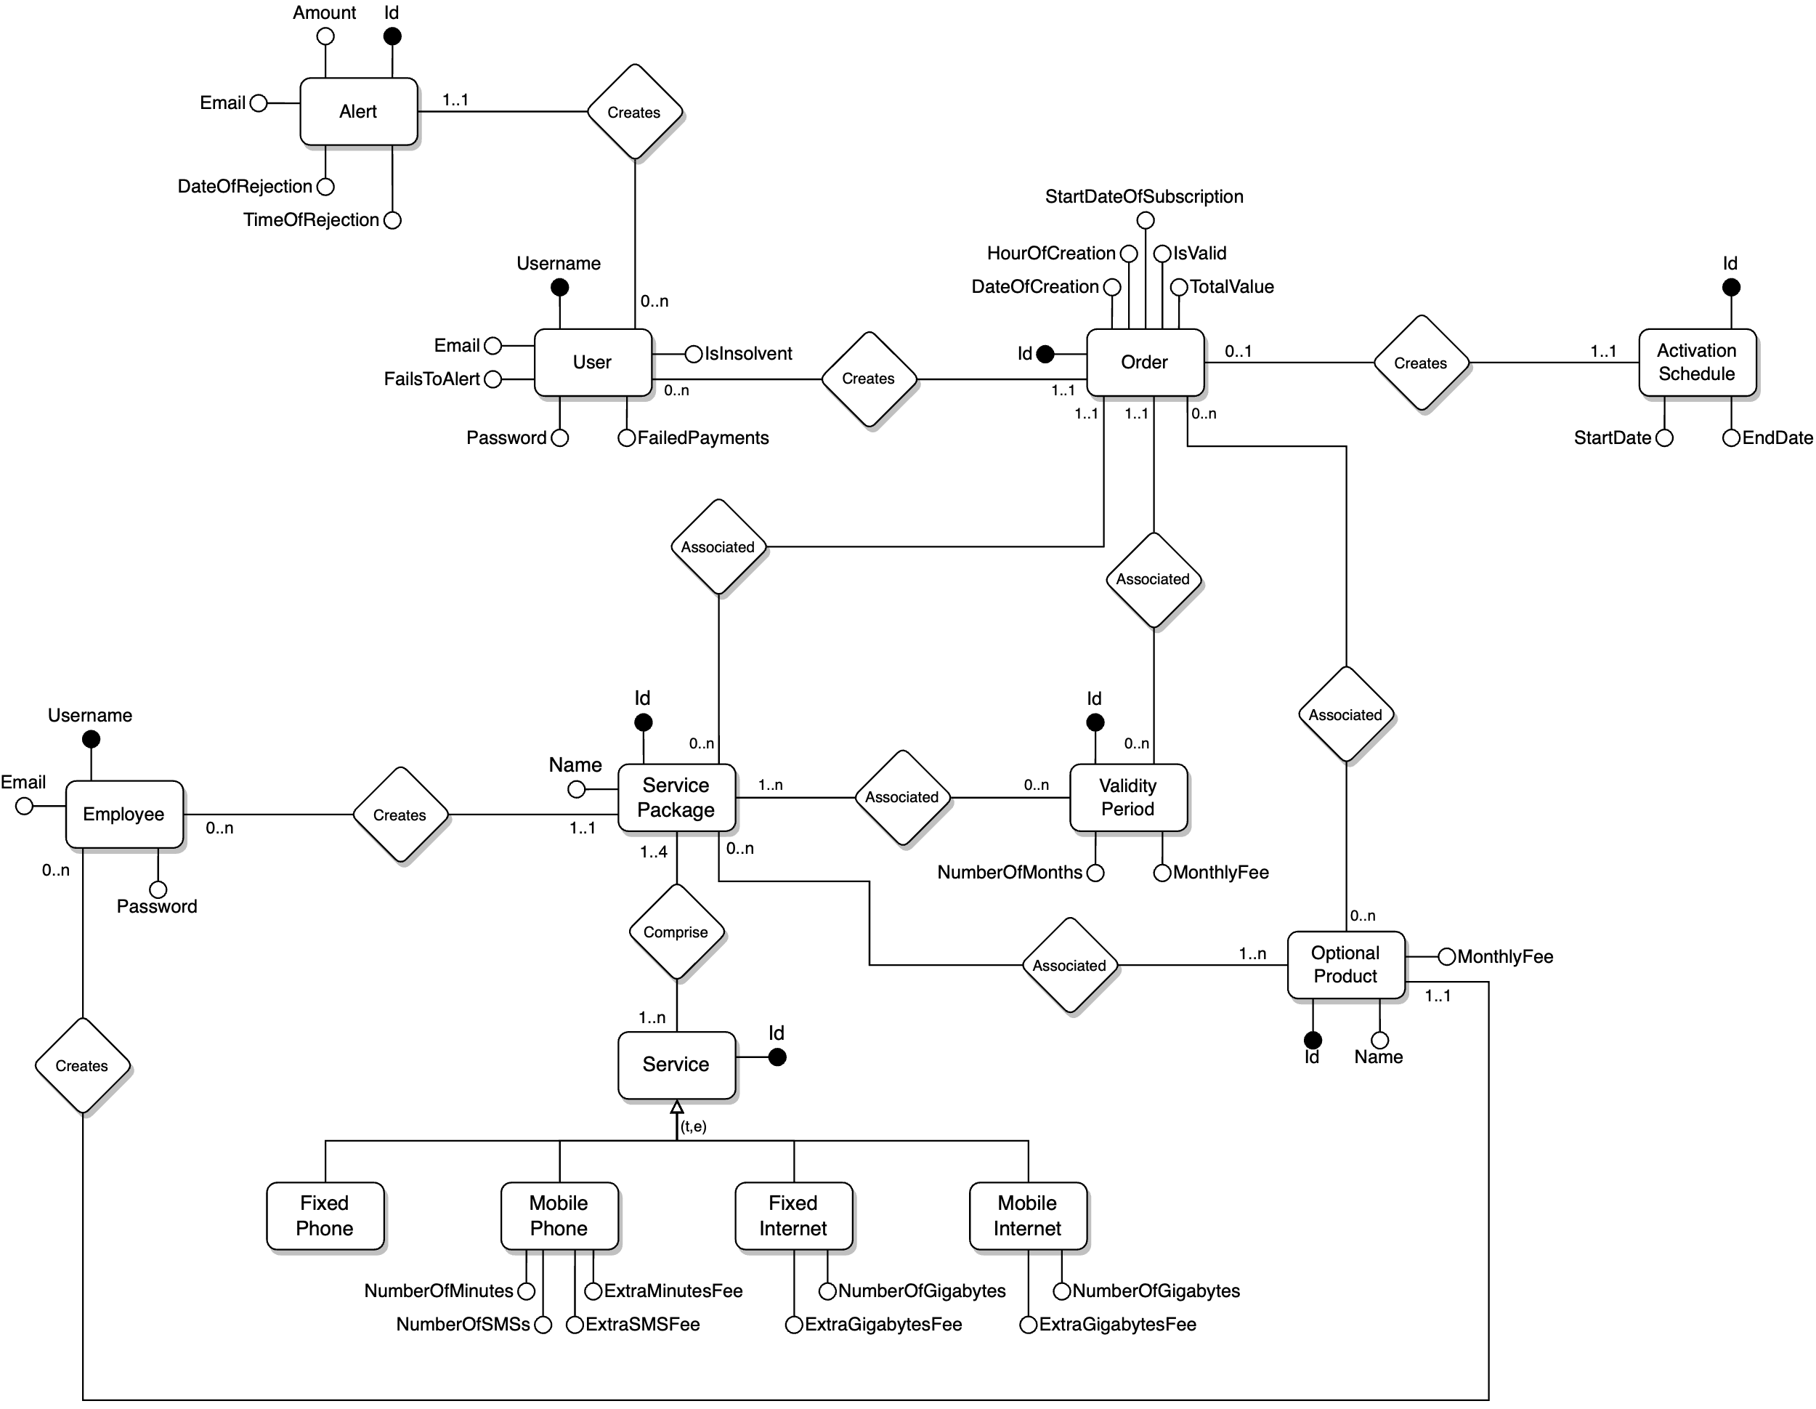

Slide 8
RELATIONAL SQL MODEL

Slide 9
User
CREATE TABLE User
(
username VARCHAR(255) NOT NULL,
password VARCHAR(255) NOT NULL,
email VARCHAR(255) NOT NULL,
isInsolvent TINYINT(1) NOT NULL,
failedPayments TINYINT(1) NOT NULL,
failsToAlert TINYINT(1) NOT NULL,
PRIMARY KEY (username)
);

Slide 10
Alert
CREATE TABLE Alert
(
id INT NOT NULL AUTO_INCREMENT,
amount DECIMAL(10, 2) NOT NULL,
userUsernameFK VARCHAR(255) NOT NULL,
email VARCHAR(255) NOT NULL,
dateOfRejection DATE NOT NULL,
hourOfRejection TIME NOT NULL,
PRIMARY KEY (id),
CONSTRAINT userUsernameFK_Alert
FOREIGN KEY (userUsernameFK)
REFERENCES User (username)
ON DELETE CASCADE
ON UPDATE CASCADE
);

Slide 11
Employee
CREATE TABLE Employee
(
username VARCHAR(255) NOT NULL,
email VARCHAR(255) NOT NULL,
password VARCHAR(255) NOT NULL,
PRIMARY KEY (username)
);

Slide 12
ServicePackage
CREATE TABLE ServicePackage
(
id INT NOT NULL AUTO_INCREMENT,
name VARCHAR(255) NOT NULL,
PRIMARY KEY (id),
UNIQUE INDEX UNIQUE (name ASC) VISIBLE
);

Slide 13
Service
CREATE TABLE Service
(
id INT NOT NULL AUTO_INCREMENT,
serviceType VARCHAR(255) NOT NULL,
numberOfMinutes INT NULL,
numberOfSMSs INT NULL,
extraSMSsFee DECIMAL(10,2) NULL,
extraMinutesFee DECIMAL(10,2) NULL,
numberOfGigabytes INT NULL,
extraGigabytesFee DECIMAL(10,2) NULL,
PRIMARY KEY (id),
UNIQUE INDEX UNIQUE_MP (numberOfMinutes ASC, numberOfSMSs ASC,
extraSMSsFee ASC, extraMinutesFee ASC) VISIBLE,
UNIQUE INDEX UNIQUE_FMI (numberOfGigabytes ASC, extraGigabytesFee ASC,
serviceType ASC) VISIBLE;
);

Slide 14
ValidityPeriod
CREATE TABLE ValidityPeriod
(
id INT NOT NULL AUTO_INCREMENT,
numberOfMonths INT NOT NULL,
monthlyFee DECIMAL(10,2) NOT NULL,
PRIMARY KEY (id),
UNIQUE INDEX UNIQUE (numberOfMonths ASC, monthlyFee ASC) VISIBLE
);

Slide 15
OptionalProduct
CREATE TABLE OptionalProduct
(
id INT NOT NULL AUTO_INCREMENT,
name VARCHAR(255) NOT NULL,
monthlyFee DECIMAL(10,2) NOT NULL,
PRIMARY KEY (id),
UNIQUE INDEX UNIQUE (name ASC) VISIBLE
);

Slide 16
UserOrder
CREATE TABLE UserOrder
(
id INT NOT NULL AUTO_INCREMENT,
dateOfCreation DATE NOT NULL,
hourOfCreation TIME NOT NULL,
totalValue DECIMAL(10,2) NOT NULL,
startDateOfSubscription DATE NOT NULL,
isValid TINYINT(1) NOT NULL,
userUsernameFK VARCHAR(255) NOT NULL,
servicePackageIdFK INT NOT NULL,
validityPeriodIdFK INT NOT NULL,
PRIMARY KEY (id),
CONSTRAINT userUsernameFK_UserOrder
FOREIGN KEY (userUsernameFK)
REFERENCES User (username)
ON DELETE CASCADE
ON UPDATE CASCADE,
CONSTRAINT servicePackageIdFK_UserOrder
FOREIGN KEY (servicePackageIdFK)
REFERENCES ServicePackage (id)
ON DELETE CASCADE
ON UPDATE CASCADE,
CONSTRAINT validityPeriodIdFK_UserOrder
FOREIGN KEY (validityPeriodIdFK)
REFERENCES ValidityPeriod (id)
ON DELETE CASCADE
ON UPDATE CASCADE,
CONSTRAINT activationScheduleIdFK_UserOrder
FOREIGN KEY (activationScheduleIdFK)
REFERENCES ActivationSchedule (id)
ON DELETE SET NULL
ON UPDATE CASCADE
);

Slide 17
ActivationSchedule
CREATE TABLE ActivationSchedule
(
id INT NOT NULL AUTO_INCREMENT,
startDate DATE NOT NULL,
endDate DATE NOT NULL,
userOrderIdFK INT NOT NULL,
PRIMARY KEY (id),
CONSTRAINT userOrderIdFK
FOREIGN KEY (userOrderIdFK)
REFERENCES UserOrder (id)
ON DELETE CASCADE
ON UPDATE CASCADE
);

Slide 18
ServicePackageJTService
CREATE TABLE ServicePackageJTService
(
servicePackageIdFK INT NOT NULL,
serviceIdFK INT NOT NULL,
PRIMARY KEY (servicePackageIdFK, serviceIdFK),
CONSTRAINT servicePackageIdFK_ServicePackageJTService
FOREIGN KEY (servicePackageIdFK)
REFERENCES ServicePackage (id)
ON DELETE CASCADE
ON UPDATE CASCADE,
CONSTRAINT serviceIdFK_ServicePackageJTService
FOREIGN KEY (serviceIdFK)
REFERENCES Service (id)
ON DELETE CASCADE
ON UPDATE CASCADE
);

Slide 19
ServicePackageJTValidityPeriod
CREATE TABLE ServicePackageJTValidityPeriod
(
servicePackageIdFK INT NOT NULL,
validityPeriodIdFK INT NOT NULL,
PRIMARY KEY (servicePackageIdFK, validityPeriodIdFK),
CONSTRAINT servicePackageIdFK_ ServicePackageJTValidityPeriod
FOREIGN KEY (servicePackageIdFK)
REFERENCES ServicePackage (id)
ON DELETE CASCADE
ON UPDATE CASCADE,
CONSTRAINT validityPeriodIdFK_ ServicePackageJTValidityPeriod
FOREIGN KEY (validityPeriodIdFK)
REFERENCES ValidityPeriod (id)
ON DELETE CASCADE
ON UPDATE CASCADE
);

Slide 20
ServicePackageJTOptionalProduct
CREATE TABLE ServicePackageJTOptionalProduct
(
servicePackageIdFK INT NOT NULL,
optionalProductIdFK INT NOT NULL,
PRIMARY KEY (servicePackageIdFK, optionalProductIdFK),
CONSTRAINT servicePackageIdFK_ ServicePackageJTOptionalProduct
FOREIGN KEY (servicePackageIdFK)
REFERENCES ServicePackage (id)
ON DELETE CASCADE
ON UPDATE CASCADE,
CONSTRAINT optionalProductIdFK_ ServicePackageJTOptionalProduct
FOREIGN KEY (optionalProductIdFK)
REFERENCES OptionalProduct (id)
ON DELETE CASCADE
ON UPDATE CASCADE
);

Slide 21
UserOrderJTOptionalProduct
CREATE TABLE UserOrderJTOptionalProduct
(
userOrderIdFK INT NOT NULL,
optionalProductIdFK INT NOT NULL,
PRIMARY KEY (userOrderIdFK, optionalProductIdFK),
CONSTRAINT userOrderIdFK_OrderJTOptionalProduct
FOREIGN KEY (userOrderIdFK)
REFERENCES UserOrder (id)
ON DELETE CASCADE
ON UPDATE CASCADE,
CONSTRAINT OptionalProductIfFK_OrderJTOptionalProduct
FOREIGN KEY (optionalProductIdFK)
REFERENCES OptionalProduct (id)
ON DELETE CASCADE
ON UPDATE CASCADE
);

Slide 22
ORM Design

Slide 23
Preliminary information
All the relationships have been implemented as bidirectional, even though some of them are not.
Relationships involving the employee are not represented in this section, since they have not been implemented in the Java code.
UserOrder table is reported as Order here (as in the ER diagram).
TelcoService table is reported as Service here (as in the ER diagram).

Slide 24
Relationship “creates”
creates
Alert → User
@ManyToOne
FetchType = EAGER
User → Alert
@OneToMany
FetchType = LAZY
CascadeType = ALL
OprhanRemoval = TRUE
Alert
User
1:1
0:N
1
Alert
User
Alert
*
User

Slide 25
Relationship “creates”
creates
User → Order
@OneToMany
FetchType = LAZY
CascadeType = ALL
OrphanRemoval = TRUE
Order → User
@ManyToOne
FetchType = EAGER
User
Order
0:N
1:1
*
User
Order
User
1
Order

Slide 26
Relationship “creates”
creates
Order → ActivationSchedule
@OneToOne
FetchType = EAGER
CascadeType = ALL
ActivationSchedule → Order
@OneToOne
FetchType = EAGER
Order
ActivationSchedule
0:1
1:1
1
Order
ActivationSchedule
Order
1
ActivationSchedule

Slide 27
Relationship “associated”
associated
ServicePackage → Order
@OneToMany
FetchType = LAZY
CascadeType = ALL
OrphanRemoval = TRUE
Order → ServicePackage
@ManyToOne
FetchType = EAGER
ServicePackage
Order
0:N
1:1
*
ServicePackage
Order
ServicePackage
1
Order

Slide 28
Relationship “associated”
associated
ValidityPeriod → Order
@OneToMany
FetchType = LAZY
CascadeType = ALL
OrphanRemoval = TRUE
Order → ValidityPeriod
@ManyToOne
FetchType = EAGER
ValidityPeriod
Order
0:N
1:1
*
ValidityPeriod
Order
ValidityPeriod
1
Order

Slide 29
Relationship “associated”
associated
OptionalProduct → Order
@ManyToMany
FetchType = LAZY
Order → OptionalProduct
@ManyToMany
FetchType = LAZY
OptionalProduct
Order
0:N
0:N
*
OptionalProduct
Order
OptionalProduct
*
Order

Slide 30
Relationship “associated”
associated
ServicePackage → ValidityPeriod
@ManyToMany
FetchType = LAZY
CascadeType = {
PERSIST, MERGE, REFRESH, DETACH
}
ValidityPeriod → ServicePackage
@ManyToMany
FetchType = LAZY
ServicePackage
ValidityPeriod
1:N
0:N
*
ServicePackage
ValidityPeriod
ServicePackage
*
ValidityPeriod

Slide 31
Relationship “associated”
associated
ServicePackage → OptionalProduct
@ManyToMany
FetchType = LAZY
CascadeType = {
PERSIST, MERGE, REFRESH, DETACH
}
OptionalProduct → ServicePackage
@ManyToMany
FetchType = LAZY
ServicePackage
OptionalProduct
0:N
1:N
*
ServicePackage
OptionalProduct
ServicePackage
*
OptionalProduct

Slide 32
Relationship “comprise”
comprise
ServicePackage → Service
@ManyToMany
FetchType = EAGER
CascadeType = {
PERSIST, MERGE, REFRESH, DETACH
}
ServicePackage → Service
@ManyToMany
FetchType = LAZY
ServicePackage
Service
1:4
1:N
*
ServicePackage
Service
ServicePackage
*
Service

Slide 33
Entities Code

Slide 34
@Entity public class ActivationSchedule { @Id @GeneratedValue(strategy = GenerationType.IDENTITY) private Long id; @Temporal(TemporalType.DATE) private Date startDate; @Temporal(TemporalType.DATE) private Date endDate; @OneToOne(fetch = FetchType.EAGER) @JoinColumn(name = "userOrderIdFK") private UserOrder userOrder; public ActivationSchedule() { }

Slide 35
@Entity @NamedQuery(name = "Alert.findAll", query = "SELECT a FROM Alert a") public class Alert { @Id @GeneratedValue(strategy = GenerationType.IDENTITY) private Long id; private BigDecimal amount; private String email; @Temporal(TemporalType.DATE) private Date dateOfRejection; @Temporal(TemporalType.TIME) private Date hourOfRejection; @ManyToOne(fetch = FetchType.EAGER) @JoinColumn(name = "userUsernameFK") private User user; public Alert() { } public Alert(BigDecimal amount, User user, String email, Date dateOfRejection, Date hourOfRejection) { this.amount = amount; this.user = user; this.email = email; this.dateOfRejection = dateOfRejection; this.hourOfRejection = hourOfRejection; }

Slide 36
@Entity public class Employee { @Id private String username; private String email; private String password; public Employee() { } public Employee(String username, String password, String email) { this.username = username; this.email = email; this.password = password; }

Slide 37
@Entity @NamedQuery(name = "OptionalProduct.findAll", query = "SELECT o FROM OptionalProduct o") public class OptionalProduct { @Id @GeneratedValue(strategy = GenerationType.IDENTITY) private Long id; private String name; private BigDecimal monthlyFee; @ManyToMany(mappedBy = "optionalProducts", fetch = FetchType.LAZY) private List<ServicePackage> servicePackages; @ManyToMany(mappedBy = "optionalProducts", fetch = FetchType.LAZY) private List<UserOrder> userOrders; public OptionalProduct() { } public OptionalProduct(String name, BigDecimal monthlyFee) { this.name = name; this.monthlyFee = monthlyFee; }

Slide 38
@Entity @NamedQuery(name = "ServicePackage.findAll", query = "SELECT s FROM ServicePackage s") public class ServicePackage { @Id @GeneratedValue(strategy = GenerationType.IDENTITY) private Long id; private String name; @ManyToMany(fetch = FetchType.EAGER, cascade = {CascadeType.PERSIST, CascadeType.MERGE, CascadeType.REFRESH, CascadeType.DETACH}) @JoinTable( name = "ServicePackageJTService", joinColumns = @JoinColumn(name = "servicePackageIdFK"), inverseJoinColumns = @JoinColumn(name = "serviceIdFK")) private List<TelcoService> services = new ArrayList<>(); @ManyToMany(fetch = FetchType.LAZY, cascade = {CascadeType.PERSIST, CascadeType.MERGE, CascadeType.REFRESH, CascadeType.DETACH}) @JoinTable( name = "ServicePackageJTValidityPeriod", joinColumns = @JoinColumn(name = "servicePackageIdFK"), inverseJoinColumns = @JoinColumn(name = "validityPeriodIdFK")) private List<ValidityPeriod> validityPeriods = new ArrayList<>(); @ManyToMany(fetch = FetchType.LAZY, cascade = {CascadeType.PERSIST, CascadeType.MERGE, CascadeType.REFRESH, CascadeType.DETACH}) @JoinTable( name = "ServicePackageJTOptionalProduct", joinColumns = @JoinColumn(name = "servicePackageIdFK"), inverseJoinColumns = @JoinColumn(name = "optionalProductIdFK")) private List<OptionalProduct> optionalProducts = new ArrayList<>(); @OneToMany(mappedBy = "servicePackage", cascade = CascadeType.ALL, orphanRemoval = true, fetch = FetchType.LAZY) private List<UserOrder> userOrders; public ServicePackage() { } public ServicePackage(String name) { this.name = name; }

Slide 39
@Entity @Table(name = "Service") @NamedQuery(name = "TelcoService.findByServiceType", query = "SELECT s FROM TelcoService s WHERE s.serviceType = ?1") public class TelcoService { @Id @GeneratedValue(strategy = GenerationType.IDENTITY) private Long id; @Convert(converter = ServiceTypeConverter.class) private ServiceType serviceType; private Integer numberOfMinutes; private Integer numberOfSMSs; private BigDecimal extraSMSsFee; private BigDecimal extraMinutesFee; private Integer numberOfGigabytes; private BigDecimal extraGigabytesFee; @ManyToMany(mappedBy = "services", fetch = FetchType.LAZY) private List<ServicePackage> servicePackages; public TelcoService() { this.serviceType = ServiceType.FIXED_PHONE; } public TelcoService(int numberOfMinutes, int numberOfSMSs, BigDecimal extraMinutesFee, BigDecimal extraSMSFee) { this.serviceType = ServiceType.MOBILE_PHONE; this.numberOfMinutes = numberOfMinutes; this.numberOfSMSs = numberOfSMSs; this.extraMinutesFee = extraMinutesFee; this.extraSMSsFee = extraSMSFee; } public TelcoService(ServiceType serviceType, int numberOfGigabytes, BigDecimal extraGigabytesFee) { switch (serviceType) { case FIXED_INTERNET: this.serviceType = ServiceType.FIXED_INTERNET; break; case MOBILE_INTERNET: this.serviceType = ServiceType.MOBILE_INTERNET; break; default: this.serviceType = null; } this.numberOfGigabytes = numberOfGigabytes; this.extraGigabytesFee = extraGigabytesFee; }

Slide 40
@Entity @NamedQuery(name = "User.getIsInsolventByUsername", query = "SELECT u.isInsolvent FROM User u WHERE u.username = ?1") @NamedQuery(name = "User.findAllInsolvents", query = "SELECT u FROM User u WHERE u.isInsolvent = 1") public class User { @Id private String username; private String email; private String password; @Column(columnDefinition = "TINYINT", length = 1) private boolean isInsolvent; private int failedPayments; @OneToMany(mappedBy = "user", cascade = CascadeType.ALL, orphanRemoval = true, fetch = FetchType.LAZY) private List<Alert> alerts; @OneToMany(mappedBy = "user", cascade = CascadeType.ALL, orphanRemoval = true, fetch = FetchType.LAZY) private List<UserOrder> userOrders; public User() { } public User(String username, String email, String password) { this.username = username; this.email = email; this.password = password; this.isInsolvent = false; this.failedPayments = 0; }

Slide 41
@Entity @NamedQuery(name = "UserOrder.getInvalidOrdersByUser", query = "SELECT o FROM UserOrder o WHERE o.isValid = 0 and o.user = ?1") @NamedQuery(name = "UserOrder.getSumOfAllInvalidOrdersCostByUser", query = "SELECT SUM(o.totalValue) FROM UserOrder o WHERE o.isValid = 0 and o.user = ?1") @NamedQuery(name = "UserOrder.getNumberOfInvalidOrdersByUser", query = "SELECT COUNT(o.id) FROM UserOrder o WHERE o.isValid = 0 and o.user = ?1") @NamedQuery(name = "UserOrder.findAllInvalids", query = "SELECT o FROM UserOrder o WHERE o.isValid = 0") public class UserOrder { @Id @GeneratedValue(strategy = GenerationType.IDENTITY) private Long id; @Temporal(TemporalType.DATE) private Date dateOfCreation; @Temporal(TemporalType.TIME) private Date hourOfCreation; private BigDecimal totalValue; @Temporal(TemporalType.DATE) private Date startDateOfSubscription; @Column(columnDefinition = "TINYINT", length = 1) private boolean isValid; @ManyToOne(fetch = FetchType.EAGER) @JoinColumn(name = "userUsernameFK") private User user; @ManyToOne(fetch = FetchType.EAGER) @JoinColumn(name = "servicePackageIdFK") private ServicePackage servicePackage; @ManyToOne(fetch = FetchType.EAGER) @JoinColumn(name = "validityPeriodIdFK") private ValidityPeriod validityPeriod; @ManyToMany(fetch = FetchType.LAZY) @JoinTable( name = "userOrderJTOptionalProduct", joinColumns = @JoinColumn(name = "userOrderIdFK"), inverseJoinColumns = @JoinColumn(name = "optionalProductIdFK")) private List<OptionalProduct> optionalProducts; @OneToOne(mappedBy = "userOrder", fetch = FetchType.EAGER, cascade = CascadeType.ALL) private ActivationSchedule activationSchedule; public UserOrder() { }

Slide 42
@Entity @NamedQuery(name = "ValidityPeriod.findAll", query = "SELECT v FROM ValidityPeriod v") public class ValidityPeriod { @Id @GeneratedValue(strategy = GenerationType.IDENTITY) private Long id; private int numberOfMonths; private BigDecimal monthlyFee; @ManyToMany(mappedBy = "validityPeriods", fetch = FetchType.LAZY) private List<ServicePackage> servicePackages; @OneToMany(mappedBy = "validityPeriod", cascade = CascadeType.ALL, orphanRemoval = true, fetch = FetchType.LAZY) private List<UserOrder> userOrders; public ValidityPeriod() { } public ValidityPeriod(int numberOfMonths, BigDecimal monthlyFee) { this.numberOfMonths = numberOfMonths; this.monthlyFee = monthlyFee; }

Slide 43
TRIGGERS

Slide 44
Preliminary information
Triggers involving the creation of an Order have been implemented to fire when the Order’s Activation Schedule is created: in this way, it is granted that the Order is a valid one.
An alternative approach could be to implement those triggers to fire when a new Order is created; however in this case a check must be performed to guarantee that the Order is a valid one. Furthermore, for each trigger, an additional trigger should be implemented to take into account the case in which the Order changes status from invalid to valid.
Even though in the Project’s specifications it is said to show the «best seller Optional Product», in case of an equal amount of sales, all the Optional Products having this amount will be shown as «best sellers». It is more representative of the rate of sales in case of equality (this is only a personal interpretation of the requirements).
Data regarding the point involving «list of insolvent Users, suspended Orders and Alerts» have not been computed by means of triggers, but directly with JPQL queries in the Java code (since, as stated on the WeBeep forum, these data are not really aggregate data and we were free to choose between queries or materialization triggers).

Slide 45
Number of total purchases per Package

Slide 46
Materialized view table
CREATE TABLE TotalPurchasesPerSP
(
spId INT NOT NULL,
totalAmount INT NOT NULL,
PRIMARY KEY (spId)
);

Slide 47
SQL view code
CREATE VIEW TotalPurchasesPerSP AS
SELECT O.servicePackageIdFK AS spId,
COUNT(*) AS totalAmount
FROM UserOrder O
WHERE O.isValid = 1
GROUP BY O.servicePackageIdFK

Slide 48
EVENT: insert into ServicePackage
CONDITION: none
ACTION: insert a new row in TotalPurchasesPerSP table as a base for counting
CREATE DEFINER = CURRENT_USER TRIGGER
`TelcoDB`.`InitTotalPurchasesPerSP`
AFTER INSERT ON `ServicePackage`
FOR EACH ROW
BEGIN
INSERT INTO TotalPurchasesPerSP VALUES (new.id, 0);
END

Slide 49
EVENT: insert into ActivationSchedule
CONDITION: none
ACTION: update TotalPurchasesPerSP increment counter by 1
CREATE DEFINER = CURRENT_USER TRIGGER
`TelcoDB`.`UpdateTotalPurchasesPerSPAfterInsert`
AFTER INSERT ON `ActivationSchedule`
FOR EACH ROW
BEGIN
UPDATE TotalPurchasesPerSP T
SET T.totalAmount = T.totalAmount + 1
WHERE T.spId = (SELECT U.servicePackageIdFK
FROM UserOrder U
WHERE U.id = new.userOrderIdFK);
END

Slide 50
Total number of purchases per Package and Validity Period

Slide 51
Materialized view table
CREATE TABLE TotalPurchasesPerSPAndVP
(
spId INT NOT NULL,
vpId INT NOT NULL,
totalAmount INT NOT NULL,
PRIMARY KEY (spId, vpId)
);

Slide 52
SQL view code
CREATE VIEW TotalPurchasesPerSPAndVP AS
SELECT O.servicePackageIdFK AS spId,
O.validityPeriodIdFK AS vpId,
COUNT(*) AS totalAmount
FROM UserOrder O
WHERE O.isValid = 1
GROUP BY O.servicePackageIdFK, O.validityPeriodIdFK

Slide 53
EVENT: insert into ServicePackageJTValidityPeriod
CONDITION: none
ACTION: insert a new row in TotalPurchasesPerSPAndVP as a base for counting
CREATE DEFINER = CURRENT_USER TRIGGER
`TelcoDB`.`InitTotalPurchasesPerSPAndVP`
AFTER INSERT ON `ServicePackageJTValidityPeriod`
FOR EACH ROW
BEGIN
INSERT INTO TotalPurchasesPerSPAndVP
VALUES (new.servicePackageIdFK, new.validityPeriodIdFK, 0);
END

Slide 54
EVENT: insert into ActivationSchedule
CONDITION: none
ACTION: update TotalPurchasesPerSPAndVP increment counter by 1
CREATE DEFINER = CURRENT_USER TRIGGER
`TelcoDB`.`UpdateTotalPurchasesPerSPAndVPAfterInsert`
AFTER INSERT ON `ActivationSchedule`
FOR EACH ROW
BEGIN
UPDATE TotalPurchasesPerSPAndVP T
SET T.totalAmount = T.totalAmount + 1
WHERE T.spId = (SELECT U.servicePackageIdFK
FROM UserOrder U
WHERE U.id = new.userOrderIdFK) AND
T.vpId = (SELECT O.validityPeriodIdFK
FROM UserOrder O
WHERE O.id = new.userOrderIdFK);
END

Slide 55
Total value of Packages with and without Optional Products

Slide 56
Materialized view table
CREATE TABLE TotalSalesValueOfSP
(
spId INT NOT NULL,
totValueWithOP DECIMAL(10, 2) NOT NULL,
totValueWithoutOP DECIMAL(10, 2) NOT NULL,
PRIMARY KEY (spId)
);

Slide 57
SQL view code
CREATE VIEW TotalSalesValueOfSP AS
SELECT O.servicePackageIdFK AS spId,
SUM(O.totalValue) AS totValueWithOP,
(
SELECT SUM(V.numberOfMonths * V.monthlyFee)
FROM ValidityPeriod V
WHERE V.id IN (SELECT U.validityPeriodIdFK
FROM UserOrder U
WHERE U.servicePackageIdFK =
O.servicePackageIdFK)
) AS totValueWithoutOP
FROM UserOrder O
WHERE O.isValid = 1
GROUP BY O.servicePackageIdFK

Slide 58
EVENT: insert into ServicePackage
CONDITION: none
ACTION: insert a new row in TotalSalesValueOfSP as a base for increment
CREATE DEFINER = CURRENT_USER TRIGGER
`TelcoDB`.`InitTotalSalesValueOfSP`
AFTER INSERT ON `ServicePackage`
FOR EACH ROW
BEGIN
INSERT INTO TotalSalesValueOfSP VALUES (new.id, 0, 0);
END

Slide 59
EVENT: insert into ActivationSchedule
CONDITION: none
ACTION: update TotalSalesValueOfSP increment value with Optional Products
CREATE DEFINER = CURRENT_USER TRIGGER
`TelcoDB`.`UpdateTotalSalesValueOfSPWithOPAfterInsert`
AFTER INSERT ON `ActivationSchedule`
FOR EACH ROW
BEGIN
UPDATE TotalSalesValueOfSP T
SET T.totValueWithOP = T.totValueWithOP + (SELECT O.totalValue
FROM UserOrder O
WHERE O.id = new.userOrderIdFK)
WHERE T.spId = (SELECT U.servicePackageIdFK
FROM UserOrder U
WHERE U.id = new.userOrderIdFK);
END

Slide 60
EVENT: insert into ActivationSchedule
CONDITION: none
ACTION: update TotalSalesValueOfSP increment value without Optional Products
CREATE DEFINER = CURRENT_USER TRIGGER
`TelcoDB`.`UpdateTotalSalesValueOfSPWithoutOPAfterInsert`
AFTER INSERT ON `ActivationSchedule`
FOR EACH ROW
BEGIN
UPDATE TotalSalesValueOfSP T
SET T.totValueWithoutOP = T.totValueWithoutOP +
(SELECT numberOfMonths * monthlyFee
FROM ValidityPeriod V
WHERE V.id = (SELECT O.validityPeriodIdFK
FROM UserOrder O
WHERE O.id = new.userOrderIdFK))
WHERE T.spId = (SELECT R.servicePackageIdFK
FROM UserOrder R
WHERE R.id = new.userOrderIdFK);
END

Slide 61
Average number of Optional Products sold together with each Package

Slide 62
Materialized view table
CREATE TABLE AverageNumberOfOPWithSP
(
spId INT NOT NULL,
averageOPs FLOAT NOT NULL,
PRIMARY KEY (spId)
);

Slide 63
SQL view code
CREATE VIEW AverageNumberOfOPWithSP AS
SELECT U.servicePackageIdFK as spId,
(CAST(COUNT(UP.userOrderIdFK) AS FLOAT) /
(
SELECT COUNT(id)
FROM UserOrder R
WHERE R.isValid = 1 AND
R.servicePackageIdFK = U.servicePackageIdFK)
) AS averageOPs
FROM UserOrder U JOIN UserOrderJTOptionalProduct UP
ON U.id = UP.userOrderIdFK
WHERE U.isValid = 1
GROUP BY U.servicePackageIdFK

Slide 64
EVENT: insert into ServicePackage
CONDITION: none
ACTION: insert a new row in AverageNumberOfOPWithSP as a base for update
CREATE DEFINER = CURRENT_USER TRIGGER
`TelcoDB`.`InitAverageNumberOfOPWithSP`
AFTER INSERT ON `ServicePackage`
FOR EACH ROW
BEGIN
INSERT INTO AverageNumberOfOPWithSP VALUES (new.id, 0);
END

Slide 65
EVENT: insert into ActivationSchedule
CONDITION: none
ACTION: update AverageNumberOfOPWithSP set average number of Optional Products
CREATE DEFINER = CURRENT_USER TRIGGER
`TelcoDB`.`UpdateAverageNumberOfOPWithSPAfterInsert`
AFTER INSERT ON `ActivationSchedule`
FOR EACH ROW
BEGIN
UPDATE AverageNumberOfOPWithSP AP
SET AP.averageOPs =
(
SELECT (CAST(A.NUMr AS FLOAT) / CAST(A.DIVr AS FLOAT))
FROM
(
SELECT
(
SELECT COUNT(UP.userOrderIdFK)
FROM UserOrder U JOIN UserOrderJTOptionalProduct UP ON U.id = UP.userOrderIdFK
WHERE U.isValid = 1 AND U.servicePackageIdFK = (SELECT O.servicePackageIdFK
FROM UserOrder O
WHERE O.id = new.userOrderIdFK)
) AS NUMr,
(
SELECT COUNT(id)
FROM UserOrder R
WHERE R.isValid = 1 AND R.servicePackageIdFK = (SELECT S.servicePackageIdFK
FROM UserOrder S
WHERE S.id = new.userOrderIdFK)
) AS DIVr
) A
)
WHERE AP.spId = (SELECT E.servicePackageIdFK
FROM UserOrder E
WHERE E.id = new.userOrderIdFK);
END

Slide 66
Best seller Optional Product

Slide 67
Materialized view table
CREATE TABLE BestSellerOptionalProduct
(
opId INT NOT NULL,
PRIMARY KEY (opId)
);

Slide 68
SQL view code
CREATE VIEW BestSellerOptionalProduct AS
SELECT U.optionalProductIdFK AS opId
FROM UserOrderJTOptionalProduct U
GROUP BY U.optionalProductIdFK
HAVING COUNT(*) = (SELECT MAX(cres.tot)
FROM (SELECT COUNT(*) AS tot
FROM UserOrder UO JOIN UserOrderJTOptionalProduct UJTO
ON UO.id = UJTO.userOrderIdFK
GROUP BY UJTO.optionalProductIdFK) cres);

Slide 69
EVENT: insert into ActivationSchedule
CONDITION: none
ACTION: delete previous content from BestSellerOptionalProduct and insert new best
seller(s) in BestSellerOptionalProduct
CREATE DEFINER = CURRENT_USER TRIGGER
`TelcoDB`.`InsertIntoBestSellerOptionalProductAfterInsert`
AFTER INSERT ON `ActivationSchedule`
FOR EACH ROW
BEGIN
DELETE FROM BestSellerOptionalProduct;
INSERT BestSellerOptionalProduct(opId)
SELECT U.optionalProductIdFK
FROM UserOrderJTOptionalProduct U
GROUP BY U.optionalProductIdFK
HAVING COUNT(*) = (SELECT MAX(cres.tot)
FROM (SELECT COUNT(*) AS tot
FROM UserOrder UO JOIN UserOrderJTOptionalProduct UJTO
ON UO.id = UJTO.userOrderIdFK
GROUP BY UJTO.optionalProductIdFK) cres);
END

Slide 70
APPLICATION COMPONENTS

Slide 71
Client Tier
buyServicePackagePage.html
confirmationPage.html
createSPPage.html
employeePage.html
index.html
inspectionPage.html
login.html
orderCreatedPage.html
registerBeforePurchasePage.html
userHomepage.html
403.html

Slide 72
Server Web Tier
BuyServicePackagePageController
ConfirmationPageController
CreateSPPageController
EmployeePageController
HomepageController
InspectionPageController
OrderCreatedPageController
UserHomepageController

Slide 73
Server Business Tier
The notion of session has been achieved by directly manipulating the HttpSession.
Since the project has been developed using Spring Boot MVC, all components in this tier are singleton stateless beans.
Methods’ signatures (without parameters) are provided for completeness.

Slide 74
Server Business Tier
EmployeeService
public void saveEmployee()
public void saveFixedPhoneService()
public void saveMobilePhoneService()
public void saveFixedMobileInternetService()
public void saveValidityPeriod()
public void saveOptionalProduct()
public void saveServicePackage()
ExceptionFormatterService
public String formatSQLUserAlreadyExists()
public String formatSQLServicePackageAlreadyExists()
public String formatSQLGenericElementAlreadyExists()

Slide 75
Server Business Tier
InspectionPageService
public List<ANOOPWSP> findAllANOOPWSPs()
public List<BSOP> findAllBSOPs()
public List<TPPSP> findAllTPPSPs()
public List<TPPSPAVP> findAllTPPSPAVPs()
public List<TSVOSP> findAllTSVOSPs()
public List<User> findAllInsolvents()
public List<UserOrder> findAllInvalids()
public List<Alert> findAllAlerts()
UserService
saveUser()

Slide 76
Server Business Tier
QueryService
public List<OptionalProduct> findAllOptionalProducts()
public List<ValidityPeriod> findAllValidityPeriods()
public List<ServicePackage> findAllServicePackages()
public List<TelcoService> findServiceByServiceType()
public boolean getIsInsolventByUsername()
public List<UserOrder> getInvalidOrdersByUsername()
public BigDecimal getSumOfAllInvalidOrdersCostByUsername()
public long getNumberOfInvalidOrdersByUsername()
public ServicePackage findServicePackageById()
public UserOrder findUserOrderById()

Slide 77
Server Business Tier
SessionService
public void addServicePackageToServicePackageOrder()
public void resetServicePackageOrder()
public boolean isServicePackageAlreadySelected()
public ServicePackageOrder addSelectedItemsToServicePackageOrder()
public ServicePackageOrder getServicePackageOrder()
OrderManagerService
public boolean createOrderAndAlert()
public boolean tryPaymentAgainAndAlert()
public UserOrder createOrder()
public UserOrder tryPaymentAgain()
public void createActivationSchedule()
public boolean createAlert()

Slide 78
UML SEQUENCE DIAGRAMS

Slide 79
Preliminary information
In this section, relevant sequences of events are reported by means of UML Sequence Diagrams.
In order to give a more clear and understandable overview, only two actors are represented: one client and one server. This has been done on purpose, since the quantity of backend components figures could have made the diagrams unreadable.
Method calls on arrows do not respect their real implementation name: also this has been done with the sole purpose of making more readable and easy to understand diagrams.
For brevity, only the main backend steps are reported (storing and fetching from the database is implicitly done but rarely reported).
For instance, in the purchase Sequence Diagram, the operations of creating and storing a new order are omitted due to the excessive length of the diagram.
These three main scenarios are presented in the next slides:
Registration and subsequent login of a user.
Purchase of a service package (in this case, we assume the user performs login at the beginning; the case in which the user has to login before the payment is only a simple extension to this case).
Creation of a service package (here we assume the employee also creates a mobile phone service before creating the service package itself).

Slide 80
Registration and subsequent login of a user

Slide 81
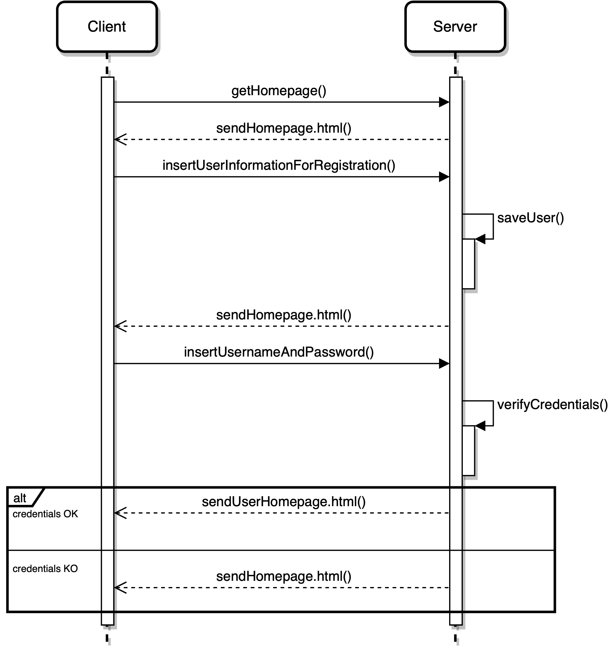

Slide 82
Purchase of a Service Package

Slide 83
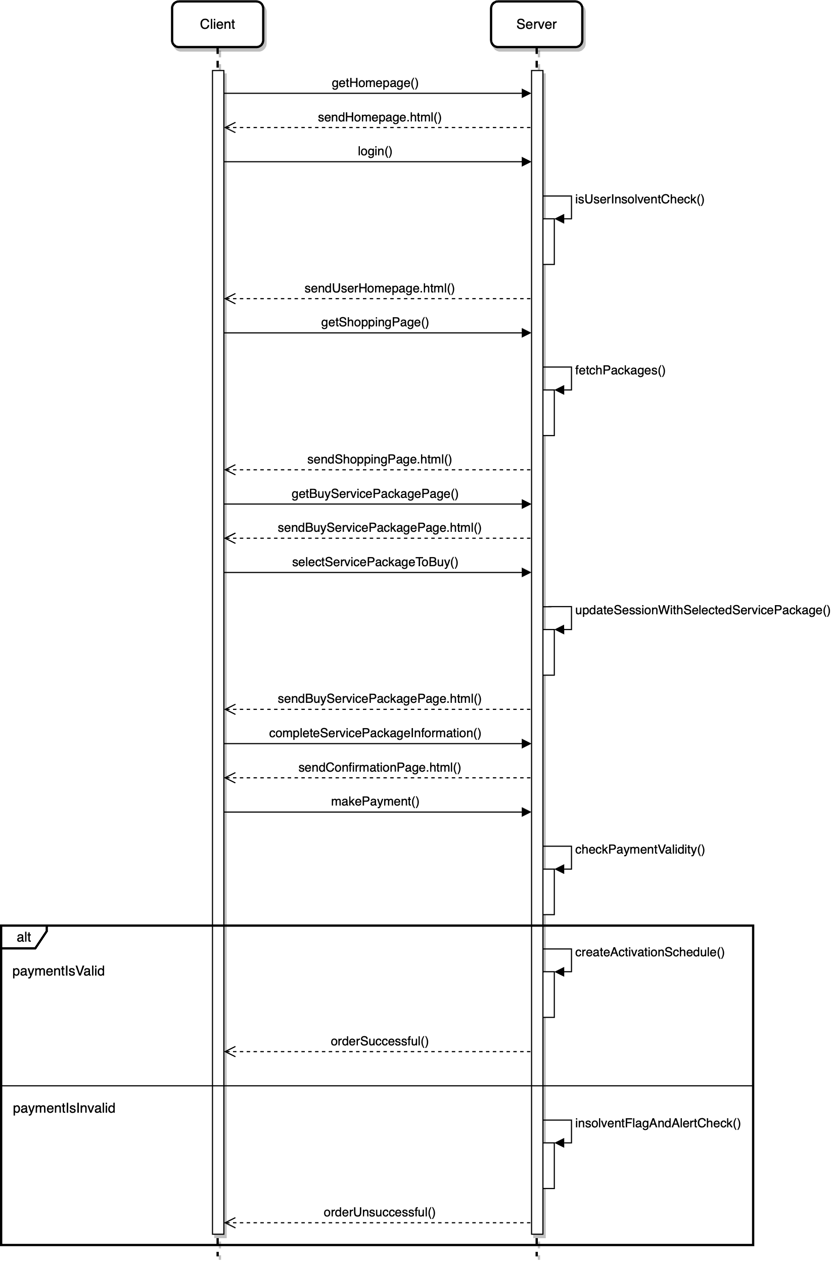

Slide 84
Creation of a Service Package

Slide 85
