Slide 1
ORGANIZACIÓN Y PROGRAMACIÓN DE COMPUTADORAS
OPC
A – D 2019

Slide 2
Procedures for File Operations
The Files can be binary or textual.
CreateOutputFile - Creates new file for writing in output mode
WriteToFile - Writes buffer to output file
OpenInputFile – Opens existing file for input
ReadFromFile – Reads input file into buffer
CloseFile – Closes an open file

Slide 3
CreateOutputFile
Creates a new file and opens it for writing.
Must place the offset of a filename in EDX
After returns, EAX will contain a valid file handle (32-bit integer) if the file was created successfully.
Otherwise, EAX equals INVALID_HANDLE_VALUE (a constant).
Example
.DATA
filename BYTE "newfile.txt",0
.CODE
mov EDX, OFFSET filename
call CreateOutputFile
; EAX contains a valid File Handle if no error happened

Slide 4
WriteToFile
Writes the contents of a buffer to an output file.
Must pass a valid file handle in EAX, the offset of the buffer in EDX, and the number of bytes to write in ECX.
After return, if EAX is greater than zero, it contains a count of the number of bytes written; otherwise, an error occurred.
Example:
BufferSize = 5000
.DATA
fileHandle DWORD ?
buffer BYTE BufferSize DUP(?)
.CODE
mov EAX, fileHandle
mov EDX, OFFSET buffer
mov ECX, BufferSize
call WriteToFile

Slide 5
OpenInputFile
Opens an existing file for input.
Must pass the offset of a filename in EDX.
After return, if the file was opened successfully, EAX will contain a valid file handle.
Otherwise, EAX will equal INVALID_HANDLE_VALUE (a constant).
Example:
.DATA
filename BYTE "myfile.txt",0
.CODE
mov EDX, OFFSET filename
call OpenInputFile
; EAX contains a valid File Handle if no error happened

Slide 6
ReadFromFile
Reads an input file into a memory buffer (offset in EDX).
Must pass an open file handle in EAX.
Leading spaces are ignored. ECX must contain the máximum chars to read.
The return value, placed in EAX, is the number of bytes read from file, if CF==0, otherwise is a system error.
Example:
.DATA
BufferSize = 5000
buffer BYTE BufferSize DUP(?)
bytesRead DWORD ?
.CODE
; EAX contains a File Handle
mov EDX, OFFSET buffer ; points to buffer
mov ECX, BufferSize ; max bytes to read
call ReadFromFile ; read the file
mov bytesRead, EAX ; count of bytes actually read if CF==0

Slide 7
CloseFile
Closes a file that was previously created or opened.
The file is identified by a 32-bit integer file handle, which is passed in EAX.
If the file is closed successfully, the value returned in EAX will be nonzero.
Example:
mov EAX, fileHandle
call CloseFile

Slide 8
Procedures for File Operations
Reviewing Input / Output with Strings.
WriteString - Writes a null-terminated string to the console window
ReadString - Reads a string from the keyboard, terminated by the Enter key
Procedures to manipulate Strings.
StrLength – Returns the length of a string

Slide 9
WriteString
WriteString
It writes a null-terminated string to the console window.
Pass, in EDX register, the string’s offset.
Sample call
.DATA
line BYTE “Enter the data: “, 0
.CODE
MOV EDX, OFFSET line
CALL WriteString

Slide 10
ReadString
ReadString
It reads a string from the keyboard, stopping when the user types the ENTER key.
Pass the buffer’s offset in EDX register.
Set ECX to the maximum number of characters that the user can type, plus 1 to save space for the terminting null byte.
It returns, in EAX, the count of the number of characters typed by the user.
Sample
.DATA
bufferR BYTE 81 DUP(0)
charCountR DWORD ?
.CODE
MOV EDX, OFFSET bufferR
MOV ECX, 81
CALL ReadString
MOV charCountR, EAX

Slide 11
StrLength
Returns the length of a null-terminated string in EAX.
Call args: EDX = offset of the string.
Return arg: EAX = number of non-null bytes.
Example
.DATA
buffer BYTE "abcde",0
bufLength DWORD ?
.CODE
mov edx, OFFSET buffer
call StrLength
mov bufLength, EAX

Slide 12
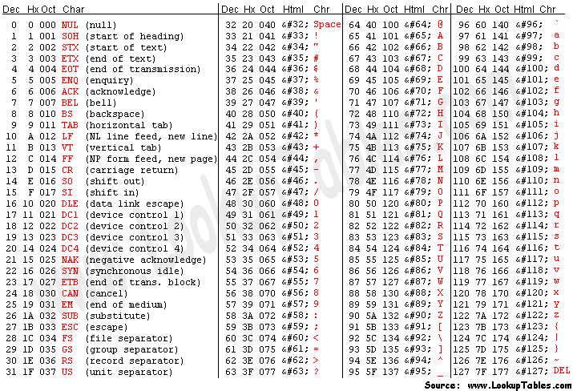
ASCII Code (7-bit) American Standard Code for Information Interchange

Slide 13
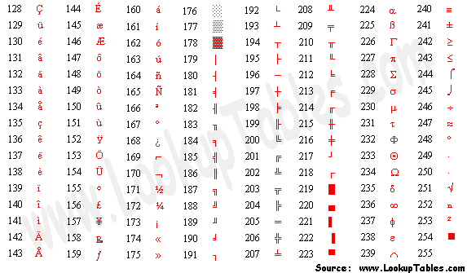
8-bit ASCII Codes: 128-255

Slide 14
References
Capítulos: Irvine, Kip R. Assembly Language for x86 Processors.
Notas de referencia, Ramón Ríos
12-nov-2019

