Slide 1
ORGANIZACIÓN Y PROGRAMACIÓN DE COMPUTADORAS
OPC
A – D 2019

Slide 2
SHIFT and ROTATE Instructions
SHIFTs: Logical and Arithmetic
SHL Instruction
SHR Instruction
SAL and SAR Instructions
SHLD/SHRD Instructions
ROTATEs
ROL Instruction
ROR Instruction
RCL and RCR Instructions
All these instructions affect the Overflow and Carry Flags

Slide 3
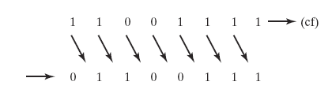
Logical Shift
A LOGICAL SHIFT fills the newly created bit position with zero:

Slide 4
Arithmetic Shift
An ARITHMETIC SHIFT fills the newly created bit position with a copy of the number’s sign bit:

Slide 5
SHL Instruction
The SHL (SHift Left) instruction performs a LOGICAL LEFT SHIFT on the destination operand, filling the lowest bit with 0.
Syntax and Operand types for SHL:
SHL destination, shiftscount
SHL reg,imm8
SHL mem,imm8
SHL reg,CL
SHL mem,CL
(Same for all shift and rotate instructions)

Slide 6
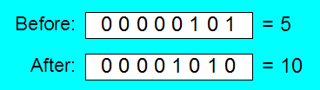
Fast Multiplication
Shifting left 1 bit multiplies a number by 2
MOV DL,5
SHL DL,1
; CF= ___
Shifting left n bits multiplies the operand by 2^{n}
For example, 5 * 2¹ = 10
For example, 5 * 2² = 20
MOV DL,5
SHL DL,2 ; DL = 20, 00010100b, or 14h
; CF= ___

Slide 7
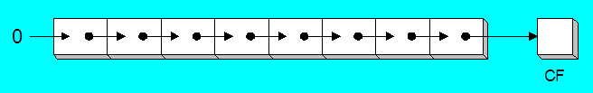
SHR Instruction
The SHR (SHift Right) instruction performs a LOGICAL RIGHT SHIFT on the destination operand. The highest bit position is filled with a zero.
Shifting right n bits divides the operand by 2^{n}
MOV DL,80
SHR DL,1 ; DL = 40 [= 80 / 2¹] CF=__
SHR DL,2 ; DL = 10 [= 40 / 2²] CF=__

Slide 8
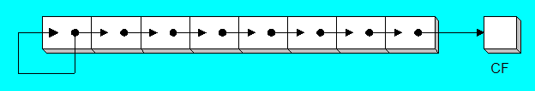
SAL and SAR Instructions
SAL (Shift Arithmetic Left) is identical to SHL.
SAR (Shift Arithmetic right) performs a RIGHT ARITHMETIC SHIFT on the destination operand.
An arithmetic shift preserves the number's sign.
MOV DL,-80 ; -01010000b, 10110000b
SAR DL,1 ; DL= -40, 11011000b, CF=_
SAR DL,2 ; DL= -10, 11110110b, CF=_

Slide 9
Your turn . . .
Indicate the hexadecimal value of AL after each shift:
MOV AL,5Ch
SHR AL,1 a.___
SHL AL,3 b.___
MOV AL,8Ch
SAR AL,1 c.___
SAR AL,3 d.___

Slide 10
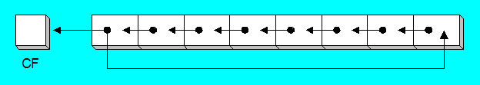
ROL Instruction
ROL (rotate) shifts each bit to the left
The highest bit is copied into both the Carry flag and into the Lowest bit
No bits are lost
MOV AL,11110000b
ROL AL,1 ; AL = 11100001b
MOV DL,3Fh
ROL DL,4 ; DL = F3h

Slide 11
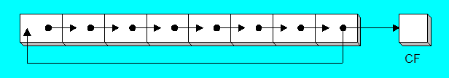
ROR Instruction
ROR (rotate right) shifts each bit to the right
The lowest bit is copied into both the Carry flag and into the highest bit
No bits are lost
MOV AL,11110000b
ROR AL,1 ; AL = 01111000b
MOV DL,3Fh
ROR DL,4 ; DL = F3h

Slide 12
Your turn . . .
Indicate the hexadecimal value of AL after each rotation:
MOV AL,6Bh
ROR AL,1 a.____
ROL AL,3 b.____

Slide 13
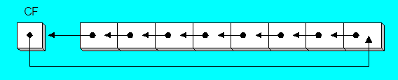
RCL Instruction
RCL (Rotate Carry Left) shifts each bit to the left
Copies the Carry flag to the Least significant bit
Copies the Most significant bit to the Carry flag
CLC ; CF = 0
MOV BL,88h ; CF= 0, BL= 10001000b
RCL BL,1 ; CF= 1, BL= 00010000b
RCL BL,1 ; CF=0, BL= 00100001b

Slide 14
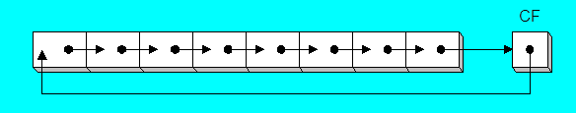
RCR Instruction
RCR (Rotate Carry Right) shifts each bit to the right
Copies the Carry flag to the Most significant bit
Copies the Least significant bit to the Carry flag
STC ; CF = 1
MOV AH,10h ; CF= 1, AH= 00010000b
RCR AH,1 ; CF= 0, AH= 10001000b

Slide 15
Your turn . . .
Indicate the hexadecimal value of AL after each rotation:
STC
MOV AL,6Bh
RCR AL,1 a. CF=__, AL=__
RCL AL,3 b. CF=__, AL=__

Slide 16
SHLD (SHift Left Double) Instruction
Shifts a destination operand a given number of bits to the left
The bit positions opened up by the shift are filled by the most significant bits of the source operand
The source operand is not affected
Affected: Sign, Zero, Auxiliary, Parity and Carry flags.
Syntax:
SHLD destination, source, shiftscount
Operand types:
SHLD reg16/32, reg16/32, imm8/CL
SHLD mem16/32, reg16/32, imm8/CL

Slide 17
SHLD (SHift Left Double) Example
Shift count of 1:
MOV AL,11100000b
MOV BL,10011101b
SHLD AL,BL,1 ; dest=AL, source=BL

Slide 18
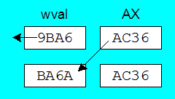
Another SHLD Example
Shift wval 4 bits to the left and replace its lowest 4 bits with the high 4 bits of AX:
.DATA
wval WORD 9BA6h
.CODE
MOV AX,0AC36h
SHLD wval,AX,4 ;CF=__
Before:
After:

Slide 19
SHRD (Shift Right Double) Instruction
Shifts a destination operand a given number of bits to the right
The bit positions opened up by the shift are filled by the least significant bits of the source operand
The source operand is not affected
Syntax:
SHRD destination, source, shiftscount
Operand types:
SHRD reg16/32, reg16/32, imm8/CL
SHRD mem16/32, reg16/32, imm8/CL

Slide 20
SHRD Example
Shift count of 1:
MOV AL,11000001b
MOV BL,00011101b
SHRD AL,BL,1 ; dest=AL, source=BL

Slide 21
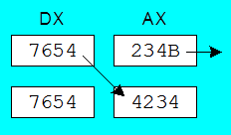
Another SHRD Example
Shift AX 4 bits to the right and replace its highest 4 bits with the low 4 bits of DX:
MOV AX,234Bh
MOV DX,7654h
SHRD AX,DX,4 ;CF=__
Before:
After:

Slide 22
Your turn . . .
Indicate the hexadecimal values of each destination operand:
MOV AX,7C36h
MOV DX,9FA6h
SHLD DX,AX,4 ;a) CF=__, DX=____
SHRD DX,AX,8 ;b) CF=__, DX=____

Slide 23
Referencias
Capítulos: Irvine, Kip R. Assembly Language for x86 Processors.
Notas de referencia, Ramón Ríos
14-nov-2019

