Slide 1
ORGANIZACIÓN Y PROGRAMACIÓN DE COMPUTADORAS
OPC
A – D 2019

Slide 2
x86 Floating-Point
Floating-Point Binary Representation
Floating-Point Unit

Slide 3
Floating-Point Decimal (Real) Number
A FP Decimal Number contains three components:
a sign (+, -)
negative in -38.7512 x 10⁵
a significand (or mantissa)
38.7512 in -38.7512 x 10⁵
an exponent
5 in -38.7512 x 10⁵

Slide 4
IEEE Floating-Point Binary Reals
Format Types (IEEE Standard 754-1985 for Binary FP Arithmetic)
Single Precision (short real)
32 bits: 1 bit for the sign, 8 bits for the exponent, and 23 bits for the fractional part of the significand (mantissa).
Approximate normalized range: 2⁻¹²⁶ to 2¹²⁷
Double Precision (long real)
64 bits: 1 bit for the sign, 11 bits for the exponent, and 52 bits for the fractional part of the significand.
Approximate normalized range: 2⁻¹⁰²² to 2¹⁰²³
Double Extended Precision (extended real)
80 bits: 1 bit for the sign, 16 bits for the exponent, and 63 bits for the fractional part of the significand.
Approximate normalized range: 2⁻¹⁶³⁸² to 2¹⁶³⁸³

Slide 5
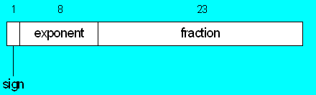
Single-Precision (SP) Format
Approximate normalized range: 2⁻¹²⁶ to 2¹²⁷. Also called a short real.
MSB on the left, for SIGN (+, -), out of the 32 bits.
FRACTION is the significand, after normalize it.
8-bit EXPONENT, range 0 – 255.
Invidual bytes are stored, in memory, in little endian order; LSB at the starting address.

Slide 6
Components of a Single-Precision Real
(c1) Sign
1 = negative, 0 = positive
(c2) Fraction, Significand or mantissa
Binary digits to the left & right of decimal point
weighted positional notation:
11.1011₂ = (1 x 2¹) + (1 x 2⁰) + (1 x 2^{–1}) + (0 x 2^{–2}) + (1 x 2^{–3}) + (1 x 2^{–4})
123.154₁₀ = (1 x 10²) + (2 x 10¹) + (3 x 10⁰) + (1 x 10^{–1}) + (5 x 10^{–2}) + (4 x 10^{–3})

Slide 7
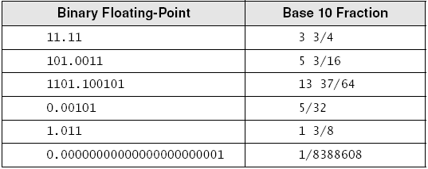
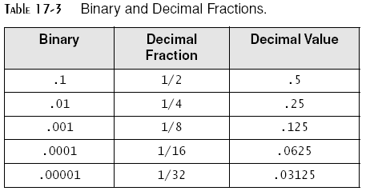
Binary F-P vs Decimal Fractions

Slide 8
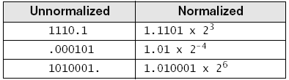
Normalizing Binary F-P Numbers
Mantissa is normalized when a single 1 appears to the left of the binary point
Unnormalized: shift binary point until exponent is zero
Examples

Slide 9
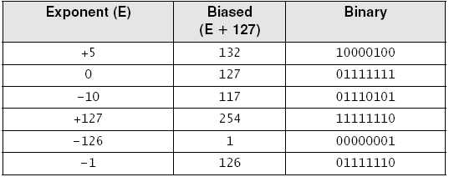
The Exponent
(c3) Exponent represented in Binary as Unsigned integer (0-255)
Integer bias (127 for single precision)
Add 127 to actual exponent to produce the biased exponent
The biased exponent never reaches 0 or 255.

Slide 10
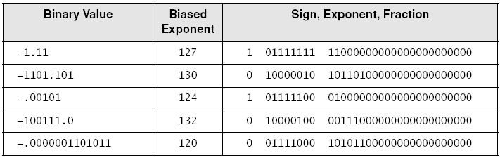
Examples (Single Precision)
Order: sign bit, exponent bits, and fractional part (mantissa)
What is missing? on, ze
What in common between the three binary components?

Slide 11
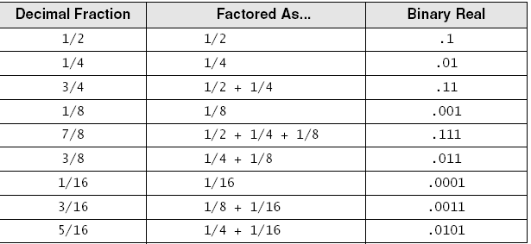
Converting Fractions to Binary Reals
Express as a sum of fractions having denominators that are powers of 2
Examples

Slide 12
Converting Single-Precision to Decimal
If the MSB is 1, the number is negative; otherwise, it is positive.
The next 8 bits represent the exponent. Subtract binary 01111111 (decimal 127), producing the unbiased exponent. Convert the unbiased exponent to decimal.
The next 23 bits represent the significand. Notate a “1.”, followed by the significand bits. Trailing zeros can be ignored. Create a floating-point binary number, using the significand, the sign determined in step 1, and the exponent calculated in step 2.
Unnormalize the binary number produced in step 3. (Shift the binary point the number of places equal to the value of the exponent. Shift right if the exponent is positive, or left if the exponent is negative.)
From left to right, use weighted positional notation to form the decimal sum of the powers of 2 represented by the floating-point binary number.

Slide 13
Example - 1
Convert 0 10000010 10110000000000000000000 to Decimal
The number is positive.
The unbiased exponent is binary 00000011, or decimal 3 (10000010 – 01111111= 00000011 ).
Combining the sign, exponent, and significand, the binary number is +1.1011 x 2³.
The unnormalized binary number is +1101.1₂.
The decimal value is +13 1/2, or +13.5₁₀.

Slide 14
Example - 2
Convert 0 10000011 00101100000000000000000 to Decimal
The number is positive.
The unbiased exponent is binary 00000100, or decimal 4 (10000011 – 01111111= 00000100 ).
Combining the sign, exponent, and significand, the binary number is +1.001011 x 2⁴.
The unnormalized binary number is +10010.11₂.
The decimal value is +17 1/2+1/4, or +17.75₁₀.

Slide 15
FPU binary representation
Do the real numbers can always fit in these binary representations?

Slide 16
Real-Number Encodings
Normalized finite numbers
all the nonzero finite values that can be encoded in a normalized real number between zero and infinity
Positive and Negative Zero
Positive and Negative Infinity
NaN (Not a Number)
bit pattern that is not a valid FP value
Two types: Q and S
Quiet
Signaling

Slide 17
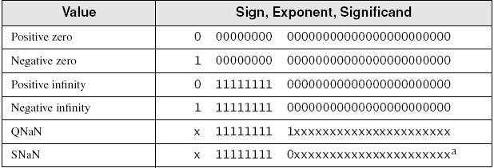
Real-Number Encodings
Specific encodings (single precision):

Slide 18
Referencias
Capítulos: Irvine, Kip R. Assembly Language for x86 Processors.
Notas de referencia, Ramón Ríos
26-nov-2018

