Slide 1
ORGANIZACIÓN Y PROGRAMACIÓN DE COMPUTADORAS
OPC
A – D 2019

Slide 2
x86 Floating-Point
Floating-Point Binary Representation
Floating-Point Unit

Slide 3
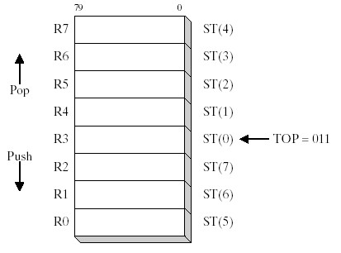
Floating-Point Unit
FPU Data Register Stack, core of the FPU
Eight individually addressable 80-bit FPU Data Registers named R0 through R7
Three-bit field named TOP in the FPU status word identifies then FPU Data Register Number that is currently the top of stack.

Slide 4
FPU Stack: Push and Pop
PUSH / LOAD operation
LOAD operand
TOP - -
ST(0) <- operand
POP / STORE operation
STORE operand
operand <- ST(0)
TOP + +

Slide 5
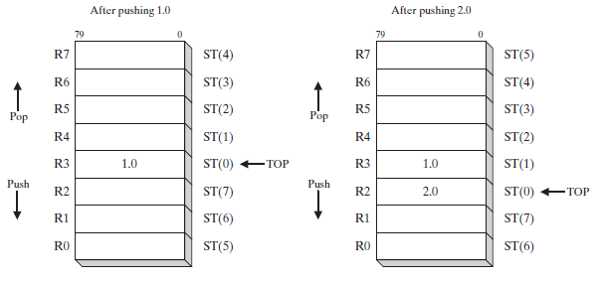
X86 Floating-Point Unit
FPU Stack, initial value, TOP = 100₂ , ST(0) is R4
FPU Stack after pushing 1.0 and 2.0
TOP--, ST(0) <- 1.0; TOP--, ST(0) <- 2.0
TOP = ___? TOP = ___?

Slide 6
Issues
FPU stack works in a circular fashion
Situations
If TOP equals 7 (R7) before the POP, TOP++ reaches R0.
PUSHing a value into a full stack, can overwrite a data register, launching an exception.

Slide 7
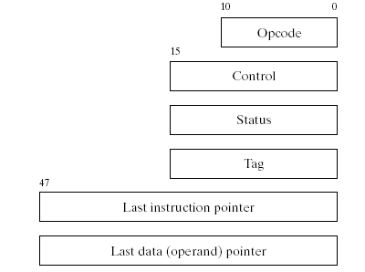
FPU Special-Purpose Registers
• Opcode register: stores opcode of last non-control instruction executed
• Control register: controls precision and rounding method for calculations
• Status register: top-of-stack pointer, condition codes, exception warnings
• Tag register: indicates content type of each register in the register stack (size)
• Last instruction pointer register: pointer to last non-control executed instruction
• Last data (operand) pointer register: points to data operand used by last executed instruction

Slide 8
FPU Stack
Stack does it great evaluating expressions in postfix format
Infix expression
(5*6)+4
Postfix expression
5 6 * 4 +

Slide 9
Floating-Point Exceptions
Five types of exception conditions
Invalid operation
Divide by zero
Denormalized operand
Numeric overflow
Inexact precision
Each has a corresponding mask bit
if set when an exception occurs, the exception is handled automatically by FPU
if clear when an exception occurs, a software exception handler is invoked

Slide 10
FPU Instruction Set - 1
Instruction mnemonics begin with letter F
Second letter identifies data type of memory operand
B = BCD
I = binary integer
no letter: floating point, real numbers
Examples
FB BL D load Binary Coded Decimal
F I S T P store integer and pop stack
F M U L multiply floating-point operands

Slide 11
FPU Instruction Set - 2
Operands
zero, one, or two
no immediate operands
no general-purpose registers (EAX, EBX, ...)
integers must be loaded (pushed) from memory onto the stack and converted to floating-point before being used in calculations
if a FPU instruction has two operands, one must be a FPU register

Slide 12
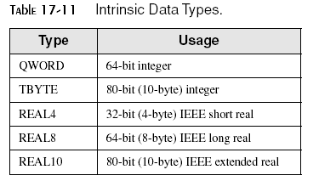
FP Data Types
.DATA
One REAL4 21.3
Two REAL8 781.65
Four REAL8 2.03E-7

Slide 13
Floating-Point I/O
Irvine32 library procedures
ReadFloat
reads FP value from keyboard, pushes it on the FPU stack
WriteFloat
writes value from ST(0) to the console window in exponential format
ShowFPUStack
displays contents of FPU stack

Slide 14
Floating-Point Instruction Set
Basic categories of instructions.
Data transfer
Basic arithmetic
Comparison
Transcendental
Load constants (specialized predefined constants only)
And, many more . . .

Slide 15
First FPU Instruction
FINIT
The FINIT instruction initializes the FPU.
Sets the initial states of the FPU.
Control instruction

Slide 16
Data Transfer Instructions
Very First Ones
FLD
FST
FSTP

Slide 17

Load a Floating-Point Value
FLD
LoaDs Floating point operand from memory into the top of the FPU stack, ST(0)
TOP--; ST(0) <- memory location, a push.

Slide 18
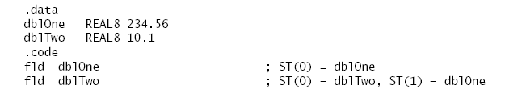
FLD
FLD Example

Slide 19
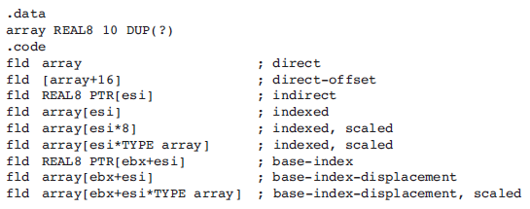
Memory Operand Types
Addressing operand types are similar to the integer operand

Slide 20
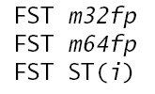
Store Floating-Point Value
FST
copies floating point operand from the top of the FPU stack and store it into memory
memory location <- ST(0)
FSTP
pops the stack after copying
memory location <- ST(0), TOP++, a pop

Slide 21
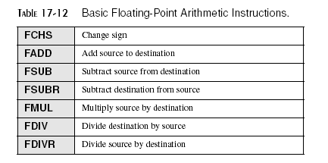
Arithmetic Instructions
Same operand types as FLD and FST

Slide 22
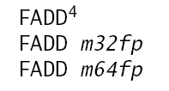
Floating-Point Add
FADD
adds source to destination
No-operand version, pops the FPU stack

Slide 23
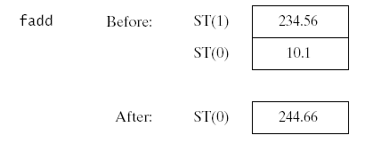
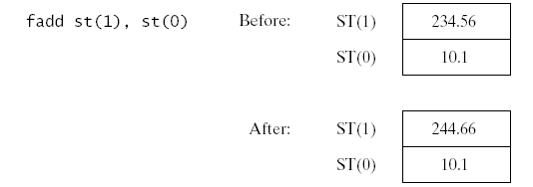
Floating-Point Add
FADD Examples:

Slide 24
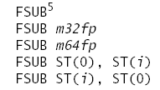
Floating-Point Subtract
FSUB
subtracts source from destination.
No-operand version, pops the FPU stack after subtracting

Slide 25
Floating-Point Subtract
Example:

Slide 26
Referencias
Capítulos: Irvine, Kip R. Assembly Language for x86 Processors.
Notas de referencia, Ramón Ríos
26-nov-2019

