Slide 1
ORGANIZACIÓN Y PROGRAMACIÓN DE COMPUTADORAS
OPC
A – D 2019

Slide 2
FADD and FSUB Families +
FADDP ; What P stands for?
FIADD
FSUBP ; What P stands for?
FISUB
FSUBR ; What R stands for?
FSUBRP
FISUBR
Check for operands

Slide 3
x86 FPU References
Irvine’s book, 7th e.
Chapter 12, Floating-Point Unit
Appendix B.3, Floating-Point Instructions

Slide 4
Loading Constants
The following instructions load specialized constants on the stack. With no operands.
FLD1: pushes 1.0 onto the register stack.
FLDZ (load zero): pushes 0.0 on the FPU stack.
FLDL2T: pushes log₂10 onto the register stack.
FLDL2E: pushes log₂e onto the register stack.
FLDPI: pushes PI onto the register stack.
FLDLG2: pushes log₁₀2 onto the register stack.
FLDLN2: pushes log_{e}2 onto the register stack.

Slide 5
Conversions: Integer <> Floating-Point
FILD,
Load Integer. Instruction converts a 16-, 32-, or 64-bit signed integer source operand to double-precision floating point and loads it into ST(0).
FIST,
Store Integer. Instruction converts the value in ST(0) to signed integer and stores the result in the destination operand.
FILD/FIST m16int FILD/FIST m32int FILD/FIST m64int

Slide 6
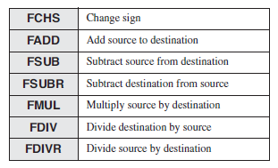
Arithmetic Instructions
Similar operand types as FLD and FST

Slide 7
SIGN modifier instruction
FCHS, change sign,
reverses the sign of the floating-point value in ST(0).
FABS, absolute sign,
clears the sign of the number in ST(0) to create its absolute value.
With no operands.

Slide 8
Floating-Point Multiply / Division
FMUL
Multiplies source by destination, stores product in destination
FDIV
Divides destination by source, then pops the stack
Examples
fmul mySingle ; ST(0) *= mySingle
fdiv mySingle ; ST(0) /= mySingle
FMUL/FDIV FMUL/FDIV m32fp FMUL/FDIV m64fp FMUL/FDIV ST(0), ST(i) FMUL/FDIV ST(i), ST(0)

Slide 9
Floating-Point Division
Examples
.DATA
dblOne REAL8 1234.56
dblTwo REAL8 10.0
dblQuot REAL8 ?
.CODE
fld dblOne ; load into ST(0), (push dblOne) ST(0)=1234.56
fdiv dblTwo ; divide ST(0) by dblTwo, ST(0)=ST(0)/dblTwo=1234.56/10.0
fstp dblQuot ; store ST(0) to dblQuot, (pop dblQuot) dblQuot=123.456

Slide 10
FMUL and FDIV Families +
FMULP
FIMUL
FDIVP
FIDIV
Check for operands

Slide 11
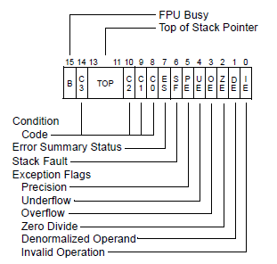
Where is the TOP field?
FPU Status Word
The TOP field, from bits 11 through 13.
FNSTSW,
Store FPU Status Word in a 16-bit integer.
E.g. FNSTSW AX
Get the TOP field.

Slide 12
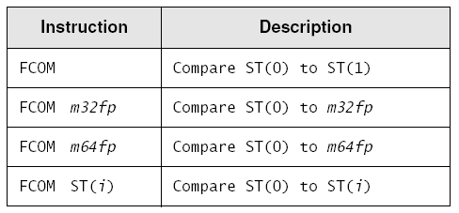
Comparing Floating-Points Values - 1
FCOM instruction
Operands
Family +
FCOMP, FCOMPP

Slide 13
Comparing Floating-Point Values - 2
FCOM, family of comparing instructions
Compares two floating-values, affecting the flags of the FPU Status Word
The flags of the FPU Status Word must be passed to EFLAGS, to use de jconds.
Cannot use the macro-directive to compare floating-point values.

Slide 14
Jumping after FCOMs
Required steps:
Use the F N S T S W AX instruction to move the F P U status word into A X.
Use the S A H F instruction to copy AH into the EFLAGS register.
Use J A, J B, etc, to do the jumping.
FNSTSW m2byte FNSTSW AX
SAHF Store AH into Flags

Slide 15
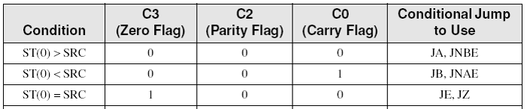
FCOM, FCOMP, FCOMPP
Condition codes set by F P U Status Word
codes similar and equivalent to C P U flags

Slide 16
FCOMs Sample - 1
.DATA
X REAL8 1.2
Y REAL8 3.0
N DWORD 0
.CODE
; if( X < Y )
; N = 1
fld X ; ST(0) = X
fcomp Y ; compare ST(0) to Y
fnstsw ax ; move FPU Status Word into AX
sahf ; copy AH into EFLAGS
jnb L1 ; X not < Y? skip
mov N, 1 ; N = 1
L1:
// C++ double X = 1.2; double Y = 3.0; int N = 0; if( X < Y ) N = 1;

Slide 17
FCOMI
FCOMI ST(0), ST(i)
It compares two floating-point values and sets the Zero, Parity, and Carry flags directly, in EFLAGS

Slide 18
FCOMs Sample - 2
.DATA
X REAL8 1.2
Y REAL8 3.0
N DWORD 0
.CODE
; if( X < Y )
; N = 1
fld Y ; ST(0) = Y
fld X ; ST(0) = X
fcomi ST(0), ST(1) ; compare ST(0) to ST(1)
jnb L1 ; ST(0) not < ST(1)? skip
mov N, 1 ; N = 1
L1:
// C++ double X = 1.2; double Y = 3.0; int N = 0; if( X < Y ) N = 1;

Slide 19
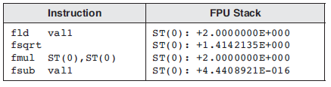
Comparing for Equality - 1
Calculating
(sqrt(2.0) * sqrt(2.0)) – 2.0 ?
val1 REAL8 2.0

Slide 20
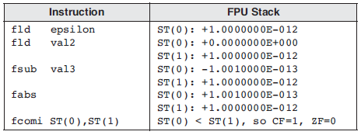
Comparing for Equality - 2
Calculate the absolute value of the difference between two floating-point values
.DATA
épsilon REAL8 1.0E-12
val2 REAL8 0.0 ; value to compare
val3 REAL8 1.001E-13 ; considered equal to val2
.CODE
; if( val2 == val3 ), display "Values are equal".
fld epsilon
fld val2
fsub val3
fabs
fcomi ST(0), ST(1)
ja skip
call WriteString <"Values are equal",0dh,0ah>
skip:

Slide 21
FPU Code Example - 1
; Evaluating an Expression: valD = -valA + (valB * valC).
.DATA
valA REAL8 1.5
valB REAL8 2.5
valC REAL8 3.0
valD REAL8 ? ; expected +6.0
.CODE
fld valA ; ST(0) = valA
fchs ; change sign of ST(0)
fld valB ; load valB into ST(0)
fmul valC ; ST(0) *= valC
fadd ; ST(0) += ST(1)
fstp valD ; store ST(0) to valD

Slide 22
FPU Code Example - 2
; Sum of an Array
ARRAY_SIZE = 20
.DATA
sngArray REAL8 ARRAY_SIZE DUP(?)
.CODE
mov esi,0 ; array index
fldz ; push 0.0 on stack
mov ecx, ARRAY_SIZE
L1: fld sngArray[esi] ; load mem into ST(0)
fadd ; add ST(0), ST(1), pop
add esi, TYPE REAL8 ; move to next element
loop L1
call WriteFloat ; display the sum in ST(0)

Slide 23
FPU Code Example - 3
; Sum of Square Roots
.DATA
valA REAL8 25.0
valB REAL8 36.0
.CODE
fld valA ; push valA
fsqrt ; ST(0) = sqrt(valA)
fld valB ; push valB
fsqrt ; ST(0) = sqrt(valB)
fadd ; add ST(0), ST(1)

Slide 24
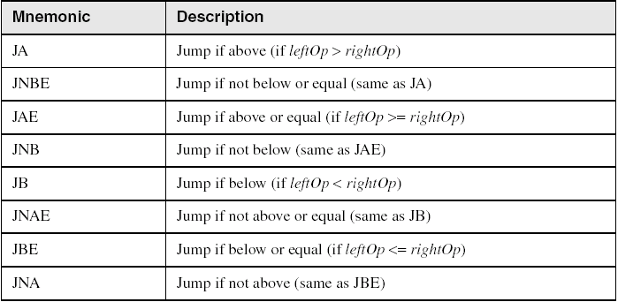
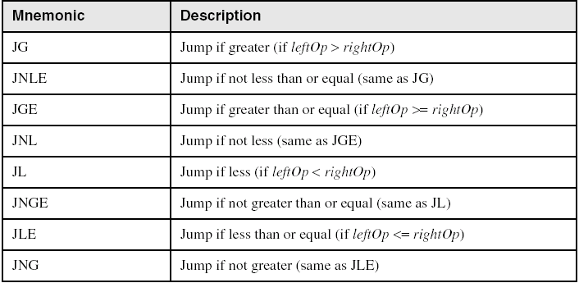
jconds

Slide 25
Referencias
Capítulos: Irvine, Kip R. Assembly Language for x86 Processors.
Intel Architecture Software Developer’s Manual: Floating-Point Unit
Notas de referencia, Ramón Ríos
28-nov-2019

