Slide 1
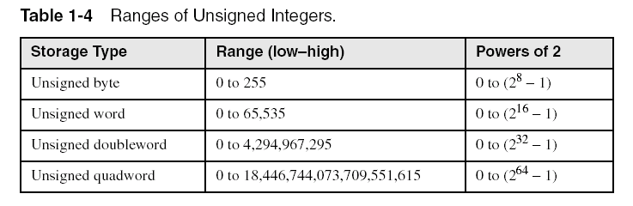
Ranges of Unsigned Integers
Standard sizes:
What is the largest unsigned integer that may be stored in 20 bits?

Slide 2
Signed Integers
The highest bit indicates the sign. 1 = negative, 0 = positive
If the highest digit of a hexadecimal integer is > 7, the value is negative. Examples: F5, 8A, C5, A2, 9D

Slide 3
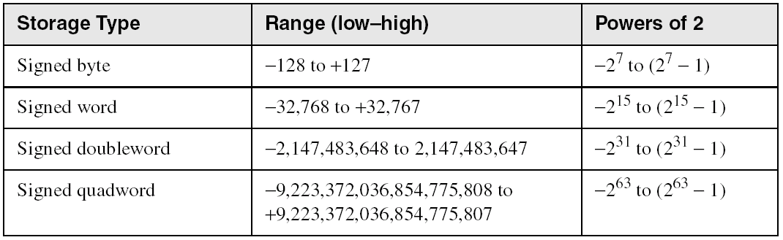
Ranges of Signed Integers
The highest bit is reserved for the sign. This limits the range:
Practice: What is the largest positive value that may be stored in 20 bits?

Slide 4
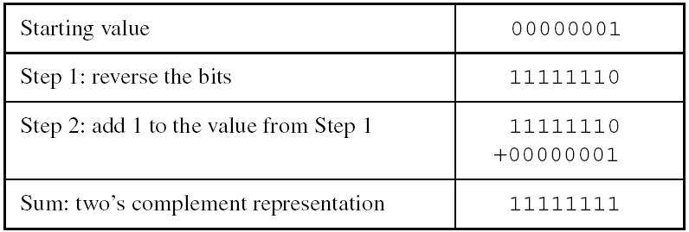
Forming the Two's Complement
Negative numbers are stored in two's complement notation
Represents the additive Inverse
Note that 00000001 + 11111111 = 00000000

Slide 5
Binary Subtraction
When subtracting A – B, convert B to its two's complement
Add A to (–B)
0 0 0 0 1 1 0 0 0 0 0 0 1 1 0 0
– 0 0 0 0 0 0 1 1 1 1 1 1 1 1 0 1
0 0 0 0 1 0 0 1

Slide 6
Learn How To Do the Following:
Form the two's complement of a hexadecimal integer
Convert signed binary to decimal
Convert signed decimal to binary
Convert signed decimal to hexadecimal
Convert signed hexadecimal to decimal

Slide 7
Hex One’s Complement
Hex |  | bin |  | bin C1s |  | Hex C1s
0 | > | 0000 | > | 1111 | > | F
1 | > | 0001 | > | 1110 | > | E
2 | > | 0010 | > | 1101 | > | D
3 | > | 0011 | > | 1100 | > | C
4 | > | 0100 | > | 1011 | > | B
5 | > | 0101 | > | 1010 | > | A
6 | > | 0110 | > | 1001 | > | 9
7 | > | 0111 | > | 1000 | > | 8
8 | > | 1000 | > | 0111 | > | 7
9 | > | 1001 | > | 0110 | > | 6
A | > | 1010 | > | 0101 | > | 5
B | > | 1011 | > | 0100 | > | 4
C | > | 1100 | > | 0011 | > | 3
D | > | 1101 | > | 0010 | > | 2
E | > | 1110 | > | 0001 | > | 1
F | > | 1111 | > | 0000 | > | 0

Slide 8
Referencias
Chapters: Irvine, Kip R. Assembly Language for x86 Processors.
Notas de Ramón Ríos.
20-Agosto-2019

