Slide 1
Character Interpretation & Storage
Character sets
Standard ASCII (0 – 127)
‘u’, ‘U’, ‘A’, ‘8’, ‘2’
Extended ASCII (0 – 255)
ANSI (0 – 255)
Unicode (0 – 65,535)

Slide 2
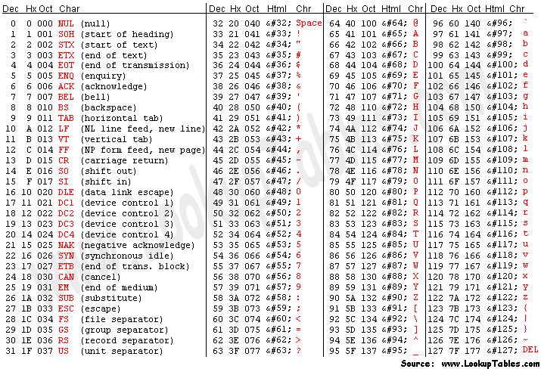
ASCII Code (7-bit) American Standard Code for Information Interchange

Slide 3
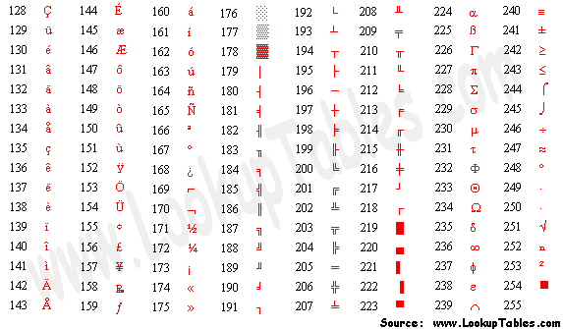
Extended ASCII Code (8-bit)

Slide 4
Character Interpretation & Storage
String
A set or Array of characters
“Mundo”
Null-terminated String
Array of characters followed by a null byte

Slide 5
Numeric Data Representation
pure binary
can be calculated directly
ASCII binary
string of digits: "01010101"
ASCII decimal
string of digits: "65"
ASCII hexadecimal
string of digits: "9C"

Slide 6
Boolean Operations
Bit-to-bit
True:1, False:0
NOT
AND
OR
Operator Precedence
Truth Tables

Slide 7
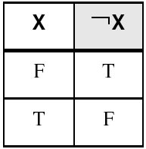
NOT
Inverts (reverses) a boolean value
One operand
If operator is T, than T, if F, than F
Truth table for Boolean NOT operator:
Digital gate diagram for NOT:

Slide 8
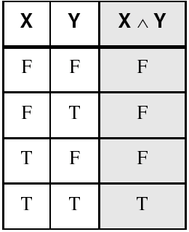
AND
Two operands
Both must be T for T, otherwise F
Truth table for Boolean AND operator:
Digital gate diagram for AND:

Slide 9
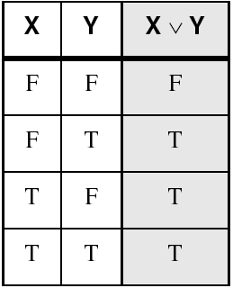
OR
Two operands
Both must be F for F, otherwise T
Truth table for Boolean OR operator:
Digital gate diagram for OR:

Slide 10

Boolean Operator Precedence
The order of evaluation is:
1.
Parentheses ( )
2.
NOT
3.
AND
4.
OR v
Example 1: F = A ^ (B v C) ^ (C v D)
Example 2: F = A ^ B v C ^ C v D
10

Slide 11
NAND
Two operands
Both T = F, otherwise T
Truth table for Boolean NAND operator:
X
Y
X NAND Y
F
F
T
Digital gate diagram for NAND:
F
T
T
T
F
T
NAND
T
T
F

Slide 12
NOR
Two operands
Any T = F, otherwise T
Truth table for Boolean NOR operator:
X
Y
X NOR Y
F
F
T
Digital gate diagram for NAND:
F
T
F
T
F
F
NOR
T
T
F

Slide 13
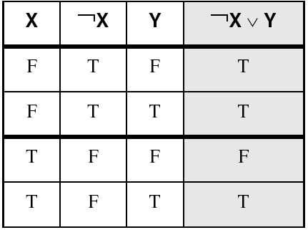
Truth Tables
A Boolean function has one or more Boolean inputs, and returns a single Boolean output.
A truth table shows all the inputs and outputs of a Boolean function
Example: ¬X ∨ Y

Slide 14
Referencias
Chapters: Irvine, Kip R. Assembly Language for x86 Processors.
Notas de Ramón Ríos.
20-Ago-2019

