Slide 1
ORGANIZACIÓN Y PROGRAMACIÓN DE COMPUTADORAS
OPC
A – D 2019

Slide 2
Instruction Format
x86 instruction format
[label:] [mnemonic [operands]] [;comments]
mnemonic [operands]
Mnemonic NOP
mnemonic source MUL 4 destino es EAX
mnemonic destination inc EBX
mnemonic destination, source add AL 7
mnemonic destination, source-1 , source-2

Slide 3
Operand Types
Imm-ediate – a constant integer (8, 16, or 32 bits)
value is encoded within the instruction
Reg-ister – the name of a register
register name is converted to a number and encoded within the instruction
Mem-ory – reference to a location in memory
memory address is encoded within the instruction, or a register holds the address of a memory location

Slide 4
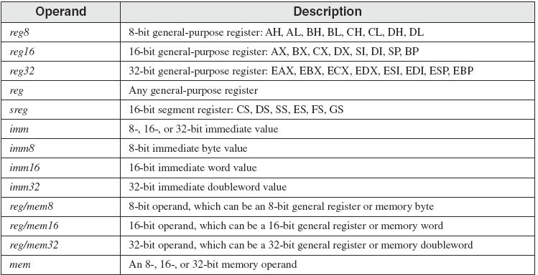
Instruction Operand Notation

Slide 5
Instruction Set
Data Transfer Instruction
MOV

Slide 6
General Operand-Variants of MOV
MOV reg, reg
MOV mem, reg
MOV reg, mem
MOV mem, imm
MOV reg, imm

Slide 7
Direct Memory Operands
A direct memory operand is a named reference to storage in memory
The named reference (label) is automatically dereferenced by the assembler
.DATA
var1 BYTE 10h
.CODE
MOV EAX,21h ; EAX = 00000021h
MOV ECX,EAX ; ECX = 00000021h
MOV AL,var1 ; AL = 10h
MOV AL,[var1] ; AL = 10h

Slide 8
MOV Instruction
Move from source to destination. Syntax:
MOV destination, source
No more than one memory operand permitted
CS, EIP, and IP cannot be the destination
No immediate to segment moves
.DATA
count BYTE 100
wVal WORD 2
.CODE
MOV BL,count ; ?
MOV AX,wVal ; ?
MOV count,AL ; ?
MOV AL,wVal (8 vs 16 bits) ; ?
MOV AX,count (16 vs 8 bits) ; ?
MOV EAX,count (32 vs 8 bits) ; ?

Slide 9
MOV Instruction
Explain why each of the following MOV statements are invalid:
.DATA
bVal BYTE 100
bVal2 BYTE ?
wVal WORD 2
dVal DWORD 5
.CODE
MOV DS,45
MOV ESI,wVal
MOV EIP,dVal
MOV 25,bVal
MOV bVal2,bVal
;immediate move to DS not permitted
;size mismatch
;EIP cannot be the destination
;immediate value cannot be destination
;memory-to-memory move not permitted

Slide 10
Direct-Offset Operands
A constant offset is added to a data label to produce an effective address (EA). The address is dereferenced to get the value inside its memory location.
.DATA
arrayB BYTE 10h,20h,30h,40h
.CODE
MOV AL,arrayB+1 ; AL = 20h
MOV AL,[arrayB+1] ; alternative notation
Q: Why doesn't arrayB+1 produce 11h?
Porque le sumo 1 a la dirección de arrayB no al valor

Slide 11
Direct-Offset Operands (cont)
A constant offset is added to a data label to produce an effective address (EA). The address is dereferenced to get the value inside its memory location.
.DATA
arrayW WORD 1000h,2000h,3000h
arrayD DWORD 1,2,3,4
.CODE
MOV AX,[arrayW+2 (20h)] ; AX = 2000h
MOV AX,[arrayW+4 (30h)] ; AX = 3000h
MOV EAX,[arrayD+4] ; EAX = 00000002h
; Will the following statements assemble?
MOV AX,[arrayW-2] ; ??
MOV EAX,[arrayD+16] ; ??
What will happen when they run?

Slide 12
Two operand instructions ADD, SUB
ADD reg, reg SUB reg, reg
ADD mem, reg SUB mem, reg
ADD reg, mem SUB reg, mem
ADD mem, imm SUB mem, imm
ADD reg, imm SUB reg, imm

Slide 13
One operand instructions INC, DEC
INC reg DEC reg
INC mem DEC mem
No se pueden valores inmediatos

Slide 14
Referencias
Chapters: Irvine, Kip R. Assembly Language for x86 Processors.
Notas de Ramón Ríos.
5-Sep-2019

