Slide 1
ORGANIZACIÓN Y PROGRAMACIÓN DE COMPUTADORAS
OPC
A – D 2019

Slide 2
Operators in operands
Data-Related Operators in operands

Slide 3
Data-Related Operators in Operands
Data-Related Operators are a kind of Directives, that are not executable instructions, instead they are only assembled by the assemblers (.CODE segment).
OFFSET Operator
TYPE Operator
LENGTHOF Operator
SIZEOF Operator
and more …

Slide 4

OFFSET Operator
OFFSET returns the distance in bytes, of a label from the beginning of its enclosing DATA segment
Protected mode: 32, 64 bits
Real mode: 16 bits

Slide 5
OFFSET Examples
Let's assume that the DATA segment begins at 00000000h:
.DATA
BYTE 404000h DUP(?)
bVal BYTE ?
wVal WORD ?
dVal DWORD ?
dVal2 DWORD ?
.CODE
MOV ESI,OFFSET bVal ; ESI = 00404000
MOV ESI,OFFSET wVal ; ESI = 00404001
MOV ESI,OFFSET dVal ; ESI = 0040____
MOV ESI,OFFSET dVal2 ; ESI = 0040____

Slide 6
Relating to C/C++
The value returned by OFFSET is a pointer. Compare the following code written for both C++ and assembly language:
// C++ version:
char array[1000];
char * p = array;
; Assembly language:
.DATA
array BYTE 1000 DUP(?)
.CODE
MOV ESI,OFFSET array

Slide 7
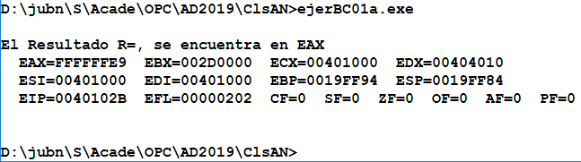
First Assembly Program (Code)
ejerBC01a.asm
The running

Slide 8
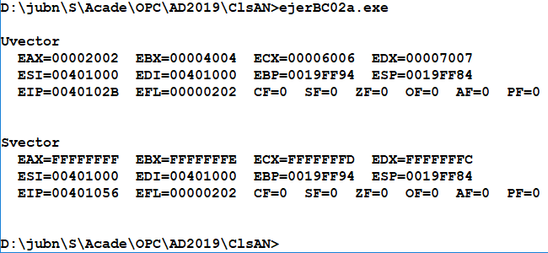
Second Assembly Program (Code)
ejerBC02a.asm
The running

Slide 9
TYPE Operator
The TYPE operator returns the size, in bytes, of a single element of a data declaration.
.DATA
var1 BYTE ?
var2 WORD ?
var3 DWORD ?
var4 QWORD ?
.CODE
MOV EAX, TYPE var1 ; 1
MOV EAX, TYPE var2 ; 2
MOV EAX, TYPE var3 ; 4
MOV EAX, TYPE var4 ; _

Slide 10
LENGTHOF Operator
The LENGTHOF operator counts the number of elements (magnitude) in a single data declaration.
.DATA LENGTHOF label
byte1 BYTE 10,20,30 ; 3
array1 WORD 30 DUP(?),0,0 ; 32
array2 WORD 5 DUP(3 DUP(?)) ; 15
array3 DWORD 1,2,3,4 ; 4
digitStr BYTE "12345678",0 ; 9
.CODE
MOV ECX, LENGTHOF array1 ; 32
ADD EBX, LENGTHOF digitStr ; 9
ADD EBX, TYPE digitStr ; __
MOV EAX, TYPE array3 ; __

Slide 11
SIZEOF Operator
The SIZEOF operator returns a value (Bytes) that is equivalent to multiplying LENGTHOF by TYPE.
.DATA SIZEOF label
byte1 BYTE 10,20,30 ; 3
array1 WORD 30 DUP(?),0,0 ; 64
array2 WORD 5 DUP(3 DUP(?)) ; 30
array3 DWORD 1,2,3,4 ; 16
digitStr BYTE "12345678",0 ; 9
.CODE
MOV EAX,TYPE array1 ; __
MOV EBX,LENGTHOF array1 ; __
MOV ECX,SIZEOF array1 ; __

Slide 12
Spanning Multiple Lines (1 of 2)
In the following example, array1 identifies only the first WORD directive. Compare the values returned by LENGTHOF and SIZEOF here to those in the next slide:
.DATA
array1 WORD 10,20
WORD 30,40
WORD 50,60
.CODE
mov eax, LENGTHOF array1 ; 2
mov ebx, SIZEOF array1 ; 4

Slide 13
Spanning Multiple Lines (2 of 2)
A data Directive spans multiple lines if each line (except the last) ends with a comma. The LENGTHOF and SIZEOF operators include all lines belonging to the same Directive:
.DATA
array1 WORD 10,20,
30,40,
50,60
.CODE
MOV EAX,LENGTHOF array1 ; 6
MOV EBX,SIZEOF array1 ; __

Slide 14
Symbols, Symbolic Constant
A symbol is an identifier.
ValorFinal, Fecha23
Symbolic constant (is not a label)
Is an identifier associated with a 32/64-bit integer expression (or constant)
Syntax identifier = expression (“=“ equal-sign directive)
ValorFinal = 452
MOV EAX, ValorFinal (really MOV EAX, 452)

Slide 15
Symbols, Symbolic Constant - 2
Symbols do not reserve storage.
Symbols are not labels.
Symbols only exist during the time while the Assembler is Assembling a program in Assemly Language.

Slide 16
Symbolic Constants
May be redifined
ValorFinal = 483
MOV EAX, ValorFinal ; really MOV EAX, 483
ValorFinal = 627
MOV EAX, ValorFinal ; really MOV EAX, 627
Why use Symbols? Clarifies the program
Better when you see ValorFinal instead of 483
EscKey = 27
MOV AL, EscKey ; really MOV EAX, 27

Slide 17
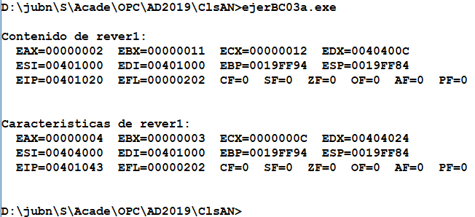
First Assembly Program (Code)
ejerBC03a.asm
The running

Slide 18
Referencias
Capítulos: Irvine, Kip R. Assembly Language for x86 Processors.
Notas de Ramón Ríos
19-sep-2019

