Slide 1
ORGANIZACIÓN Y PROGRAMACIÓN DE COMPUTADORAS
OPC
A – D 2019

Slide 2
Program structure
TITLE primer
;Descripcion del programa, fecha, versión
INCLUDE Irvine32.inc ;libreria de funciones; falta agregar más
.DATA
; directivas de almacenamiento y tipos de datos
.CODE
main PROC ; Inicia el procedimiento main
; instrucciones mnemónicos
main ENDP ; Termina el procedimiento principal
END main ; Termina el area de Ensamble

Slide 3
Irvine32 Library Procedures
INCLUDE Irvine32.inc ; chapter 5
DumpRegs
DumpMem
ReadInt
ReadHex
WriteInt
WriteHex
WriteString
Crlf
ReadString

Slide 4
DumpRegs
DumpRegs
It desplays all the general registers and the flags.
Sample call
.CODE
MOV ECX, 0
CALL DumpRegs
MOV EAX, 8Fh
CALL DumpRegs

Slide 5
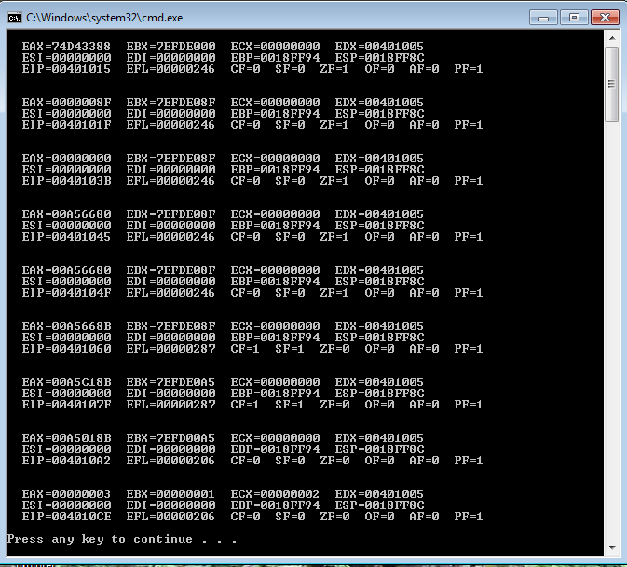
DumpRegs example

Slide 6
DumpMem
DumpMem
It writes a range of memory to the console window in hexadecimal.
Pass, in ESI the starting address, in ECX the number of units or elements, and in EBX the unit size (1 : byte, 2 : word, 4 : doubleword).
Sample call
.DATA
array DWORD 11, 12, 13
.CODE
MOV ESI, OFFSET array
MOV ECX, 3 ; ? ________
MOV EBX, 4 ; ? ________
CALL DumpMem

Slide 7
WriteInt
WriteInt
Writes a 32-bit signed integer to the console window in decimal format with a leading sign and no leading zeros.
Pass the integer into EAX.
Sample
.DATA
valInt SDWORD -317432
.CODE
MOV EAX, valInt
CALL WriteInt
MOV EAX, 235896
CALL WriteInt

Slide 8
WriteHex
WriteHex
Writes a 32-bit unsigned integer to the console window in 8-digit hexadecimal format.
Leading zeroes are inserted if necessary.
Pass the integer into EAX.
Sample
.DATA
valHex DWORD 6ABCh
.CODE
MOV EAX, valHex
CALL WriteHex
MOV EAX, 8EF9h
CALL WriteHex

Slide 9
ReadInt
ReadInt
Reads a 32-bit signed integer from the keyboard and returns the value in EAX register.
Can be typed an optional leading plus or minus sign.
It sets the Overflow flag and display an error message if the value cannot be represented as a 32-bit signed integer (-2,147,483,648 to + 2,147,483,647)
Sample
.DATA
valInt SDWORD ?
.CODE
CALL ReadInt
MOV valInt, EAX

Slide 10
ReadHex
ReadHex
Reads a 32-bit hexadecimal integer from the keyboard and returns the value in EAX register.
No error checking is performed for invalid characteres.
Can use both uppercase letters and lowercase letters for the digits A through F.
Sample
.DATA
valHex DWORD ?
.CODE
CALL ReadHex
MOV valHex, EAX

Slide 11
WriteString
WriteString
It writes a null-terminated string to the console window.
Pass, in EDX register, the string’s offset.
Sample call
.DATA
line BYTE “Enter the data: “, 0
.CODE
MOV EDX, OFFSET line
CALL WriteString

Slide 12
Crlf
Crlf
It advances the cursor, inwindow console, to the beginning of the next line.
It writes down a string containing the ASCII characters 0Dh and 0Ah.
0Dh is the code of CR (Carriage Return, Enter) and 0Ah is the code of LF (Line Feed).
Check out the appendices 8-bit ASCII Code tables.
Sample call
.DATA
line BYTE “Enter the data: “, 0
.CODE
MOV EDX, OFFSET line
CALL WriteString
CALL Crlf

Slide 13
ReadString
ReadString
It reads a string from the keyboard, stopping when the user types the ENTER key.
Pass the buffer’s offset in EDX register.
Set ECX to the maximum number of characters that the user can type, plus 1 to save space for the terminting null byte.
It returns, in EAX, the count of the number of characters typed by the user.
Sample
.DATA
bufferR BYTE 81 DUP(0)
charCountR DWORD ?
.CODE
MOV EDX, OFFSET bufferR
MOV ECX, 81
CALL ReadString
MOV charCountR, EAX

Slide 14
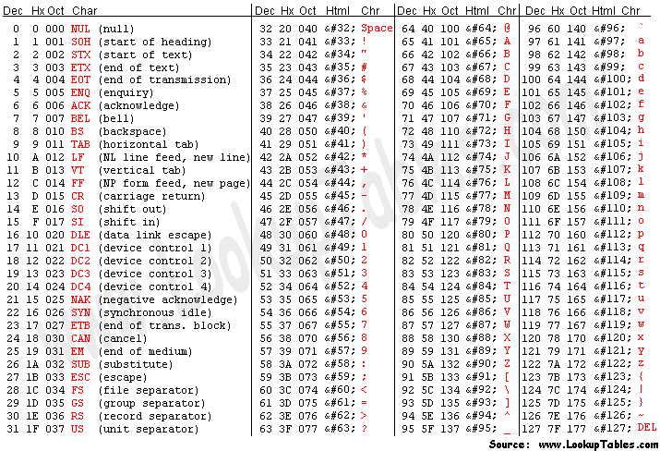
8-bit ASCII Codes: 0-127

Slide 15
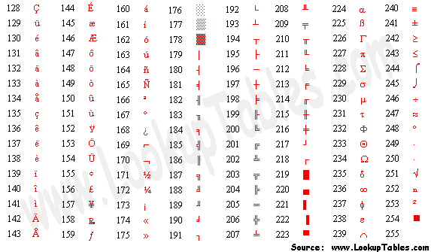
8-bit ASCII Codes: 128-255

Slide 16
Review these procedures
Chapter 5 (5.4.2, 5.4.3)
Clrscr
ReadChar, ReadDec, ReadKey
WriteBin, WriteBinB
WriteChar, WriteDec, WriteHexB

Slide 17
Referencias
Capítulos: Irvine, Kip R. Assembly Language for x86 Processors.
Notas de Ramón Ríos
01-oct-2019

