Slide 1
ORGANIZACIÓN Y PROGRAMACIÓN DE COMPUTADORAS
OPC
A – D 2019

Slide 2
Transfer of Control Instructions
Transfer of Control (jump) Instructions
Unconditional or Imperative Transfer of Control Instruction
Jump instruction: JMP
Conditional Transfer of Control Instructions
Conditional Jump instructions: Jcond family

Slide 3
Jump instruction
JMP instruction
Causes an unconditional transfer of control (jump) to a destination (label:), inside .CODE.
This destination (label:) is translated like an offset.
Syntax: JMP label
Logic: EIP ← OFFSET label
Examples:
.CODE
lbl2:
.
.
JMP lbl2
.CODE
JMP lbl3
.
.
lbl3:

Slide 4
Conditional Jump instructions
Jcond instructions
The conditional transfer (Jcond) to a destination (label:), inside .CODE, jumps, only if the condition of a flag is or several flags are met.

Slide 5
HLL Structured instructions. via
Algorithm ---- program
Structured thinking
Algorithm structures or Structured instructions
Selectives: If-then, if-then-else, switch-case
Repetitives: while, for, do-while, repeat
There are not such instructions in machine language.
The programmer must implement those algorithm structures.

Slide 6
Conditional Jump instructions
A conditional jump instruction (Jcond) branches to a label:, when a specific flag or several flag conditions are met.
The Jcond analyze the CPU status flags of the last executed instruction.
Some conditional jumps:
JC - jump to a label if the Carry flag is set
JZ - jump to a label if the Zero flag is set
JS - jump to a label if the Sign flag is set

Slide 7
Jconds usage
Example 1
Example2
instruction
Jcond la1
. . .
. . .
la1:. . .
la2:
. . .
. . .
instruction
Jcond la2
. . .

Slide 8
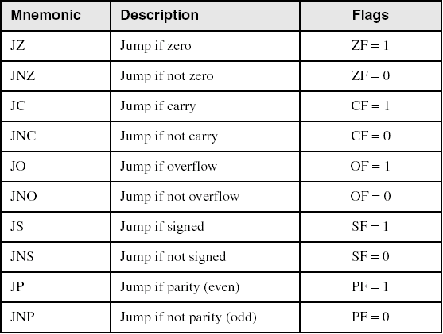
Jconds Based on one Flag (after instruction)

Slide 9
Jconds examples
Example 1
Example2
MOV EAX,1
SUB EAX,1
JZ la1
. . .
la1:. . .
la2:
. . .
MOV EAX,1
ADD EAX,1
JNC la2
. . .

Slide 10
Flags to Test for a Jcond?
How many flags have to be tested for a Jcond, when implementing a Boolean expression of a HLL’s Algorithm Structure (if, while, …)?
For not signed expressions?
Chiefly, CF and ZF
For signed expressions?
Mainly, SF and OF

Slide 11
Referencias
Capítulos: Irvine, Kip R. Assembly Language for x86 Processors.
Notas de referencia, Ramón Ríos
08-oct-2019

