Slide 1
ORGANIZACIÓN Y PROGRAMACIÓN DE COMPUTADORAS
OPC
A – D 2019

Slide 2
Jconds
Hard to use them, because the predecessor instructions usually affect several flags at the same time, not necessaraly one flag.

Slide 3
CMP in Structured Instructions
CMP instruction is used to create conditional logic structures
When follow CMP with a conditional jump instruction, the result is the assembly language equivalent of an IF or a WHILE statement, or any other structured High Level Language instruction.

Slide 4
CMP Instruction
Syntax: CMP leftOp, rightOp
Compares the leftOp operand to the rightOp operand
Nondestructive implied subtraction of rightOp from leftOp (neither operand is changed)
Logic: leftOp - rightOp
The comparation affect all the flags.
The following operand combinations are permitted
CMP reg, reg
CMP reg, mem
CMP reg, imm
CMP mem, reg
CMP mem, imm

Slide 5
CMP of two Unsigned operands
Example 1: it works when leftOp == rightOp
MOV AL,5
CMP AL,5 ; ZF=1, CF=0
Example 2: it works when leftOp < rightOp
MOV AL,4
CMP AL,5 ; ZF=0, CF=1
Example 3: it works when leftOp > rightOp
MOV AL,6
CMP AL,5 ; ZF = 0, CF = 0

Slide 6
CMP + Jconds usage
Example 1 looks like an IF
Example2 looks like repetive
cmp EAX,uno
Jcond la1
. . .
. . .
la1:. . .
la2:
. . .
. . .
cmp dos,EBX
Jcond la2
. . .

Slide 7
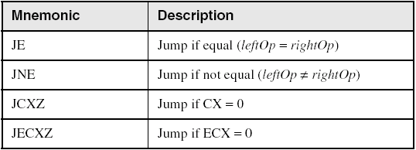
Jconds Based on Equality
For UNSIGNED or SIGNED use.

Slide 8
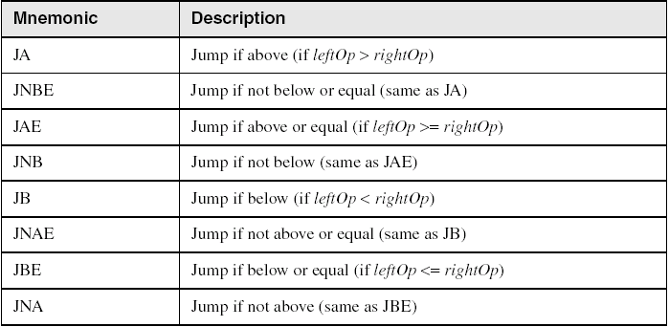
Jconds Based on Unsigned operands
Better use JA, JAE, JB and JBE Above, Below

Slide 9
Examples, Unsigned- 1
Task: Jump to a label if unsigned EAX is greater than EBX
Solution: Use CMP, followed by JA
CMP EAX,EBX
JA Larger
Jump to label L1 if unsigned EAX is less than or equal to Val1
CMP EAX,Val1
JBE L1 ; below or equal

Slide 10
CMP of two Signed operands
Example 4: it works when leftOp > rightOp
mov al,5
cmp al,-2 ; Sign flag == Overflow flag
Example 5: it works when leftOp < rightOp
mov al,-1
cmp al,5 ; Sign flag != Overflow flag
Example 6: it works when leftOp == rightOp
mov al,-1
cmp al,-1 ; ZF=1, CF=don´t care

Slide 11
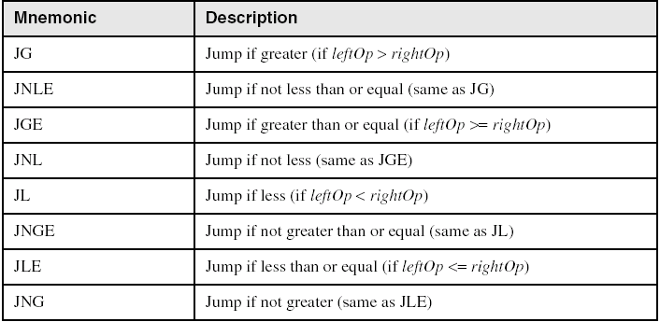
Jconds Based on Signed operands
Better use JG, JGE, JL and JLE Greater, Lower

Slide 12
Examples, Signed- 2
Task: Jump to a label if signed EAX is greater than EBX
Solution: Use CMP, followed by JG
CMP EAX,EBX
JG Greater
Jump to label L1 if signed EAX is less than or equal to Val1
CMP EAX,Val1
JLE L1

Slide 13
Referencias
Capítulos: Irvine, Kip R. Assembly Language for x86 Processors.
Notas de referencia, Ramón Ríos
08-oct-2018

