Slide 1
ORGANIZACIÓN Y PROGRAMACIÓN DE COMPUTADORAS
OPC
A – D 2019

Slide 2
Bitwise Boolean Instructions
To build up compound conditional expressions for IF-then, IF-then-else, WHILE, DO-WHILE, REPEAT-UNTIL and FOR, logical Boolean instructions are required.
(A > B) && (C <= 5)
&& is the Logical Boolean operator and, in a HLL
Issue: there are not logical Boolean Assembly instructions,
Only Bitwise (bit to bit): AND, OR, XOR, NOT, TEST

Slide 3
AND Instruction
AND, bitwise, bit to bit
Syntax: AND destination, source
The following operand combinations are permitted
AND reg, reg
AND reg, mem
AND reg, imm
AND mem, reg
AND mem, imm
Operands can be 8, 16, 32, or 64 bits, must be same size
Bit masking with the source operand.
Set INTERSECTION of bits

Slide 4
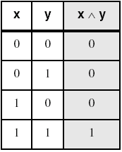
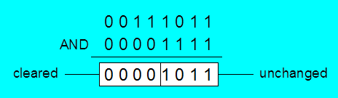
AND Instruction
Performs a Boolean AND operation between each pair of matching bits in two operands
Flags
Clears Overflow, Carry
Modifies Sign, Zero, and Parity
Syntax:
AND destination, source
(same operand types as MOV)
AND
Bit masking, source: 0 in source clears a bit, 1 leaves it unchanged.

Slide 5
OR Instruction
OR, bitwise, bit to bit
Syntax: OR destination, source
The following operand combinations are permitted
OR reg, reg
OR reg, mem
OR reg, imm
OR mem, reg
OR mem, imm
Operands can be 8, 16, 32, or 64 bits, must be same size
Useful when you want to set one or more bits without affecting the other bits
Set UNION of bits

Slide 6
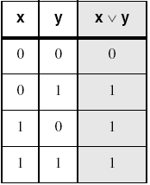
OR Instruction
Performs a Boolean OR operation between each pair of matching bits in two operands
Flags
Clears Overflow, Carry
Modifies Sign, Zero, and Parity
Syntax:
OR destination, source
OR
1 in source set a bit, 0 leaves it unchanged.

Slide 7
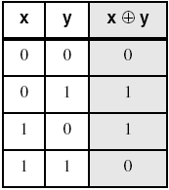
XOR Instruction
Performs a Boolean eXclusive-OR bitwise operation between each pair of matching bits in two operands
XOR with 0 retains its value, with 1 reverses value
Flags
Clears Overflow, Carry
Modifies Sign, Zero, and Parity
Syntax:
XOR destination, source
XOR
XOR is a useful way to toggle (invert) the bits in an operand.

Slide 8
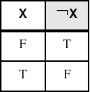
NOT Instruction
Performs a Boolean NOT bitwise operation on a single destination operand
The following operand combinations are permitted
NOT reg
NOT mem
Flags
No flags are affected
Syntax:
NOT destination
NOT
Results called one’s complement
Set COMPLEMENT of bits

Slide 9
Bit-Mapped Set Operations
Set Complement
MOV EAX, SetX
NOT EAX
Set Intersection
MOV EAX, setX
AND EAX, setI
Set Union
MOV EAX, setX
OR EAX,setU

Slide 10
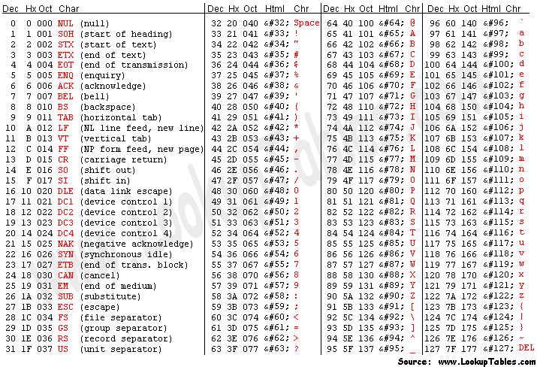
ASCII Code

Slide 11
Applications (1 of 4)
Task: Convert the character in AL to UPPER CASE.
Solution: Use the AND instruction to clear bit 5.
mov al,'a' ; AL = 01100001b, ‘a’
and al,11011111b ; AL = 01000001b, ‘A’

Slide 12
Applications (2 of 4)
Task: Convert a binary decimal byte into its equivalent ASCII Decimal Digit.
Solution: Use the OR instruction to set bits 4 and 5.
MOV AL,6 ; AL = 00000110b, 6
OR AL,00110000b ; AL = 00110110b, ‘6’
The ASCII digit '6' = 00110110b

Slide 13
Applications (3 of 4)
Task: Jump to a label if an integer is even.
Solution: AND the lowest bit with a 1. If the result is Zero, the number was even.
MOV AX, wordVal
AND AX, 1 ; low bit set?
JZ EvenValue ; jump if Zero flag set
Your turn: Write code that jumps to a label if an integer is negative.

Slide 14
Applications (4 of 4)
Task: Jump to a label if the value in AL is not zero.
Solution: OR the byte with itself, then use the JNZ (jump if not zero) instruction.
OR AL,AL
JNZ IsNotZero ; jump if not zero
ORing any number with itself does not change its value.

Slide 15
TEST Instruction
Performs a nondestructive AND bitwise operation between each pair of matching bits in two operands
No operands are modified.
Always clears the Overflow and Carry flags.
Modifies the Sign, Zero, and Parity flags.
Example: jump to a label if either bit 0 or bit 1 in AL is set.
TEST AL,00000011b
JNZ ValueFound
TEST AL,000Bh
JNZ ValueFound
Example: jump to a label if neither bit 0 nor bit 1 in AL is set.
TEST AL,00000011b
JZ ValueNotFound

Slide 16
Example
The value 0000 0011 in this example is called a bit mask.
TEST AL,00000011b
0 0 1 0 0 1 0 1 <- AL input value
0 0 0 0 0 0 1 1 <- test value
0 0 0 0 0 0 0 1 <- result: ZF = 0
TEST AL,00001001b
0 0 1 0 0 1 0 0 <- AL input value
0 0 0 0 1 0 0 1 <- test value
0 0 0 0 0 0 0 0 <- result: ZF = 1
The value 0000 1001 in this example is called a bit mask.

Slide 17
Referencias
Capítulos: Irvine, Kip R. Assembly Language for x86 Processors.
Notas de referencia, Ramón Ríos
10-oct-2019

