Slide 1
ORGANIZACIÓN Y PROGRAMACIÓN DE COMPUTADORAS
OPC
A – D 2019

Slide 2
CONDITIONAL CONTROL FLOW MACRO-DIRECTIVES
MACRO-DIRECTIVE
A MACRO procedure is a named block of Assembly Language instructions. Every time that this named block is invoked , expands itself a copy of the block, of instructions, into the programe code.
Macro-Directives, in Section 6.7, Irvine.

Slide 3
Conditional Control Flow Directives
Directive | Description
.BREAK | Generates code to terminate a .WHILE or .REPEAT block
.CONTINUE | Generates code to jump to the top of a .WHILE or .REPEAT block
.ELSE | Begins block of statements to execute when the .IF condition is false
.ELSEIF condition | Generates code that tests condition and executes statements that follow, until an .ENDIF directive or another .ELSEIF directive is found
.ENDIF | Terminates a block of statements following an .IF, .ELSE, or .ELSEIF directive
.ENDW | Terminates a block of statements following a .WHILE directive
.IF condition | Generates code that executes the block of statements if condition is true.
.REPEAT | Generates code that repeats execution of the block of statements until condition becomes true
.UNTIL condition | Generates code that repeats the block of statements between .REPEAT and .UNTIL until condition becomes true
.WHILE condition | Generates code that executes the block of statements between .WHILE and .ENDW as long as condition is true

Slide 4
.IF family macro-directives
.IF, .ELSE, .ELSEIF, and .ENDIF can be used to evaluate runtime expressions and create block-structured IF statements.
Examples:
.IF eax > ebx
mov edx,1
.ELSE
mov edx,2
.ENDIF
.IF eax > ebx && eax > ecx
mov edx,1
.ELSE
mov edx,2
.ENDIF
MASM generates (macro-expands) "hidden" code for you, consisting of code labels, CMP and conditional jump instructions.

Slide 5
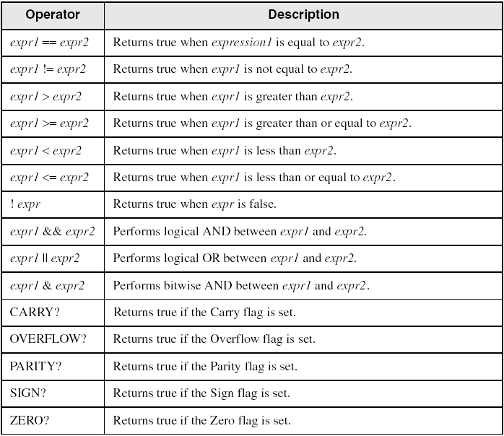
Relational and Logical Operators

Slide 6
AND and OR: Compound Expressions
When using any directive, the || is the logical OR
.IF expression1 || expression2
Statements . . .
.ENDIF
When using any directive, the && symbol is the logical AND
.IF expression1 && expression2
Statements . . .
.ENDIF

Slide 7
Expression examples
eax > 10000h
val1 <= 100
val2 == eax
val3 != ebx
(eax > 0) && (eax > 10000h)
(val1 <= 100) || (val2 <= 100)
(val2 != ebx) && !CARRY?
(dl < 0) || (dl > 79)

Slide 8
Signed and Unsigned Comparisons - 1
.DATA
val1 DWORD 5
result DWORD ?
.CODE
mov eax,6
.IF eax > val1
mov result,1
.ENDIF
Generated code:
mov eax,6
cmp eax,val1
jbe @C0001
mov result,1
@C0001:
MASM automatically generates an unsigned jump (JBE) because val1 is unsigned.

Slide 9
Signed and Unsigned Comparisons - 2
.data
val1 SDWORD 5
result SDWORD ?
.code
mov eax,6
.IF eax > val1
mov result,1
.ENDIF
Generated code:
mov eax,6
cmp eax,val1
jle @C0001
mov result,1
@C0001:
MASM automatically generates a signed jump (JLE) because val1 is signed.

Slide 10
Signed and Unsigned Comparisons - 3
.DATA
result DWORD ?
.CODE
mov ebx,5
mov eax,6
.IF eax > ebx
mov result,1
.ENDIF
Generated code:
mov ebx,5
mov eax,6
cmp eax,ebx
jbe @C0001
mov result,1
@C0001:
MASM automatically generates an unsigned jump (JBE) when both operands are registers . . .

Slide 11
Signed and Unsigned Comparisons - 4
.DATA
result SDWORD ?
.CODE
mov ebx,5
mov eax,6
.IF SDWORD PTR eax > ebx
mov result,1
.ENDIF
Generated code:
mov ebx,5
mov eax,6
cmp eax,ebx
jle @C0001
mov result,1
@C0001:
. . . unless you prefix one of the register operands with the SDWORD PTR operator. Then a signed jump is generated.

Slide 12
Example 1
SetCursorPosition PROC
; Sets the cursor position.
; Receives: DL = X-coordinate, DH = Y-coordinate.
; Checks the ranges of DL and DH.
; Returns: nothing
; ------------------------------------------------
. DATA
BadXCoordMsg BYTE " X-Coordinate out of range! " , 0Dh, 0Ah, 0
BadYCoordMsg BYTE " Y-Coordinate out of range! " , 0Dh, 0Ah, 0
. CODE
.IF ( dl < 0 ) | | ( dl > 79 )
mov edx, OFFSET BadXCoordMsg
call WriteString
jmp quit
.ENDIF
.IF ( dh < 0 ) | | ( dh > 2 4)
mov edx, OFFSET BadYCoordMsg
call WriteString
jmp quit
.ENDIF
call Gotoxy
quit:
ret
SetCursorPosition ENDP
. CODE
; .IF ( dl < 0 ) | | ( dl > 7 9 )
cmp dl, 000h
jb @C0002
cmp dl, 04Fh
jbe @C0001
@C0002 :
mov edx, OFFSET BadXCoordMsg
call WriteString
jmp quit
; . ENDIF
@C0001:
; .IF ( dh < 0 ) | | ( dh > 2 4)
cmp dh, 000h
jb @C0005
cmp dh, 018h
jbe @C0004
@C0005:
mov edx, OFFSET BadYCoordMsg
call WriteString
jmp quit
; .ENDIF
@C0004:
call Gotoxy
quit:
ret

Slide 13
Example 2
; Determine registration based on two criteria:
; Average Grade
; Credits the person wants to take
. data
TRUE = 1
FALSE = 0
gradeAverage WORD 275 ; test value
credits WORD 12 ; test value
OkToRegister BYTE ?
.code
mov OkToRegister, FALSE
.IF gradeAverage > 350
movOkToRegister, TRUE
.ELSEIF (gradeAverage > 250 ) && ( credits <= 16)
mov OkToRegister, TRUE
.ELSEIF ( credits <= 12 )
mov OkToRegister, TRUE
.ENDIF
mov byte ptr OkToRegister, FALSE
;.IF gradeAverage > 350
cmp word ptr gradeAverage, 350
jbe @C0006
mov byte ptr OkToRegister, TRUE
jmp @C0008
@C0006:
;.ELSEIF (gradeAverage > 250 ) && ( credits <= 16)
cmp word ptr gradeAverage, 250
jbe @C0009
cmp word ptr credits, 16
ja @C0009
mov byte ptr OkToRegister, TRUE
jmp @C0008
@C0009 :
;.ELSEIF ( credits <= 12 )
cmp word ptr credits, 12
ja @C0008
mov byte ptr OkToRegister, TRUE
@C0008:
;.ENDIF

Slide 14
.REPEAT family directives
Executes the loop body before testing the loop condition associated with the .UNTIL directive.
.REPEAT
statements
.UNTIL condition
Example:
; Display integers 1 – 10:
mov eax,0
.REPEAT
inc eax
call WriteDec
call Crlf
.UNTIL eax == 10

Slide 15
.WHILE family directives
Tests the loop condition before executing the loop body The .ENDW directive marks the end of the loop.
.WHILE
statements
.ENDW
Example:
; Display integers 1 – 10:
mov eax,0
.WHILE eax < 10
inc eax
call WriteDec
call Crlf
.ENDW

Slide 16
Example 3: .WHILE nesting an .IF
;HLL
while( op1 < op2 )
{
op1++;
if( op1 == op3 )
X = 2 ;
else
X = 3 ;
}
;ASM
. DATA
X DWORD 0
op1 DWORD 2 ; test data
op2 DWORD 4 ; test data
op3 DWORD 5 ; test data
. CODE
mov eax, op1
mov ebx, op2
mov ecx, op3
.WHILE eax < ebx
inc eax
.IF eax == ecx
mov X, 2
.ELSE
mov X, 3
.ENDIF
.ENDW

Slide 17
Referencias
Capítulos: Irvine, Kip R. Assembly Language for x86 Processors.
Notas de referencia, Ramón Ríos
15-oct-2019

