Slide 1
ORGANIZACIÓN Y PROGRAMACIÓN DE COMPUTADORAS
OPC
A – D 2019

Slide 2
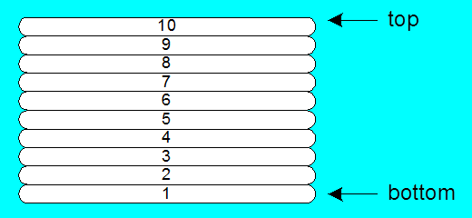
STACK
STACK data structure
A STACK of values (data)
values are only added to the top (PUSH operation)
values are only removed from the top (POP operation)
LIFO (Last-in, First-out) data structure

Slide 3
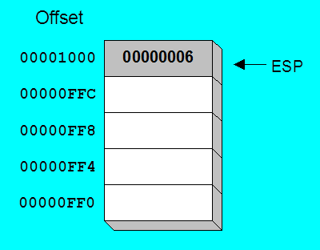
Runtime STACK
STACK inside every Process
Managed by the CPU, using a stack pointer register
ESP (Extended Stack Pointer)
ESP always points to the last value added

Slide 4
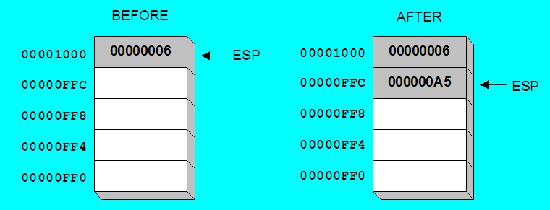
PUSH operation 1
A PUSH operation decrements the stack pointer by n (2 [16 bits] or 4 [32 bits]), and copies a value into the location pointed to by the stack pointer ESP.
ESP ← ESP – n ; n=4 with a 32-bit operand
STACK [ESP] ← reg/var/value

Slide 5
PUSH Instruction
PUSH syntax, ESP ← ESP – n and saves:
PUSH reg/mem16 ; n=2 for 16-bit operand
PUSH reg/mem32 ; n=4 for 32-bit operand
PUSH reg/mem64 ; n=8 for 64-bit operand
PUSH imm32 ; n=4 for 32-bit operand
PUSH imm64 ; n=8 for 64-bit operand

Slide 6
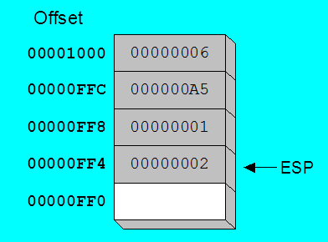
PUSH operation 2
Same stack after pushing two more integers:
The stack grows downward. The area below ESP is always available (unless the stack has overflowed).

Slide 7
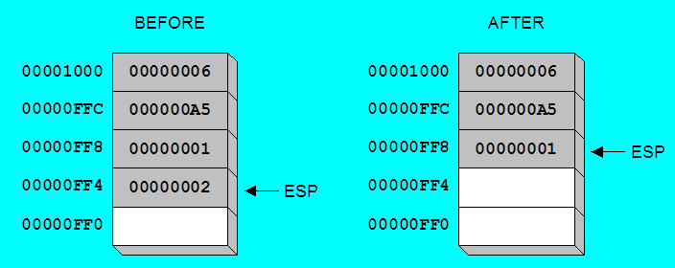
POP Operation
Copies value at STACK[ESP] into a register or variable.
Reg/Var ← STACK[ESP]
Adds n to ESP, where n is either 2 or 4.
value of n depends on the attribute of the operand receiving the data
ESP ← ESP + n

Slide 8
POP Instruction
POP syntax: recovers and ESP ← ESP + n:
POP r/m16 ; n=2 for 16-bit operand
POP r/m32 ; n=4 for 32-bit operand
POP r/m64 ; n=8 for 64-bit operand

Slide 9
Using PUSH and POP
Save and restore registers when they contain important values. PUSH and POP instructions occur in the opposite order.
.DATA
dwordVal DWORD 675
.CODE
PUSH ESI ; push registers
PUSH ECX
PUSH EBX
MOV ESI,OFFSET dwordVal ; display some memory
MOV ECX,LENGTHOF dwordVal
MOV EBX,TYPE dwordVal
CALL DumpMem
POP EBX ; restore registers
POP ECX ; aware of LIFO
POP ESI

Slide 10
Related Instructions
PUSHFD and POPFD
push and pop the EFLAGS register
PUSHAD pushes the 32-bit general-purpose registers on the stack
order: EAX, ECX, EDX, EBX, ESP, EBP, ESI, EDI
POPAD pops the same registers off the stack in reverse order
PUSHA and POPA, do the same for 16-bit registers
order: AX, CX, DX, BX, SP, BP, SI, DI

Slide 11
PUSHAD
The value pushed for the ESP register is its value before prior to pushing the first register.
Temporary = ESP;
Push(EAX);
Push(ECX);
Push(EDX);
Push(EBX);
Push(Temporary);
Push(EBP);
Push(ESI);
Push(EDI);

Slide 12
POPAD
The ESP register is incremented after each register is loaded.
EDI = Pop(); ESP=ESP+4
ESI = Pop(); ESP=ESP+4
EBP = Pop(); ESP=ESP+4
ESP = ESP + 4; //skip next 4 bytes of stack
EBX = Pop(); ESP=ESP+4
EDX = Pop(); ESP=ESP+4
ECX = Pop(); ESP=ESP+4
EAX = Pop(); ESP=ESP+4

Slide 13
Stack applications - 1
Temporary save area for registers, once the registers end a set of operations, their original values can be restored.
The stack provides temporary storage for local variables.

Slide 14
Stack applications - 2
The Call for a procedure, saves an address that uses up the Return of the procedure called.

Slide 15
Referencias
Capítulos: Irvine, Kip R. Assembly Language for x86 Processors.
Notas de referencia, Ramón Ríos
17-oct-2019

