Slide 1
ORGANIZACIÓN Y PROGRAMACIÓN DE COMPUTADORAS
OPC
A – D 2019

Slide 2
Creating Procedures
Large problems can be divided into smaller tasks to make them more MANAGEABLE, MODULAR, and UNDERSTANDABLE
Declared using PROC and ENDP directives
A named block of statements
Must be assigned a name (valid identifier)
A procedure is the ASM equivalent of a Java Method, C or C++ Function.
Following is an assembly language procedure named sample:
nomPro PROC
.
.
RET ;return instruction
nomPro ENDP

Slide 3
.DATA vision for Procedures
.DATA
;Local for PROC “main”
egm SDWORD 2002h
resul DWORD ?
- - -
;Local for PROC “nomPro”
finp SDWORD ?
- - -
;
.CODE
main PROC
.
;call nomPro(egm)
CALL nomPro
.
EXIT
main ENDP
;nomPro(finp) Stack?
nomPro PROC
.
.
RET ;return
nomPro ENDP
END main

Slide 4
Documenting Procedures
Suggested documentation for each procedure:
A description of all tasks accomplished by the procedure.
Receives: A list of input parameters; state their usage and requirements.
Returns: A description of values returned by the procedure.
Requires: Optional list of requirements called preconditions that must be satisfied before the procedure is called.
If a procedure is called without its preconditions satisfied, it will probably not produce the expected output.

Slide 5
Example: SumOf Procedure
main PROC
. . .
CALL SumOf
. . .
main ENDP
;---------------------------------------------------------
SumOf PROC
; Calculates and returns the sum of three 32-bit integers.
; Receives: EAX, EBX, ECX, the three integers. May be
; signed or unsigned.
; Returns: EAX = sum, and the status flags (Carry,
; Overflow, etc.) are changed.
; Requires: nothing
;---------------------------------------------------------
ADD EAX,EBX
ADD EAX,ECX
RET
SumOf ENDP
END main

Slide 6
CALL-RET Example 1
main PROC
00000020 CALL MySub
00000025 MOV EAX,EBX
.
.
main ENDP
MySub PROC
00000040 MOV EAX,EDX
.
.
000000B0 RET
MySub ENDP
END main
0000025 is the offset of the instruction immediately following the CALL instruction
00000040 is the offset of the first instruction inside MySub

Slide 7
CALL and RET Instructions
The CALL instruction calls a procedure
Pushes the offset of next instruction, after CALL, on the stack: PUSH EIP
Copies the address of the called procedure into EIP (Program Counter): MOV EIP, OFFSET nomProc
The RET instruction returns from a procedure
pops top of stack, having the offset of the next-instruction offset, into EIP (Program Counter): POP EIP

Slide 8
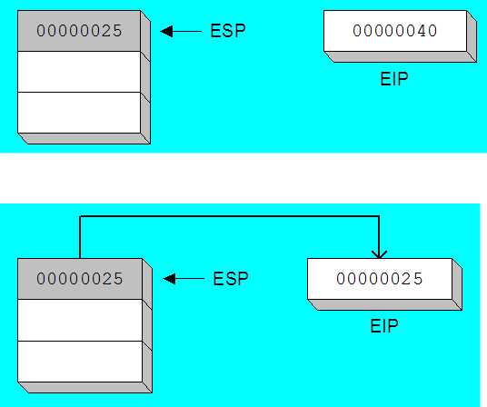
CALL-RET Example 2
The CALL instruction pushes 00000025 onto the stack, and loads 00000040 into EIP
(stack shown before RET executes)
The RET instruction pops 00000025 from the stack into EIP

Slide 9
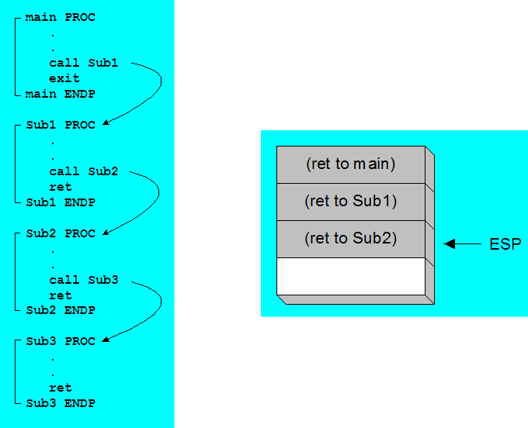
Nested Procedure Calls
By the time Sub3 is called, the stack contains all three return addresses:

Slide 10
Global Scope of Data Labels
All Data Labels (variables) defined in the .DATA segment are global to every procedure defined in the .CODE segment, of the same file.
Using global variables (Data Labels) inside a procedure, to pass values, is a bad practice.
A better conceptual approach, is to hold a Local Area for each procedure, having own local variables, and passing arguments using stack and CPU-Registers at CALLing and RETurning time.

Slide 11
Global Data Labels
The ArraySum procedure calculates the sum of an array. It makes two references to specific variable names:
ArraySum PROC
MOV ESI,0 ; array index
MOV EAX,0 ; set the sum to zero
MOV ECX,LENGTHOF myArray ; set number of elements
L1: ADD EAX,myArray[ESI] ; add each integer to sum
ADD ESI,TYPE myArray ; point to next integer
LOOP L1 ; repeat for array size ECX
MOV theSum,EAX ; store the sum
RET
ArraySum ENDP
What if you wanted to invoke to calculate the sum two or three with different arrays?

Slide 12
Global Values with Registers
REGISTERS. All CPU Registers are global to every procedure in the .CODE segment.
Using CPU Registers inside a procedure, to pass values, is not the best practice; but, at least, the Registers allow some extent of flexibility, passing values at CALLing and RETurning time.

Slide 13
Global Data with Registers
This version of ArraySum returns the sum of any doubleword array whose address is in ESI. The sum is returned in EAX:
ArraySum PROC
; Receives: ESI points to an array of doublewords,
; EBX = TYPE doubleword
; ECX = number of array elements.
; Returns: EAX = sum
;-----------------------------------------------------
MOV EAX,0 ; set the sum to zero
L1: ADD EAX,[ESI] ; add each integer to sum
ADD ESI,EBX ; point to next integer
LOOP L1 ; repeat for array size ECX
RET
ArraySum ENDP

Slide 14
Procedure Arguments / Parameters
A good procedure might be usable in many different programs
but carefully when general-purpose registers and even worst when offset variable are used
Arguments / Parameters help to make procedures flexible because parameter values can change at runtime

Slide 15
Stack application – passing values
The CPU, pushes an offset, with CALL or INVOKE to a PROCEDURE.
The CPU, pops an offset, with RETurn from a PROCEDURE.
When calling a PROCEDURE, you can pass arguments PUSHing them on the stack.
Inside a PROCEDURE, you can recover arguments POPing them from the stack.

Slide 16
.DATA vision for Procedures
.DATA
;Local for PROC “main”
egm SDWORD 2002h
resul DWORD ?
- - -
;Local for PROC “nomPro”
finp SDWORD ?
dirRet DWORD
- - -
; >>
.CODE
main PROC
.
;call nomPro(egm)
push egm
CALL nomPro
pop resul
.
EXIT
main ENDP
nomPro PROC
;nomPro(finp)
pop dirRet
pop finp
add finp, 15h
push finp
push dirRet
RET ;return
nomPro ENDP
END main

Slide 17
Class exercise
Read EjercicioBL.docx

Slide 18
Referencias
Capítulos: Irvine, Kip R. Assembly Language for x86 Processors.
Notas de referencia, Ramón Ríos
29-oct-2019

