Slide 1
OPC - Basic Concepts: Overview
Computer Structure - hardware
Assembly Language
Data Representation

Slide 2
General Computer Structure
.
0
CPU
*PC
MAR
Central
Memory
.
Stored-program
.
1
IR
MBR
Instruction
*SP
I/O AR
Instruction
I/O BR
Instruction
execution
unit
.
.
*PSW
BUS
.
PC - Program Counter
IR - Instruction Register
SP – Stack Pointer
*Must be saved and restored
Data
Data
Data
I/O Module Controllers
Data
.
.
.
.
N
.
MAR - Memory Address Register
MBR - Memory Buffer Register
I/O AR - I/O Address Register
I/O BE - I/O Buffer Register
Buffers

Slide 3
Assembly Language (AL)
What is an assembler?
What background should I have?
How does assembly language (AL) relate to machine language?
How do C++ and Java relate to AL?
Is AL portable?

Slide 4
Translating Languages
English: Display the sum of A times B plus C.
C++: cout << (A * B + C);
Intel Machine Language:
A1 00000000
F7 25 00000004
03 05 00000008
E8 00500000
- - - -
Assembly Language:
mov EAX, A
mul B
add EAX, C
call WriteInt
mov F, EAX

Slide 5
Assembly Data Representation
Binary Numbers
Binary Addition
Integers
Storage Sizes
Unsigned Integers
Hexadecimal Integers

Slide 6

Binary Numbers
Digits are 1 and 0
1 = true
0 = false
MSB – most significant bit
LSB – least significant bit
Bit numbering:

Slide 7
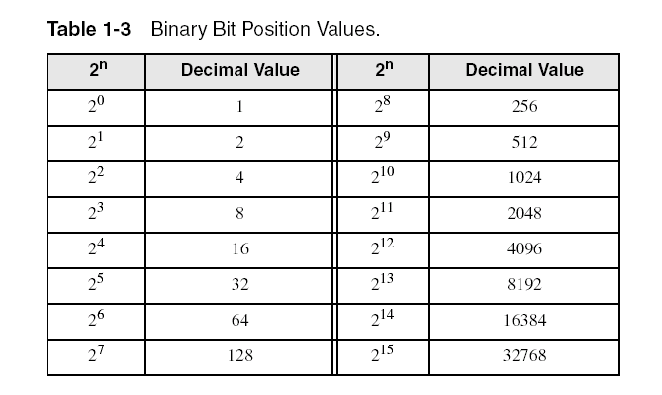
Unsigned Binary Numbers
Each digit (bit) is either 1 or 0
Each bit represents a power of 2:
Every binary number is a sum of powers of 2

Slide 8
Translating Binary to Decimal
Weighted positional notation shows how to calculate the decimal value of each binary bit:
dec = (B_{n-1} × 2^{n-1}) + (B_{n-2} × 2^{n-2}) + ... + (B₁ × 2¹) + (B₀ × 2⁰)
B = binary digit
binary 00001001 = decimal 9:
(1₂ × 2³) + (1₂ × 2⁰) = 9₁₀

Slide 9
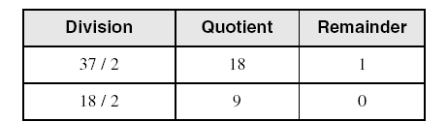
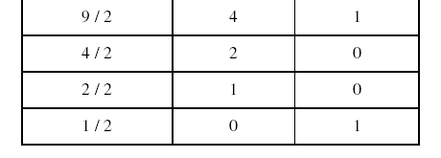
Translating Unsigned Decimal to Binary
Repeatedly divide the decimal integer by 2. Each remainder is a binary digit in the translated value:
B₀
B₁
B₂
B₃
B₄
B₅
37 = 100101
37₁₀ = 100101₂

Slide 10
Binary Addition
Starting with the LSB, add each pair of digits, include the carry if present.

Slide 11
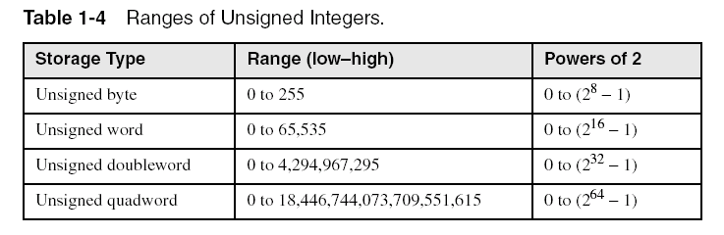
Integers and Storage Sizes
Standard sizes:
What is the largest unsigned integer that may be stored in 20 bits?

Slide 12
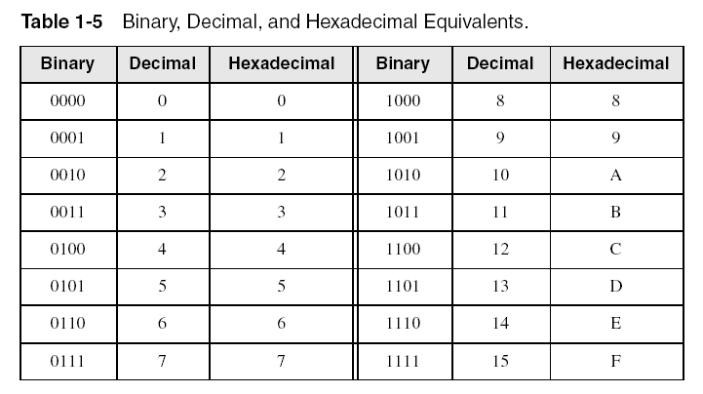
Hexadecimal Integers
Binary values are represented in hexadecimal.

Slide 13

Translating Binary to Hexadecimal
Each hexadecimal digit corresponds to 4 binary bits.
Example: Translate the binary integer 000101101010011110010100₂ to hexadecimal:

Slide 14
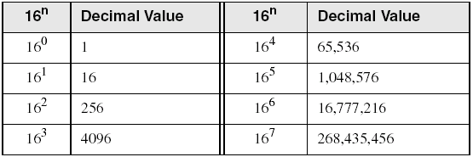
Powers of 16
Used when calculating hexadecimal values up to 8 digits long:

Slide 15
Converting Hexadecimal to Decimal
Multiply each digit by its corresponding power of 16:
dec = (H₃ × 16³) + (H₂ × 16²) + (H₁ × 16¹) + (H₀ × 16⁰)
Hex 1234₁₆ equals (1 × 16³) + (2 × 16²) + (3 × 16¹) + (4 × 16⁰), or decimal 4,660₁₀.
Hex 3BA4₁₆ equals (3 × 16³) + (11 * 16²) + (10 × 16¹) + (4 × 16⁰), or decimal 15,268₁₀.

Slide 16
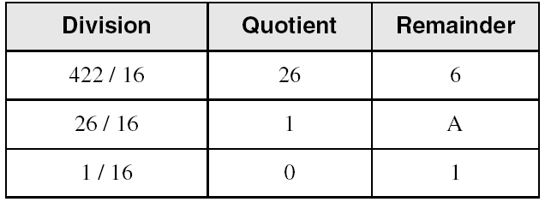
Converting Decimal to Hexadecimal
H₀
H₁
H₂
decimal 422₁₀ = 1A6₁₆ hexadecimal

Slide 17
Hexadecimal Addition
Divide the sum of two digits by the number base (16). The quotient becomes the carry value, and the remainder is the sum digit.
1
1
36 28 28 6A
42 45 58 4B
78 6D 80 B5
21 / 16 = 1, rem 5
Important skill: Programmers frequently add and subtract the addresses of variables and instructions.

Slide 18
Binary Subtraction
Subtract A – B
0 0 0 0 1 1 0 0
– 0 0 0 0 0 0 1 1
Practice: Subtract 0101 from 1001.

Slide 19
Central Memory
Conformed by RAM
Ordered collection of bytes (like a vector)
Memory address as index of a byte
Each byte of the memory has a memory address for access

Slide 20
Hexadecimal Subtraction
When a borrow is required from the digit to the left, add 16 (decimal) to the current digit's value:
16 + 5 = 21
−1
C6 75
A2 47
24 ??
Practice: The address of var1 is 00400020. The address of the next variable after var1 is 0040006A. How many bytes are used by var1?

Slide 21
Referencias
Chapters: Tanenbaum, A. S.; Operating Systems.
Chapters: Irvine, Kip R.; Assembly Language for x86 Processors.
Notas: Ramón Ríos.
15-Ago-2019

