Slide 1
General Concepts
Processor Architecture
Cache Memory
Instruction execution cycle
Reading from Memory

Slide 2
Processor Architecture
Central Processor Unit (CPU)
Control unit (CU) coordinates sequence of execution steps
Arithmetic and Logic Unit (ALU) performs arithmetic and bitwise processing
Clock synchronizes CPU operations (oscillator)
Block diagram of a microcomputer

Slide 3
Registers vs Memory locations
Conventional memory is outside the CPU, and it responds more slowly to access requests than registers
Registers are hard-wired inside the CPU.

Slide 4
Basic Microcomputer Design
Memory Storage Unit: main memory (Instructions + Data)
I/O Devices: Input / Output devices
Bus
Control channel: determines where data comes from and goes, and ALU activities
Address channel: selects where data comes from or goes to
Data channel: moves data between memory bytes, I/O and CPU registers

Slide 5
Clock (Oscillator)
Synchronizes all CPU and BUS operations
A tick every cycle
Machine (clock) cycle measures time of a single operation / instruction
Clock is used to trigger events

Slide 6
Computer BUS
BUS has became a content element between all the components attached up
CPU has to compete, against other devices, to seize the memory unit (main, central, or RAM memory)
CPU needs to access the main memory to fetch next instruction and execute it up

Slide 7
Cache Memory
Closer to the CPU
Access time: faster than Main Memory (RAM)
Storage size: smaller than Main Memory
Time to time: a block of Main Memory locations is copied, by CPU, to Cache Memory

Slide 8
Main Memory <> Cache Memory
Memory
Address
Slot
Number
Tag
Block
0
0
1
1
2
Block
(k words)
2
3
C - 1
Block Length
(k words)
(b) Cache Memory
Block
2^{n} - 1
Word Length
(a) Main Memory
Sistemas Operativos
8

Slide 9
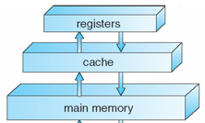
Storage Hierarchy
Storage systems organized, in hierarchy, by
Access Speed ____
Cost per bit ____
Storage Size _____

Slide 10
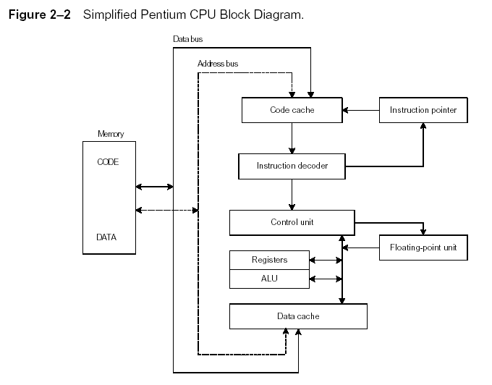
Instruction Execution Cycle
Loop
Fetch
Decode
Fetch operands
Execute
Store output
Repeat Loop until
HALT

Slide 11
Reading from Memory
Multiple machine cycles are required when reading from memory, because it responds much more slowly than the CPU. The steps are:
Execution step
Cycle 1: address placed on address bus
Cycle 2: Read Line (RD) set low (0), changing the value of processor’s RD
Cycle 3: CPU waits one cycle for memory chips to respond
Cycle 4: Read Line (RD) goes to 1, indicating that the data is on the data bus and can be copied
Memory Read Cycle

Slide 12
Issue
What issue arises from having a Main Memory and a Cache Memory? _____

Slide 13
Referencias
Chapters: Irvine, Kip R. Assembly Language for x86 Processors.
Notas de Ramón Ríos.
22-Ago-2019

