Slide 1
Basic Execution Environment
IA-32
Addressable memory
General-purpose registers
Index and base registers
Specialized register uses
Status flags

Slide 2
IA-32 Addressable Memory
Protected mode
4 GB
32-bit address (0 - 4,294,967,295)
Real-address mode and Virtual-8086 sub-mode
1 MB space
20-bit address (0 - 1,048,575)
In protected mode running multiple (Virtual-8086 sub mode) programs, each program has its own 1 MB memory area

Slide 3
Program Execution Registers
Named storage locations inside the CPU, optimized for high-speed.

Slide 4
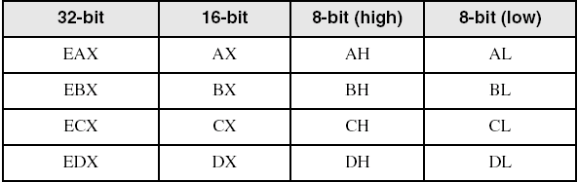
General-Purpose Registers (1/2)
32 bit-Registers: EAX, EBX, ECX, and EDX
Primarily used for arithmetic and data movement
Lower half of these registers can be broken down as:
two 8-bit values, or / and
one 16-bit value (both for backward-compatibility)

Slide 5
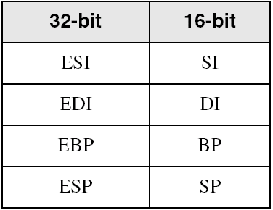
General-Purpose Registers (2/2)
32 bit-Registers: ESI, EDI, EBP, and ESP
These registers are used for addressing
Lower half of these registers can be broken down as:
one 16-bit value

Slide 6
Some Specialized Register Uses (1 / 2)
32-bit General-Purpose Registers
EAX – extended accumulator (mult, divi)
ECX – CPU loop counter
ESP – CPU extended stack pointer or SP
ESI, EDI – index registers
EBP – extended frame pointer (stack, for high-level languages parameters)
Should not be used for arithmetic or data transfer
16-bit Segment Registers (for processes)
CS – code segment
DS – data segment
SS – stack segment
ES, FS, GS - additional segments

Slide 7
Some Specialized Register Uses (2 / 2)
EIP – instruction pointer (traditional PC, Program Counter)
Contains address of next instruction to be executed
EFLAGS – Processor Status Flags
status and control flags
each flag is a single binary bit
A flag is set when it equals 1; it is clear (or reset) when it equals 0
The flags are affected after exec instructions

Slide 8
Status 1-bit Flags / EFLAGS
Carry
unsigned arithmetic out of range
Overflow
signed arithmetic out of range
Sign
result is negative
Zero
result is zero
Auxiliary Carry
carry from bit 3 to bit 4, in 8-bit operand
Parity
sum of 1 bits, is an even number (in LSB)

Slide 9
64-bit x86-64 Processors - 1
Intel64 (x86-64 specification)
P6 series, extended to 64 GB (___-bit addressing)
64-bit linear address space
64-bit Mode, Windows 64 uses this
Protected, Real-address and System Management Modes.
IA-32e Mode (backward-compatibility) has two sub-modes
Compatibility Mode for legacy 16- and 32-bit applications, Windows supports only 32-bit apps in this mode
64-bit Mode uses 64-bit addresses and 64-bit (and 32-bit) operands

Slide 10
64-bit x86-64 Processors - 2
64-bit Operating Systems over x86-64 Processors
E.g. Windows v7, v10, servers v2012, …
What exec programs are installed inside the next folders:
“C:\Program Files”? ________
“C:\Program Files (x86)” ? ________
Why Are these folders Split Up?
________
________
Task Manager display it up > (32 bits)

Slide 11
64-bit x86-64 Processors
Basic Execution Environment
addresses can be 64 bits (48 bits, in practice)
16 64-bit general purpose registers RAX-R16
A 64-bit status flags named RFLAGS
64-bit instruction pointer (Program Counter) named RIP

Slide 12
64-Bit General Purpose Registers
8-bit general purpose registers:
AL, BL, CL, DL, DIL, SIL, BPL, SPL, R8B-R15B
16-bit general purpose registers:
AX, BX, CX, DX, DI, SI, BP, SP, R8W-R15W
32-bit general purpose registers:
EAX, EBX, ECX, EDX, EDI, ESI, EBP, ESP, R8D-R15D
64-bit general purpose registers:
RAX, RBX, RCX, RDX, RDI, RSI, RBP, RSP, R8-R15

Slide 13
Endianness memory storage
Is the sequential order in which Bytes, representing a numerical value, are stored in main memory.
Numerical value storage > 1 Byte
Two formats for Endianness
Big-endian, MSB stored first, … LSB stored last
Little-endian, LSB stored first, … MSB stored last

Slide 14
Little Endian Order
4-Byte Example, integer variable alfa:
alfa, has a memory address location of 00000000₂
alfa: containing a numerical value of 12345678_{h}
0000 0000: | 78h
0000 0001: | 56h
0000 0002: | 34h
0000 0003: | 12h

Slide 15
Referencias
Chapters: Irvine, Kip R. Assembly Language for x86 Processors.
Notas de Ramón Ríos.
29-Ago-2019

