Slide 1
ORGANIZACIÓN Y PROGRAMACIÓN DE COMPUTADORAS
OPC
A – D 2019

Slide 2
Instruction Set
Data Transfer Instructions (cont…)
Besides MOV

Slide 3
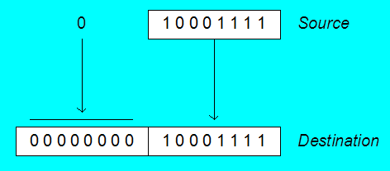
Zero Extension
When you copy a smaller value into a larger destination, the MOVZX instruction fills (extends) the upper half of the destination with zeros.
MOV BL,10001111b
MOVZX AX,BL ; zero-extension
The destination must be a register.

Slide 4
General Variants of MOVZX
MOVZX reg32, reg/mem8
MOVZX reg32, reg/mem16
MOVZX reg16, reg/mem8

Slide 5
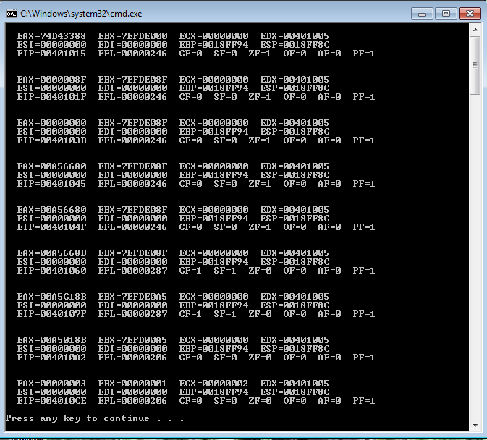
MOVZX with EAX register
CALL DumpRegs
MOV BL,10001111b ; chart Zero Extension
MOVZX EAX,BL ; showing MOVZX with EAX register
CALL DumpRegs

Slide 6
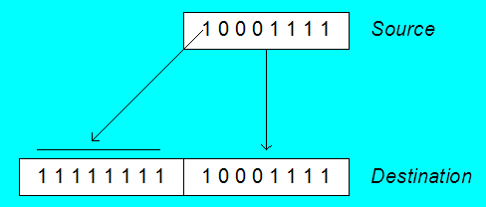
Sign Extension
The MOVSX instruction fills the upper half of the destination with a copy of the source operand's sign bit.
MOV BL,10001111b
MOVSX AX,BL ; sign extension
The destination must be a register.

Slide 7
General Variants of MOVSX
MOVSX reg32, reg/mem8
MOVSX reg32, reg/mem16
MOVSX reg16, reg/mem8

Slide 8
XCHG Instruction
XCHG exchanges the values of two operands. At least one operand must be a register. No immediate operands are permitted.
.DATA
var1 WORD 1000h
var2 WORD 2000h
.CODE
; EAX contains 12345678h, EBX has ABCDEF01h.
XCHG var1,BX ; exchange mem, reg
XCHG EAX,EBX ; exchange 32-bit regs
XCHG AX,BX ; exchange 16-bit regs
XCHG AH,AL ; exchange 8-bit regs
XCHG var1,var2 ; error: two memory operands

Slide 9
General Variants of XCHG
XCHG reg, reg
XCHG reg, mem
XCHG mem, reg

Slide 10
Your turn. . .
Write a program that rearranges the values of three doubleword values in the following array as: 3, 1, 2.
.data
arrayD DWORD 1,2,3
Step1:
MOV EAX, arrayD
XCHG . . .
Step 2:
XCHG . . .
MOV . . .

Slide 11
XCHG Example
; xchg examples
CALL DumpRegs
MOV EAX, arrayD
XCHG EAX, [arrayD+4]
XCHG EAX, [arrayD+8]
. . .
MOV arrayD, EAX
MOV EAX, [arrayD]
MOV EBX, [arrayD+4]
MOV ECX, [arrayD+8]
CALL DumpRegs

Slide 12
Evaluate this . . .
.data
myBytes BYTE 80h,66h,0A5h
How about the following code. Is anything missing?
; EAX has 00A5668Bh, EBX has 7EFDE08Fh
MOVZX AX, myBytes
MOV BL,[myBytes+1]
ADD AX, BX
MOV BL,[myBytes+2]
ADD AX, BX ; AX = ?

Slide 13
Evaluate this . . . (cont)
CALL DumpRegs
; MOVZX examples EAX: 00A5668Bh, EBX: 7EFDE08Fh
MOVZX AX, myBytes ; EAX: 00A50080h
MOV BL, [myBytes+1] ; EBX: 7EFDE066h
ADD AX, BX ; EAX: 00A5E0E6h
MOV BL, [myBytes+2] ; EBX: 7EFDE0A5h
ADD AX, BX ; AX = EAX: 00A5C18Bh
CALL DumpRegs

Slide 14
Evaluate this . . . (cont)
CALL DumpRegs
; MOVZX examples EAX: 00A5668Bh, EBX: 7EFDE08Fh
MOVZX AX,myBytes ; EAX: 00A50080h
MOV BX,0 ; EBX: 7EFD0000h
MOV BL,[myBytes+1] ; EBX: 7EFD0066h
ADD AX,BX ; EAX: 00A500E6h
MOV BL,[myBytes+2] ; EBX: 7EFD00A5h
ADD AX,BX ; AX = EAX: 00A5018Bh
CALL DumpRegs

Slide 15
Referencias
Chapters: Irvine, Kip R. Assembly Language for x86 Processors.
Notas de Ramón Ríos.
10-Sep-2019

