Slide 1
ORGANIZACIÓN Y PROGRAMACIÓN DE COMPUTADORAS
OPC
A – D 2019

Slide 2
Main, or Central, Memory
Main Memory structure
A Linear Vector of Memory Bytes (content), with the indexes being the memory addresses to Access the content of the Memory Bytes
Hardware components
EPROMs
xRAMs (e.g. DRAM)
Device Controllers: each one with Control Registers and a Data Buffer

Slide 3
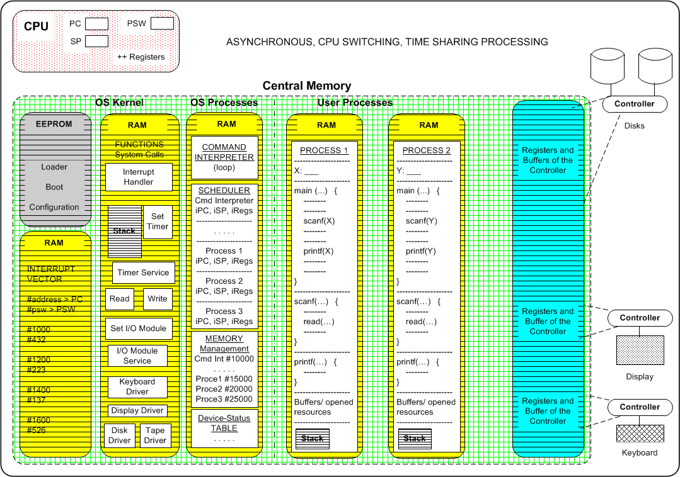
Memory Layout for Multiprogrammed System

Slide 4
Numerical Values: meanings
Data content: unsigned and signed values
Registers
Memory Byte locations
Memory Addresses
To Access Memory Byte locations
Represented as numerical unsigned values

Slide 5
Main Memory Addressing

Slide 6
Multiple Memory Byte Values
Byte Values used as Data
One-byte content
Two-byte content
Four-byte content
Eight-byte content
Always Powers of 2-byte content

Slide 7
Referencias
Chapters: Irvine, Kip R. Assembly Language for x86 Processors.
Notas de Ramón Ríos.
27-Ago-2019

