Slide 1



SQL PROJECT
ANDREA MARINO AND THAIS TERNUS
Data Analytics
Part-time Course

Slide 2

MISSION
CONNECT POTENTIAL STUDENTS TO THE RIGHT TECH SCHOOL TO LEVERAGE THEIR PROFESSIONAL FUTURE

Slide 3
TECHNICAL
CONNECTION
DATA MANIPULATING
DATA CLEANING
Connecting
Python to SQL
mysql.connector
pymysql
sqlalchemy
Drop columns
Rename columns
Fill null values
Cleaned junky strings

Slide 4
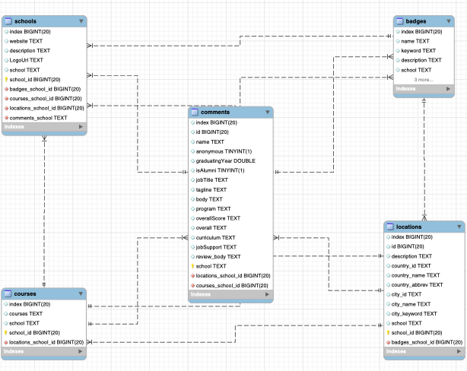
SCHEMA

Slide 5


STUDENT PROFILES
Andrea is Support Engineer at Microsoft, 29 years old, he is looking for a course to change his career within the company. He is very interested in the area of intelligence and data engineering. However, he has many responsibilities and cannot dedicate himself exclusively to the course, but he wants to study at the best school.
Eduarda just left the university, she is 22 years old. She graduated in design, but she doesn't want to do a master's degree right now. She loves digital product design and has a dream to make life easier for users. She is looking for a UX/UI course outside Portugal, so she can learn, get a job as soon as she finishes, make new friends from other countries and enjoy warm country.

Slide 6
ANDREA’S PLAN
TARGET
Online;
Part-Time;
The best School.
METHODOLOGY
From Badges table filtered to find out Online & Part-Time Courses:
Creating Temporary Tables
Connecting with Comments Table:
Inner Join
Calculating Average Votes From Alumni
Order by and Group By

Slide 7
ANDREA’S PLAN
RESULTS
According to the queries those are the best Courses Online & Part-Time
Average Score based on the number of votes and relevant number of samples
Program | School | AVG Score | Samples
UX Design | springboard | 4,58 | 264
Data Science Career Track | springboard | 4,53 | 248
Part-time Web Development | ironhack | 4,89 | 194
Bootcamp Prep | app-academy | 4,71 | 154
Introduction to Data Science | springboard | 4,44 | 60
UX Career Track | springboard | 4,59 | 54

Slide 8
EDUARDA’S PLAN
TARGET
UX/UI;
Outside Portugal;
Warm country.
METHODOLOGY
Connected the tables courses and locations;
Filtered courses name and taking out Portugal
Connected the tables courses and comments;
Filtered just Is Alumni, to get Job suport score

Slide 9
EDUARDA’S PLAN
RESULTS
Eduarda has 8 different cities, but just one school
Ironhack is the only school option, but according to the alumni they have a good job support
To have a warm country the best choices to her is Mexico City and Miami
Courses | School | City | Country | AVG Job support
UX/UI Design Bootcamp | ironhack | Berlin | Germany | 5
UX/UI Design Bootcamp | ironhack | Mexico City | Mexico | 5
UX/UI Design Bootcamp | ironhack | Amsterdam | Netherlands | 5
UX/UI Design Bootcamp | ironhack | São Paulo | Brazil | 5
UX/UI Design Bootcamp | ironhack | Paris | France | 5
UX/UI Design Bootcamp | ironhack | Miami | United States | 5
UX/UI Design Bootcamp | ironhack | Madrid | Spain | 5
UX/UI Design Bootcamp | ironhack | Barcelona | Spain | 5

Slide 10
NEXT STEPS
CONCLUSIONS
Analyzing and filtering Alumni comments to have a better understanding of datas;
To have better analysis of Eduarda's profile, the Badges table could bring the period that the classes would start;
The comments table could also have a column specifying which city the person filled in from;
And to have more options, add more school could be more interesting;
Create more customized profiles.

Slide 11
ANY QUESTION?
THANK YOU!
Data Analytics
Part-time Course

