Slide 1
Passenger and Freight Railroad Employee Data
By Dora Cheng, Andrea Curo, Sonam Shah

Slide 2
The Data
Survey of freight and railroad employees
Position, age, sex of employees
Caffeine Factors
Intake Amount
Sleep Factors
Work Schedule
Activity Log

Slide 3
The Data Cont.
Separate
Reformat

Slide 4
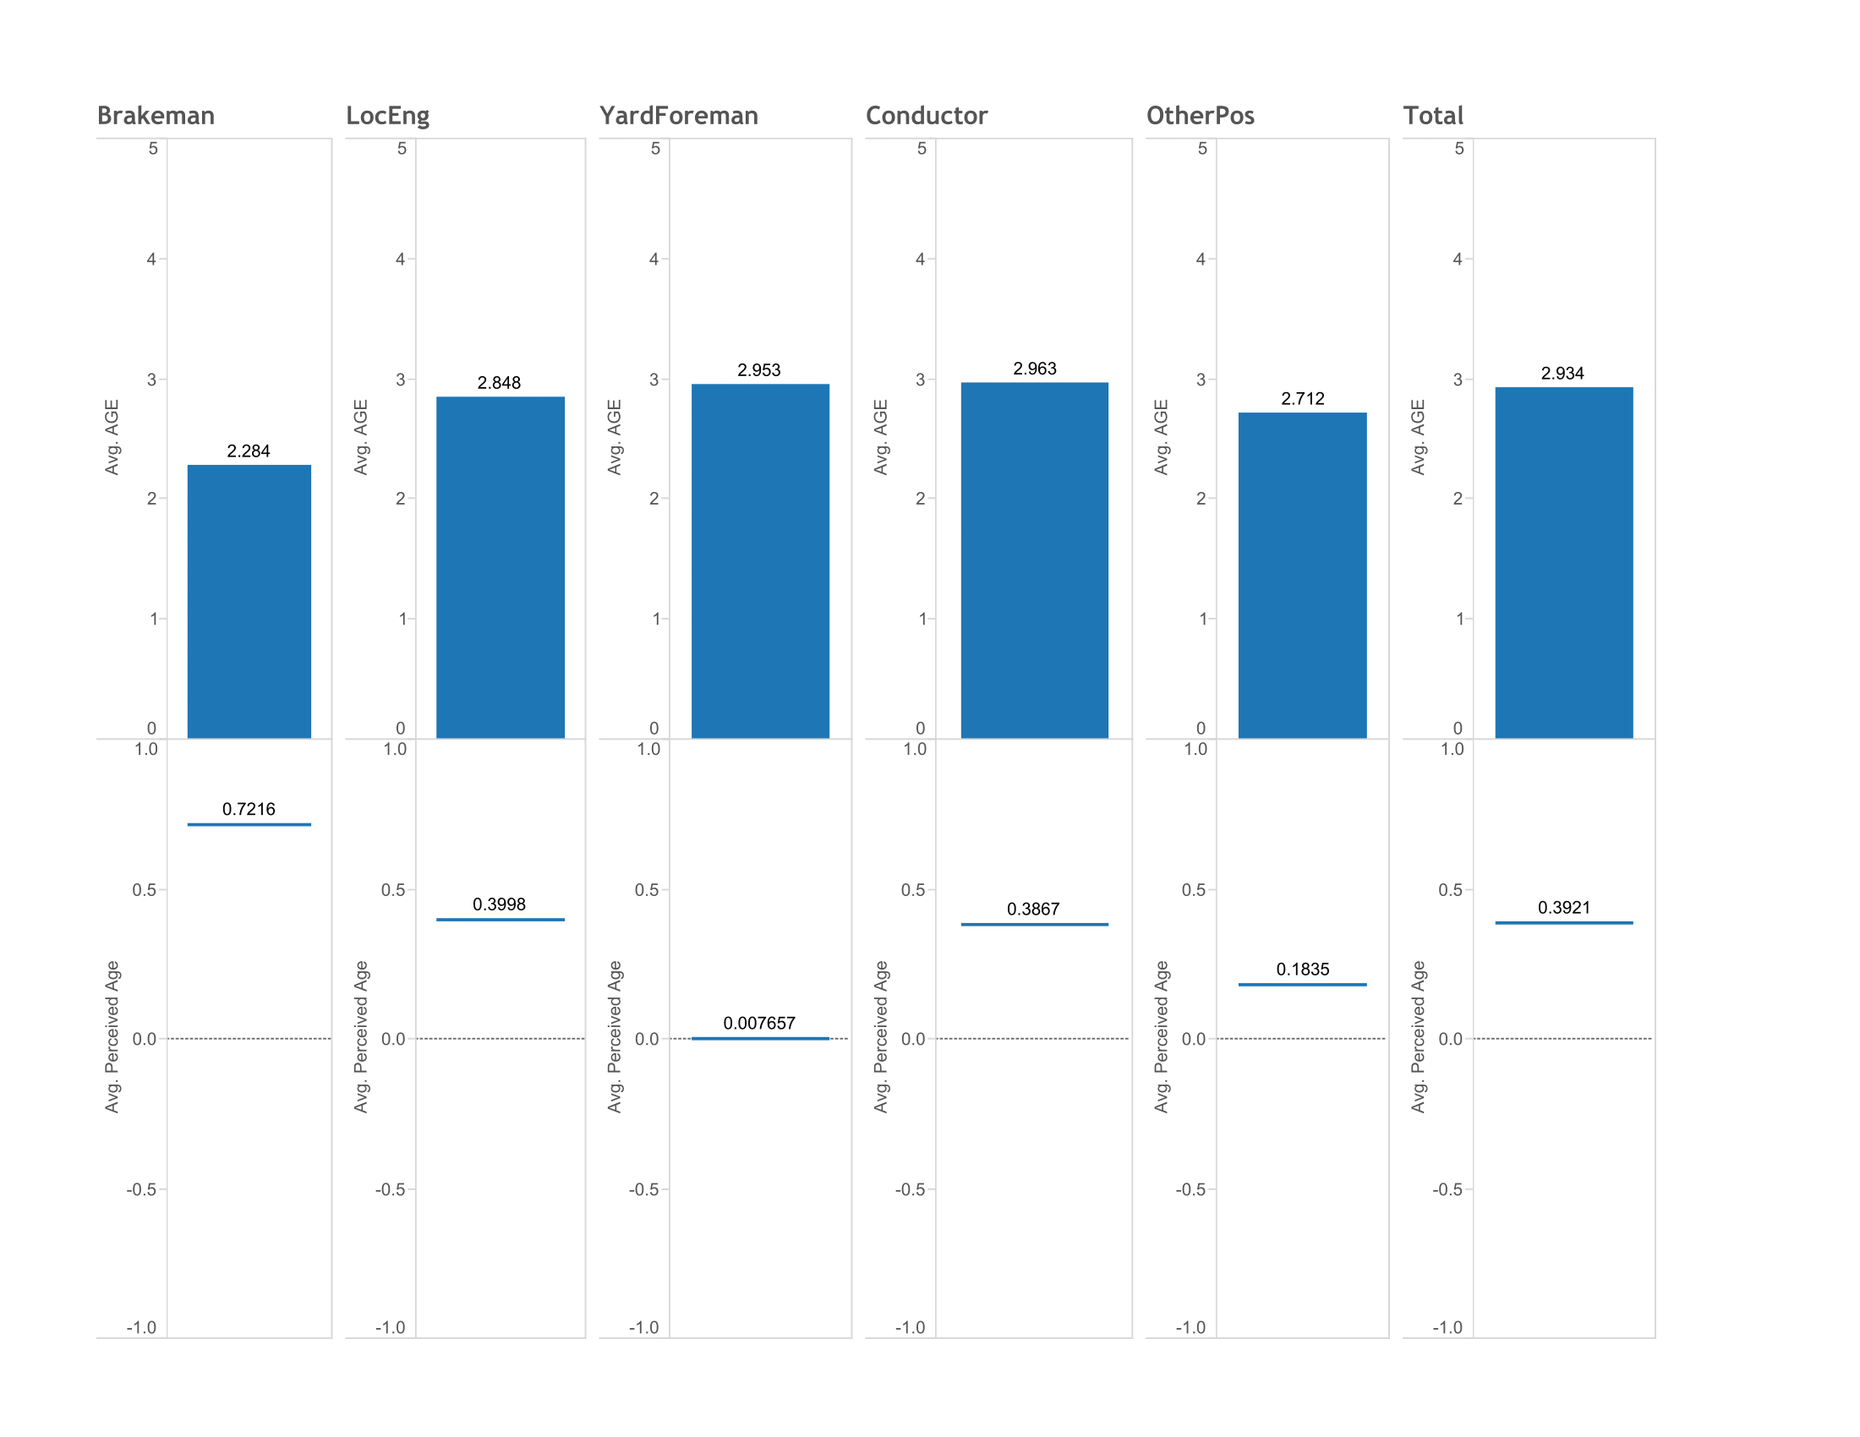
Job and Age Status
Data Reformatting

