Slide 1
Passenger and Freight Railroad Employee Data
By Dora Cheng, Andrea Curo, Sonam Shah

Slide 2
The Data - Description
Survey of freight and railroad employees
Position, age, sex of employees
Caffeine Factors
Intake Amount
Sleep Factors
Work Schedule
Activity Log

Slide 3
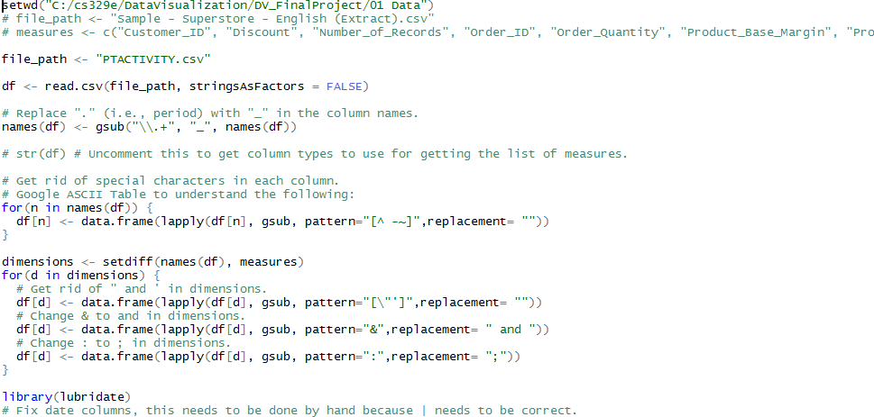
The Data - Processing
Separate
Reformat

Slide 4
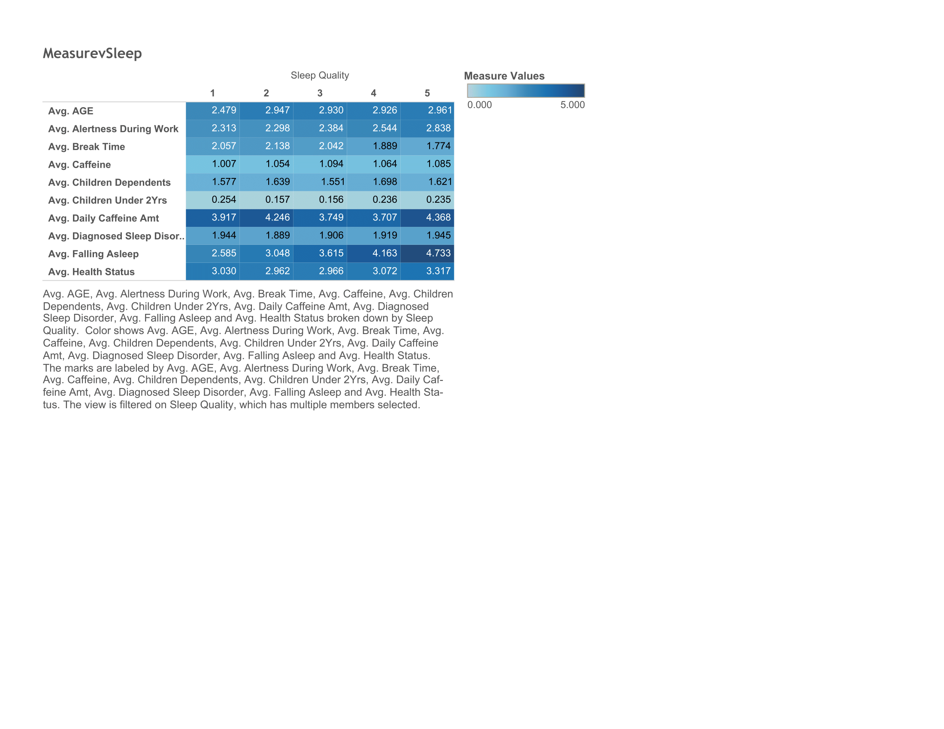
Overview of the Data
Sleep Quality versus various measures
Sleep Quality
5 (very good) – 1 (very poor)
Falling Asleep
5 (very easy) – 1 (very difficult)
Health Status
4 (excellent) – 1 (poor)

Slide 5
Time per Activity Type
Reformatting Data

Slide 6
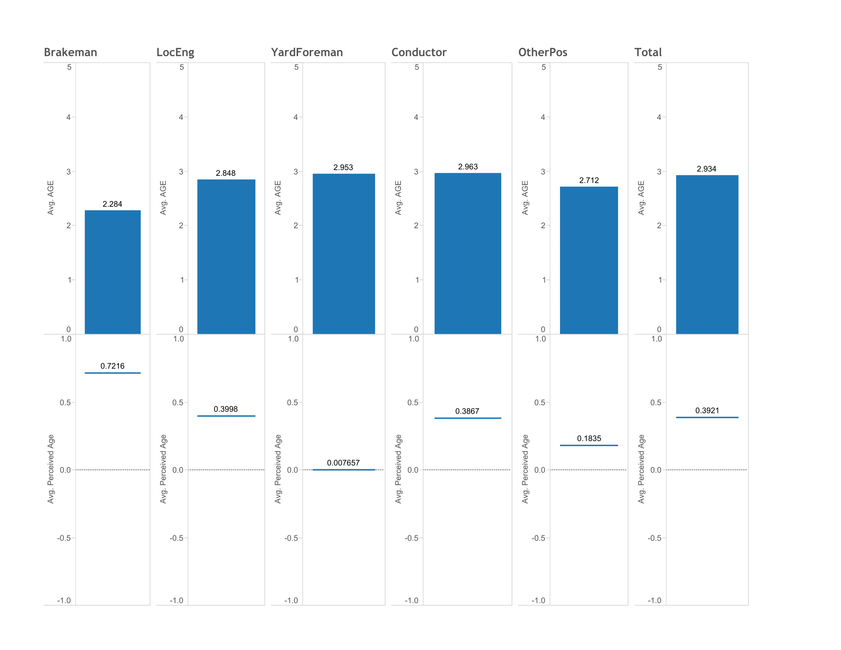
Job and Age Status
Jobs titles as dimensions
Separate worksheets
Utilized dashboard

