Slide 1
BOOM! COLOR CRASH
AMA GLANZENT
MICROCOMPUTER PACKAGES 2 (CS 20)

Slide 2
TABLE OF CONTENTS
01
02
03
04
ACKNOWLEDGMENT
STATEMENT OF THE PROBLEM
SOLUTION TO THE PROBLEM
SOFTWARE AND HARDWARE USED IN DEVELOPMENT

Slide 3
TABLE OF CONTENTS
05
06
07
08
09
SOFTWARE AND HARDWARE REQUIREMENTS
VIDEO GAME MECHANICS/CONTROLS
SCREENSHOT SOFTWARE
TEAM COMPOSITION
CONCLUSION

Slide 4
01
ACKNOWLEDGEMENT

Slide 5
ACKNOWLEDGEMENT
First and foremost, praises and thanks to God, the Almighty, for his showers of blessing throughout this thesis.
We would like to express our deep and sincere gratitude to our CS20 professor, Mr. Joselito Borces for giving us the opportunity to do this thesis and providing invaluable guidance throughout this thesis. We would also like to thank our respective panelists for taking time today with us.
To our family, friends and classmates, we thank them for supporting us in creating this thesis; for always being there to encourage us.
We wish to extend our special thanks to Google and all software that we used for providing us the tools that we needed to complete this thesis. Without them, this thesis wouldn’t be possible.

Slide 6
STATEMENT OF THE PROBLEM
02

Slide 7
STATEMENT OF THE PROBLEM
Boredom
Getting used to everyday rotation activity and bring dullness.
Inattentiveness
Other games have been found not thrilling that players would pay less attention to it.
Limited Resources
Players tend to use low specifications for the personal computers.
Hassle Maintenance
Games nowadays will have the user to update the game themselves and that causes hassle.
Portability
There are games that would only run on a specific operating system.

Slide 8
03
SOLUTION TO THE PROBLEM

Slide 9
SOLUTION TO THE PROBLEM
Create a new game, “Boom! Color Crash”. An easy game that makes your time pass.
Create a new game that will make the player focus and develop attention skills with tracking fast-moving objects.
Create a game that helps the player to play regardless of low PC specifications.
Create a game that new updates get automatically configured and would only cost little storage to update.
Create a game that can be played smoothly on various operating systems and browsers.

Slide 10
SOFTWARE AND HARDWARE USED IN DEVELOPMENT
04

Slide 11
HARDWARE USED IN DEVELOPMENT
Hardware
Laptop
Asus X455L
Processor : Intel Core i5-5200U Processor 2.2GHz
Operating System : Windows 10
Memory : 4GB 1x DRAM DDR3
USB mouse

Slide 12
SOFTWARE USED IN DEVELOPMENT
Software
Visual Studio Code
Visual Studio Code, also commonly referred to as VS Code, is a source-code editor made by Microsoft for Windows, Linux and macOS. Features include support for debugging, syntax highlighting, intelligent code completion, snippets, code refactoring, and embedded Git.

Slide 13
SOFTWARE USED IN DEVELOPMENT
Software
Microsoft Word any Edition
Microsoft Word is a word processor developed by Microsoft. It was first released on October 25, 1983, under the name Multi-Tool Word for Xenix systems.
Google Chrome
Google Chrome is a cross-platform web browser developed by Google. It was first released in 2008 for Microsoft Windows, built with free software components from Apple WebKit and Mozilla Firefox. It was later ported to Linux, macOS, iOS, and Android, where it is the default browser. The browser is also the main component of Chrome OS, where it serves as the platform for web applications.

Slide 14
05
SOFTWARE AND HARDWARE REQUIREMENTS

Slide 15
SOFTWARE AND HARDWARE REQUIREMENTS
Minimum
Processor: Intel Pentium 4 or AMD Athlon XP 2000+
Memory: 2GB RAM
Storage: 4GB Available Space
Recommended
Processor: Intel Celeron N4000 or AMD A4-9125
Memory: 4GB RAM
Storage: 8GB Available Space

Slide 16
SOFTWARE AND HARDWARE REQUIREMENTS
This game requires the following for the players to play.
OS: Linux, Mac OS, Windows 7, Windows 8, Windows 10, and/or Windows 11.
Browser: Firefox, Google Chrome, Microsoft Edge, Apple Safari.
Additional Requirements: Monitor, Mouse, Keyboard

Slide 17
Video Game Mechanics/Controls
06

Slide 18
VIDEO GAME MECHANICS/CONTROLS
Boom! Color Crash is a fixed shooter in which the player moves a white block horizontally across the bottom of the screen and fires at the shooting color blocks overhead. The player will be given 3 lives. If the player is hit by the falling color blocks. The player will lose 1 life and will be invincible for 2 seconds. The goal in this game is to avoid blocks of colors that are falling, and the player should fire and hit the color blocks (opponents) to have a 15 score in every color block.
Use the Left and Right arrows to move or “A” to move Left and “D” to move Right. Spacebar to shoot/fire. If the game’s over, click or press the spacebar to play again. If you want to pause the game just click the screen, the same if you want to resume the game.

Slide 19
07
SOFTWARE SCREENSHOTS

Slide 20
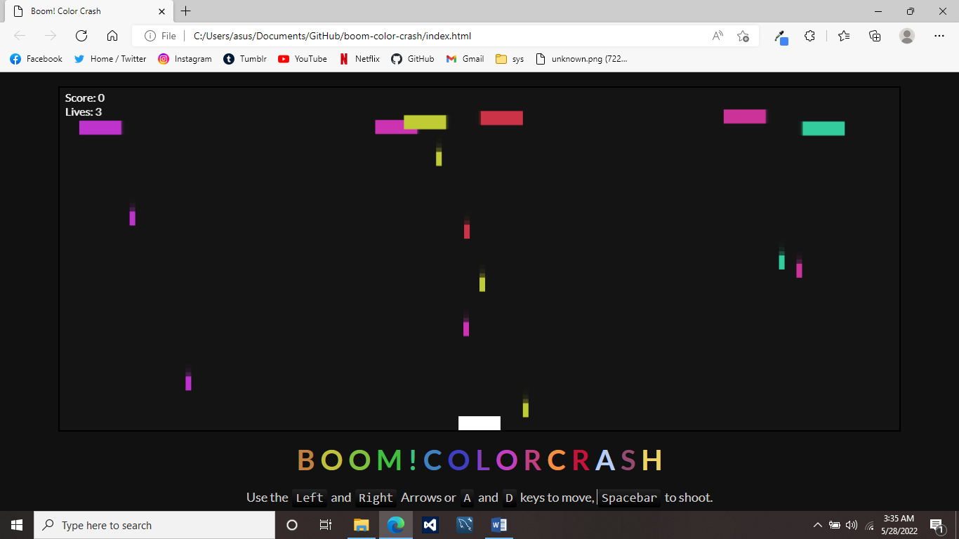
SOFTWARE SCREENSHOTS

Slide 21
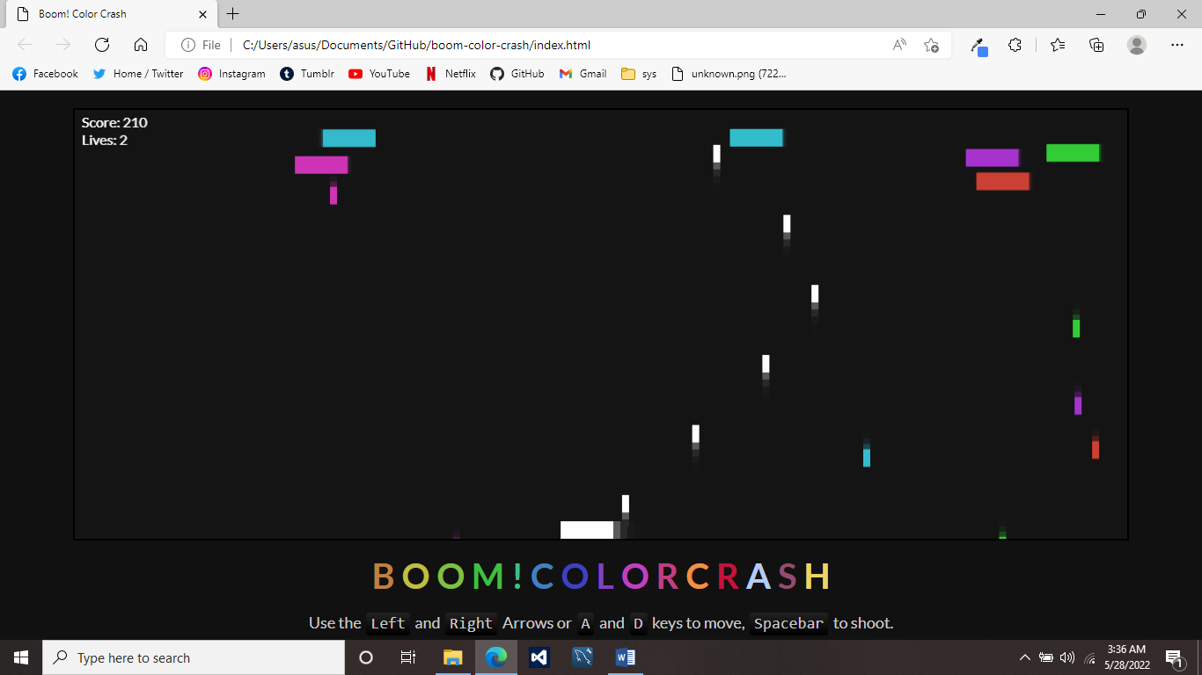
SOFTWARE SCREENSHOTS

Slide 22
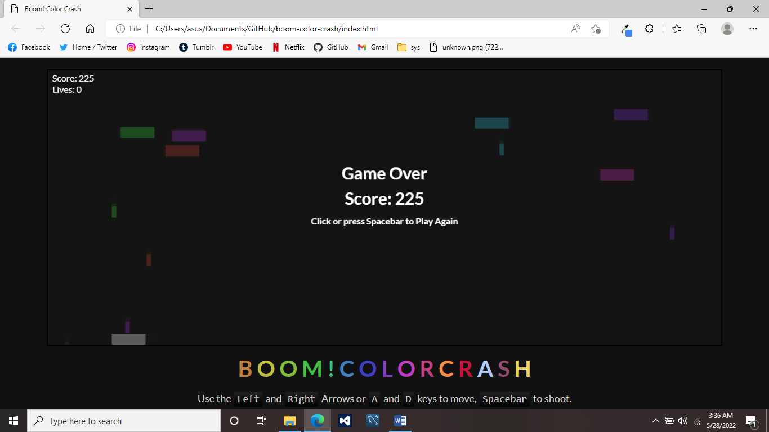
SOFTWARE SCREENSHOTS

Slide 23
TEAM COMPOSITION
08

Slide 24
OUR TEAM
FRANCISCO, MARK HERBERT P. Programmer
PETILLA, AILEEN JOY A. - Researcher
RAFAEL, ANDREA MAE NICOLE B. Leader/Programmer

Slide 25
09
CONCLUSION

Slide 26
CONCLUSION
The game is easy to play, and the graphics make the game look good. Web games are played in moderation and mindfulness as they are a viable source of stress relief. The player actively contributions to the level of satisfaction they attain from this medium and thus is more invested and willing to engage in the elements of the game.

