Slide 1

Documentation Tsunami Marketplace
Harry Chandra 535170076
Marvellino 535180101
Andrean Lay 535180104
Sudono Wijaya 535180113

Slide 2
Tsunami Road Map
Early September
September, 17 2020
End Of October
Tsunami Design Process
Realize concept to vanilla HTML, CSS, JS web application
Started to convert created concept to Vue.js
Early December
Early November
Final version of Tsunami Marketplace deployed.
Started the work on backend related stuff.

Slide 3
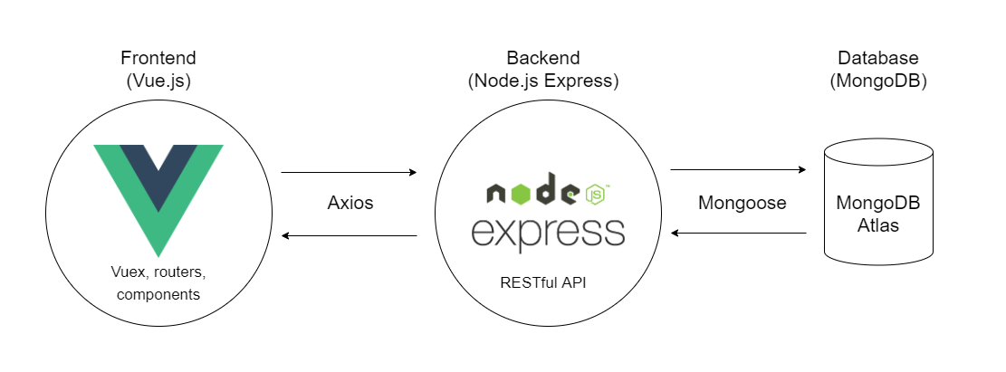
Tech Stack

Slide 4
New Features
Latest Release :
Able to register new accounts and login
Realtime product add, edit, and delete system
Improved Account Setting, Product Detail, Product Card Design
Added new Weather card in Account Dashboard

Slide 5
Server Depedencies
cors : v2.8.5
Express : v4.17.1
Mongoose : v5.10.13
mongoose-sequence : v5.3.0
Morgan : v1.10.0

Slide 6
Client Depedencies
axios : v0.21.0
bootstrap : v4.5.3
bootstrap-vue : v2.18.1
core-js : v3.6.5
Firebase : v8.0.2
Vue : v2.6.11
vue-carousel : v0.18.0
vue-quill-editor : v3.0.6
vue-router : v3.4.8
vue-typer : v1.2.0
Vuex : v3.5.1

Slide 7


Sekian dan Terima Kasih
©Tsunami-Marketplace 2020

