Slide 1
Tema #2 Tour por un OS
Sistemas Operativos 1.0
UNITEC
Basado en los slides de
William Stallings
Notes:
“Operating Systems: Internal and Design Principles”, 7/e, by William Stallings, Chapter 2 “Operating System Overview”.

Slide 2
Un sistema operativo es…
Un programa que controla la ejecución de aplicaciones
Una interface entre las aplicaciones y el hardware
Objetivos principales de un OS:
Conveniencia
Eficiencia
Capacidad de evolucionar
Notes:
An OS is a program that controls the execution of application programs and acts as
an interface between applications and the computer hardware. It can be thought of
as having three objectives:
• Convenience: An OS makes a computer more convenient to use.
• Efficiency: An OS allows the computer system resources to be used in an efficient
manner.
• Ability to evolve: An OS should be constructed in such a way as to permit the
effective development, testing, and introduction of new system functions without
interfering with service.

Slide 3
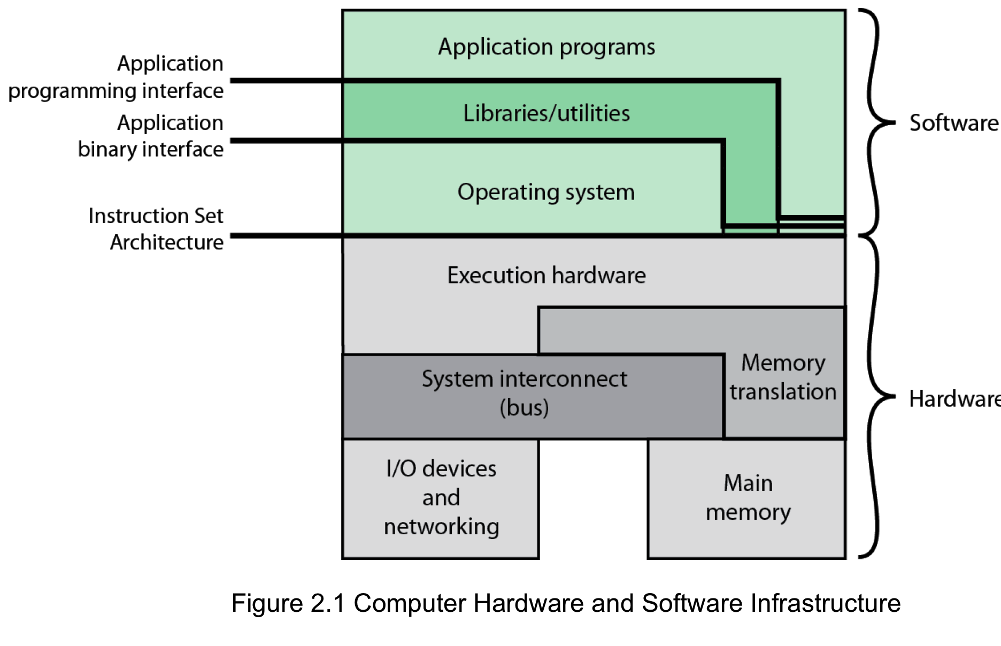
Harware y la infraestructura de Soft.
Notes:
The Operating System as a User/Computer Interface
The hardware and software used in providing applications to a user can be viewed
in a layered or hierarchical fashion, as depicted in Figure 2.1 . The user of those
applications, the end user, generally is not concerned with the details of computer
hardware. Thus, the end user views a computer system in terms of a set of applications.
An application can be expressed in a programming language and is developed
by an application programmer. If one were to develop an application program as a
set of machine instructions that is completely responsible for controlling the computer
hardware, one would be faced with an overwhelmingly complex undertaking.
To ease this chore, a set of system programs is provided. Some of these programs
are referred to as utilities, or library programs. These implement frequently used
functions that assist in program creation, the management of files, and the control of
I/O devices. A programmer will make use of these facilities in developing an application,
and the application, while it is running, will invoke the utilities to perform
certain functions. The most important collection of system programs comprises the
OS. The OS masks the details of the hardware from the programmer and provides
the programmer with a convenient interface for using the system. It acts as mediator,
making it easier for the programmer and for application programs to access and
use those facilities and services.

Slide 4
Servicios de un OS
Desarrollo de Programas
Ejecución de programas
Acceso a dispositivos de I/O
Acceso controlado a archivos
Acceso al sistema
Detección y respuesta de errores
Contabilización de uso
Notes:
Briefly, the OS typically provides services in the following areas:
• Program development: The OS provides a variety of facilities and services,
such as editors and debuggers, to assist the programmer in creating programs.
Typically, these services are in the form of utility programs that, while not
strictly part of the core of the OS, are supplied with the OS and are referred to
as application program development tools.
• Program execution: A number of steps need to be performed to execute a
program. Instructions and data must be loaded into main memory, I/O devices
and files must be initialized, and other resources must be prepared. The OS
handles these scheduling duties for the user.
• Access to I/O devices: Each I/O device requires its own peculiar set of instructions
or control signals for operation. The OS provides a uniform interface
that hides these details so that programmers can access such devices using simple
reads and writes.
• Controlled access to files: For file access, the OS must reflect a detailed understanding
of not only the nature of the I/O device (disk drive, tape drive) but
also the structure of the data contained in the files on the storage medium.
In the case of a system with multiple users, the OS may provide protection
mechanisms to control access to the files.
• System access: For shared or public systems, the OS controls access to the
system as a whole and to specific system resources. The access function must
provide protection of resources and data from unauthorized users and must
resolve conflicts for resource contention.
• Error detection and response: A variety of errors can occur while a computer
system is running. These include internal and external hardware errors, such
as a memory error, or a device failure or malfunction; and various software
errors, such as division by zero, attempt to access forbidden memory location,
and inability of the OS to grant the request of an application. In each case,
the OS must provide a response that clears the error condition with the least
impact on running applications. The response may range from ending the program
that caused the error, to retrying the operation, to simply reporting the
error to the application.
• Accounting: A good OS will collect usage statistics for various resources and
monitor performance parameters such as response time. On any system, this
information is useful in anticipating the need for future enhancements and in
tuning the system to improve performance. On a multiuser system, the information
can be used for billing purposes.

Slide 5
Interfaces Primarias
Instruction set architecture (ISA)
Application binary interface (ABI)
Application programming interface (API)
Notes:
Figure 2.1 also indicates three key interfaces in a typical computer system:
• Instruction set architecture (ISA) : The ISA defines the repertoire of machine
language instructions that a computer can follow. This interface is the boundary
between hardware and software. Note that both application programs
and utilities may access the ISA directly. For these programs, a subset of the
instruction repertoire is available (user ISA). The OS has access to additional
machine language instructions that deal with managing system resources
(system ISA).
• Application binary interface (ABI) : The ABI defines a standard for binary
portability across programs. The ABI defines the system call interface to
the operating system and the hardware resources and services available in a
system through the user ISA.
• Application programming interface (API) : The API gives a program access
to the hardware resources and services available in a system through the user
ISA supplemented with high-level language (HLL) library calls. Any system
calls are usually performed through libraries. Using an API enables application
software to be ported easily, through recompilation, to other systems that
support the same API.

Slide 6
El rol de un OS
Una computadora es un conjunto de recursos para el movimiento, almacenamiento y procesamiento de data
El OS es responsable de administrar esos recursos
Notes:
A computer is a set of resources for the movement, storage, and processing of data
and for the control of these functions. The OS is responsible for managing these
resources.

Slide 7
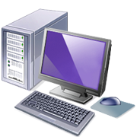
El OS como software
Funciona de la misma manera que cualquier software
Programa, o conjunto de programas ejecutados por el procesador
Frecuentemente libera el control y depende del procesador para que le permita retomar el control
Notes:
The OS, as a control mechanism is unusual in two respects:
• The OS functions in the same way as ordinary computer software; that is, it is
a program or suite of programs executed by the processor.
• The OS frequently relinquishes control and must depend on the processor to
allow it to regain control.
Like other computer programs, the OS provides instructions for the processor.
The key difference is in the intent of the program. The OS directs the processor
in the use of the other system resources and in the timing of its execution of other
programs. But in order for the processor to do any of these things, it must cease
executing the OS program and execute other programs. Thus, the OS relinquishes
control for the processor to do some “useful” work and then resumes control long
enough to prepare the processor to do the next piece of work. The mechanisms
involved in all this should become clear as the chapter proceeds.

Slide 8
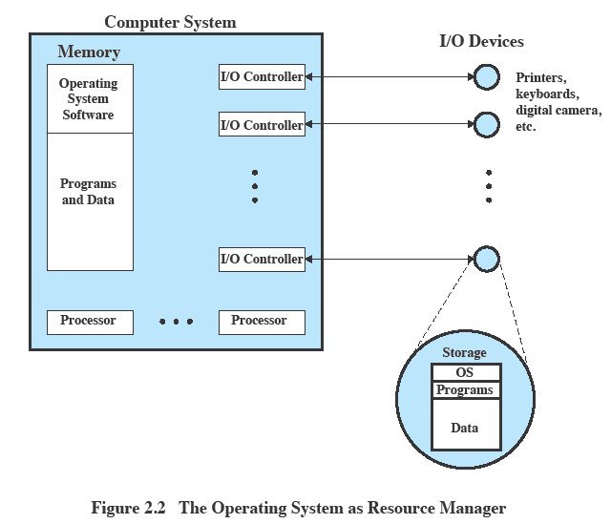
OS como administrador de recursos
Notes:
Figure 2.2 suggests the main resources that are managed by the OS. A portion
of the OS is in main memory. This includes the kernel , or nucleus , which contains
the most frequently used functions in the OS and, at a given time, other portions
of the OS currently in use. The remainder of main memory contains user programs
and data. The memory management hardware in the processor and the OS jointly
control the allocation of main memory, as we shall see. The OS decides when an I/O
device can be used by a program in execution and controls access to and use of files.
The processor itself is a resource, and the OS must determine how much processor
time is to be devoted to the execution of a particular user program. In the case of a
multiple-processor system, this decision must span all of the processors.

Slide 9

Features necesarios en el hardware
Protección de memoria para el OS
Mientras el programa del usuario está ejecutando, no debe alterar la memoria del OS
Timer
Evita que un proceso monopolice el sistema
Instrucciones privilegiadas
Sólamente pueden ser ejecutadas por el OS
Interrupts
Le da al OS más flexibilidad en controlar los programas del usuario
Notes:
The monitor, or batch OS, is simply a computer program. It relies on the ability
of the processor to fetch instructions from various portions of main memory to
alternately seize and relinquish control. Certain other hardware features are also
desirable:
• Memory protection: While the user program is executing, it must not alter the
memory area containing the monitor. If such an attempt is made, the processor
hardware should detect an error and transfer control to the monitor. The
monitor would then abort the job, print out an error message, and load in the
next job.
• Timer: A timer is used to prevent a single job from monopolizing the system.
The timer is set at the beginning of each job. If the timer expires, the user program
is stopped, and control returns to the monitor.
• Privileged instructions : Certain machine level instructions are designated privileged
and can be executed only by the monitor. If the processor encounters
such an instruction while executing a user program, an error occurs causing
control to be transferred to the monitor. Among the privileged instructions
are I/O instructions, so that the monitor retains control of all I/O devices. This
prevents, for example, a user program from accidentally reading job control
instructions from the next job. If a user program wishes to perform I/O, it must
request that the monitor perform the operation for it.
Interrupts : Early computer models did not have this capability. This feature
gives the OS more flexibility in relinquishing control to and regaining control
from user programs.

Slide 10
Modo dual de operación
Modo usuario
Aplicaciones del usuario ejecutan en modo usuario
Se protegen ciertas áreas de memoria
No se permite la ejecución de ciertas instrucciones
Modo kernel
OS ejecuta en modo kernel
Se pueden ejecutar instrucciones privilegiadas
Se puede accesar toda la memoria
Notes:
Considerations of memory protection and privileged instructions lead to the
concept of modes of operation. A user program executes in a user mode , in which
certain areas of memory are protected from the user’s use and in which certain
instructions may not be executed. The monitor executes in a system mode, or what
has come to be called kernel mode , in which privileged instructions may be executed
and in which protected areas of memory may be accessed.
Of course, an OS can be built without these features. But computer vendors
quickly learned that the results were chaos, and so even relatively primitive batch
operating systems were provided with these hardware features.

Slide 11
El OS introduce cierto overhead (sobrecosto)
Tiempo del procesador alterna entre la ejecución de procesos del usuario y ejecución del OS
Sacrificios:
Cierta cantidad de memoria asignada al OS
Algo de tiempo de procesador lo consume el OS
A pesar del overhead, el OS mejora la utilización del sistema completo
Notes:
With a batch OS, processor time alternates between execution of user programs
and execution of the monitor. There have been two sacrifices: Some main
memory is now given over to the monitor and some processor time is consumed by
the monitor. Both of these are forms of overhead. Despite this overhead, the simple
batch system improves utilization of the computer.

Slide 12
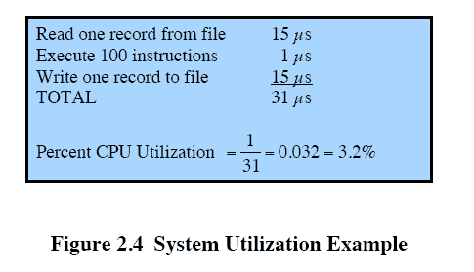
Qué ocurre en un sistema batch multiprogramado
Procesador está casi siempre desocupado (idle)
Dispositivos de I/O son más lentos que el CPU
Notes:
Even with the automatic job sequencing provided by a simple batch OS, the processor
is often idle. The problem is that I/O devices are slow compared to the processor.
Figure 2.4 details a representative calculation. The calculation concerns a program
that processes a file of records and performs, on average, 100 machine instructions
per record. In this example, the computer spends over 96% of its time waiting for
I/O devices to finish transferring data to and from the file.

Slide 13

Uniprogramación
El procesador pasa cierto tiempo ejecutando hasta que ocurre una instrucción de I/O; debe esperar hasta que la operación concluya antes de proceder
Notes:
Figure 2.5a illustrates this situation, where we have a single program, referred to as uniprogramming.
The processor spends a certain amount of time executing, until it reaches an I/O instruction.
It must then wait until that I/O instruction concludes before proceeding.

Slide 14
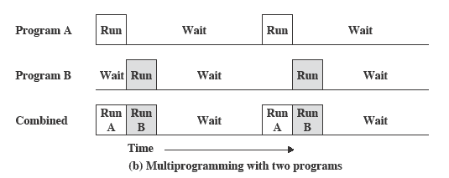
Multiprogramación
Debe haber suficiente memoria para mantener el OS y un proceso de usuario
Cuando un proceso necesita esperar operaciones de I/O, el procesador puede intercambiarse al otro proceso, que no está esperando I/O
Notes:
This inefficiency is not necessary. We know that there must be enough
memory to hold the OS (resident monitor) and one user program. Suppose that
there is room for the OS and two user programs. When one job needs to wait for
I/O, the processor can switch to the other job, which is likely not waiting for I/O
( Figure 2.5b ).

Slide 15
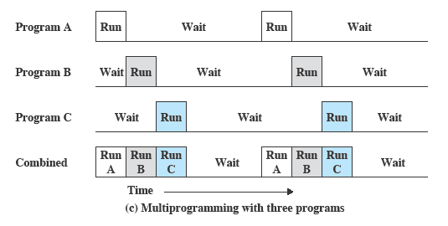
Multiprogramación
Multiprogramación
También conocida como multitasking
Se incrementa la memoria para tener tres, cuatro o más procesos en memoria, y multiplexar entre ellos
Notes:
Furthermore, we might expand memory to hold three, four, or more
programs and switch among all of them ( Figure 2.5c ). The approach is known as
multiprogramming , or multitasking . It is the central theme of modern operating
systems.

Slide 16
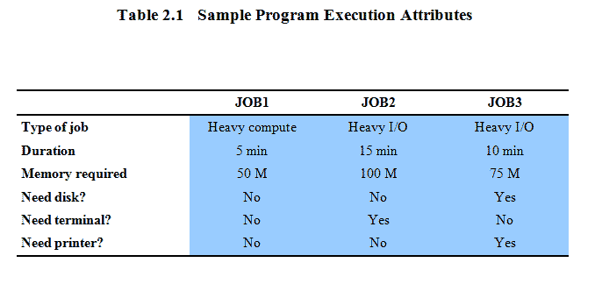
Ejemplo de multiprogramación
Notes:
To illustrate the benefit of multiprogramming, we give a simple example.
Consider a computer with 250 Mbytes of available memory (not used by the OS),
a disk, a terminal, and a printer. Three programs, JOB1, JOB2, and JOB3, are
submitted for execution at the same time, with the attributes listed in Table 2.1 .
We assume minimal processor requirements for JOB2 and JOB3 and continuous
disk and printer use by JOB3. For a simple batch environment, these jobs will be
executed in sequence. Thus, JOB1 completes in 5 minutes. JOB2 must wait until
the 5 minutes are over and then completes 15 minutes after that. JOB3 begins after
20 minutes and completes at 30 minutes from the time it was initially submitted.

Slide 17
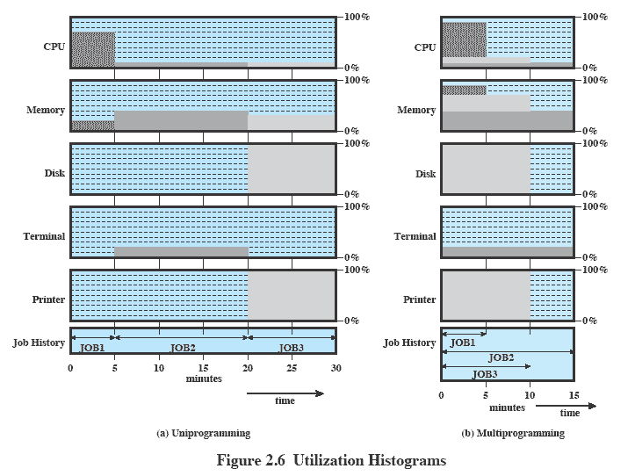
Histogramas de utilización
Notes:
Device-by-device utilization is illustrated in
Figure 2.6a . It is evident that there is gross underutilization for all resources when
averaged over the required 30-minute time period.
Now suppose that the jobs are run concurrently under a multiprogramming
OS. Because there is little resource contention between the jobs, all three can run
in nearly minimum time while coexisting with the others in the computer (assuming
that JOB2 and JOB3 are allotted enough processor time to keep their input
and output operations active). JOB1 will still require 5 minutes to complete, but at
the end of that time, JOB2 will be one-third finished and JOB3 half finished. All
three jobs will have finished within 15 minutes. The improvement is evident when
examining the multiprogramming column of Table 2.2 , obtained from the histogram
shown in Figure 2.6b .

Slide 18
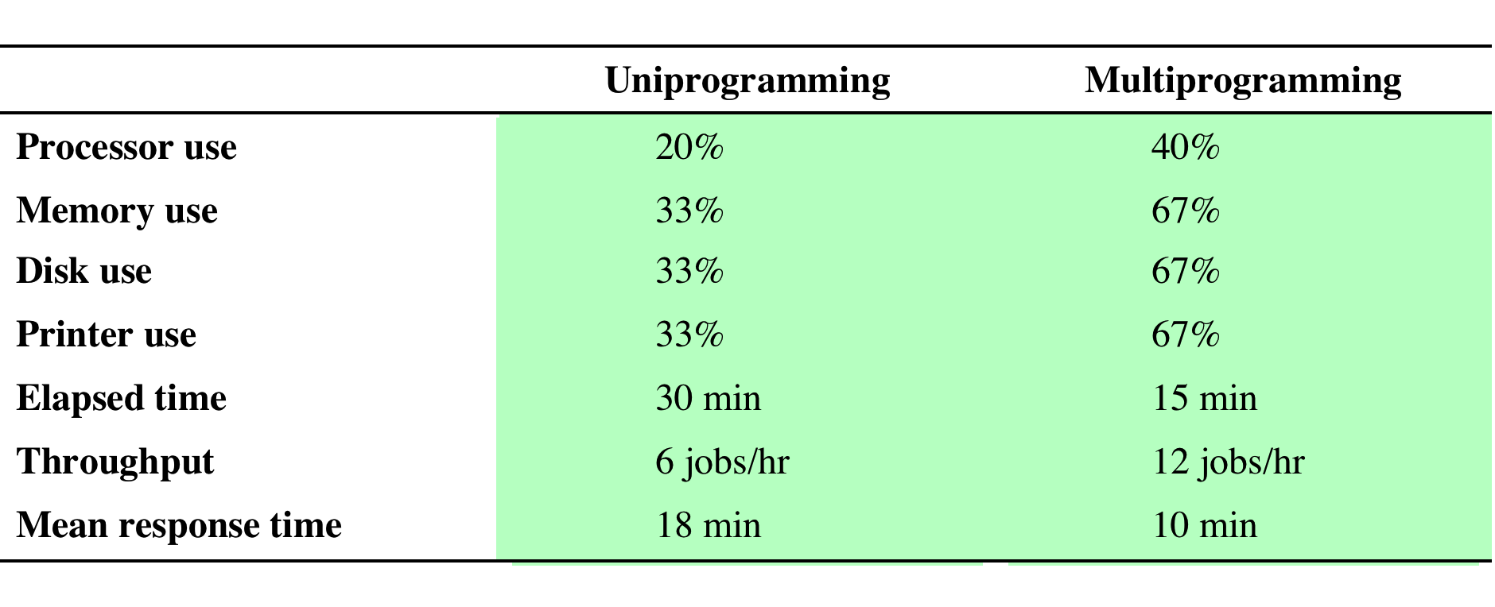
Efectos en el uso de recursos
Table 2.2 Effects of Multiprogramming on Resource Utilization
Notes:
The average resource utilization, throughput, and response times are shown in the
uniprogramming column of Table 2.2 .

Slide 19
Procesos
Concepto fundamental para la estructura del OS
Un proceso puede definirse como:
Un programa en ejecución
Una instancia de un programa corriendo
La entidad que puede ser asignada y ejecutada en un procesador
Una unidad de actividad caracterizada por un hilo de ejecución, un estado actual y un conjunto de recursos del sistema asociados
Notes:
Central to the design of operating systems is the concept of process. This term was
first used by the designers of Multics in the 1960s [DALE68]. It is a somewhat
more general term than job. Many definitions have been given for the term process ,
including
• A program in execution
• An instance of a program running on a computer
• The entity that can be assigned to and executed on a processor
• A unit of activity characterized by a single sequential thread of execution, a
current state, and an associated set of system resources

Slide 20
Componentes de un proceso
Un proceso tiene tres componentes:
Un programa ejecutable
Los datos necesarios por el programa
El contexto de ejecución o estado de proceso del programa
El contexto de ejecución es muy importante:
Datos internos que el OS usa para supervisar y controlar el proceso
Incluye el contenido de los registros del CPU
Incluye información sobre la prioridad del proceso, o si el proceso está esperando algún evento de I/O
Notes:
We can think of a process as consisting of three components:
• An executable program
• The associated data needed by the program (variables, work space, buffers, etc.)
• The execution context of the program
This last element is essential.
The execution context, or process state, is the internal data by which the OS is able to supervise and control the process.
This internal information is separated from the process, because the OS has information not permitted to the process.
The context includes all of the information that the OS needs to manage the process and that the processor needs to execute the process properly including:
contents of the various processor registers, such as the program counter and data registers
And information of use to the OS, such as the priority of the process and whether the process is waiting for the completion of a particular I/O event.

Slide 21
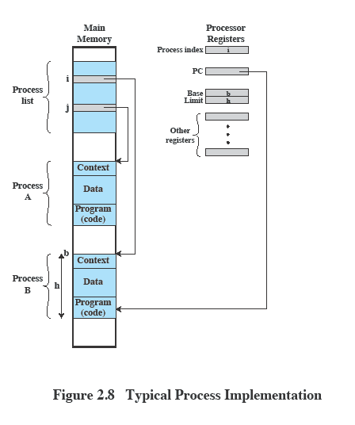
Administración de procesos
El estado completo de un proceso está contenido en su contexto
Nuevos features pueden ser diseñados e incorporados en el OS expandiendo el contexto para incluir nueva información para soportar el feature
Notes:
Figure 2.8 indicates a way in which processes may be managed. Two processes,
A and B, exist in portions of main memory. That is, a block of memory is
allocated to each process that contains the program, data, and context information.
Each process is recorded in a process list built and maintained by the OS. The
process list contains one entry for each process, which includes a pointer to the
location of the block of memory that contains the process. The entry may also
include part or all of the execution context of the process. The remainder of the
execution context is stored elsewhere, perhaps with the process itself (as indicated
in Figure 2.8 ) or frequently in a separate region of memory. The process index
register contains the index into the process list of the process currently controlling
the processor. The program counter points to the next instruction in that process
to be executed. The base and limit registers define the region in memory occupied
by the process: The base register is the starting address of the region of memory
and the limit is the size of the region (in bytes or words). The program counter and
all data references are interpreted relative to the base register and must not exceed
the value in the limit register. This prevents interprocess interference.
In Figure 2.8 , the process index register indicates that process B is executing.
Process A was previously executing but has been temporarily interrupted. The
contents of all the registers at the moment of A’s interruption were recorded in its
execution context. Later, the OS can perform a process switch and resume execution
of process A. The process switch consists of storing the context of B and restoring
the context of A. When the program counter is loaded with a value pointing into A’s
program area, process A will automatically resume execution.

Slide 22
Administración de memoria
El OS tiene cinco responsabilidades en el manejo de almacenamiento:
Aislar procesos
Almacenamiento de largo plazo
Protección y control de acceso
Soportar programación modular
Asignación automatica
Notes:
The needs of users can be met best by a computing environment that supports
modular programming and the flexible use of data. System managers need efficient
and orderly control of storage allocation. The OS, to satisfy these requirements, has
five principal storage management responsibilities:
• Process isolation: The OS must prevent independent processes from interfering
with each other’s memory, both data and instructions.
• Automatic allocation and management: Programs should be dynamically
allocated across the memory hierarchy as required. Allocation should be
transparent to the programmer. Thus, the programmer is relieved of concerns
relating to memory limitations, and the OS can achieve efficiency by assigning
memory to jobs only as needed.
• Support of modular programming: Programmers should be able to define program
modules, and to create, destroy, and alter the size of modules dynamically.
• Protection and access control: Sharing of memory, at any level of the memory
hierarchy, creates the potential for one program to address the memory space
of another. This is desirable when sharing is needed by particular applications.
At other times, it threatens the integrity of programs and even of the OS itself.
The OS must allow portions of memory to be accessible in various ways by
various users.
• Long-term storage: Many application programs require means for storing
information for extended periods of time, after the computer has been
powered down.

Slide 23
Protección y seguridad
La naturaleza de la amenaza que involucra una organización depende de sus circunstancias
El problema radica en controlar el acceso a los sistemas y a la información contenida en ellos
Temas principales
disponibilidad
confidencialidad
integridad
autenticidad
Notes:
The growth in the use of time-sharing systems and, more recently, computer networks
has brought with it a growth in concern for the protection of information.
The nature of the threat that concerns an organization will vary greatly depending
on the circumstances. However, there are some general-purpose tools that can be
built into computers and operating systems that support a variety of protection and
security mechanisms. In general, we are concerned with the problem of controlling
access to computer systems and the information stored in them.
Much of the work in security and protection as it relates to operating systems
can be roughly grouped into four categories:
• Availability: Concerned with protecting the system against interruption.
• Confidentiality: Assures that users cannot read data for which access is
unauthorized.
• Data integrity: Protection of data from unauthorized modification.
• Authenticity: Concerned with the proper verification of the identity of users
and the validity of messages or data.

Slide 24
Planificación y Administración de Recursos
Responsabilidad primaria del OS es administrar recursos
Las políticas de asignación de recursos deben considerar:
justicia
Respuesta diferenciada
eficiencia
Notes:
A key responsibility of the OS is to manage the various resources available to it (main memory space, I/O devices, processors) and to schedule their use by the various active processes.
Any resource allocation and scheduling policy must consider three factors:
Fairness:
Typically, we would like all processes that are competing for the use of a particular resource to be given approximately equal and fair access to that resource.
This is especially so for jobs of the same class, that is, jobs of similar demands.
Differential responsiveness:
On the other hand, the OS may need to discriminate among different classes of jobs with different service requirements.
The OS should attempt to make allocation and scheduling decisions to meet the total set of requirements.
The OS should also make these decisions dynamically.
e.g. if a process is waiting for the use of an I/O device, the OS may wish to schedule that process for execution as soon as possible to free up the device for later demands from other processes.
Efficiency:
The OS should attempt to
maximize throughput,
minimize response time, and
accommodate as many users as possible.
These criteria conflict;
Finding the right balance for a particular situation is an ongoing problem for operating system research.

Slide 25
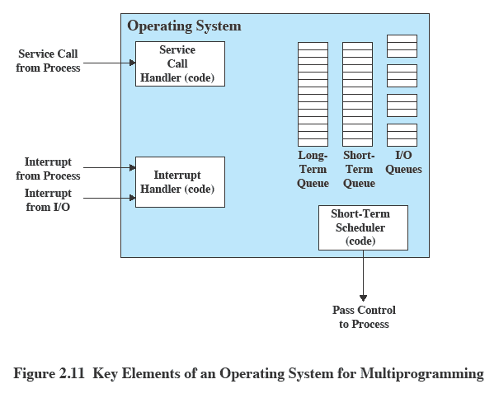
Elementos clave de un OS
Notes:
Figure 2.11 suggests the major elements of the OS involved in the scheduling
of processes and the allocation of resources in a multiprogramming environment.
The OS maintains a number of queues, each of which is simply a list of processes
waiting for some resource. The short-term queue consists of processes that are in
main memory (or at least an essential minimum portion of each is in main memory)
and are ready to run as soon as the processor is made available. Any one of these
processes could use the processor next. It is up to the short-term scheduler, or
dispatcher, to pick one. A common strategy is to give each process in the queue
some time in turn; this is referred to as a round-robin technique. In effect, the
round-robin technique employs a circular queue. Another strategy is to assign
priority levels to the various processes, with the scheduler selecting processes in
priority order.
The long-term queue is a list of new jobs waiting to use the processor. The
OS adds jobs to the system by transferring a process from the long-term queue to
the short-term queue. At that time, a portion of main memory must be allocated
to the incoming process. Thus, the OS must be sure that it does not overcommit
memory or processing time by admitting too many processes to the system. There
is an I/O queue for each I/O device. More than one process may request the use of
the same I/O device. All processes waiting to use each device are lined up in that
device’s queue. Again, the OS must determine which process to assign to an available
I/O device.
The OS receives control of the processor at the interrupt handler if an interrupt
occurs. A process may specifically invoke some OS service, such as an I/O
device handler by means of a service call. In this case, a service call handler is the
entry point into the OS. In any case, once the interrupt or service call is handled, the
short-term scheduler is invoked to pick a process for execution.
The foregoing is a functional description; details and modular design of this
portion of the OS will differ in various systems. Much of the research and development
effort in operating systems has been directed at picking algorithms and data
structures for this function that provide fairness, differential responsiveness, and
efficiency.

Slide 26
Arquitecturas de un OS
Diferentes formas de organizar el OS dependiendo de las demandas actuales:
Arquitectura de microkernel
Multithreading
Multiprocesamiento simétrico
Sistemas operativos distribuidos
Diseño orientado a objetos
Notes:
The rate of change in the demands on operating systems requires not just modifications and enhancements to existing architectures but new ways of organizing the OS.
A wide range of different approaches and design elements has been tried in both experimental and commercial operating systems, but much of the work fits into the following categories:
• Microkernel architecture
• Multithreading
• Symmetric multiprocessing
• Distributed operating systems
• Object-oriented design

Slide 27
Arquitectura microkernel
Asigna unas pocas funciones esenciales al kernel:
El enfoque:
Espacio de direccionamiento
Comunicación entre procesos (IPC)
Planificación básica
Simplifica la implementación
Provee flexibilidad
Se adapta bien a un entorno distribuido
Notes:
Most operating systems, until recently, featured a large monolithic kernel .
Most of what is thought of as OS functionality is provided in these large kernels,
including scheduling, file system, networking, device drivers, memory management,
and more. Typically, a monolithic kernel is implemented as a single process, with
all elements sharing the same address space. A microkernel architecture assigns
only a few essential functions to the kernel, including address spaces, interprocess
communication (IPC), and basic scheduling. Other OS services are provided by
processes, sometimes called servers, that run in user mode and are treated like any
other application by the microkernel. This approach decouples kernel and server
development. Servers may be customized to specific application or environment
requirements. The microkernel approach simplifies implementation, provides flexibility,
and is well suited to a distributed environment. In essence, a microkernel
interacts with local and remote server processes in the same way, facilitating construction
of distributed systems.

Slide 28
Multithreading
Técnica en la que un proceso se divide en hilos (threads) que pueden correr en forma concurrente
Thread
Unidad planificable de trabajo
Incluye un contexto de CPU y su propia área de datos para habilitar subrutias
Se ejecuta secuencialmente y es interrumpible (reentrante)
Proceso
Colección de uno o más threads y sus recursos asociados
Programador tiene mayor control sobre la modularidad de la aplicación y sus eventos
Notes:
Multithreading is a technique in which a process, executing an application, is
divided into threads that can run concurrently. We can make the following distinction:
• Thread: A dispatchable unit of work. It includes a processor context (which
includes the program counter and stack pointer) and its own data area for a
stack (to enable subroutine branching). A thread executes sequentially and is
interruptible so that the processor can turn to another thread.
• Process : A collection of one or more threads and associated system resources
(such as memory containing both code and data, open files, and devices). This
corresponds closely to the concept of a program in execution. By breaking
a single application into multiple threads, the programmer has great control
over the modularity of the application and the timing of application-related
events.
Multithreading is useful for applications that perform a number of essentially
independent tasks that do not need to be serialized. An example is a database server
that listens for and processes numerous client requests. With multiple threads running
within the same process, switching back and forth among threads involves
less processor overhead than a major process switch between different processes.
Threads are also useful for structuring processes that are part of the OS kernel as
described in subsequent chapters.

Slide 29
Multiprocesamiento simétrico (SMP)
Término se refiere a una arquitectura de hardware y también al comportamiento del OS que explota esa arquitectura
Varios procesos pueden correr en paralelo
Múltiples procesadores son transparentes para el usuario
Estos procesasores comparten la misma memoria y facilidades de I/O
Arquitecturas NUMA
Todos los procesadores pueden realizar las mismas funciones
El OS se preocupa de planificar los hilos o procesos en CPUs individuales, y de la sincronización entre CPUs
Notes:
Symmetric multiprocessing (SMP) is a term that refers to a computer hardware
architecture (described in Chapter 1 ) and also to the OS behavior that exploits
that architecture. The OS of an SMP schedules processes or threads across all of the
processors.
Multithreading and SMP are often discussed together, but the two are
independent facilities. Even on a uniprocessor system, multithreading is useful for
structuring applications and kernel processes. An SMP system is useful even for
nonthreaded processes, because several processes can run in parallel. However, the
two facilities complement each other and can be used effectively together.
An attractive feature of an SMP is that the existence of multiple processors is
transparent to the user. The OS takes care of scheduling of threads or processes on
individual processors and of synchronization among processors.

Slide 30
Ventajas del SMP
Performance
Más de un proceso corriendo simultáneamente
Disponibilidad
Falla de un proceso no detiene todo el sistema
Crecimiento
Perforrmance de un sistema puede mejorar agregando otro CPU
Escalabilidad
Se pueden crear diferentes sistemas con capacidades diferentes
Notes:
SMP has a number of potential advantages over uniprocessor architecture,
including the following:
• Performance: If the work to be done by a computer can be organized so that
some portions of the work can be done in parallel, then a system with multiple
processors will yield greater performance than one with a single processor of
the same type. This is illustrated in Figure 2.12 . With multiprogramming, only
one process can execute at a time; meanwhile all other processes are waiting
for the processor. With multiprocessing, more than one process can be running
simultaneously, each on a different processor.
• Availability: In a symmetric multiprocessor, because all processors can perform
the same functions, the failure of a single processor does not halt the
system. Instead, the system can continue to function at reduced performance.
• Incremental growth: A user can enhance the performance of a system by adding
an additional processor.
• Scaling: Vendors can offer a range of products with different price and performance
characteristics based on the number of processors configured in the
system.
It is important to note that these are potential, rather than guaranteed, benefits. The
OS must provide tools and functions to exploit the parallelism in an SMP system.

Slide 31
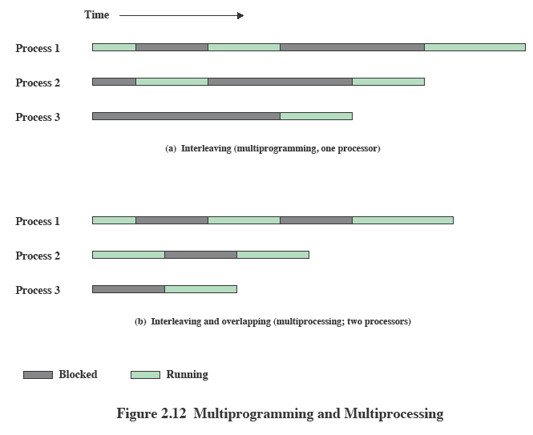
Multiprogramación Multiprocessing
Notes:
If the work to be done by a computer can be organized so that
some portions of the work can be done in parallel, then a system with multiple
processors will yield greater performance than one with a single processor of
the same type. This is illustrated in Figure 2.12 . With multiprogramming, only
one process can execute at a time; meanwhile all other processes are waiting
for the processor. With multiprocessing, more than one process can be running
simultaneously, each on a different processor.

Slide 32
Diseño de OS
Sistema operativo distribuído
Diseño orientado a objetos
Crea la ilusión de
Un único espacio de memoria
Único espacio de memoria secundaria
Facilidades de acceso unificadas
El estudio de OS distribuídos está retrasado respecto a las otras arquitecturas
Utilizado para agregar extensiones modulares al kernel
Permite a los programadores personalizar un OS sin afectar la integridad del sistema
Facilita el desarrollo de herramientas y sistemas distribuídos
Notes:
A different problem is to provide the appearance of a single
system for a cluster of separate computers—a multicomputer system. In this
case, we are dealing with a collection of entities (computers), each with its own
main memory, secondary memory, and other I/O modules. A distributed operating
system provides the illusion of a single main memory space and a single secondary
memory space, plus other unified access facilities, such as a distributed file system.
Although clusters are becoming increasingly popular, and there are many cluster
products on the market, the state of the art for distributed operating systems lags
that of uniprocessor and SMP operating systems. We examine such systems in
Part Eight.
Another innovation in OS design is the use of object-oriented technologies.
Object-oriented design lends discipline to the process of adding modular extensions
to a small kernel. At the OS level, an object-based structure enables programmers
to customize an OS without disrupting system integrity. Object orientation also
eases the development of distributed tools and full-blown distributed operating
systems.

Slide 33
Historia de MS Windows
MS-DOS 1.0 liberado en 1981
4000 lineas de assembler
Corría en 8 Kbytes de memoria
Usaba procesador Intel 8086
Windows 3.0 liberado en 1990
16-bit
GUI
Implementado como una capa sobre MS-DOS
Windows 95
32-bits
Dio paso al desarrollo de Windows 98 y Windows Me
Windows NT (3.1) liberado en 1993
32-bits con soporte de Windows, DOS y OS/2
Windows 2000
Servicios y funciones para procesamiento distribuído
Active Directory
Plug and play y manejo de energía
Windows XP liberado en 2001
Su meta era reemplazar las versiones de Windows basadas en MS-DOS, con tecnología NT
Windows Vista liberado en 2007
Windows Server 2k8 liberado en 2008
Windows 7 liberado en 2009, as´´I como Windows Server 2008 R2
Windows Azure
Cloud computing
Notes:
The story of Windows begins with a very different OS, developed by Microsoft for
the first IBM personal computer and referred to as MS-DOS. The initial version,
MS-DOS 1.0, was released in August 1981. It consisted of 4000 lines of assembly
language source code and ran in 8 Kbytes of memory using the Intel 8086
microprocessor.
The IBM PC was an important stage in a continuing revolution in computing
that has expanded computing from the data center of the 1960s, to the departmental
minicomputer of the 1970s, and to the desktop in the 1980s. The revolution has continued
with computing moving into the briefcase in the 1990s, and into our pockets
during the most recent decade.
Microsoft’s initial OS ran a single application at a time, using a command line
interface to control the system. It took a long time for Microsoft to develop a true
GUI interface for the PC; on their third try they succeeded. The 16-bit Windows
3.0 shipped in 1990 and instantly became successful, selling a million copies in six
months. Windows 3.0 was implemented as a layer on top of MS-DOS and suffered
from the limitations of that primitive system. Five years later, Microsoft shipped a
32-bit version, Windows 95, which was also very successful and led to the development
of additional versions: Windows 98 and Windows Me.
Meanwhile, it had become clear to Microsoft that the MS-DOS platform could
not sustain a truly modern OS. In 1989 Microsoft hired Dave Cutler, who had developed
the very successful RSX-11M and VAX/VMS operating systems at Digital
Equipment Corporation. Cutler’s charter was to develop a modern OS, which was
portable to architectures other than the Intel x86 family, and yet compatible with
the OS/2 system that Microsoft was jointly developing with IBM, as well as the portable
UNIX standard, POSIX. This system was christened NT (New Technology).
The first version of Windows NT (3.1) was released in 1993, with the same GUI
as Windows 3.1, the follow-on to Windows 3.0. However, NT 3.1 was a new 32-bit
OS with the ability to support older DOS and Windows applications as well as provide
OS/2 support. Several versions of NT 3.x followed with support for additional
hardware platforms. In 1996, Microsoft released NT 4.0 with the same user interface
as Windows 95. In 2000, Microsoft introduced the next major upgrade of the NT OS:
Windows 2000. The underlying Executive and Kernel architecture is fundamentally
the same as in NT 3.1, but new features have been added. The emphasis in Windows
2000 was the addition of services and functions to support distributed processing.
The central element of Windows 2000’s new features was Active Directory, which
is a distributed directory service able to map names of arbitrary objects to any kind
of information about those objects. Windows 2000 also added the plug-and-play
and power-management facilities that were already in Windows 98, the successor to
Windows 95. These features are particularly important for laptop computers.
In 2001, a new desktop version of NT was released, known as Windows XP.
The goal of Windows XP was to finally replace the versions of Windows based on
MS-DOS with an OS based on NT. In 2007, Microsoft shipped Windows Vista for
the desktop and a short time later, Windows Server 2008. In 2009, they shipped
Windows 7 and Windows Server 2008 R2. Despite the difference in naming, the
client and server versions of these systems use many of the same files, but with additional
features and capabilities enabled for servers.
Over the years, NT has attempted to support multiple processor architectures;
the Intel i860 was the original target for NT as well as the x86. Subsequently, NT
added support for the Digital Alpha architecture, the PowerPC, and the MIPS.
Later came the Intel IA64 (Itanium) and the 64-bit version of the x86, based on
the AMD64 processor architecture. Windows 7 supports only x86 and AMD64.
Windows Server 2008 R2 supports only AMD64 and IA64—but Microsoft has
announced that it will end support for IA64 in future releases. All the other processor
architectures have failed in the market, and today only the x86, AMD64, and
ARM architectures are viable. Microsoft’s support for ARM is limited to their
Windows CE OS, which runs on phones and handheld devices. Windows CE has
little relationship to the NT-based Windows that runs on slates, netbooks/laptops,
desktops, and servers.
Microsoft has announced that it is developing a version of NT that targets
cloud computing: Windows Azure. Azure includes a number of features that are
specific to the requirements of public and private clouds. Though it is closely related
to Windows Server, it does not share files in the same way that the Windows client
and server versions do.

Slide 34
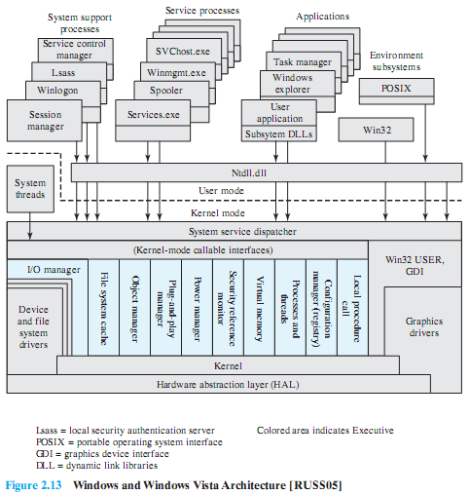
Arquitectura de Windows
Notes:
Figure 2.15 illustrates the overall structure of Windows 7; all releases of Windows
based on NT have essentially the same structure at this level of detail.
As with virtually all operating systems, Windows separates application-oriented
software from the core OS software. The latter, which includes the Executive, the
Kernel, device drivers, and the hardware abstraction layer, runs in kernel mode.
Kernel mode software has access to system data and to the hardware. The remaining
software, running in user mode, has limited access to system data.
Windows has a highly modular architecture.
Each system function is managed by just one component of the OS. The rest of the
OS and all applications access that function through the responsible component using
standard interfaces. Key system data can only be accessed through the appropriate
function. In principle, any module can be removed, upgraded, or replaced without
rewriting the entire system or its standard application program interfaces (APIs)

Slide 35
Unix tradicional
Desarrollado en Bell Labs y fue operacional en una DEC PDP-7 en 1970
Incorporando ideas de Multics
PDP-11 fue importante porque mostró que UNIX podia ser implantado en otras computadoras
Siguiente paso fue reescribir UNIX en C
Demostrando las ventajas de un lenguaje de alto nivel para el OS
Descrito en una revista técnica en 1974
Primera version disponible fuera de Bell Labs fue Version 6 en 1976
Version 7, liberada en 1978 es el ancestor de los UNIX modernos
UNIX BSD (Berkeley Software Distribution) fue muy importante, sin basarse en AT&T UNIX
Notes:
PDP-7 in 1970. Some of the people involved at Bell Labs had also participated in
the time-sharing work being done at MIT’s Project MAC. That project led to the
development of first CTSS and then Multics. Although it is common to say that
the original UNIX was a scaled-down version of Multics, the developers of UNIX
actually claimed to be more influenced by CTSS [RITC78]. Nevertheless, UNIX
incorporated many ideas from Multics.
Work on UNIX at Bell Labs, and later elsewhere, produced a series of versions
of UNIX. The first notable milestone was porting the UNIX system from the PDP-7 to
the PDP-11. This was the first hint that UNIX would be an OS for all computers. The
next important milestone was the rewriting of UNIX in the programming language
C. This was an unheard-of strategy at the time. It was generally felt that something as
complex as an OS, which must deal with time-critical events, had to be written exclusively
in assembly language. Reasons for this attitude include the following:
• Memory (both RAM and secondary store) was small and expensive by today’s
standards, so effective use was important. This included various techniques for
overlaying memory with different code and data segments, and self-modifying
code.
• Even though compilers had been available since the 1950s, the computer
industry was generally skeptical of the quality of automatically generated
code. With resource capacity small, efficient code, both in terms of time and
space, was essential.
• Processor and bus speeds were relatively slow, so saving clock cycles could
make a substantial difference in execution time.
The C implementation demonstrated the advantages of using a high-level
language for most if not all of the system code. Today, virtually all UNIX implementations
are written in C.
These early versions of UNIX were popular within Bell Labs. In 1974, the
UNIX system was described in a technical journal for the first time [RITC74]. This
spurred great interest in the system. Licenses for UNIX were provided to commercial
institutions as well as universities. The first widely available version outside Bell
Labs was Version 6, in 1976. The follow-on Version 7, released in 1978, is the ancestor
of most modern UNIX systems. The most important of the non-AT&T systems
to be developed was done at the University of California at Berkeley, called UNIX
BSD (Berkeley Software Distribution), running first on PDP and then VAX computers.
AT&T continued to develop and refine the system. By 1982, Bell Labs had
combined several AT&T variants of UNIX into a single system, marketed commercially
as UNIX System III. A number of features was later added to the OS to
produce UNIX System V.

Slide 36
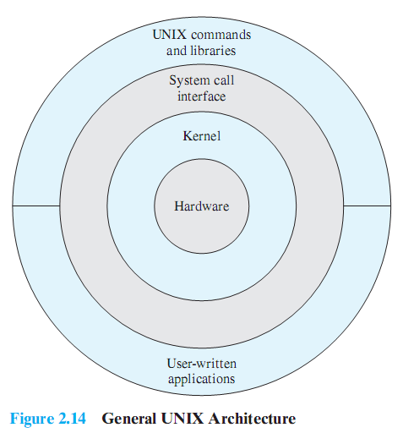
Arquitectura de UNIX
Notes:
Figure 2.16 provides a general description of the classic UNIX architecture. The
underlying hardware is surrounded by the OS software. The OS is often called the
system kernel, or simply the kernel, to emphasize its isolation from the user and applications.
It is the UNIX kernel that we will be concerned with in our use of UNIX as
an example in this book. UNIX also comes equipped with a number of user services
and interfaces that are considered part of the system. These can be grouped into
the shell, other interface software, and the components of the C compiler (compiler,
assembler, loader). The layer outside of this consists of user applications and the user
interface to the C compiler.

Slide 37
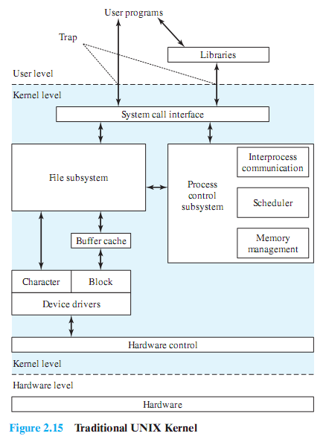
Kernel de un UNIX tradicional
Notes:
A closer look at the kernel is provided in Figure 2.17 . User programs can
invoke OS services either directly or through library programs. The system call
interface is the boundary with the user and allows higher-level software to gain
access to specific kernel functions. At the other end, the OS contains primitive routines
that interact directly with the hardware. Between these two interfaces, the
system is divided into two main parts, one concerned with process control and the
other concerned with file management and I/O. The process control subsystem is
responsible for memory management, the scheduling and dispatching of processes,
and the synchronization and interprocess communication of processes. The file system
exchanges data between memory and external devices either as a stream of
characters or in blocks. To achieve this, a variety of device drivers are used. For
block-oriented transfers, a disk cache approach is used: A system buffer in main
memory is interposed between the user address space and the external device.

Slide 38
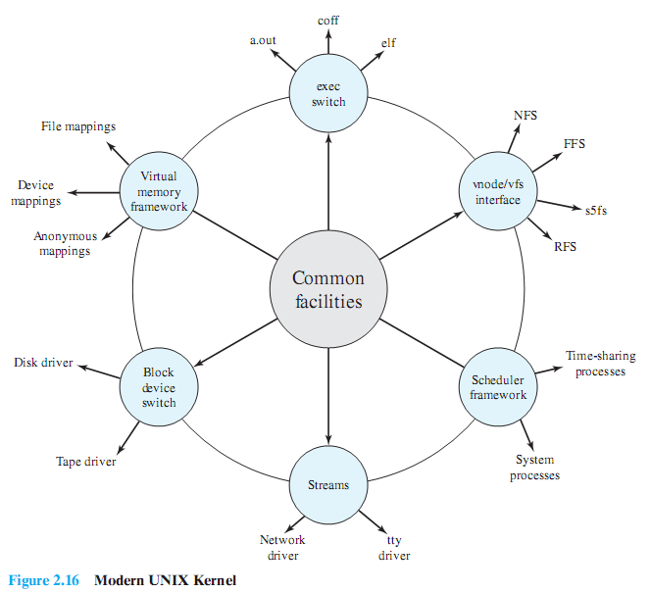
Kernel de un UNIX moderno
Notes:
As UNIX evolved, the number of different implementations proliferated, each providing
some useful features. There was a need to produce a new implementation that
unified many of the important innovations, added other modern OS design features,
and produced a more modular architecture. Typical of the modern UNIX kernel is
the architecture depicted in Figure 2.18 . There is a small core of facilities, written in
a modular fashion, that provide functions and services needed by a number of OS
processes. Each of the outer circles represents functions and an interface that may
be implemented in a variety of ways.

Slide 39
LINUX
Comenzo como una variante de UNIX para el IBM PC basado en MINIX
Escrito por Linus Torvalds, un estudiante finlandés
Linux fue posteado en Internet en1991
Hoy es un sistema UNIX complete, que corre en varias plataformas
Es libre y su código fuente está disponible
Su éxito se basa en la disponibilidad de paquetes de software libre
Altamente modular y fácilmente configurable
Notes:
Linux started out as a UNIX variant for the IBM PC (Intel 80386) architecture.
Linus Torvalds, a Finnish student of computer science, wrote the initial version.
Torvalds posted an early version of Linux on the Internet in 1991. Since then, a
number of people, collaborating over the Internet, have contributed to the development
of Linux, all under the control of Torvalds. Because Linux is free and the
source code is available, it became an early alternative to other UNIX workstations,
such as those offered by Sun Microsystems and IBM. Today, Linux is a full-featured
UNIX system that runs on all of these platforms and more, including Intel Pentium
and Itanium, and the Motorola/IBM PowerPC.
Key to the success of Linux has been the availability of free software packages
under the auspices of the Free Software Foundation (FSF). FSF’s goal is stable,
platform-independent software that is free, high quality, and embraced by the user
community. FSF’s GNU project 3 provides tools for software developers, and the
GNU Public License (GPL) is the FSF seal of approval. Torvalds used GNU tools
in developing his kernel, which he then released under the GPL. Thus, the Linux
distributions that you see today are the product of FSF’s GNU project, Torvald’s
individual effort, and the efforts of many collaborators all over the world.
In addition to its use by many individual programmers, Linux has now made
significant penetration into the corporate world. This is not only because of the
free software, but also because of the quality of the Linux kernel. Many talented
programmers have contributed to the current version, resulting in a technically
impressive product. Moreover, Linux is highly modular and easily configured. This
makes it easy to squeeze optimal performance from a variety of hardware platforms.
Plus, with the source code available, vendors can tweak applications and utilities to
meet specific requirements. Throughout this book, we will provide details of Linux
kernel internals based on the most recent version, Linux 2.6.

Slide 40
Kernel monolítico modular
Casi toda la funcionalidad del OS está en un único bloque de código que corre como un solo proceso dentro de un espacio de direccionamiento
Todos los componentes funcionales del kernel tienen acceso a todas sus estructuras y rutinas internas
Linux está estructurado como una colección de módulos
Loadable Modules
Bloques relativamente independientes
Un modulo es un archivo objeto cuyo código puede ser linkeado y deslinkeado del kernel en runtime
Un modulo se ejecuta en modo kernel a nombre del proceso actual
Dos características importantes:
Dynamic linking
Stackable modules
Notes:
Although Linux does not use a microkernel approach, it achieves many of the potential advantages of this approach by means of its particular modular architecture.
Linux is structured as a collection of modules, a number of which can be automatically loaded and unloaded on demand.
These relatively independent blocks are referred to as loadable modules.
In essence, a module is an object file whose code can be linked to and unlinked from the kernel at runtime.
The Linux loadable modules have two important characteristics:
Dynamic linking: A kernel module can be loaded and linked into the kernel while the kernel is already in memory and executing.
A module can also be unlinked and removed from memory at any time.
Saves kernel memory.
Stackable modules: The modules are arranged in a hierarchy.
Individual modules serve as libraries when they are referenced by client modules higher up in the hierarchy, and as clients when they reference modules further down.

Slide 41
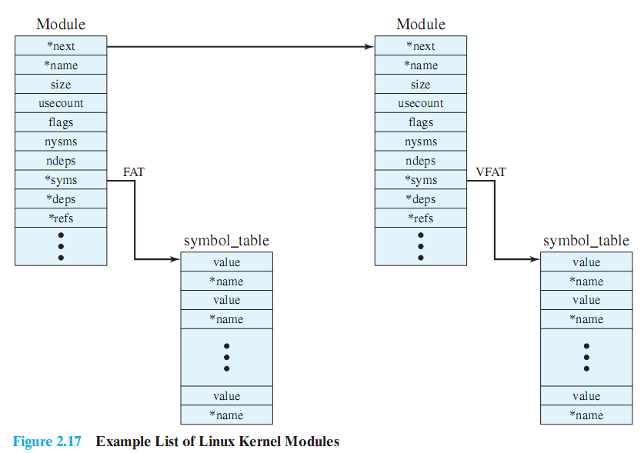
Módulos del kernel de Linux
Notes:
Figure 2.19 is an example that illustrates the structures used by Linux to
manage modules. The figure shows the list of kernel modules after only two modules
have been loaded: FAT and VFAT. Each module is defined by two tables, the module
table and the symbol table. The module table includes the following elements:
• * next: Pointer to the following module. All modules are organized into a
linked list. The list begins with a pseudomodule (not shown in Figure 2.19 ).
• * name: Pointer to module name
• size: Module size in memory pages
• usecount: Module usage counter. The counter is incremented when an operation
involving the module’s functions is started and decremented when the
operation terminates.
flags: Module flags
• nsyms: Number of exported symbols
• ndeps: Number of referenced modules
• * syms: Pointer to this module’s symbol table.
• * deps: Pointer to list of modules that are referenced by this module.
• * refs: Pointer to list of modules that use this module.
The symbol table defines those symbols controlled by this module that are
used elsewhere.
Figure 2.19 shows that the VFAT module was loaded after the FAT module
and that the VFAT module is dependent on the FAT module.

Slide 42
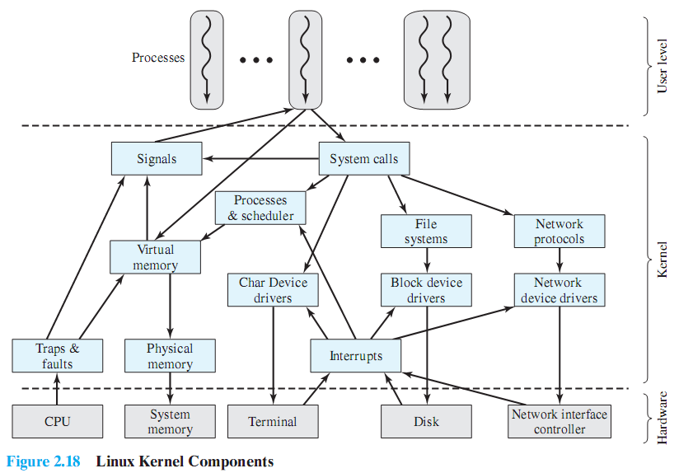
Componentes del kernel de Linux
Notes:
Figure 2.20 , taken from [MOSB02], shows the main components of the Linux kernel
as implemented on an IA-64 architecture (e.g., Intel Itanium). The figure shows
several processes running on top of the kernel. Each box indicates a separate process,
while each squiggly line with an arrowhead represents a thread of execution. 4
The kernel itself consists of an interacting collection of components, with arrows
indicating the main interactions. The underlying hardware is also depicted as a
set of components with arrows indicating which kernel components use or control
which hardware components. All of the kernel components, of course, execute on
the processor but, for simplicity, these relationships are not shown.

Slide 43
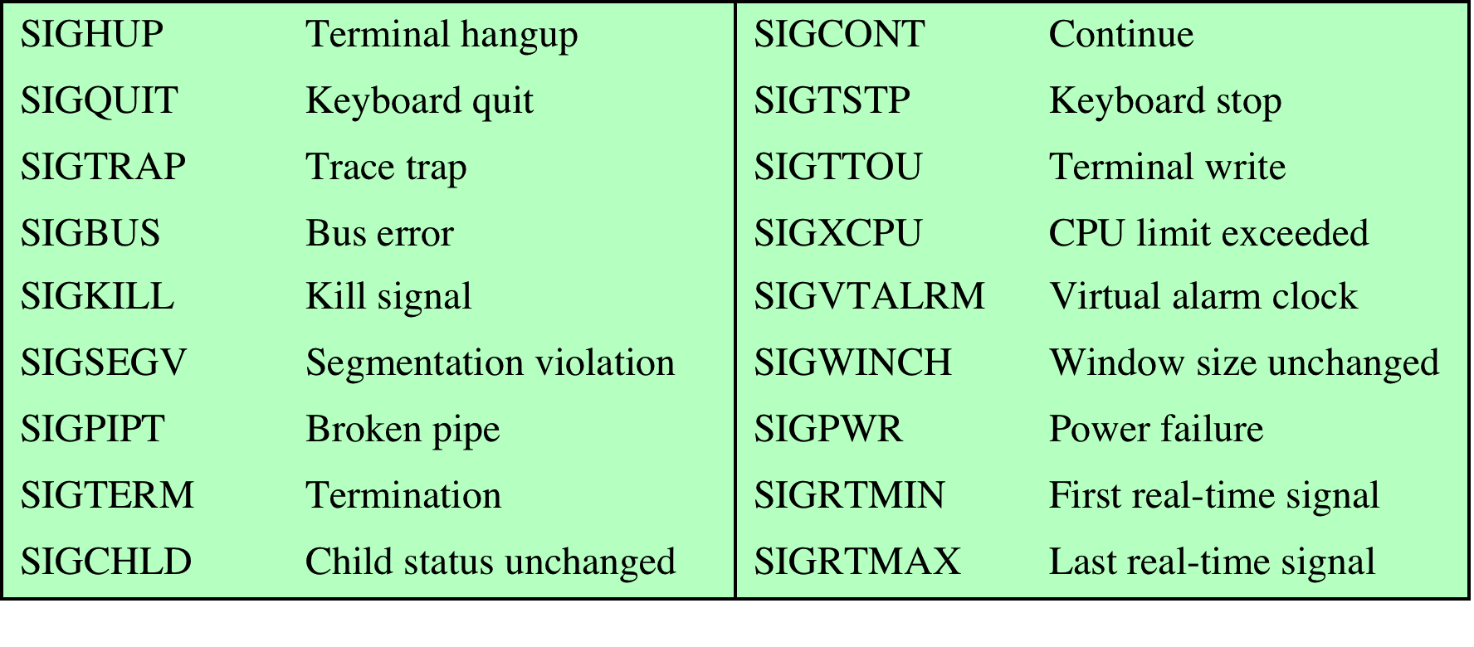
Señales (signals) en Linux
Table 2.5 Some Linux Signals
Notes:
The kernel uses signals to call into a process. For example, signals are
used to notify a process of certain faults, such as division by zero. Table 2.5
gives a few examples of signals.

