Slide 1
Mnemosyne
Implement a replicated key-value store that offers causal consistency.
Stefano Fedeli 944844
Andrea Pozzoli 944031
Lipei Liu 931693

Slide 2





Runtime-Architecture Overview
Data Centered
Load Balancer
Client-Server
Object-Oriented
Client-Server
Replica1
Client
Object-Oriented
Replica2

Slide 3

Naming Architecture
Flat Simple Naming stored on LoadBalancer with a hashmap
ID(Rep_0)
Replica
<IP, port>
Load Balancer
Object
Request
RMI Registry

Slide 4
Framework
replica1 | IP1:port | Num of user
replica2 | IP2:Port | Num of user
replica3 | IP3:port | Num of user
LB’s IP is known to all
Load
Balancer
New replica
replica1
New replica
New replica
replica2
replica3

Slide 5
Framework
replica1 | IP1 | Num of user
replica2 | IP2 | Num of user
replica3 | IP3 | Num of user
Load
Balancer
Sync
Apply for replica
replica1
Apply for replica
Replica1’s IP
Read/Write/Delete
client1
Replica2’s IP
Result
Read/Write/Delete
replica2
client2
Result
replica3

Slide 6
Communication
WHY?
Because is easier to communicate between OS and Languages with sockets
Load Balancer
Message Oriented Communication
RMI
Message Oriented Communication
RMI
Client
Replica1
Replica2

Slide 7
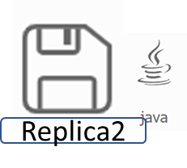
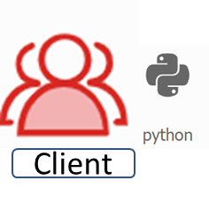
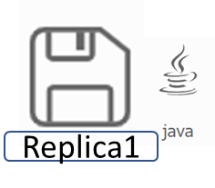
Sync
4 | 3 | 5
When a client wants to read, the actual value in the hash table is returned.
Key | Value
First | 54
Second | 63
Third | 97
4 | 3 | 6
READ(First)
4 | 3 | 7
54
Key | Value
First | 54
Second | 63
Third | 97
Fourth | 2
3
Key | Value
First | 54
Second | 63
Fourth | 2

Slide 8
Sync
4 | 3 | 5
When a client wants to write (or delete): the repica accepts the write (delete), updates the hash table, increments its vector clock at its own position and then sends the write to all the other replicas with its updated vector clock.
Key | Value
First | 54
Second | 63
Third | 97
WRITE(Second,90,[5,3,6],Rep_1)
5 | 3 | 6
4 | 3 | 6
WRITE(Second,90)
4 | 3 | 7
True
WRITE(Second,90,[5,3,6],Rep_1)
Key | Value
First | 54
Second | 90
Third | 97
Fourth | 2
Key | Value
First | 54
Second | 63
Third | 97
Fourth | 2
3
Key | Value
First | 54
Second | 63
Fourth | 2

Slide 9
Sync
4 | 3 | 5
WAITING WRITES (Replica2)
WRITE(Second,90,[5,3,6],Rep_1)
When a replica A receives a write (delete) from another replica (B), the receiver checks that
Vb[j]=Va[j]+1 for j=B’s id
and that Vb[i]<=Va[i] for i!=j
if the conditions are satisfied, so the write (delete) is performed;
otherwise the write (delete) is put in a list of waiting writes;
When a new write (delete) is performed, all the waiting writes are retried.
Key | Value
First | 54
Second | 63
Third | 97
4 | 3 | 5
5 | 3 | 6
5 | 3 | 7
Key | Value
First | 54
Second | 90
Third | 97
Fourth | 2
Key | Value
First | 54
Second | 63
Third | 97
Fourth | 2
3
Key | Value
First | 54
Second | 90
Fourth | 2

Slide 10
Sync
4 | 3 | 5
4 | 3 | 5
4 | 3 | 6
If the replica A can’t send the write (delete) to a replica B
firstly A asks to the load balancer if B is alive;
if so, A retries to send the write (delete) to B
otherwise sets B as dead;
after some times that B can’t receive the message, A puts the message in a list of pending sendings;
When another write (delete) is performed, A tries to send also the pending sendings.
Key | Value
First | 54
Second | 63
Third | 97
Key | Value
First | 54
Second | 63
Third | 97
Fourth | 2
Key | Value
First | 54
Second | 63
Third | 97
Fourth | 2
4 | 3 | 7
PENDING SENDINGS (Replica3)
WRITE(Fourth,2,[4,3,6],Rep_2)
DELETE(Third,[4,3,7],Rep_1)
DELETE(Third,[4,3,7],Rep_2)
3
Key | Value
First | 54
Second | 63
Fourth | 2

Slide 11
Failure Model
Hypothesis:
Process reliable, Internet failure model (channel crash, and partitioning)
Load Balancer
Check Status
Alive
Sync information
Replica1
Replica2

Slide 12
Failure Model
Hypothesis:
Process reliable, Internet failure model (channel crash, and partitioning)
Load Balancer
Check Status
Has been shut down
Alive
Next time: Sync information
Replica1
Replica2

Slide 13
Thank you!

