Slide 1
Building a Knowledge Graph for Chronic Disease Analysis
Andrea Pradas Agujetas

Slide 2



MOTIVATION
CHRONIC DISEASES
GAP
IMPACT
74% of all global deaths.
Discover hidden patterns in health data.
Support personalized healthcare & clinical research.

Slide 3
APPROACH & TECHNICAL CONTRIBUTION
01
PATIENT
DISEASE
RISK FACTOR
MEASUREMENTS
Structured data collection.
hasDisease
hasRiskFactor
Schema design & ontology.
02
hasMeasurement
03
KG construction.
Graph queries with SPARQL.
04
★
SNOMED CT

Slide 4
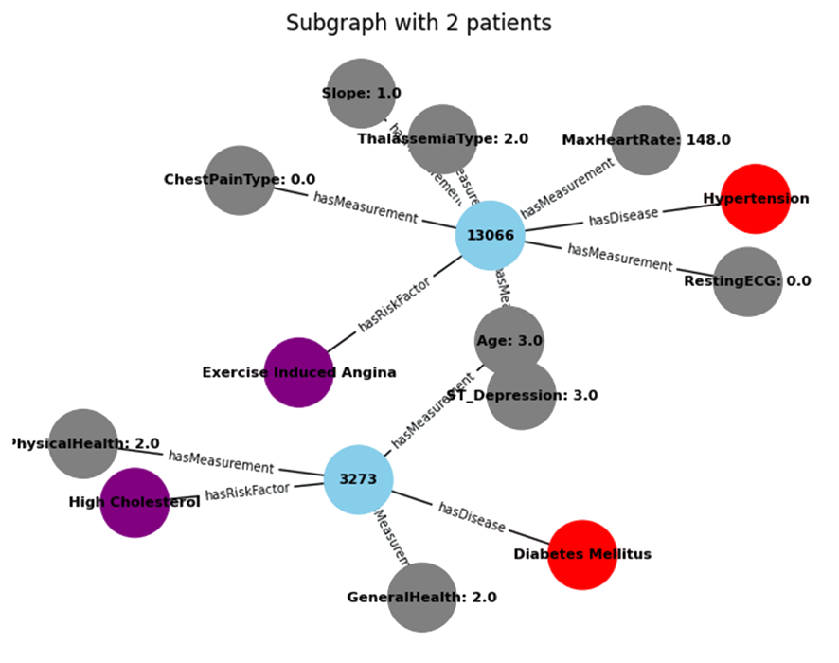
RESULTS
MEASUREMENTS
RISK FACTOR
PATIENT
DISEASE
Shared Risk Factors Identified.
Comorbidity Pathways Exposed.
Patient Clustering & Profiles.

Slide 5
CONCLUSION
UNIFY
PATTERNS
RESTRICTED
COMPLEXITY
DATA
TEMPORAL
Makes hidden knowledge explorable.
Not explicit in flat datasets.
Privacy regulations and compliance.
Computationally intensive.
Integrate diverse data types.
Dynamic models with predictive value.

