Slide 1
Low-fi Prototyping & Pilot Usability Testing
Michael F. - Alan K. - Andrea R.

Slide 2
VALUE PROPOSITION
How Musicians Meet
Notes:
Our problem domain is music and/or musician discovery. From our field research, we discovered that there are few avenues for up-and-coming musicians to share their talent with other musicians, and moreover for music enthusiasts to discover existing live shows that are in their area.

Slide 3
PROBLEM
There are few avenues for up-and-coming musicians to share their talent with other musicians through collaboration
Notes:
There are few avenues for up-and-coming musicians to share their talent with other musicians through collaboration.

Slide 4
SOLUTION
Provide a platform for musicians to create short performances, share their talent with other musicians, collaborate if there’s mutual interest, and hopefully gain exposure to each other’s fan base
Notes:
We have sought to solve this problem by providing a platform for musicians to share short, no longer than 16 second videos of their talent with other musicians, collaborate if there’s mutual interest, and hopefully gain exposure to each other’s fan base.

Slide 5
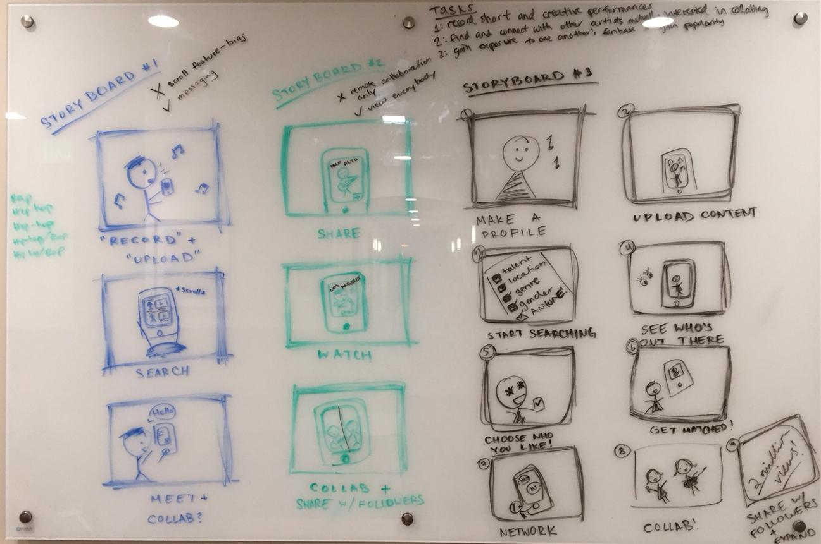
SKETCHES

Slide 6
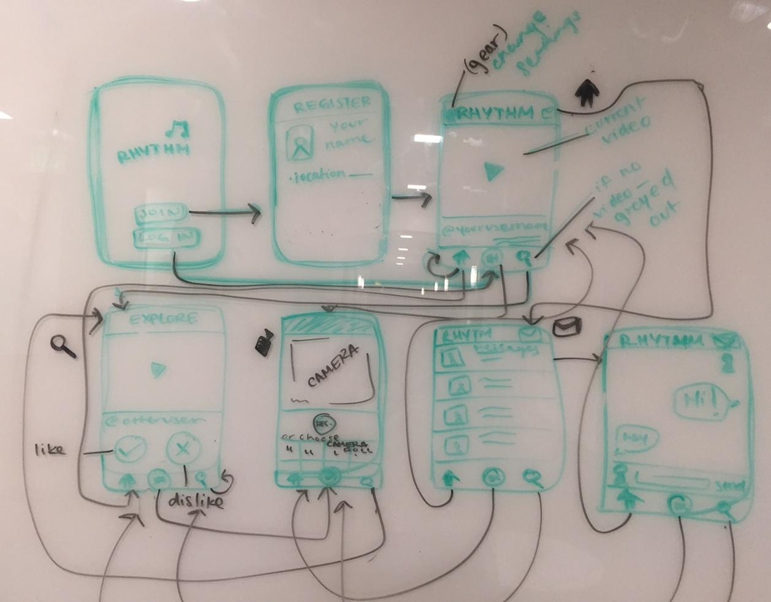
IN MORE DETAIL: UI FOR STORYBOARD I
Notes:
Our first interface design allows the user to create a profile, and record record a short, creative performance demonstrating their musical talent using the camera (or upload a video from their camera roll) to place inside of their profile. When the user signs in, the default tab is the “home” tab, which shows a feed of people around the world by profile video. The user may scroll the feed to “like” certain profiles that he/she finds impressive and may spark a collaboration through instant messaging of text, audio, and or video content. Alternatively, the user may select the “explore” tab (the search icon) to see individual profiles one by one and swipe to indicate their interest/disinterest (However they are forced to make a chance, unlike in the feed tab).

Slide 7
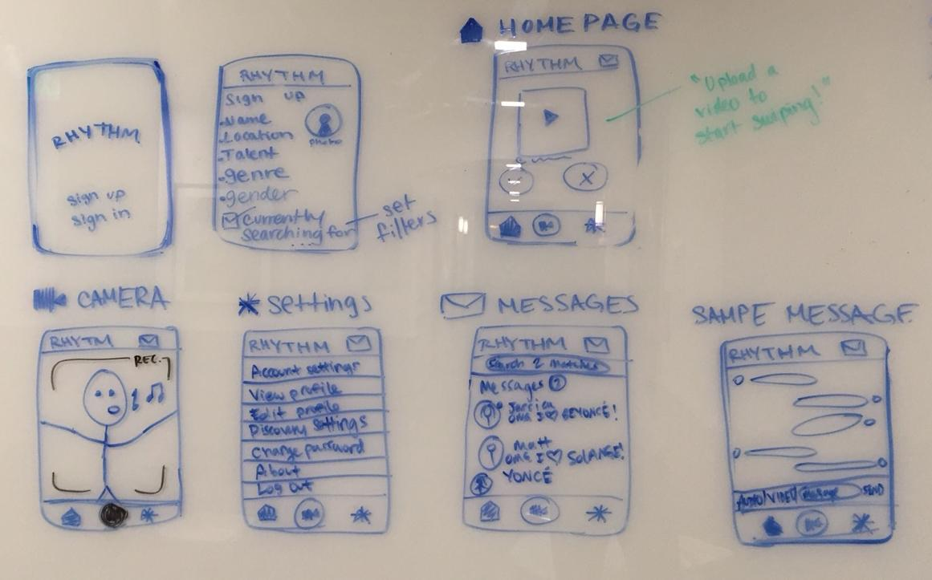
IN MORE DETAIL: UI FOR STORYBOARD II
Notes:
Our second interface design takes a lot of the functionality of the first interface, but adds/changes a few things. We removed the option to view a feed, but instead allow for greater level of customization in terms of filters for the discovery tab. Under the account settings, user may select discovery settings, which allows for users to filter which profiles they are shown by gender, talent, genre, and distance. This means that even though the user will have to swipe through profiles one-by-one, they may choose stricter filters to avoid being seen profiles of people who do not necessarily match their current artistic interests.

Slide 8
SELECTION: STORYBOARD UI II
Notes:
Our past interviews revealed that people users generally prefer simpler, less involved UIs over more complex ones even if the complex ones provide for more functionality. This leads us to think that a user would prefer one swipe/discovery tab that could be customized using discovery settings over having a swipe/discovery tab and a newsfeed-style tab.
The discovery settings allow for a user to more easily find artists who are in their location and makes it much more straightforward
It would be much more difficult to determine a good algorithm for what exactly would determine the order in which profile videos would populate a person’s feed without using some sort of “following”, “friending”, or similar such capability, which we feel may overcomplicate our app and cause it to lose some of its novelty.
We felt that a news feed setup may be inappropriate in this context and may give rise to bias. What exactly would determine whether or not a person would scroll past a user on their feed? With the swipe/discovery, we recognize that the user could still swipe through people without giving them much of a chance due to some internal bias, but we feel that forcing the user to actually make a decision on each and every video will encourage the user to give each user more of a listen before swiping.

Slide 9
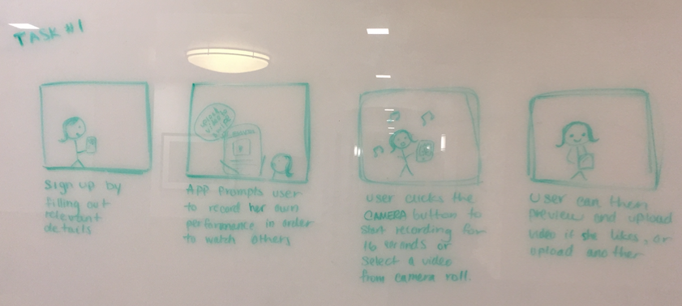
SELECTED INTERFACE DESIGN: Task 1

Slide 10
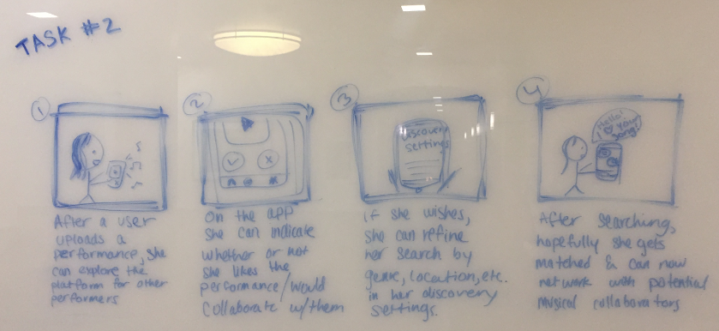
SELECTED INTERFACE DESIGN: Task 2

Slide 11
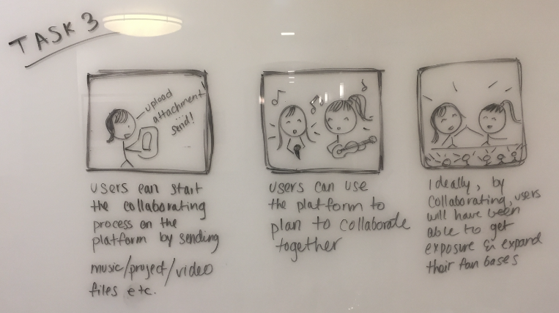
SELECTED INTERFACE DESIGN: Task 3

Slide 12
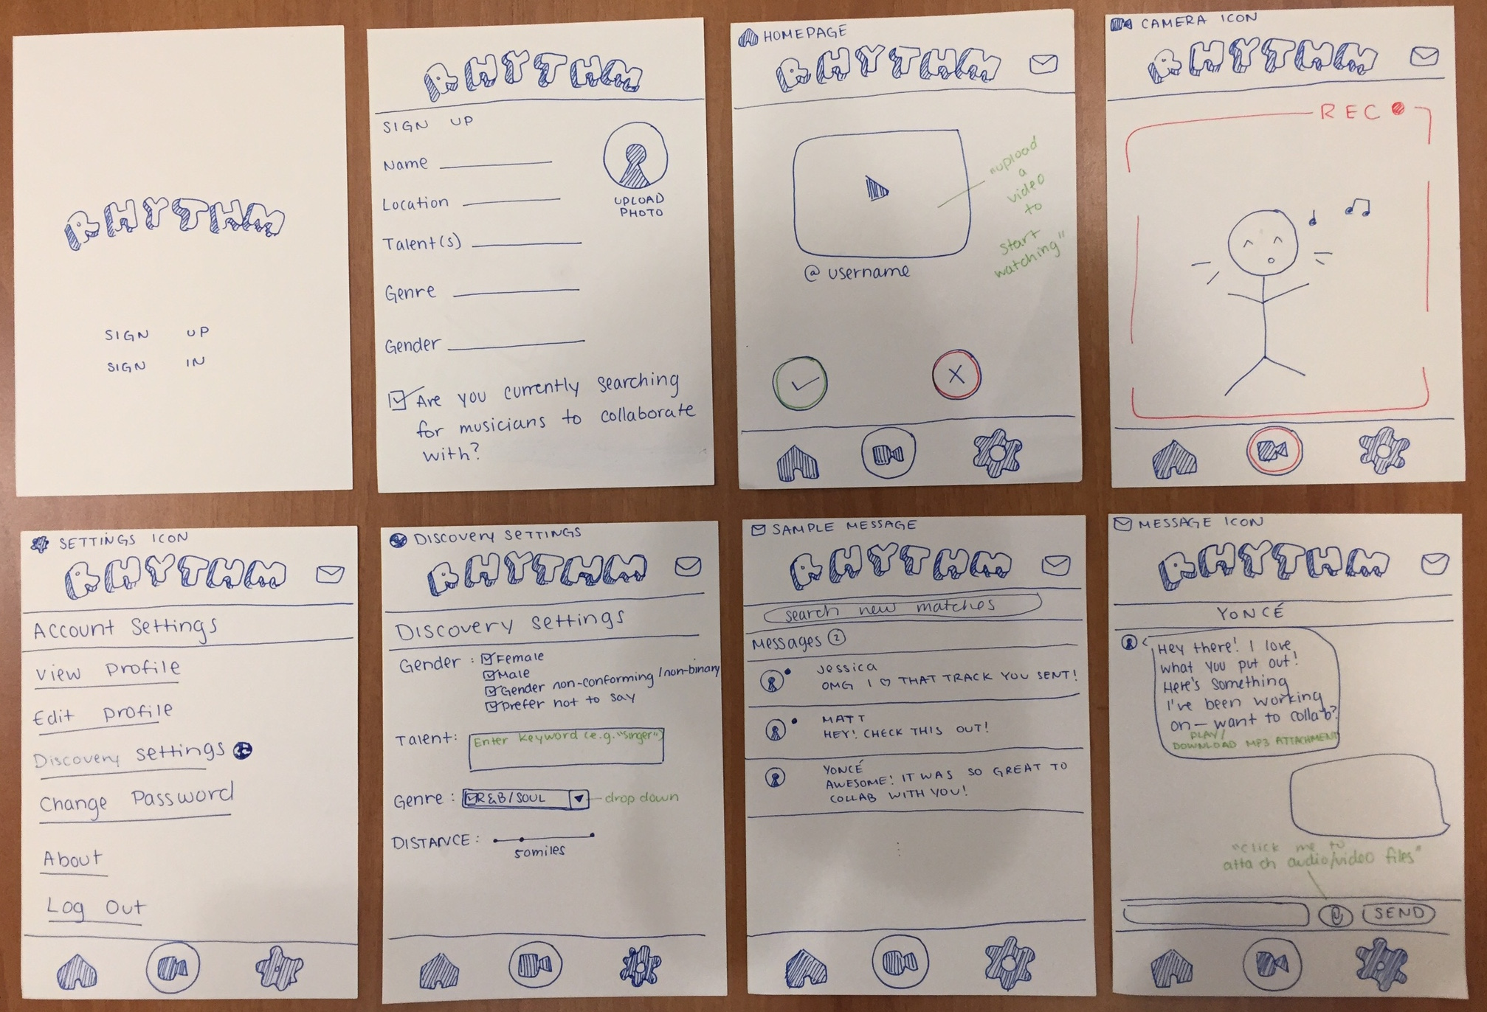
OUR PROTOTYPE

Slide 13
OUR METHOD: ENVIRONMENT
Our first interviews were found through friends at the university radio station where outside music aficionados frequently visit. Our last participant was scouted at Late Night at Arrillaga, where we interviewed him at an eating table.

Slide 14
Participant 1
Female
Age 20
Guitarist
Likes to sing sometimes
Was in band

Slide 15
Participant 2
Male
Age 27
Has electronic music projects
Tried DJing for a while

Slide 16
Participant 3
Male
Age 19
Sophomore student
Violinist
Likes all genres of music

Slide 17
OUR METHOD: TASKS
Record short and creative musical performances.
Find and connect with other musical artists interested in collaborating.
Collaborate and hopefully gain exposure to one another’s fanbase and gain popularity.

Slide 18
OUR METHOD: PROCEDURE
Each UI design was put on a page and given to the participant. They were expected to turn pages to simulate clicking through the app. Apart from the introduction page and sign-up pages, each page onwards was labeled according to the button that would bring the user there.

Slide 19
OUR METHOD: TEST MEASURES
How well they responded to the buttons and language used.
Whether the user got stuck on something for any length of time.
Asking for help.

Slide 20
Experimental Results
Participant 1: Too many questions at sign up, without much concept thought maybe you record yourself dancing, but thought the app was otherwise straightforward and had nice buttons
Participant 2: Wasn’t sure about gender option, recording should have edit options, didn’t understand yes/no buttons
Participant 3: Assumed recording page was already a video, didn’t understand discover settings, wanted to be able to receive feedback from other musicians

Slide 21
Suggested UI Changes
Larger recording screen
Add editing tools to upload screen
Less sign-up information

Slide 22
Thanks!

