Slide 1
MEDIUM-FI PROTOTYPE
Michael Freeman Alan Khaledi Andrea Rodriguez

Slide 2
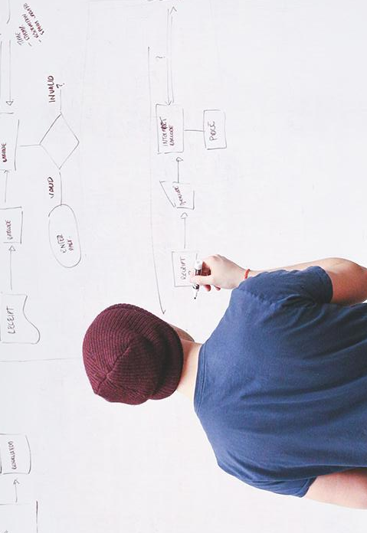
RHYTHM
Notes:
Value Proposition: How Musicians Meet Problem: There are few avenues for up-and-coming musicians to share their talent with other musicians through collaboration
Solution: Provide a platform for musicians to create short performances, share their talent with other musicians, collaborate if there’s mutual interest, and hopefully gain exposure to each other’s fan base

Slide 3
3 TASKS
SIMPLE
Record short and creative musical performances.

Slide 4
3 TASKS
MEDIUM
Find and connect with other musical artists interested in collaborating.

Slide 5
3 TASKS
COMPLEX
Collaborate and hopefully gain exposure to one another’s fanbase and gain popularity.

Slide 6
REVISED INTERFACE DESIGN

Slide 7
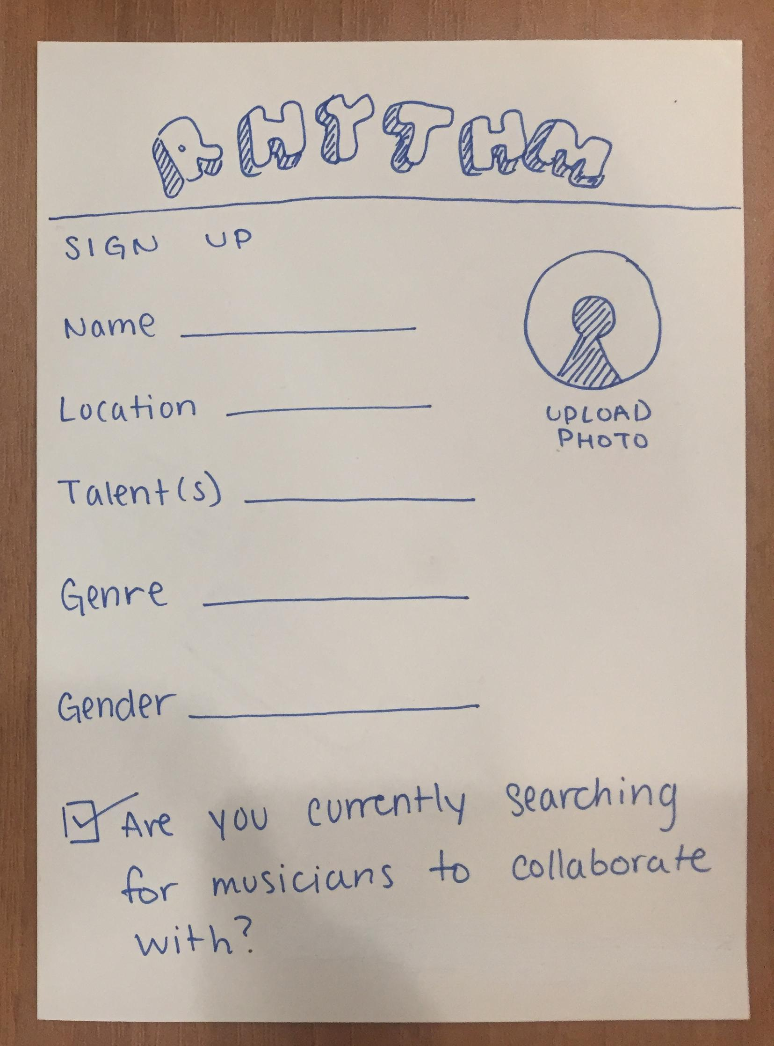
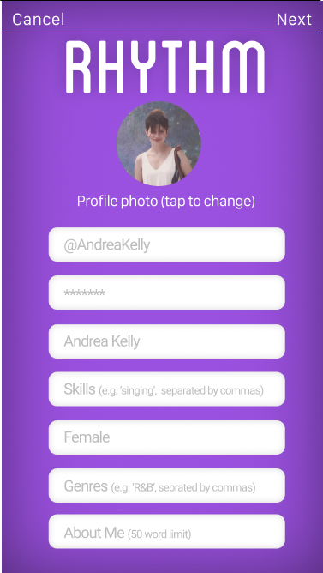
MAJOR DESIGN CHANGES
Before
After
Notes:
Sign-up page comments:
too many things to fill
“Are you currently searching…” checkbox feels redundant
Changes made:
Added sign-up with Facebook buttons to help autofill information
Removed checkbox
Organised it in such a way where it feels less overwhelming

Slide 8
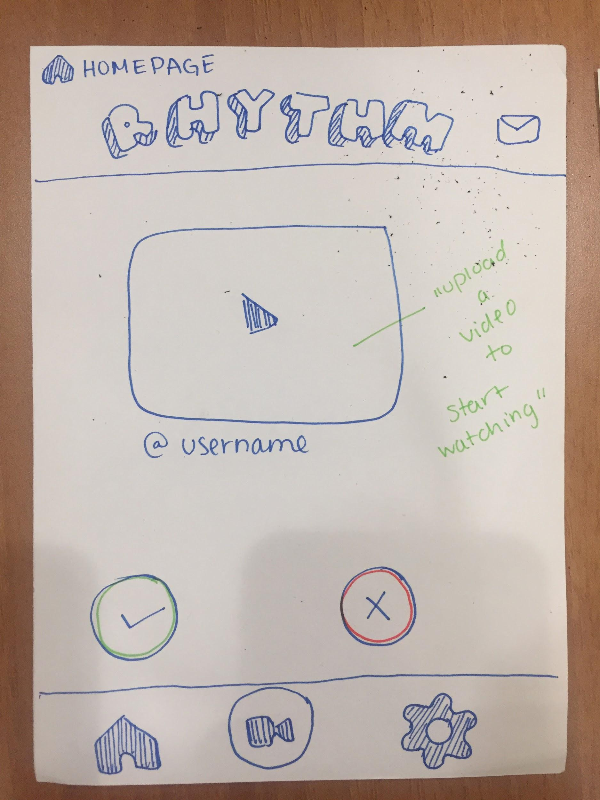
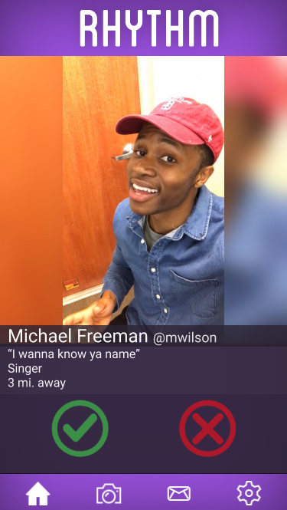
MAJOR DESIGN CHANGES
Before
After
Notes:
Homepage comments:
Mail icon looks out of place at the top right corner
@username is not descriptive enough, should have more information
Homepage changes:
Moved mail icon to menu bar
Added name, username, distance, and short about me below videos

Slide 9
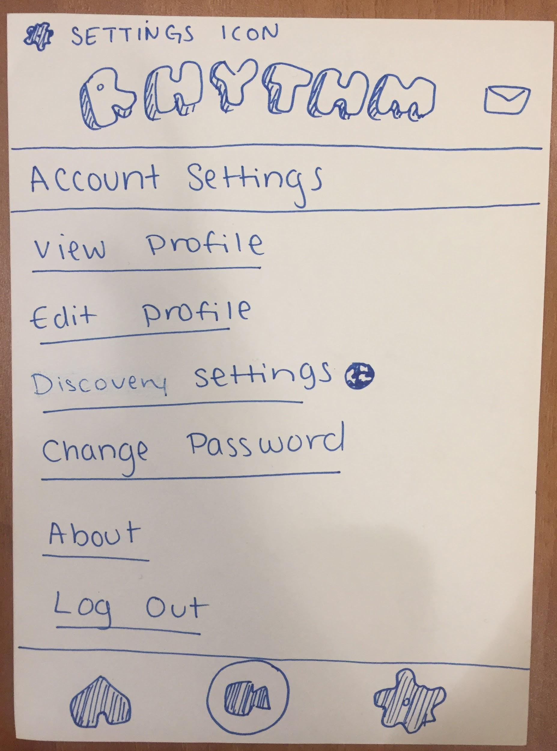
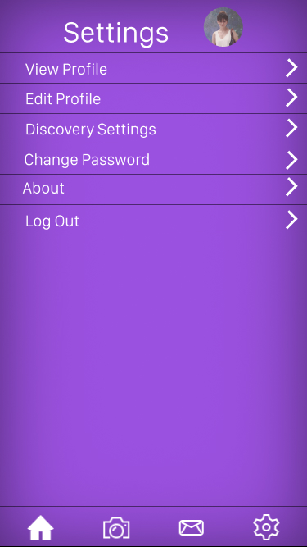
MAJOR DESIGN CHANGES
Before
After
Notes:
Settings page comments:
Account Settings title blends in with the list view, makes it look overwhelming and confusing
Settings page changes:
Removed header that blended in with the list
Organized list so it looks clearer

Slide 10
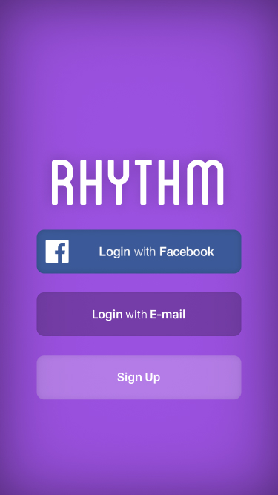
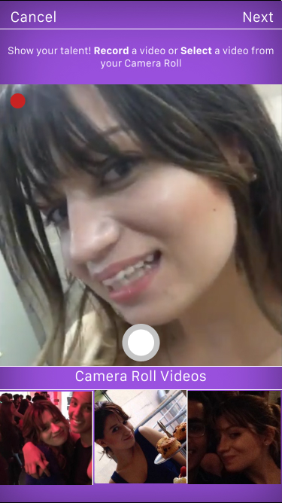
TASK FLOWS
SIMPLE
Notes:
Record short and creative musical performances.
Features
Facebook login for easy sign up
App prompts users to showcase a performance at start (option to cancel if not)

Slide 11
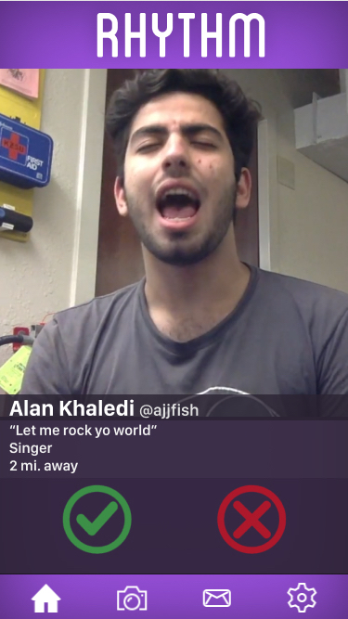
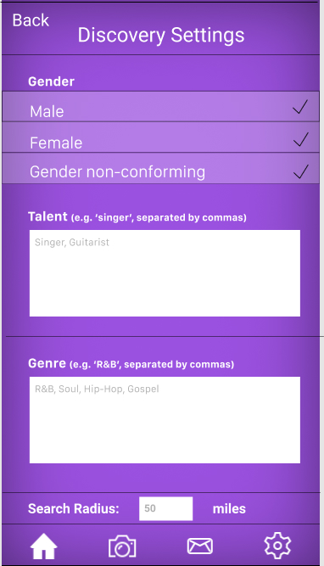
TASK FLOWS
MEDIUM
Notes:
Find and connect with other musical artists interested in collaborating. Features:
User can choose whether or not she liked a performance
User can update profile settings/videos as they please
User can refine their musician search settings by certain filters

Slide 12
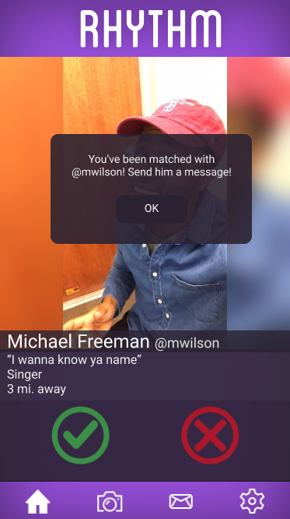
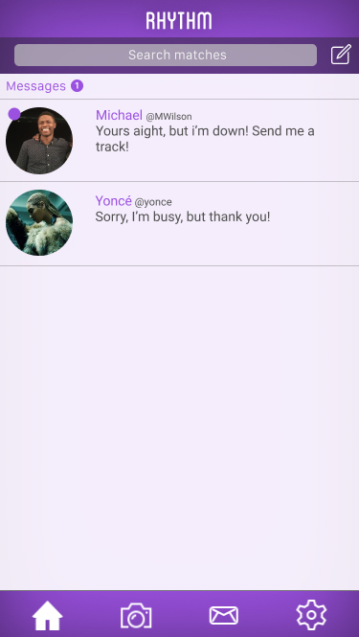
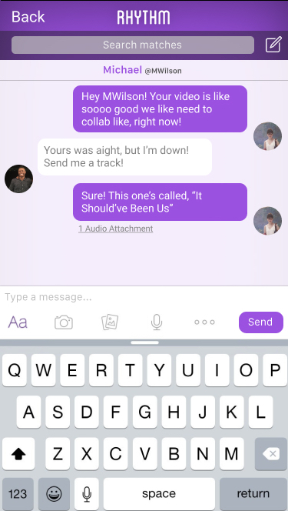
TASK FLOWS
COMPLEX
Notes:
Collaborate and hopefully gain exposure to one another’s fanbase and gain popularity. Features:
Notification for matches
Messaging interface
Messaging allows to send files over for collaborating purposes, etc.

Slide 13
PROTOTYPE
OVERVIEW

Slide 14
Prototyping Tools
Figma
InVision
Notes:
Figma: used to make sketches InVision: used to put them together

Slide 15
Limitations/Trade-offs
Videos could not be added to prototype preview
Camera/Camera roll can not actually open
Sending messages is not possible

Slide 16
Limitations/Trade-offs (continued)
Export and other features in Figma had inconsistencies
Can’t keep track of state that app is in
Small set of profiles
Notes:
Bullet 1: Inconsistencies included sizing of pages, typeface support, etc.
Bullet 2: i.e. the app has no way of keeping track of different things that you selected, so things get reset all the time

Slide 17
“Wizard of Oz” Techniques
None
Notes:
c. Any Wizard of Oz techniques required to make it work

Slide 18
Hard-coded Features
Video representations
Profiles
Messages
Notes:
Video representations needed because users need performances to evaluate
Profiles needed because the app is social and requires there to be other users in order for the features to work
Messages are included to show users communicating and how they use the app to collaborate (i.e. send files)

Slide 19
ADDITIONAL
PROTOTYPING
SCREENS

Slide 20
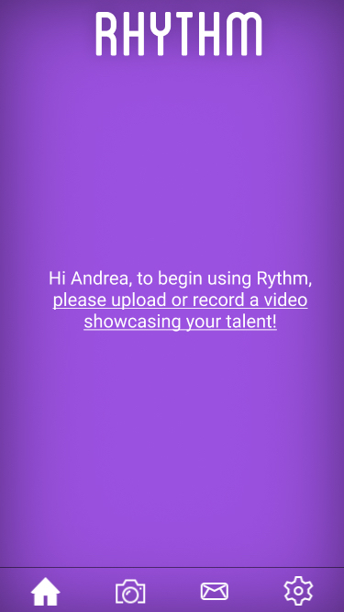
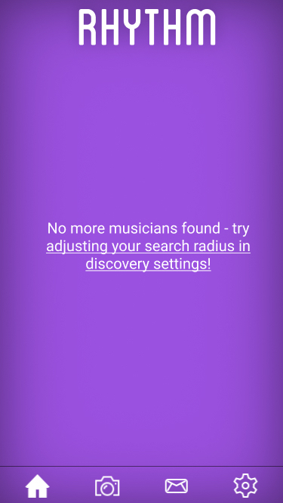
Place your screenshot here
Notes:
Left screen: If user chooses not to upload/record a performance at sign up, they can’t start seeing other performances. This screen prompts them to do so. Center screen: Example of a user video on the homepage
Right screen: This screen pops up after a user has seen all performances according to their search settings. It prompts them to adjust their search settings because they may be too limited.

Slide 21
Thank you!

