Slide 1
Needfinding MUSIC
Andrea Rodriguez Michael Freeman
Alan Khaledi

Slide 2
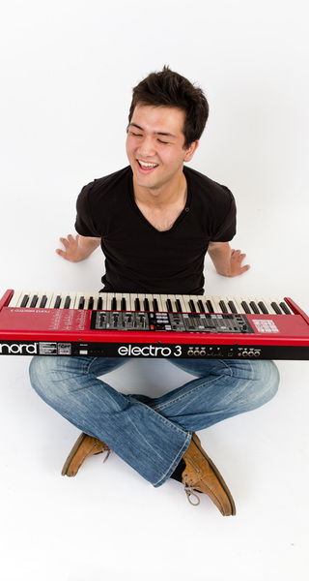
Kevin Coelho
Student musician
12 years of classical music training
Plays piano and various other instruments
Very active in jazz music scene
Puts on various musical events here at Stanford
Stanford, CA
Notes:
Interviewed: Kevin Coelho Why: He is an incredibly talented and active student musician here on campus. He has a band called Escape Hatch, 12 years worth of classical music training, is very active in the jazz music scene, has music industry peers, and puts on various musical events here at Stanford. How: In person interview Where: on campus

Slide 3
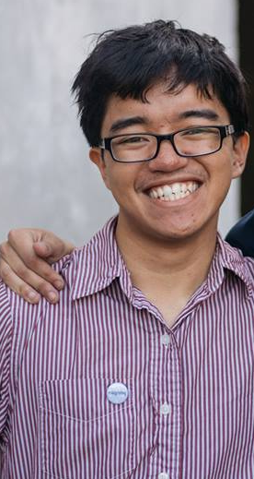
Josh Solomon
3 years as an after school music instructor
Live musician
Live sound engineering, recording, show management, etc.
Los Angeles, CA
Notes:
Why: Music Instructor, musician, How: Online Where: Los Angeles

Slide 4
Griffin Stoller
12 years experience with violin
Producer and composer
Electronic dance music
Stanford, CA
Notes:
Why: Very upcoming and modern musician. He has a long history in classical music (12 years of violin. Hence, I thought he could provide interesting insight. How: In person interview Where: Stanford, CA

Slide 5
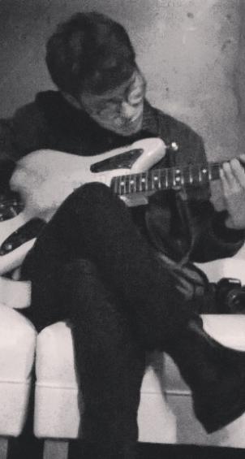
Nicholas Hodges
Co-founder of record label
Works at record store
Plays music for fun
Music Journalist
Toronto, Canada
Notes:
Why: Works at record store, started record label, also likes making music How: Online/Skype Where: Toronto

Slide 6
WHAT DID
WE ASK?
Tell me about your passion for/interest in music.
Describe a moment where you discovered or rediscovered that music is your passion.
Tell me about a time when you felt like you hit a roadblock with learning music.
(In reference to the musical memory) How did you feel about…?
Tell me a musical dream of yours.
How have you found yourself getting more involved in your music/work/etc?
What attracts you to music?
When do you feel most connected to music?
What sustains your interest in music?

Slide 7
RESULTS

Slide 8
Quotes
"I have tendonitis in both my arms, and that has been a huge challenge over the last few years... Playing with not stellar technique has made it really hard and put a huge block in my development."
“I feel most connected when the performer and the audience manage to connect and feed off of each other’s energy.”
“It’s primarily you who has to sustain your interest [in music] yourself by keeping up with it.”
“Collaboration with other artists can often get complicated… there are a lot of contracts”

Slide 9
Surprises
Even as an accomplished musician, Kevin learned improper techniques that made things much more difficult for him further down the road, and as a consequence he has had to learn to play things correctly that he’s played successfully before.
Josh continued listening and playing despite his hearing deficit.
Even though Griffin had access to explore his musical talent at a very young age, it wasn’t until he was 15 when he first learnt how to produce on a computer.
Nick uses music as inspiration for his writing.

Slide 11
ANALYSIS

Slide 12
INFERENCES
AND
CONCLUSIONS
Inferences
Love for music is something that builds over time
Despite the fact that Kevin had musical teachers, the poor techniques they had were passed onto him because he did not have a source to consult to learn proper techniques.
People who are really interested in music often really enjoy making it
Conclusions
People can build their love for music through experience
Even music students can benefit from having a resource that they can consult for proper techniques and good developmental practices when trying to master instruments.
Making the ability to create music more accessible would be of interest to many people who like music

Slide 13
QUESTIONS
How might someone nurture a potential affinity for music if they don’t know how to look for the resources?
How can a database of trusted, reliable musical knowledge be compiled for music students to consult?
Would Kevin have the same health problems if he was provided with a source to consult?

Slide 14
EMPATHY MAP

Slide 15

SAY
“I got into Jazz by going to the Stanford Jazz Workshop when I was in middle school”
"Playing with not stellar technique has made it really hard and put a huge block in my development."
“I feel most connected when the performer and the audience manage to connect and feed off of each other’s energy.”
“it’s primarily you who has to sustain the interest yourself by keeping up with it”
"You feel empowered because you just made a whole crowd react"

Slide 16
DO
Excited about his time at the Stanford Jazz Workshop
Liked to bring up collective efforts
Excited when talking about own experiences playing music
Liked to bring up personal projects
tended to refer to collaboration and a need to ease the process

Slide 17
THINK
Regrets learning improper technique - he now sees the value of proper technique in playing an instrument.
He is thankful for going to the Stanford Jazz Consortium - He sees the value of music programs for young children and music education
He is an instructor, believes in the value of music education
He might think that music is an integral part of humanity, he probably believes that it is something everyone can be greatly affected by (positively)
He realizes the large role that music has played in Kevin's life - he believes in the power and influence of music and is excited to be a part of it

Slide 18
FEEL
PROUD
APPRECIATIVE
INSPIRED
HOPEFUL
REGRETFUL

Slide 19
NEEDS
Humans need hobbies
Music students need a source to consult to ensure proper technique when attempting to master new instruments
People desire to collaborate with others when creating music

Slide 20
INSIGHTS
For those who are capable, the ability to play music is an empowering activity
For those looking to master a musical craft, a proper approach is vital to longevity
People like connecting with others through music

Slide 21
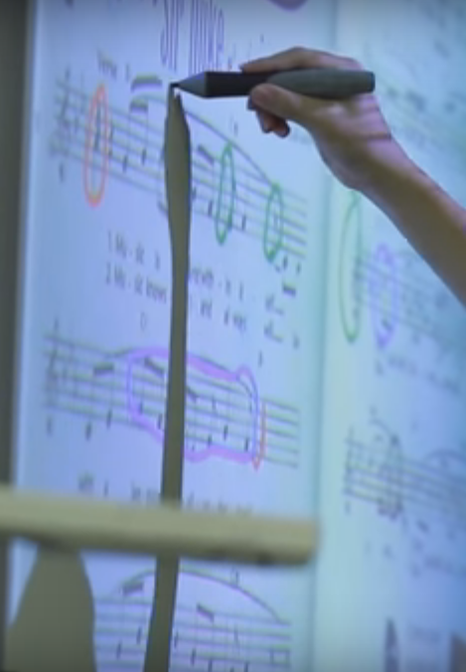
SUMMARY
Collaboration → Accessibility
Realistic Goals
Preventing Misinformation
Streamline
Musical Education
Notes:
Our needfinding led to a lot of different avenues pertaining to music. From collaboration to accessibility, we considered a lot of different options for which need we could realistically meet. We were really moved by Kevin’s story of developing tendonitis as a result of improper playing technique, and we want to develop technology that streamlines access to musical education to prevent things like this from happening and help people master their musical crafts.

Slide 22
THANK YOU!

