Slide 1
Feature Extraction
Andrea Rica Advincula
2015-04544

Slide 2
Datasets: Oranges, GREEN APPLES, Bananas
All taken from kaggle.com

Slide 3
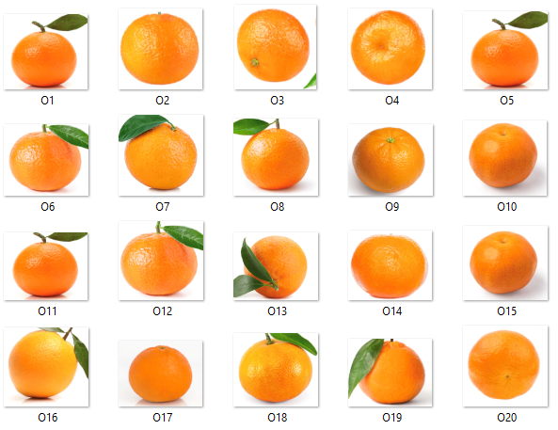
Figure 1. Dataset of oranges.

Slide 4
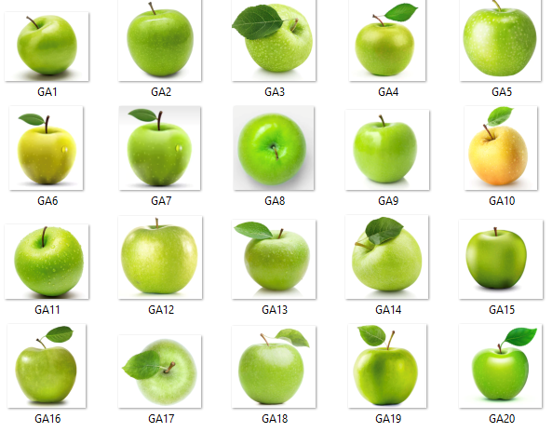
Figure 2. Dataset of green apples.

Slide 5
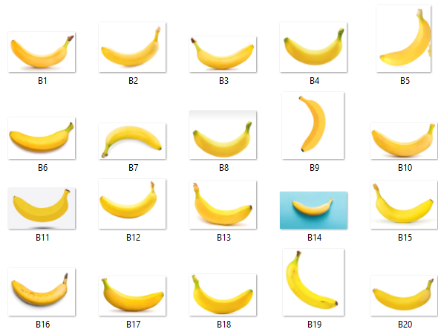
Figure 3. Dataset of bananas.

Slide 6

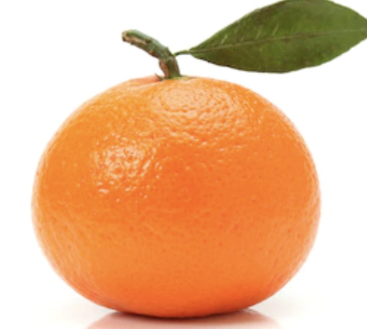
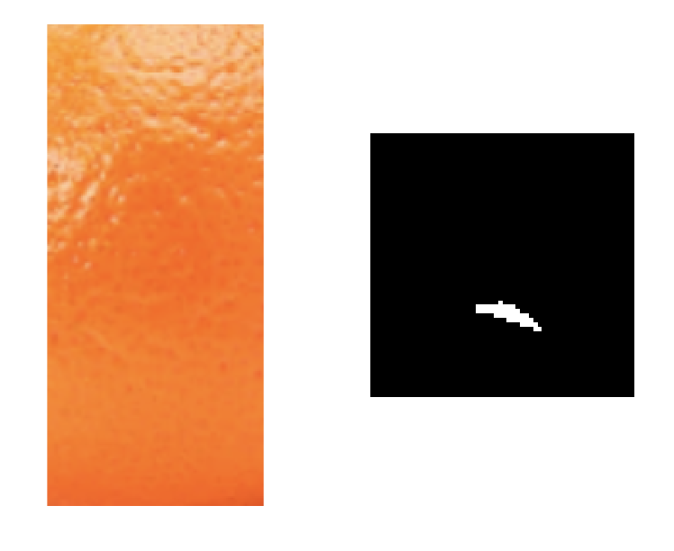
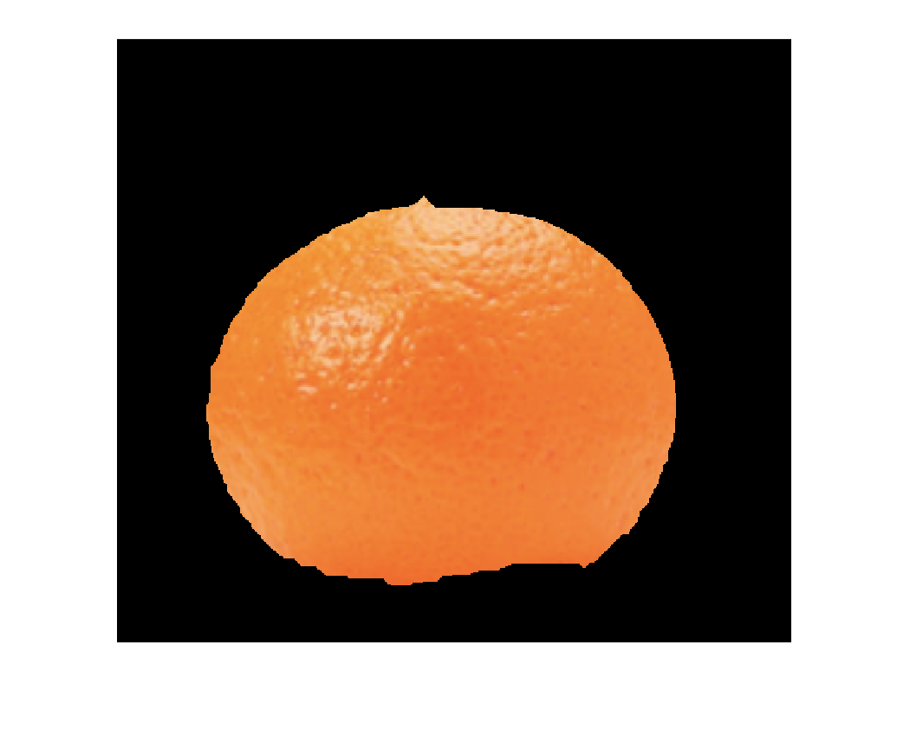
FEATURE extraction
Binary image
NON-PARAMETRIC
SEGMENTATION
DATASET IMAGE
COLOR image

Slide 7
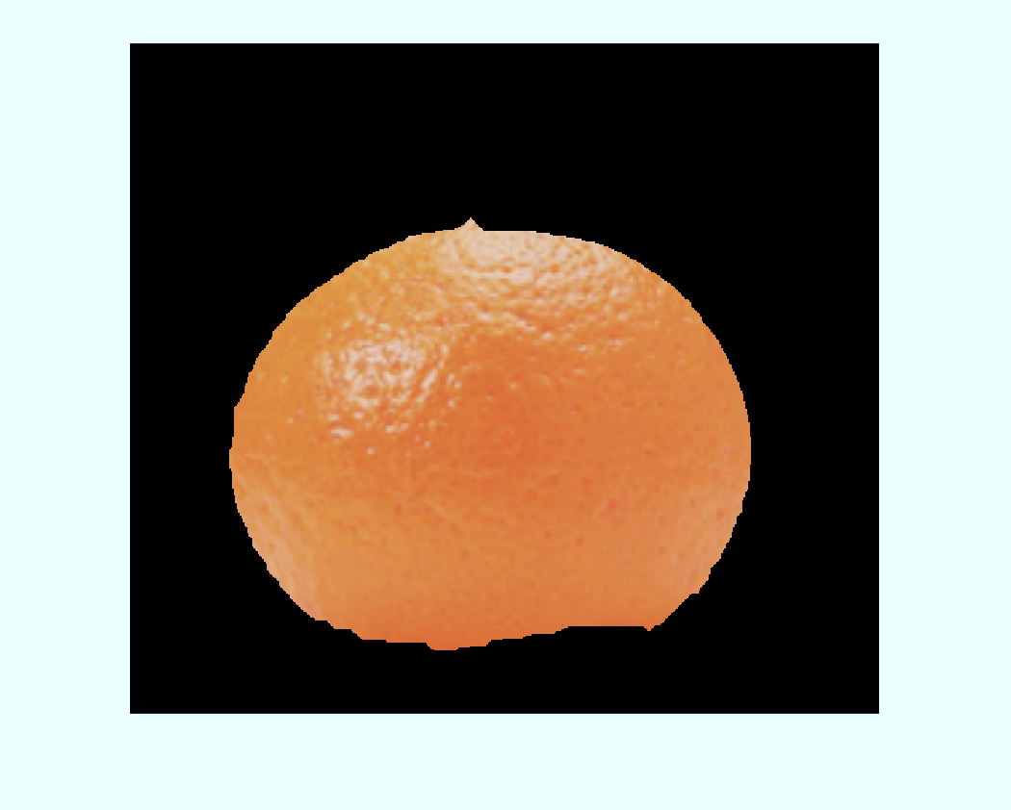
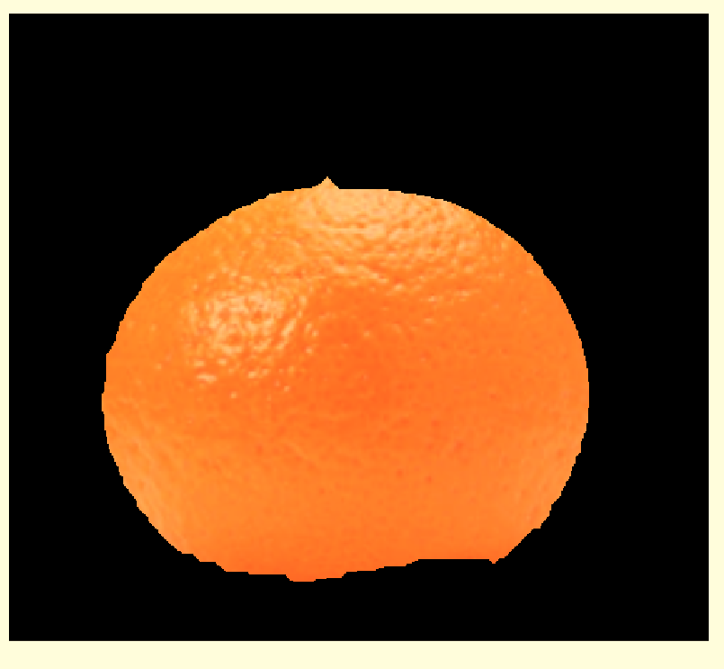
COLOR extraction (HUE)
COLOR SEGMENTED IMAGE
RGB CHANNELS
HSV CHANNELS
EXTRACT AVERAGED HUE VALUES IN HUE CHANNEL

Slide 8
ECCENTRICITY
regionprops(object, ‘Eccentricity’)
BINARY SEGMENTED IMAGE
EXTRACT ECCENTRICITY OF BLOB

Slide 9
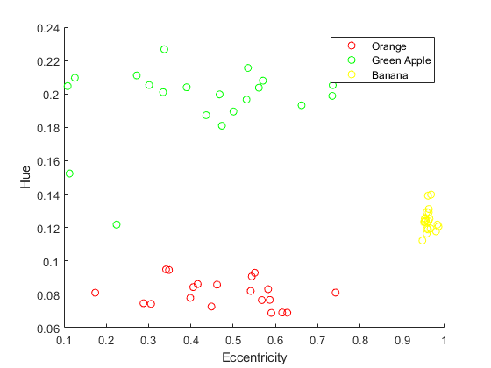
Figure 4. Feature plot of the 60 images. Eccentricity of a circle is 0 and approaches 1 as it turns into an ellipse. Hue value from 0 to 1 is of red at 0 and moves across the colors orange, yellow, green, blue, violet, and back to red for Hue = 1.

Slide 10
I thank LJ for introducing me to the HSV channels which allows us to convert colors into numbers, and rhei for answering my inquiries on the activity.
I rate myself 10/10 for accomplishing all requirements

