Slide 1
Blob Analysis
Andrea Rica Advincula
2015-04544

Slide 2
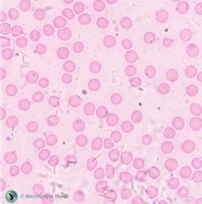
Given the image in Fig. 1 we are to extract each cell and analyze the features: area, eccentricity, major axis length, and perimeter of the cells. We are also tasked to mark out the centroid of each cell and enclose each one with a bounding box.
Figure 1. Original Image

Slide 3
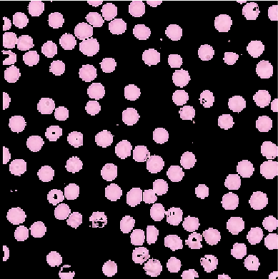
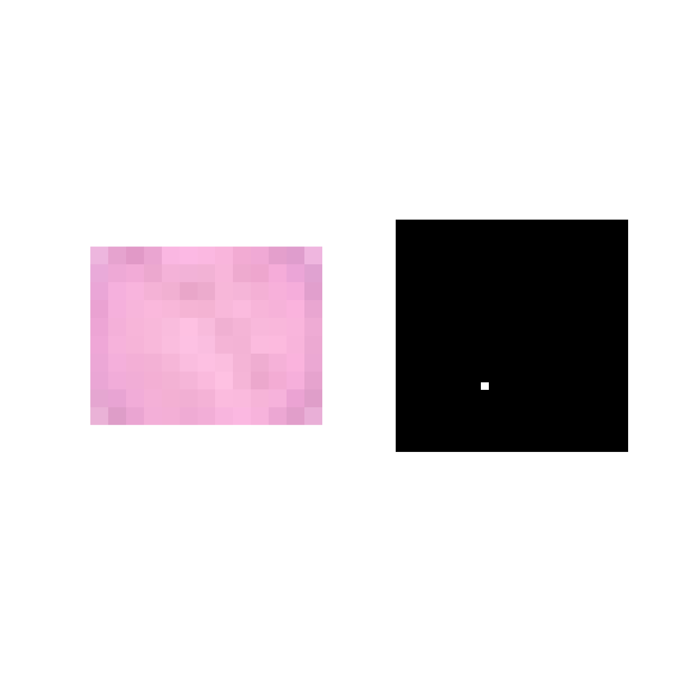
Using the skills I’ve learned from the color segmentation activity, I segmented the cells using Non-parametric segmentation. The patch I selected was from the inside of one cell including its cell wall. Fig. 2 shows the segmented cells in color.
a
Fir
b
c
Figure 2. Color segmentation through non-parametric algorithm. (a) Patch, (b) Histogram, and (c) Result.

Slide 4
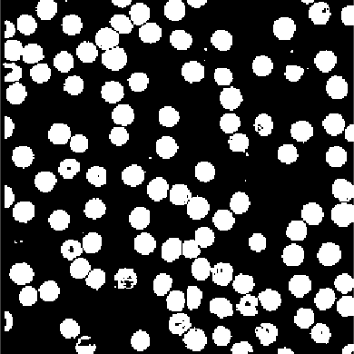

Figure 3. Segmented binary images of the cell. (a) Raw result from color segmentation. (b) Resulting processed image
a
b
To remove the outlying white spots on Fig. 3a, I used the function in Matlab bwareaopen(im,5). This removes separate blobs that are less than 5 pixels in area. Also, to fill in the black spots inside the cells I used the function imfill(im,’holes’). This function filled in the black units surrounded by white in the image. The resulting image after the two functions is shown in Fig. 3b.

Slide 5
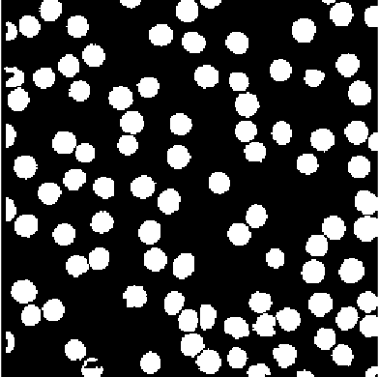
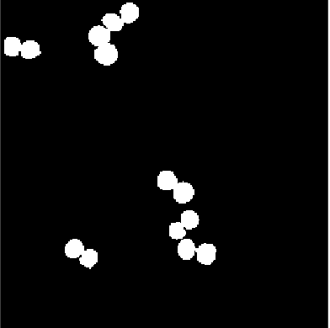
Figure 4. (a) Individual cells separated. (b) Cell blobs whose pixels are connected with other cells
a
b
The color segmentation in Fig. 3a was not able to separate every cell individually. Some other cells are clumped up with each other. I used the function regionprops(image,’Area’) to take the area of each blob and separated the blobs with a large area relative to the other values with values that are closer with each other (Fig 4b).

Slide 6
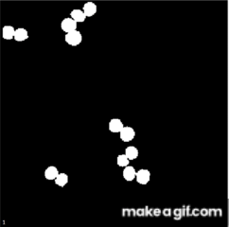
To be able to separate the connected cells in Fig. 4b, I used the function watershed(image) which is used to segment continuous regions into distinct objects. First, I have to take the distance transform (bwdist(image)) of the image and apply the watershed function (Fig. 5).
Figure 5. (1) Fig. 4b (2) Distance Transform of Fig. 4b (3) Resulting image from watershed transform

Slide 7
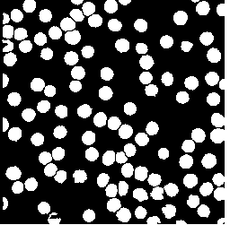

I combined the separated images into one image.
a
b
c
Figure 6 (a) Single individual cell segmented (Fig. 4a) (b) Connected cells segmented from each other (Fig. 5.3) (c) Combined image of (a), and (b).

Slide 8

As a final touch, I applied the function imclose(image, strel) using a disk structuring element to keep the shape of the cells.
Figure 7. Resulting image after imclose().

Slide 9
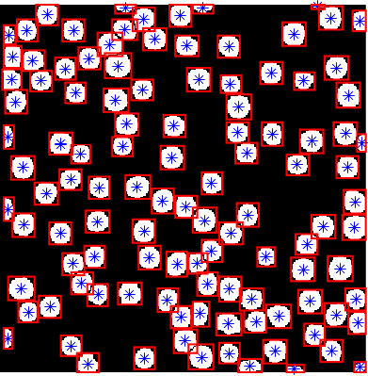
Fig. 8 shows the 111 cells in bounding boxes and each of their centroids.
Figure 8. Fig. 7 with each cells’ centroid and bounding box.

Slide 10
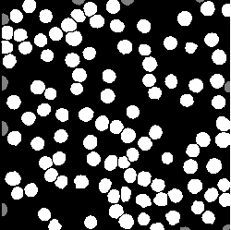
Before I can measure the average values of the features of the cells, I separated the cells that have areas that are smaller than most (I chose the threshold from the histogram of areas).
Figure 9. Final image. (Gray) Cells with small areas compared to most of the general cells. (White) Regular cells.

Slide 11
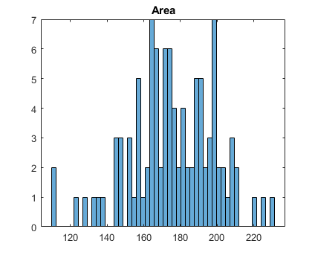
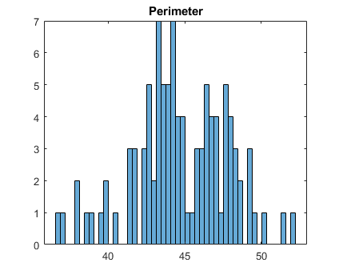
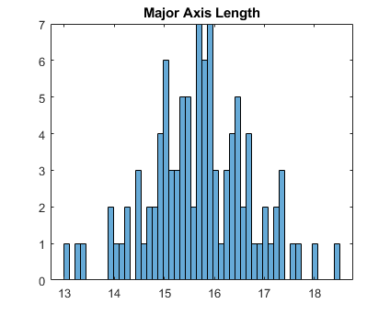
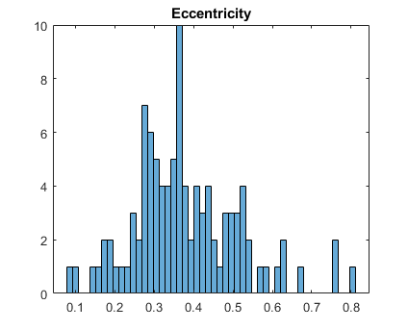
Fig. 10 and Table 1 shows the values of the features of the cells in Fig. 9. I was able to take these values using the function regionprops(image,’Area’, ‘Perimeter’, ‘MajorAxisLength’, ‘Eccentricity’).
Table 1. Average values of Areas, Perimeter, Major Axis Length, and Eccentricity from the 94 cells in Fig. 9
Average
Area | Perimeter | Major Axis Length | Eccentricity
175.5644 ± 23.1566 | 44.7095 ± 3.0580 | 15.7251 ± 1.0215 | 0.3801 ± 0.1367
Figure 10. Histogram of values. (Top-left) Area. (Top-right) Perimeter. (Bottom-left) Major Axis Length. (Bottom-right) Eccentricity.

Slide 12
I rate myself 10/10 for being able to accomplish all the requirements of the activity
I would like to thank LJ for introducing me to the watershed function.

