Slide 1

Neural Networks
Andrea Rica Advincula
2015-04544

Slide 2
Objectives
Program a neural network to learn a sine function
Classify previous fruit data

Slide 3
Program a neural network to learn a sine function
I designed two neural networks (NN) onto which a sine wave is trained. One, a single layer perceptron and a two-layer perceptron (1 hidden layer) (Fig. 1). The inputs are powers of x from x⁰ to x¹¹, initial arbitrary weights w, and the activation function g(a) for all the layers is the sigmoid function f(x) = 1/(1+e^{-a}).
x₁ = χ ⁰
x₂ = χ ¹
x₃ = χ ²
x₄ = χ ³
x₅ = χ ⁴
x₆ = χ ⁵
x₇ = χ ⁶
x₈ = χ ⁷
x₉ = χ ⁸
x₁₀ = χ ⁹
x₁₁ = χ ¹⁰
x₁₂ = χ ¹¹
x₁ = χ ⁰
x₂ = χ ¹
x₃ = χ ²
x₄ = χ ³
x₅ = χ ⁴
x₆ = χ ⁵
x₇ = χ ⁶
x₈ = χ ⁷
x₉ = χ ⁸
x₁₀ = χ ⁹
x₁₁ = χ ¹⁰
x₁₂ = χ ¹¹
g(a)
g(a)
g(a)
χ = [0:2π]
_{k}
_{j}
w_{ij}
w_{jk}
w_{ij}
_{j}
_{i}
_{i}
Figure 1. Perceptron framework. Single layer (left), and two-layer with 1-hidden layer (right) perceptron

Slide 4
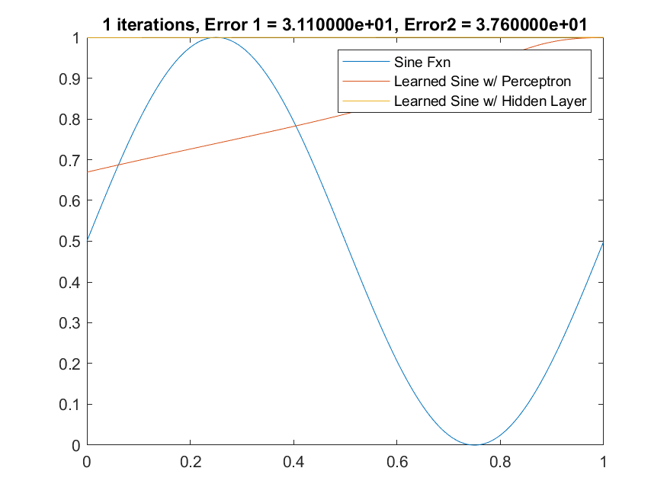
Program a neural network to learn a sine function
Visibly, the two-layer perceptron was able to learn a sine wave with errors minimized up to 1/1000 after 800 000 iterations, while the single layer perceptron only minimized up to 1/10 even after the same amount of iterations. Both networks, however, was able to successfully learn a sine function.
Figure 2. Neural network design to learn a sine function across 800 000 iterations. Error decreases as iterations increase. Error 1 corresponds to the single layer perceptron, and Error 2 corresponds to the two-layer perceptron

Slide 5
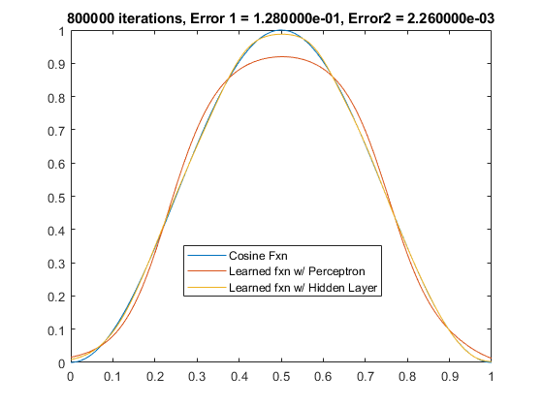
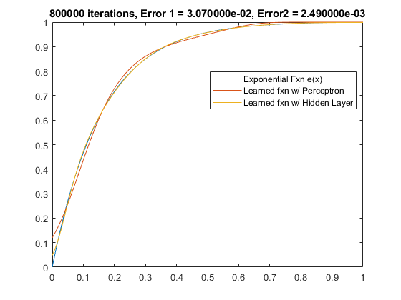
Program a neural network to learn a sine function
The network was also tested for other functions such as the cosine function f(x) = cos(x), and the exponential function f(x) = e^{x}. The network was still able to successfully learn both functions with the same degree of error except for the single layer perceptron for the exponential function where it was able to minimize the error up to 1/100.
Figure 3. Neural network design to learn a cosine (left) and an exponential (right) function after 800 000 iterations. Error 1 corresponds to the single layer perceptron, and Error 2 corresponds to the two-layer perceptron.

Slide 6
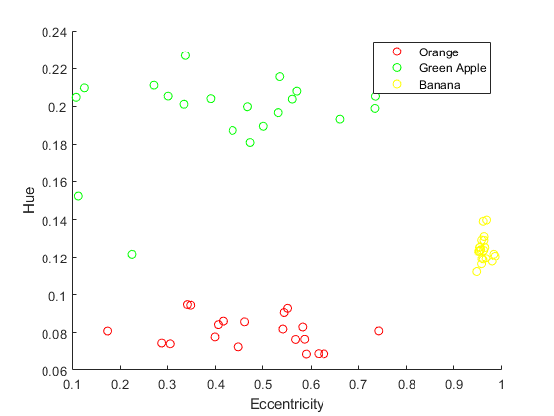
2. Classify previous fruit data
Fig. 4 (right) is composed of 20 dataset for each class(fruit). To program the neural network classifier, 10 images from each class was trained into a two-layer perceptron (Fig. 4 left), and the other 10 was set aside for later testing.
x₁ = 1
x₂ = Hue
x₃ = Eccentricity
g(a)
g(a)
_{j}
w_{jk}
_{k}
_{i}
w_{ij}
Figure 4. Neural network two-layer perceptron framework (left). Feature plot of three fruits: orange, green apple, and banana (right). Eccentricity ranges from 0, a perfect circle to 1, an ellipse. Hue ranges from 0-1 which corresponds to red, orange, yellow, green, blue, violet, and back to red across this range.

Slide 7
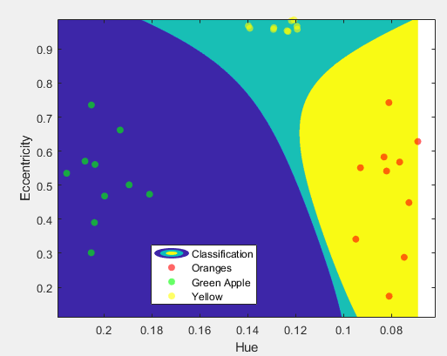
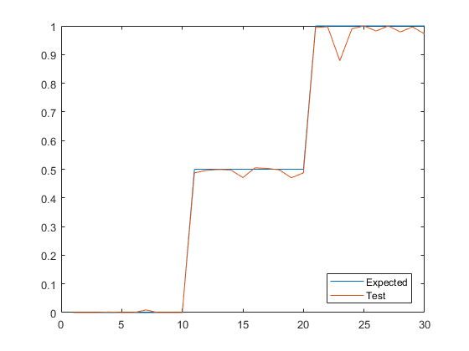

2. Classify previous fruit data
The 10 test images from each class has not been seen by the network before and it was able to classify them to their correct class. (Fig. 5 left) From the trained weights, all possible combinations of hue and eccentricity was classified and is portrayed in the contour feature plot in Fig. 5. where the 10 test images are overlaid into their locations.
Figure 5. Neural network design to classify fruits where 0 = orange, 0.5 = Green Apple, and 1 = Banana. The neural network was able to classify the fruits correctly (left). For all possible combinations of hue and eccentricity values we classify each value into the three fruits (right) where fruits classified into the blue regions are green apples, into the green regions are bananas, and into the yellow regions are oranges

Slide 8
I grade myself 10/10 for accomplishing all the tasks and I would like to thank those who helped me and whom I shared ideas with: Paolo Mawis, Jom Macalintal, Rhei Juan, and LJ Tan.

