Slide 1
Expectation maximization
Andrea Rica Advincula
2015-04544

Slide 2
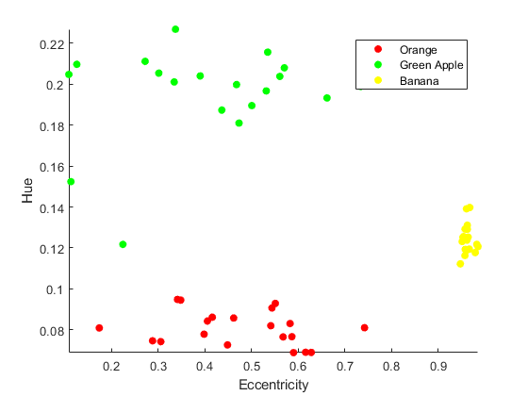
Using the data generated from activity 12, I am going to solve for the probabilitydistribution function (pdf) of each class (fruit).
Figure 1. Feature plot of the fruits green apple, banana, and orange according to their hue and eccentricity.

Slide 3
Final resulting parameters after threshold is reached after n-iterations.
Classes l = 1,2,3 | P
1 (Green Apple) | 0.05
2 (Banana) | 0.05
3 (Orange) | 0.05
Classes l = 1,2,3 | mean μ
 | Eccentricity | Hue
1 (Green Apple) | 0.456 | 0.1998
2 (Banana) | 0.9597 | 0.1241
3 (Orange) | 0.489 | 0.808
Covariance matrix Σ (Green Apple)
0.0168 | -0.0001
-0.0001 | 0.0001
Covariance matrix Σ (Banana)
0.00003481 | -0.00000044
-0.00000044 | 0.00001912
Covariance matrix Σ (Orange)
0.01 | -0.0002
-0.0002 | 0

Slide 4
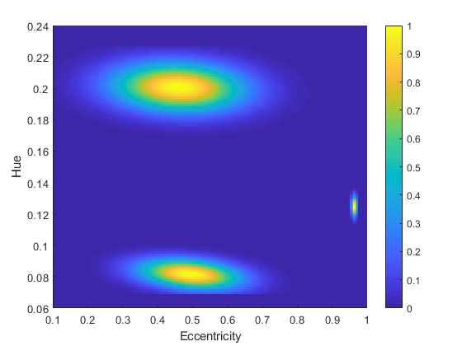
Using the final parameters, we solve the pdf for each fruit to be FIG. 2: Green apple, banana, and orange from top to bottom.
Figure 2. PDF of the three classes. Blue (0) corresponds to 0 probability, increasing towards yellow(1), corresponding to high probability.

Slide 5
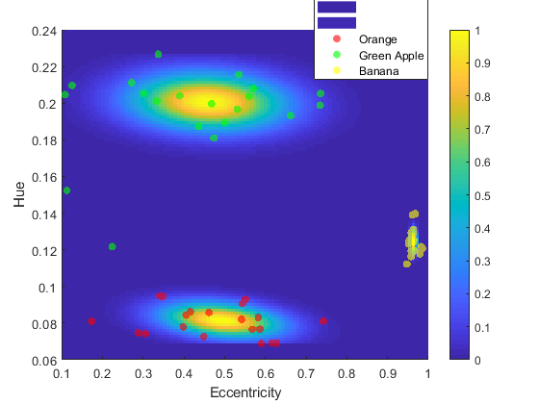
Visually it can be seen that the data points are generally within their corresponding pdf’s with only a few outliers outside.
Figure 3. Feature plot overlayed onto the pdf plot.

Slide 6
I rate myself 10/10 for accomplishing the required outputs and I would like to acknowledge and thank Rhei and LJ for the discussions on this activity.

