Slide 1

Status Report
Amara Jeide – Make It Awesome

Slide 2
Updates
Amara: adding functionality for powerups
Andreas: finished lvl1 tilemaps & areas for pickups
Caden: fixing errors with enemy pathfinding
Elizabeth: working on HUD observer pattern & adding clothes for paul
Joe: making classes for audio manager & controls for title and pause menus

Slide 3
Gantt

Slide 4
Demo

Slide 5
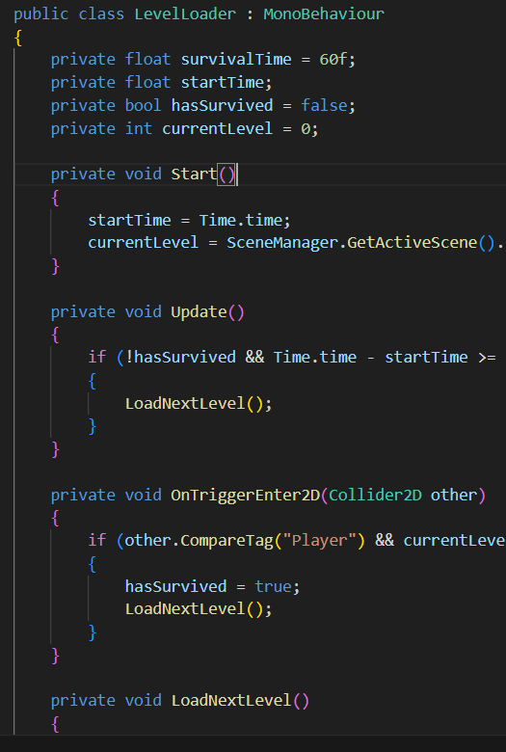
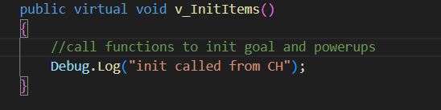
Coding Standards
Notes:
In progress, can see that variables are arranged from public-protected-private. Then functions organized start-update-unity-custom
Follows naming conventions for virtual/override functions (and I want to show off my implemented binding

