Slide 2
Capability Assessment
https://github.com/microsoft/azure-data-services-go-fast-capability-assessment
2. Current State
Project 4
1. Desired Future State
Project 3
Project 2
Project 1
3.Transition Plan

Slide 3
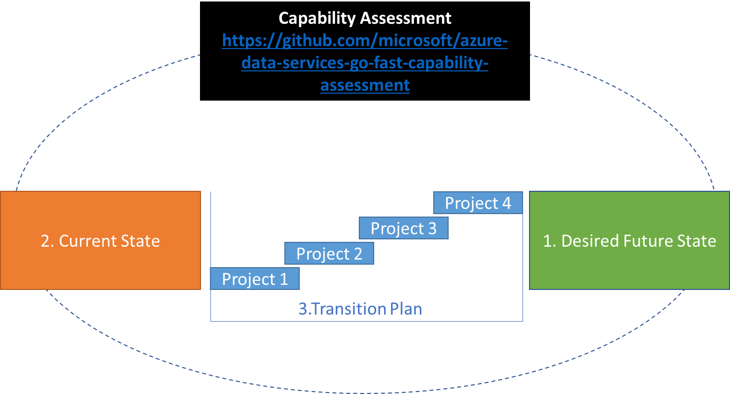


Documentation*
Azure Data Services Go Fast Framework
Codebase**
Accelerate your transition plan with a pre-built framework!!
*https://github.com/microsoft/azure-data-services-go-fast-capability-assessment
**https://github.com/microsoft/azure-data-services-go-fast-codebase

