Slide 1
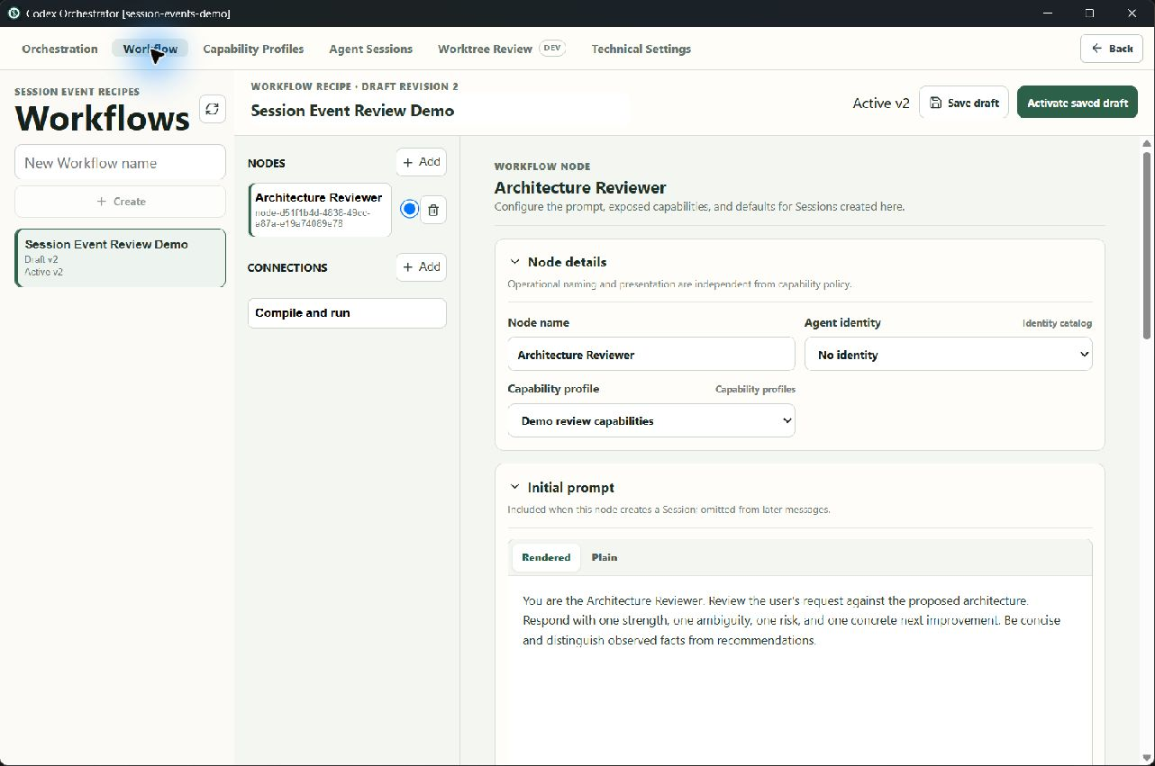
CODEX ORCHESTRATOR
Session Event UI demo
A screen-by-screen tour of the current build
Also shown clearly:
• the canvas was replaced by a list
• Workflow instance creation is missing
18 slides · no provider request was sent
Notes:
This tour shows every changed screen in the current build. It also marks the two parts that need to be restored before the Workflow UI is acceptable.
[Sources]
- Local capture: 03-workflow-node-profile.jpg
[/Sources]

Slide 2
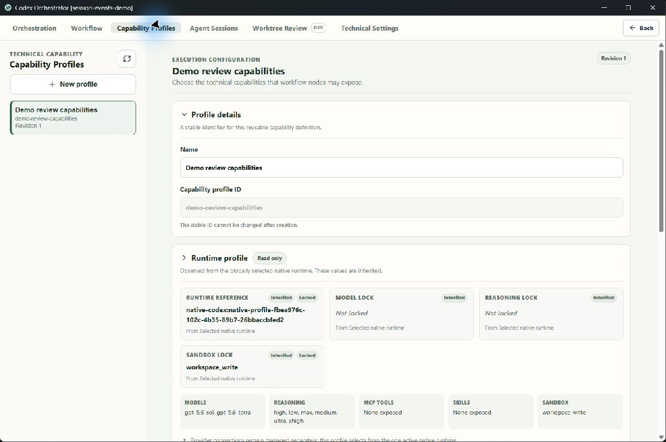
UI DEMO
02
Capability Profiles are now a separate screen
1
Profile list
Choose a profile or add a new one.
LIVE DEMO
Profile details
1
2
2
Name, key, and short description stay together.
3
Runtime profile
The selected native runtime is shown as inherited and read-only.
3
Notes:
Open Capability Profiles. The left side selects a profile. The right side edits its details and shows which native runtime it uses.
[Sources]
- Local capture: 01-capability-profile-overview.jpg
[/Sources]

Slide 3
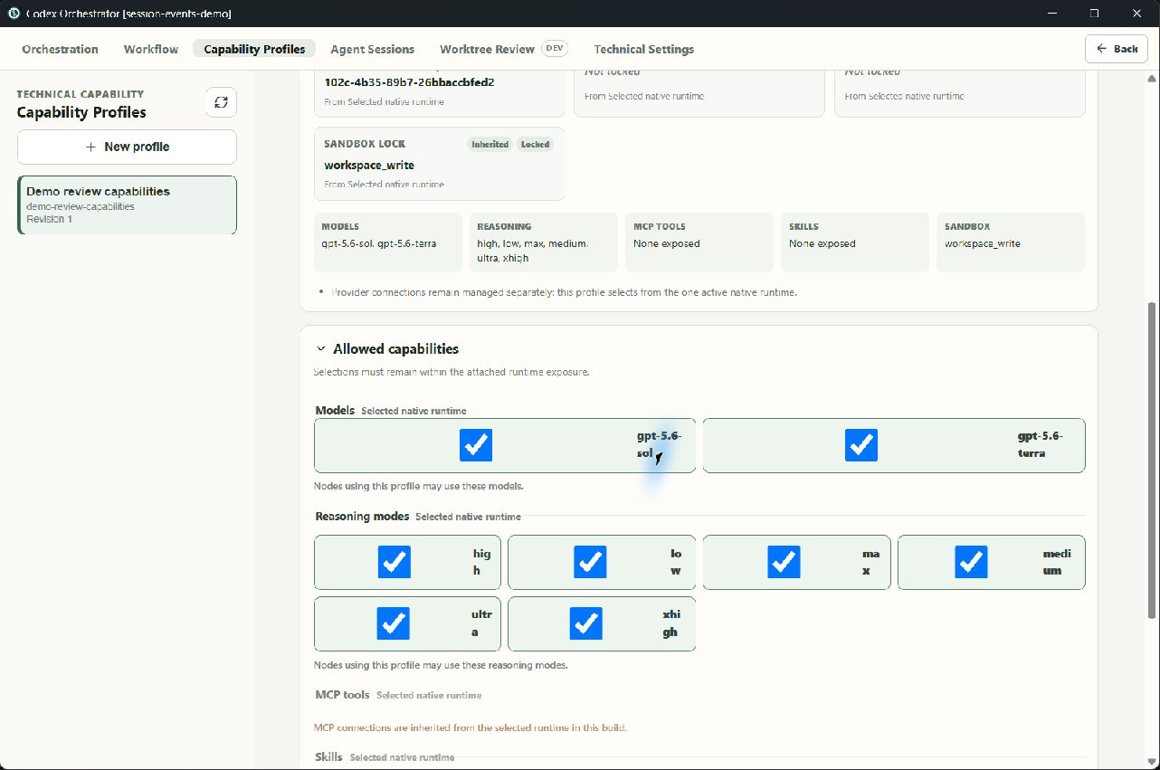
UI DEMO
03
A profile limits the choices from the runtime
1
Models
Tick the models that nodes may use.
LIVE DEMO
2
Reasoning
Tick the reasoning levels that nodes may use.
3
Inherited items
MCP tools and skills are visible but locked in this build.
1
2
3
Notes:
This screen narrows the choices already exposed by the selected runtime. It does not set up provider accounts or connections.
[Sources]
- Local capture: 02-capability-allowed-selections.jpg
[/Sources]

Slide 4
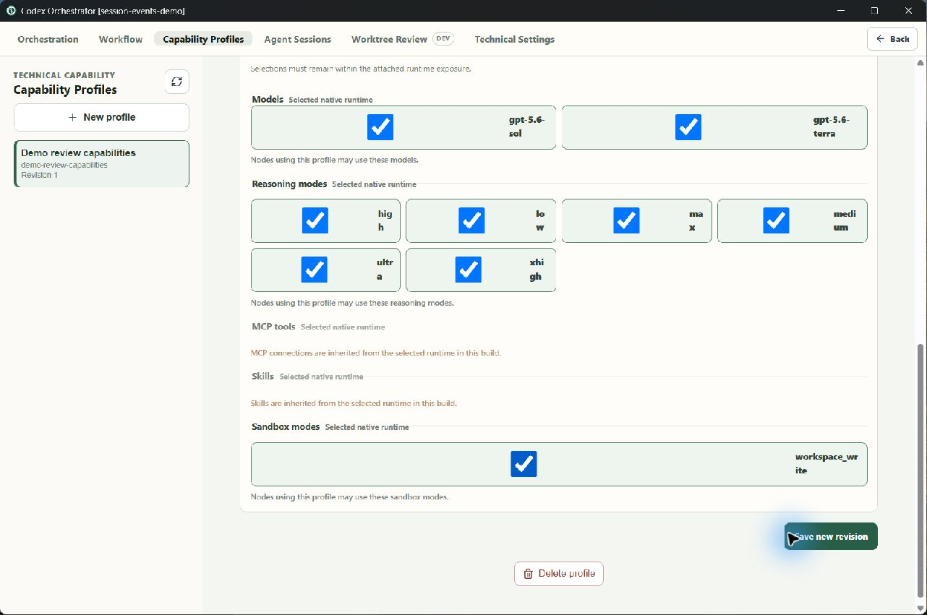
UI DEMO
04
Profiles can be saved or deleted
1
Save
Save writes the current profile changes.
LIVE DEMO
2
Delete
Delete removes the selected profile.
2
1
Notes:
The profile form has clear save and delete actions. The saved revision is shown near the bottom of the form.
[Sources]
- Local capture: 12-capability-profile-save-and-delete.png
[/Sources]

Slide 5
WORKFLOW EDITOR
05
Workflow editing now opens as a node list
1
Recipe details
The Workflow name and key are still editable.
LIVE DEMO
1
2
Node list
Nodes are selected from a list on the left.
Node form
2
!
3
3
The selected node opens as a form on the right.
Known problem: this list replaced the old flow canvas. The canvas should return.
Notes:
This is the current Workflow editor. It exposes the new node fields, but it wrongly replaced the old flow canvas with a list.
[Sources]
- Local capture: 03-workflow-node-profile.jpg
[/Sources]

Slide 6
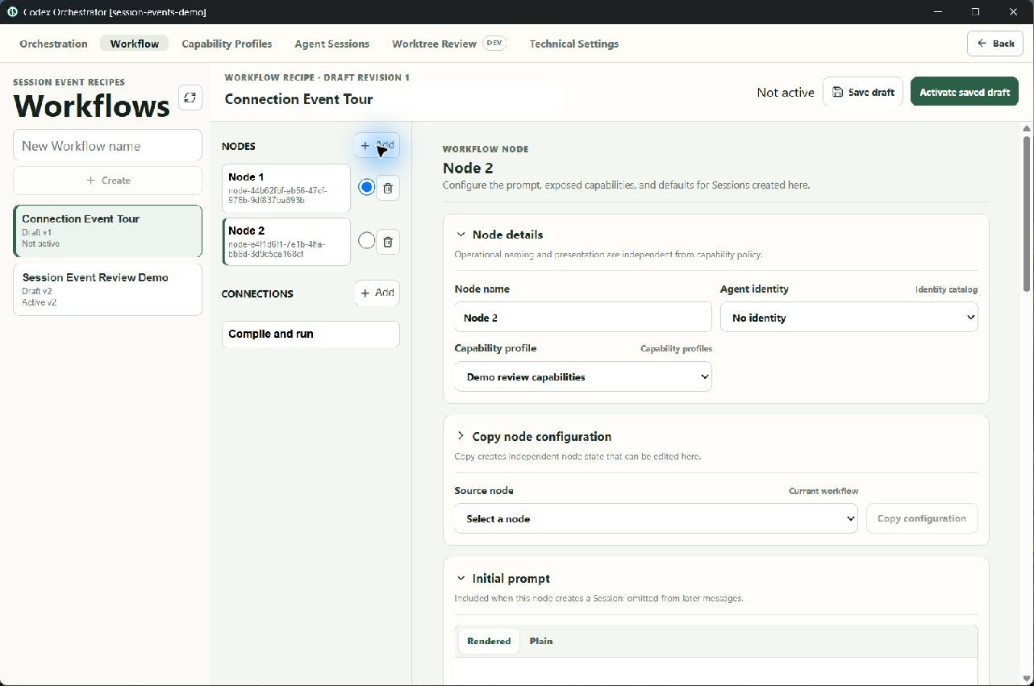
WORKFLOW EDITOR
06
A node setup can be copied
1
Independent copy
The copy becomes separate node state.
LIVE DEMO
2
Source node
Pick an existing node as the source.
3
Copy button
Copy its settings into the current node.
1
2
3
Notes:
Nodes are not reusable objects in this build. Copy is the quick way to start from an existing node and then change it.
[Sources]
- Local capture: 11-copy-node-configuration.png
[/Sources]

Slide 7
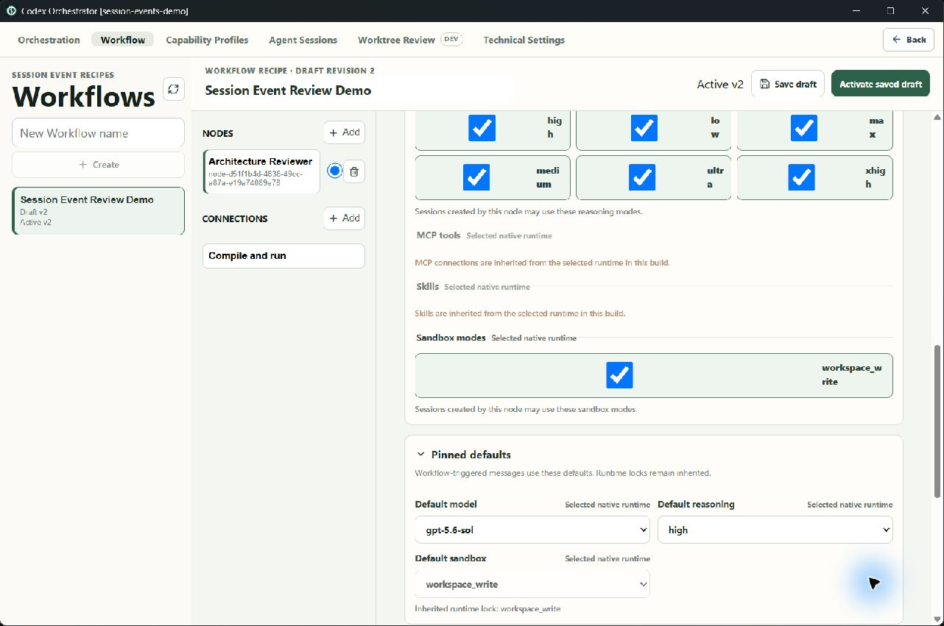
WORKFLOW EDITOR
07
A node sets defaults and limits
1
Allowed choices
Models and reasoning stay within the chosen Capability Profile.
LIVE DEMO
2
Inherited items
MCP tools and skills are visible but locked in this build.
1
3
Defaults
2
The node sets the model, reasoning, and sandbox used by Workflow messages.
3
Notes:
The node chooses a Capability Profile, then narrows it further. It also stores the first prompt and the identity shown in the product.
[Sources]
- Local capture: 04-node-restrictions-and-defaults.jpg
[/Sources]

Slide 8
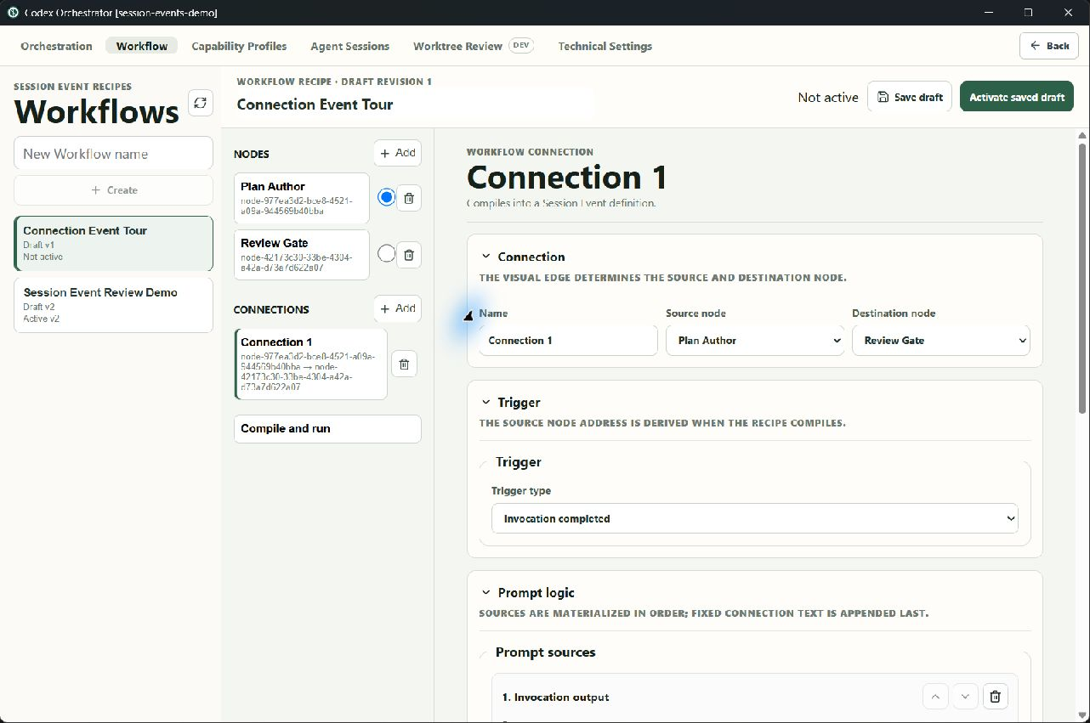
WORKFLOW EDITOR
08
A connection defines an event trigger
1
From and to
The connection names its source and destination nodes.
LIVE DEMO
2
Trigger
Choose what starts the event.
3
Prompt order
The prompt sources are listed in delivery order.
1
2
3
Notes:
Each connection becomes a Session Event definition. The editor shows which nodes it connects, what starts it, and the order of prompt parts.
[Sources]
- Local capture: 05-connection-trigger-and-prompt.jpg
[/Sources]

Slide 9
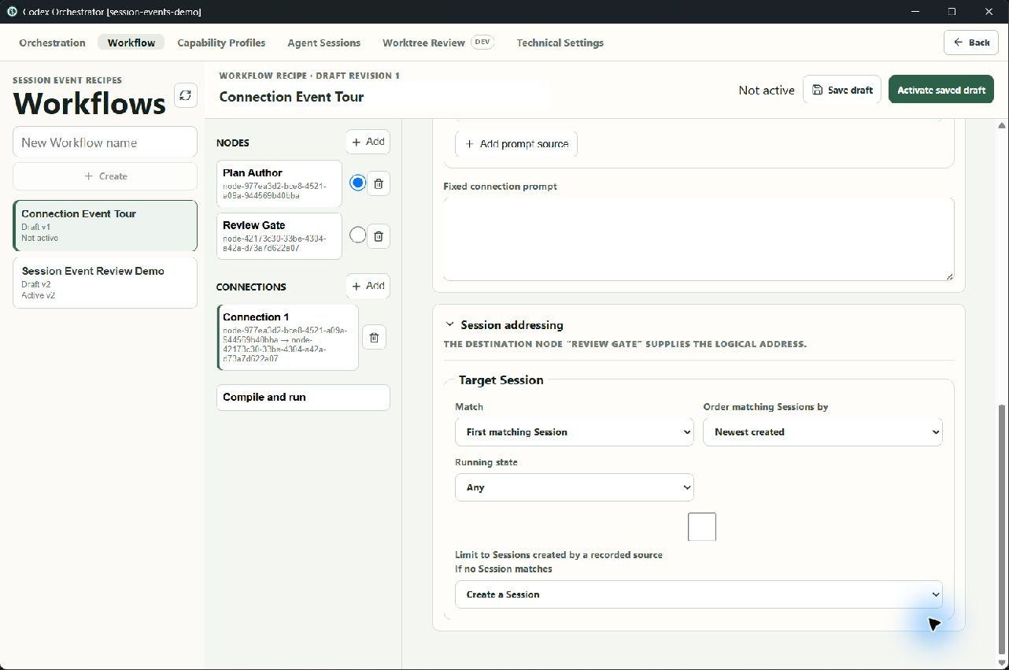
WORKFLOW EDITOR
09
A connection builds the prompt and finds Sessions
1
Prompt sources
Connection text, MCP values, file name, and node prompt can be combined.
LIVE DEMO
2
Target rules
1
Find Sessions by node and relation, then choose first, all, or newest.
3
Create if missing
The event may create a Session when no match exists.
2
3
Notes:
The connection form makes prompt assembly and Session lookup explicit. These values compile into the generic Session Event model.
[Sources]
- Local capture: 06-connection-prompt-and-target.jpg
[/Sources]

Slide 10
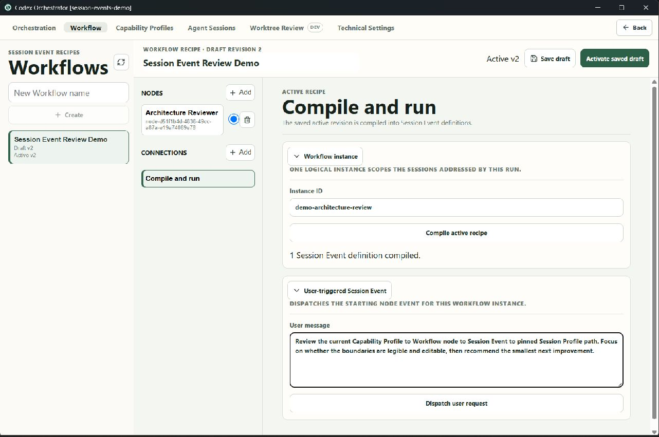
COMPILE AND RUN
10
Compile builds Session Events for a run
1
Instance ID
A typed ID is used to scope the compiled event.
LIVE · NOT SENT
2
Compile
Compile shows the event definitions before they run.
3
Staged request
A user-triggered event can be prepared without sending it.
1
2
3
Known problem: the old instance list and Create Workflow instance flow are missing. A typed ID is not a replacement.
Notes:
Compile turns the recipe into Session Event definitions. The current screen only accepts a typed instance ID. The old list and Create Workflow instance flow need to return.
[Sources]
- Local capture: 07-compile-and-run.jpg
[/Sources]

Slide 11
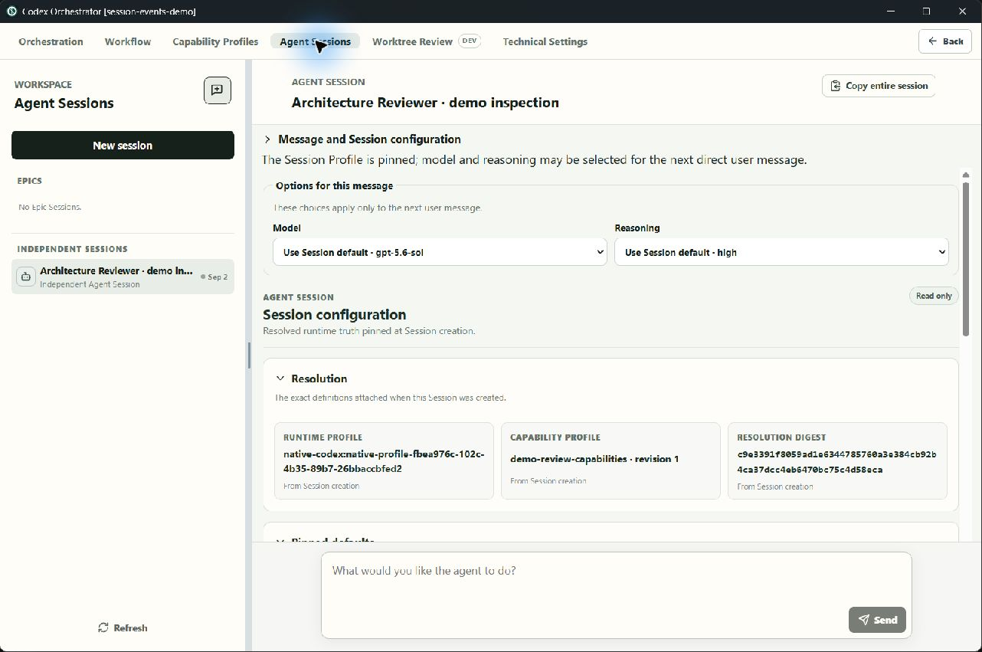
AGENT SESSION
11
Each Session shows its pinned profile
1
Next message
A direct user message may pick model and reasoning for that message.
SEEDED SESSION
2
Capability Profile
The Session keeps the resolved profile revision from creation.
1
3
Resolution digest
A digest identifies the exact pinned result.
3
2
Notes:
This seeded Session shows the new per-message controls and the profile pinned when the Session was created. No provider request was sent.
[Sources]
- Local seeded capture: 08-session-profile-and-message-controls.jpg
[/Sources]

Slide 12
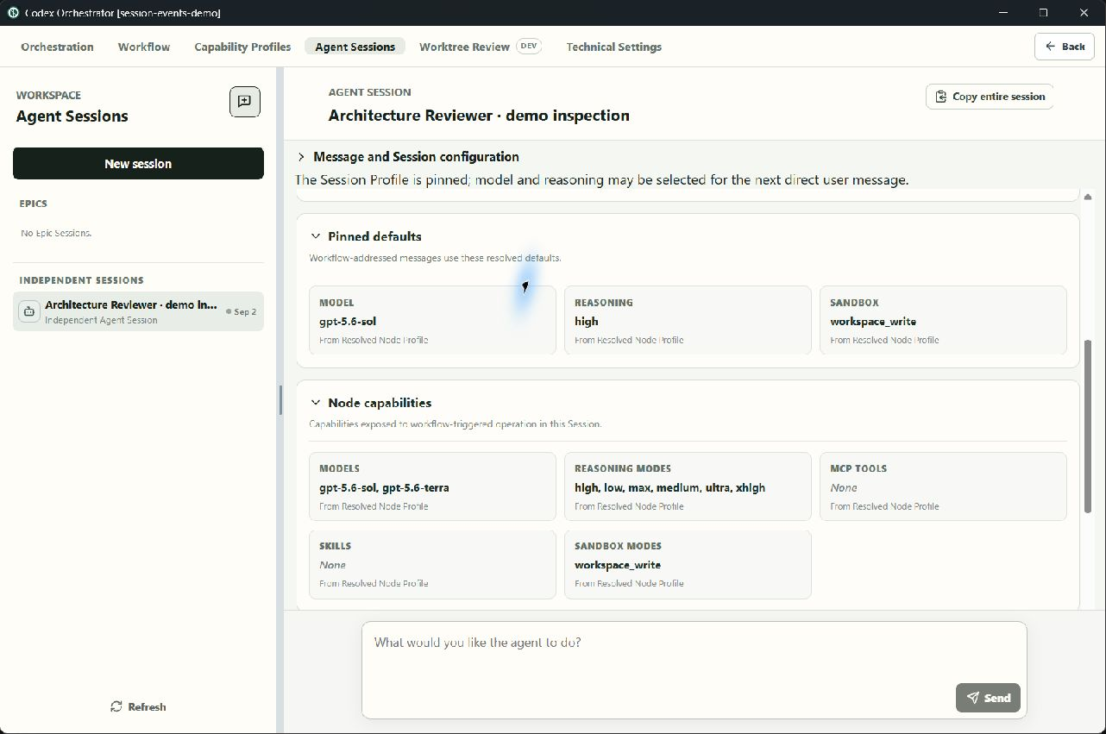
AGENT SESSION
12
Node defaults are shown in the Session
1
Workflow defaults
The pinned model, reasoning, and sandbox are shown together.
SEEDED SESSION
2
Allowed choices
The Session shows the models and reasoning levels allowed by the node.
3
Source labels
1
Each value says that it came from the resolved Node Profile.
2
3
Notes:
The Session view separates the defaults used by Workflow messages from the wider runtime choices available to a direct user prompt.
[Sources]
- Local seeded capture: 09-pinned-defaults-and-node-capabilities.jpg
[/Sources]

Slide 13
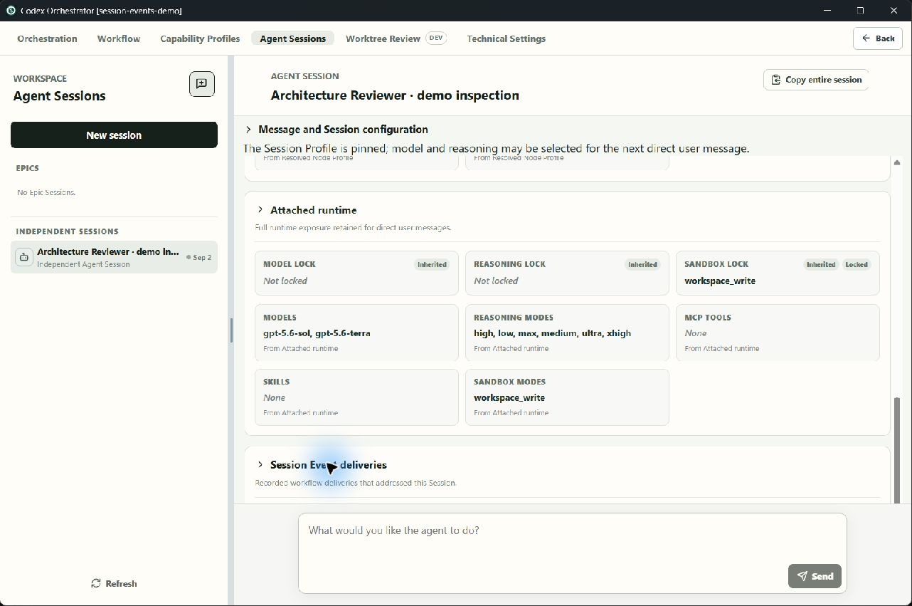
AGENT SESSION
13
Runtime exposure and delivery history are separate
1
Attached runtime
Shows the models and reasoning modes the current runtime exposes.
SEEDED SESSION
2
Delivery history
Lists Session Event deliveries tied to this Session.
1
3
Message box
The composer stays fixed at the bottom while the details scroll.
2
3
Notes:
The runtime card shows what the attached runtime can do. The delivery area below it records how Session Events reached this Session.
[Sources]
- Local seeded capture: 10-attached-runtime-and-delivery-provenance.jpg
[/Sources]

Slide 14
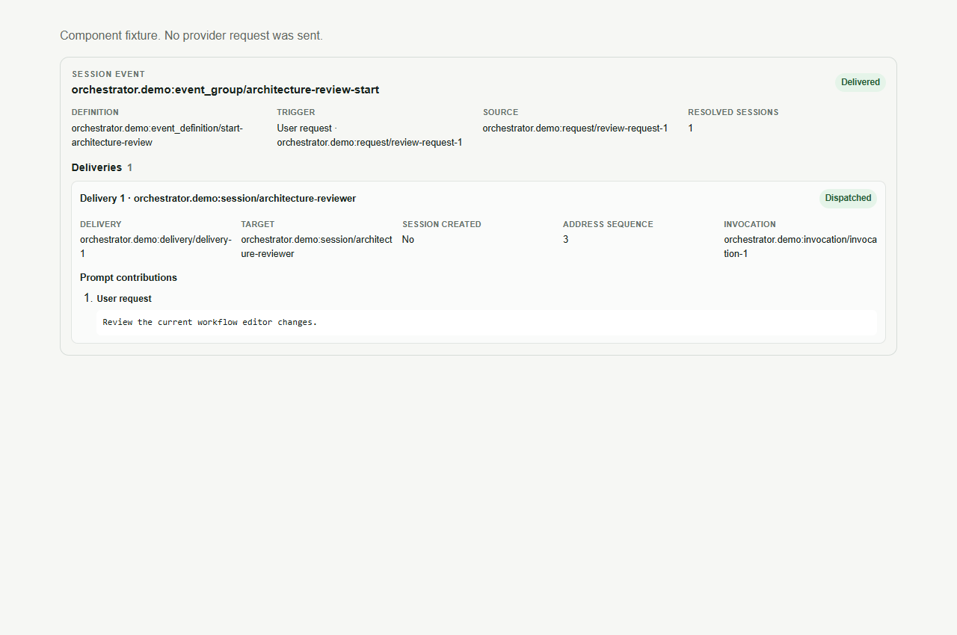
SESSION EVENT RESULT
14
One event can show every delivery
1
Event result
Shows the event definition, trigger, and prompt source.
COMPONENT FIXTURE
1
2
2
Resolved Sessions
Shows every Session selected by the target rules.
3
Delivery details
Each delivery keeps its target, status, and prompt contribution.
3
Notes:
This component fixture shows a completed event with one delivery. The same result view can hold grouped fan-out deliveries. No provider request was sent.
[Sources]
- Local component fixture: 13-event-result-and-delivery-details.png
[/Sources]

Slide 15
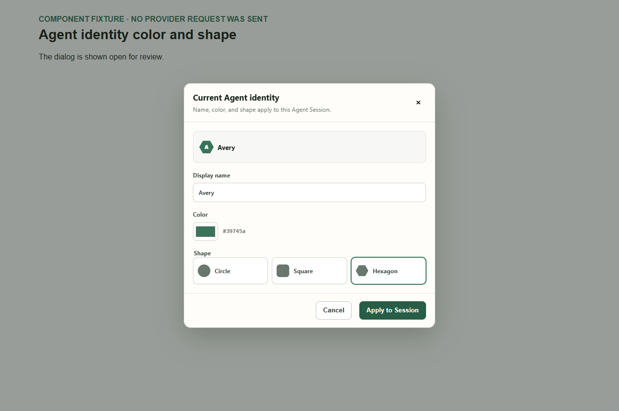
AGENT IDENTITY
15
Agent Identity uses initials, color, and shape
1
Initials badge
The Agent name is reduced to initials inside the chosen shape.
COMPONENT FIXTURE
2
Color picker
Pick one color and see its hex value.
1
3
Three shapes
Choose a circle, square, or hexagon.
2
3
Notes:
This dialog implements the identity change requested in the earlier UX review. It uses the Agent initials in a color-coded circle, square, or hexagon.
[Sources]
- Local component fixture: 14-agent-identity-color-and-shape.png
[/Sources]

Slide 16
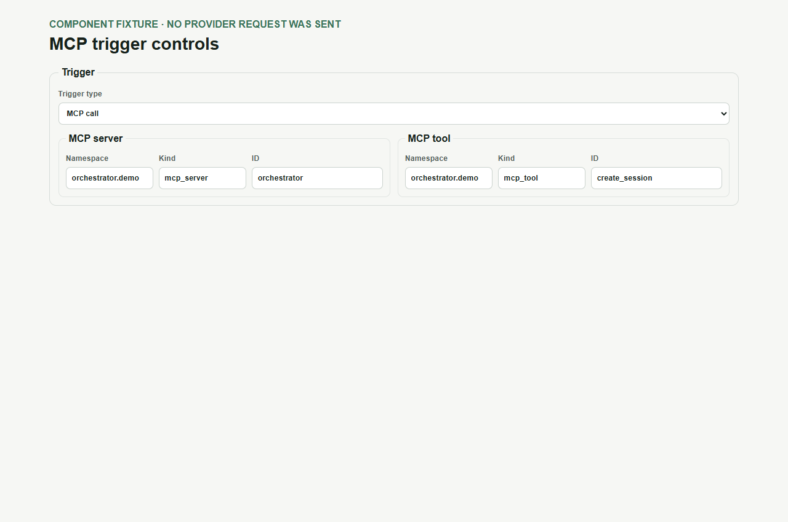
SESSION EVENT CONTROL
16
An MCP call can start a Session Event
1
Trigger type
MCP call is one of the built-in trigger choices.
COMPONENT FIXTURE
2
MCP server
1
The server is stored as a typed reference.
2
3
3
MCP tool
The tool is stored as a separate typed reference.
Notes:
The Workflow connection may use an MCP call trigger. The server and tool each use a namespace, kind, and ID.
[Sources]
- Local component fixture: 15-mcp-trigger-controls.png
[/Sources]

Slide 17
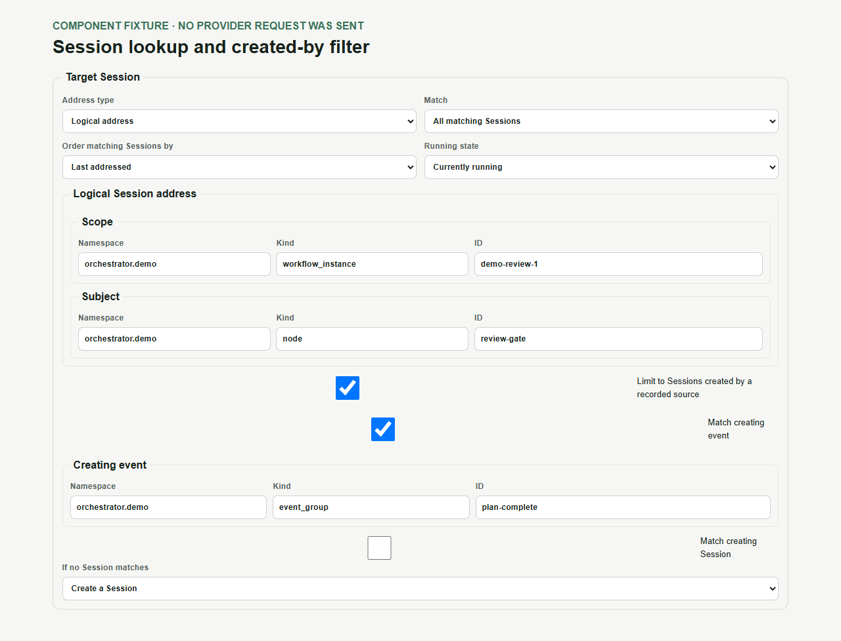
SESSION EVENT CONTROL
17
Session lookup can use its recorded creator
1
Match rules
Choose all or first, order, and running state.
COMPONENT FIXTURE
2
Logical address
The scope and node identity describe which Sessions may match.
1
3
Created-by filter
Limit matches to Sessions made by a recorded event or Session.
2
4
No match
Create a Session, fail, or do nothing.
3
4
Notes:
This shows the full generic Session lookup control. Workflow connections can hide the address details they derive from their nodes, while the event layer keeps them explicit.
[Sources]
- Local component fixture: 16-created-by-session-filter.png
[/Sources]

Slide 18
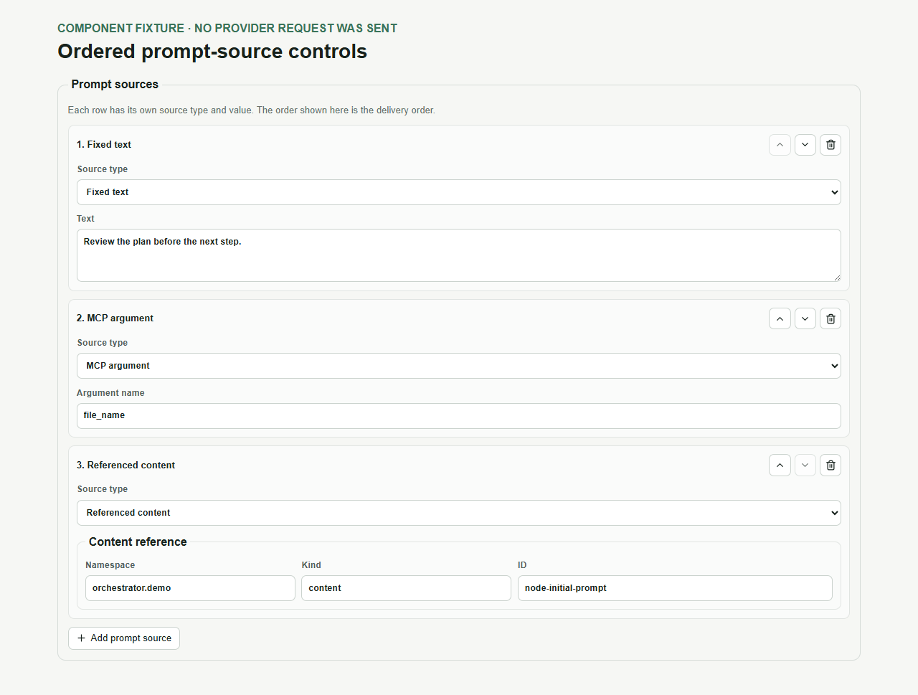
SESSION EVENT CONTROL
18
Prompt parts stay ordered and editable
1
Source and value
Each row names its source type and its value.
COMPONENT FIXTURE
2
Move or remove
Arrow buttons change the order. The bin removes a row.
2
1
3
Different sources
Fixed text, MCP values, and references can sit in one list.
4
Add a source
Add another prompt part at the end.
3
4
Notes:
The list order is the delivery order. Each row can choose a source type, edit its value, move, or be removed. A new source is added at the bottom.
[Sources]
- Local component fixture: 17-full-prompt-source-controls.png
[/Sources]

