Slide 1
CODEX ORCHESTRATOR
Merged Harness UI demo
A screen-by-screen review of the current branch
The Workflow canvas and instance flow are restored.
This deck also marks the layout issues still visible in the merged UI.
20 slides · branch 2e378bc · local fake clients · no provider call
Notes:
This walkthrough uses fresh in-app browser captures from the merged Harness branch. The fixture mounts the real React components with local fake clients. No provider request was sent.

Slide 2
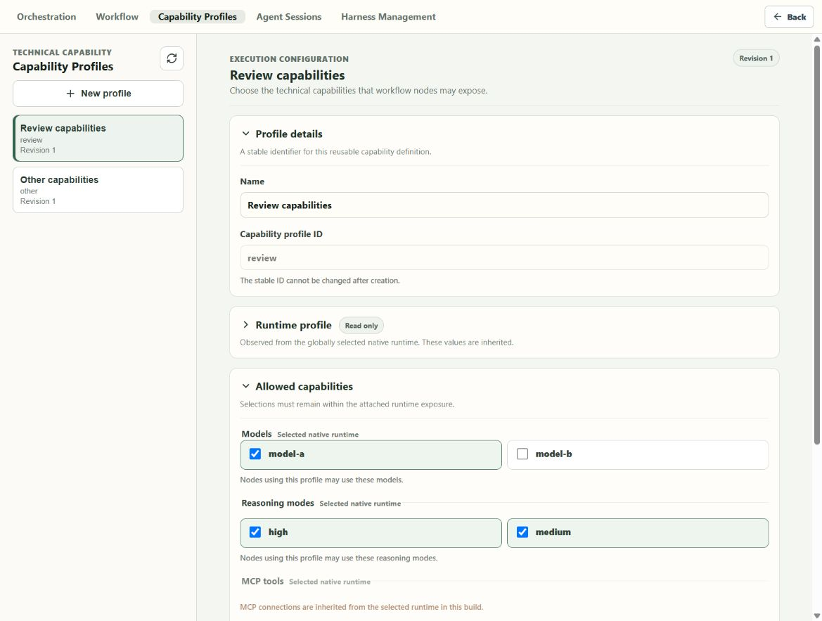
CAPABILITY PROFILES
02
Capability Profile list and details
1
Saved profiles
LIVE LOCAL FIXTURE
The left side lists each profile and its revision.
2
Stable ID
The profile name can change. The profile ID stays fixed.
3
Read-only runtime
The selected native runtime is shown as inherited.
Notes:
The new Capability Profiles screen is separate from Workflow authoring. The left side changes the selected profile. The right side edits the profile and shows the inherited runtime.
[Sources]
- Local in-app browser capture: 01-capability-profile.png
[/Sources]

Slide 3
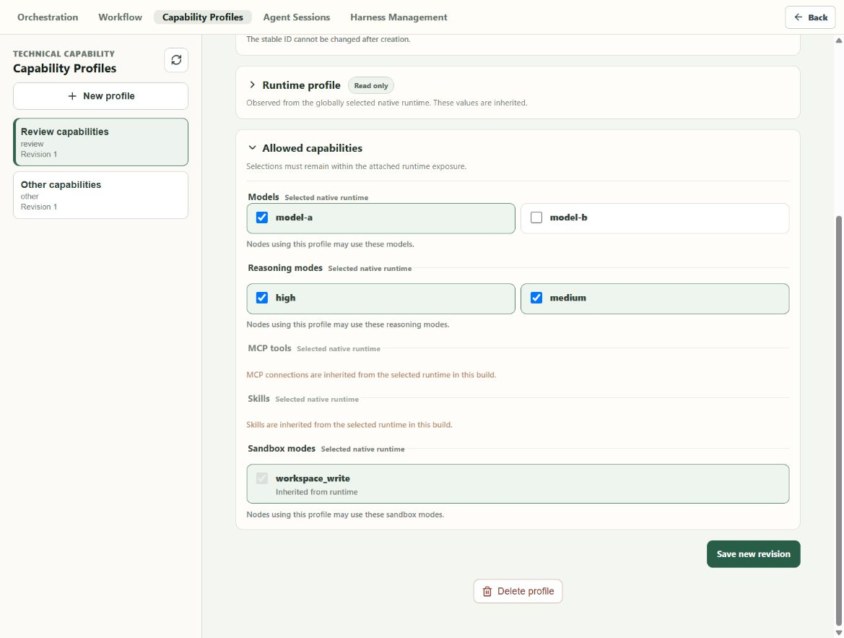
CAPABILITY PROFILES
03
Allowed capabilities
1
Models and reasoning
LIVE LOCAL FIXTURE
Tick the choices that nodes may use.
2
Inherited items
MCP tools and skills stay locked in this build.
3
Save or delete
Both actions sit at the end of the profile form.
Notes:
This is the lower part of the same profile. Model and reasoning choices can be narrowed. MCP, skills, and sandbox show what comes from the selected runtime.
[Sources]
- Local in-app browser capture: 02-allowed-capabilities.png
[/Sources]

Slide 4
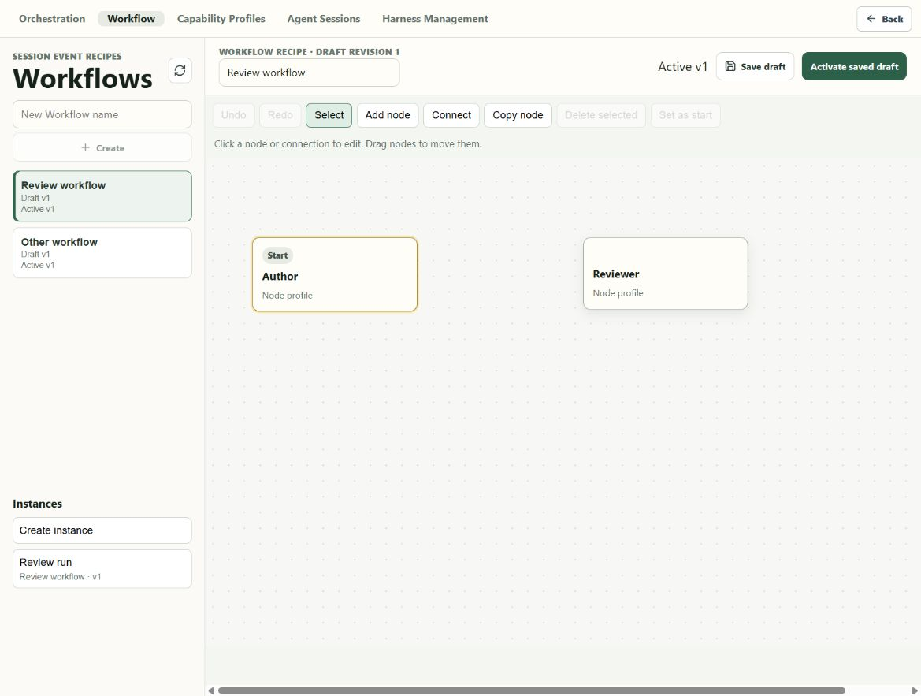
WORKFLOW
04
Workflow canvas
1
The canvas is back
LIVE LOCAL FIXTURE
Nodes and connections are shown as a flow again.
2
Edit tools
Add, connect, copy, delete, drag, undo, and redo live above the canvas.
3
Instances stay visible
Saved Workflow instances sit below the recipe list.
Notes:
The merge fixes the largest problem in the last demo. The node list no longer replaces the flow. The canvas, recipe list, and instance list now share one screen.
[Sources]
- Local in-app browser capture: 03-workflow-canvas.png
[/Sources]

Slide 5
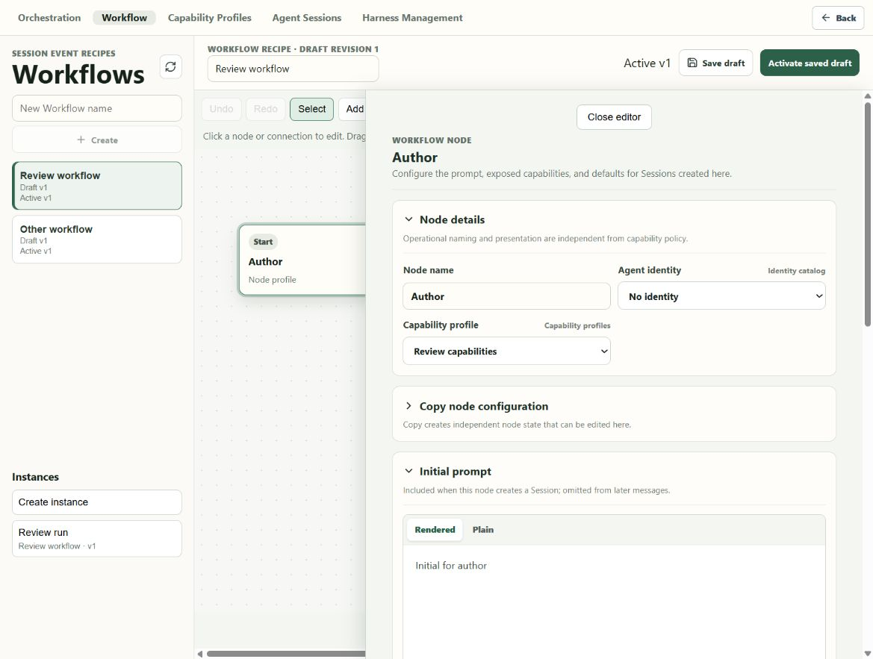
WORKFLOW NODE
05
Node profile editor
1
Editor beside the flow
LIVE LOCAL FIXTURE
Selecting a node opens its form on the right.
2
Separate choices
Agent identity and Capability Profile have their own fields.
3
Collapsible sections
Node details, copy, prompt, limits, defaults, and runtime can fold.
Notes:
The flow remains visible while the node form opens. The first screen shows the node name, identity, profile, copy section, and creation-only prompt.
[Sources]
- Local in-app browser capture: 04-node-profile.png
[/Sources]

Slide 6
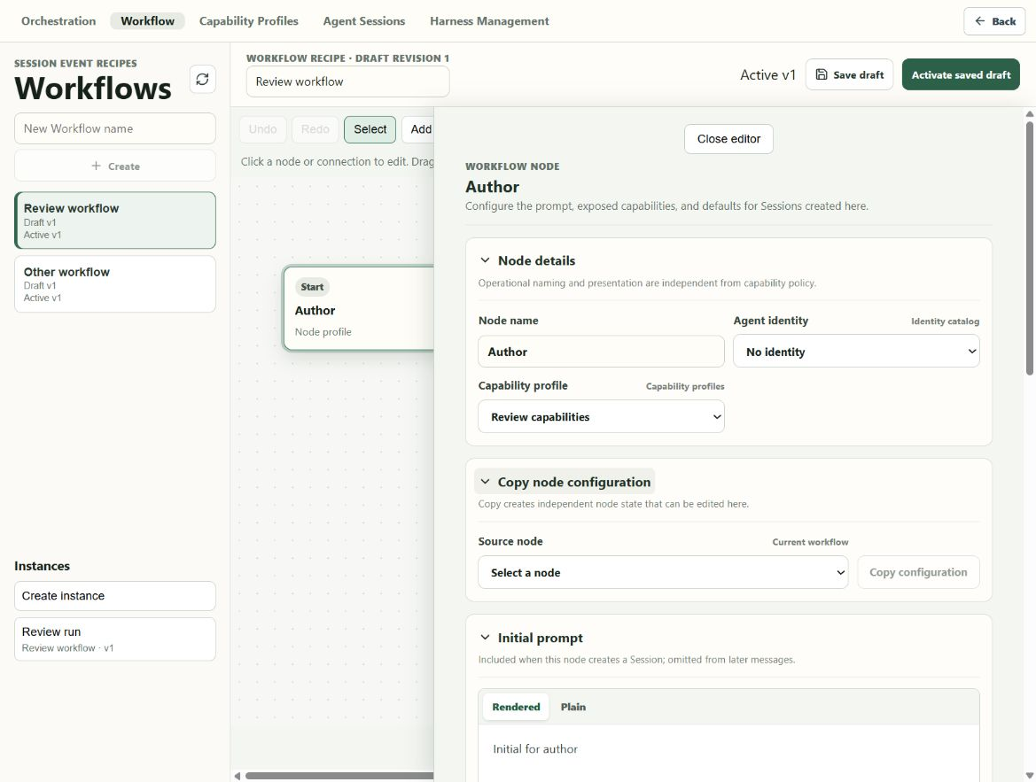
WORKFLOW NODE
06
Copy node setup
1
Choose a source
LIVE LOCAL FIXTURE
Pick another node in the same Workflow.
2
Copy the setup
The button copies that node into this node.
3
Edit it here
The copied values become separate local node state.
Notes:
There is no shared Node Profile catalog. This section supports the agreed copy-and-edit flow without creating reusable node objects.
[Sources]
- Local in-app browser capture: 05-copy-node-profile.png
[/Sources]

Slide 7
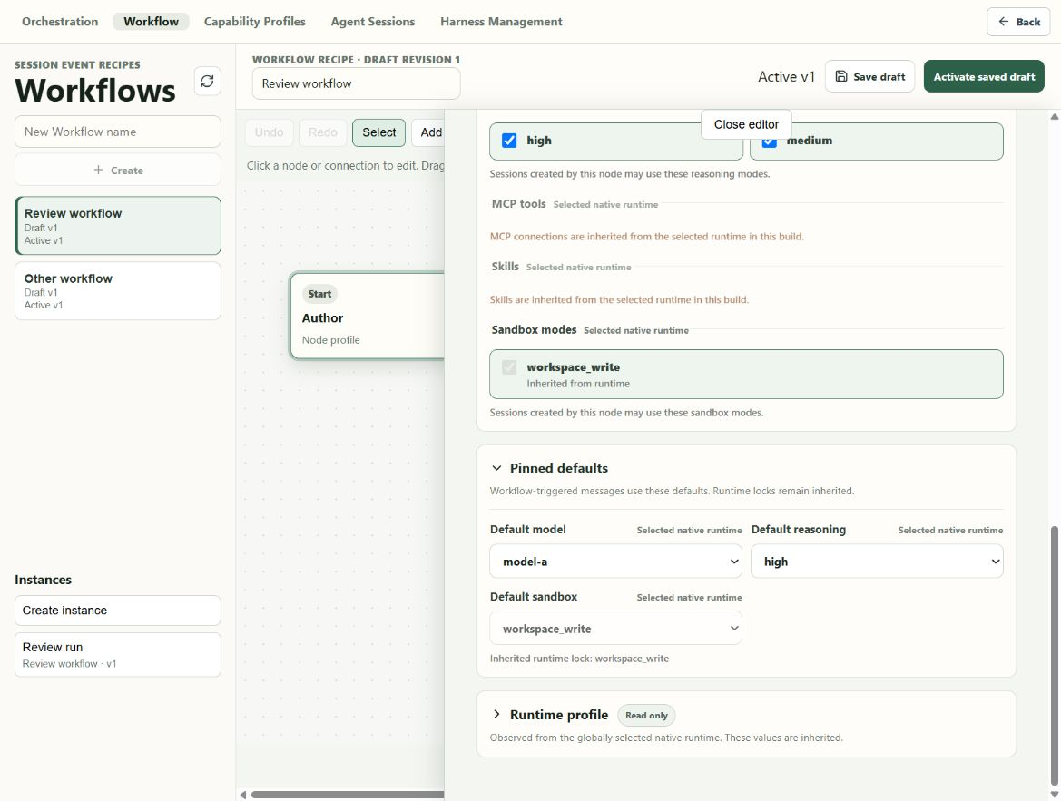
WORKFLOW NODE
07
Node limits and defaults
1
Inherited access
LIVE LOCAL FIXTURE
MCP, skills, and sandbox show their runtime source.
2
Workflow defaults
Model and reasoning are set for Workflow messages.
3
Locked sandbox
The sandbox is visible but cannot change here.
Notes:
The node may narrow its Capability Profile. The node also sets the model and reasoning used when the Workflow sends a message. The sandbox stays inherited.
[Sources]
- Local in-app browser capture: 06-node-limits-defaults.png
[/Sources]

Slide 8
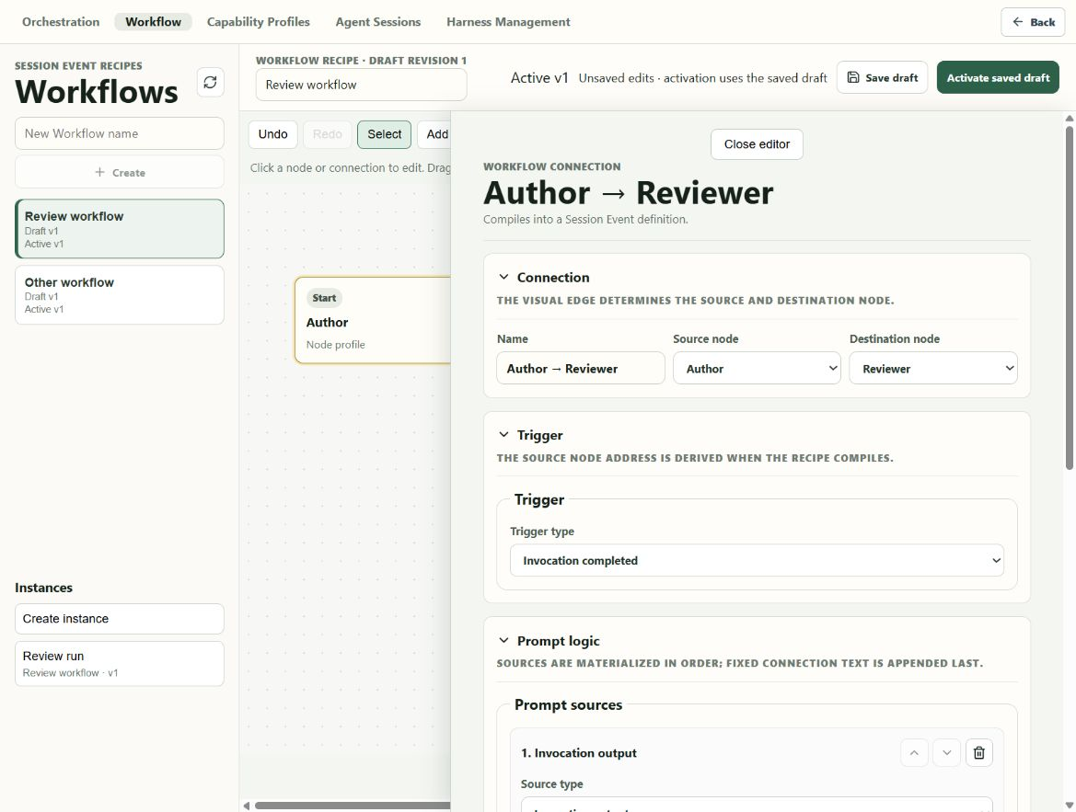
WORKFLOW CONNECTION
08
Connection trigger
1
The edge sets direction
LIVE LOCAL FIXTURE
Author is the source. Reviewer is the destination.
2
The trigger is explicit
This connection starts after an invocation completes.
3
Prompt logic follows
The ordered prompt parts sit in the next section.
Notes:
Selecting the line opens the connection editor. The top of the form names the nodes and the trigger that starts the Session Event.
[Sources]
- Local in-app browser capture: 07-connection-trigger.png
[/Sources]

Slide 9
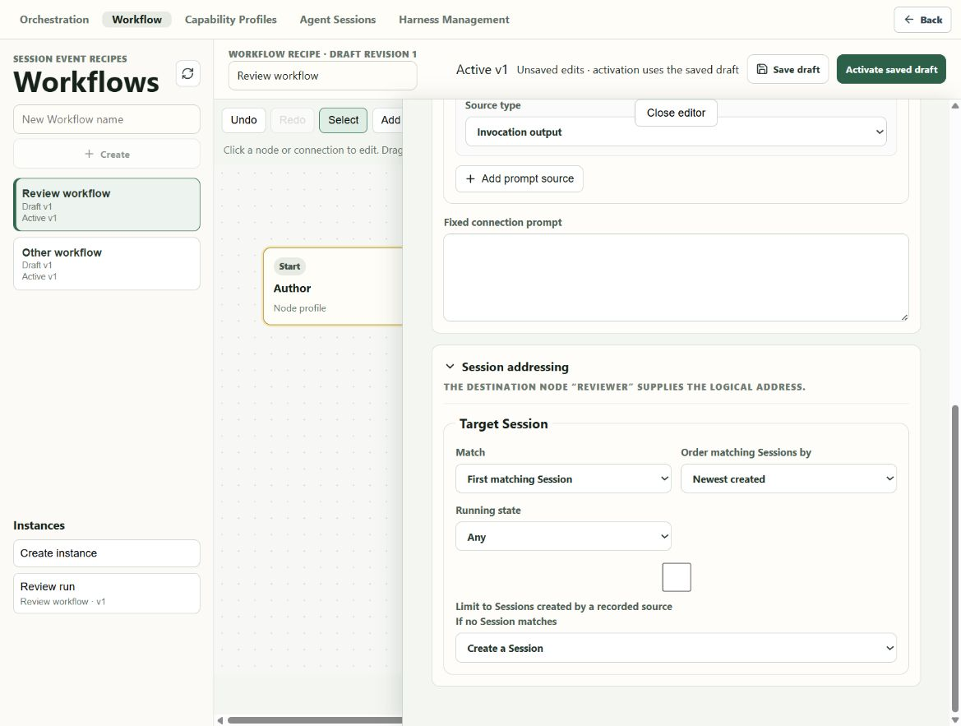
WORKFLOW CONNECTION
09
Prompt and Session target
1
Fixed prompt
LIVE LOCAL FIXTURE
The connection can append its own text.
2
Match rules
Choose the Session order and running state.
3
No match rule
The event can create a Session when none match.
Needs polish: the recorded-source checkbox sits too far from its label at this width.
Notes:
This part controls prompt text and Session lookup. The behavior is present, but the checkbox layout is still awkward at the reviewed width.
[Sources]
- Local in-app browser capture: 08-connection-prompt-target.png
[/Sources]

Slide 10
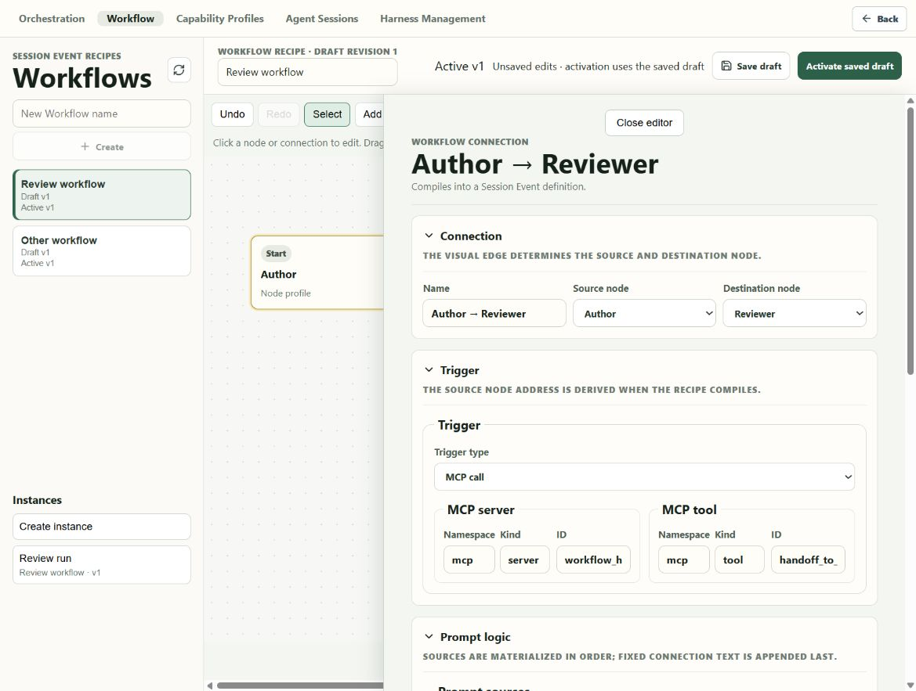
WORKFLOW CONNECTION
10
MCP trigger references
1
MCP call trigger
LIVE LOCAL FIXTURE
The trigger type can change from completion to MCP call.
2
Server reference
Namespace, kind, and ID identify the MCP server.
3
Tool reference
A second reference identifies the MCP tool.
Notes:
This state shows the built-in MCP trigger. The connection stores separate typed references for the server and the tool.
[Sources]
- Local in-app browser capture: 17-mcp-trigger.png
[/Sources]

Slide 11
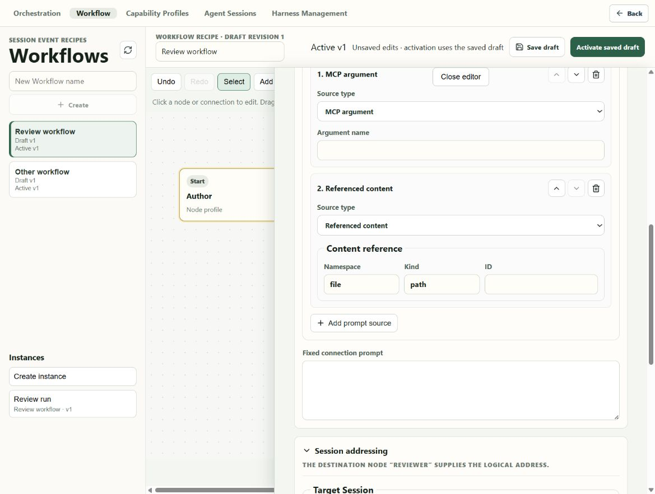
WORKFLOW CONNECTION
11
Ordered prompt sources
1
One row per source
LIVE LOCAL FIXTURE
Each row has a type and the fields for that type.
2
Order controls
Move a row up or down, or remove it.
3
More prompt parts
Add another source or fixed connection text.
Notes:
The screenshot shows an MCP argument and referenced file content in one ordered list. The order on screen is the order used in the prompt.
[Sources]
- Local in-app browser capture: 19-prompt-sources.png
[/Sources]

Slide 12
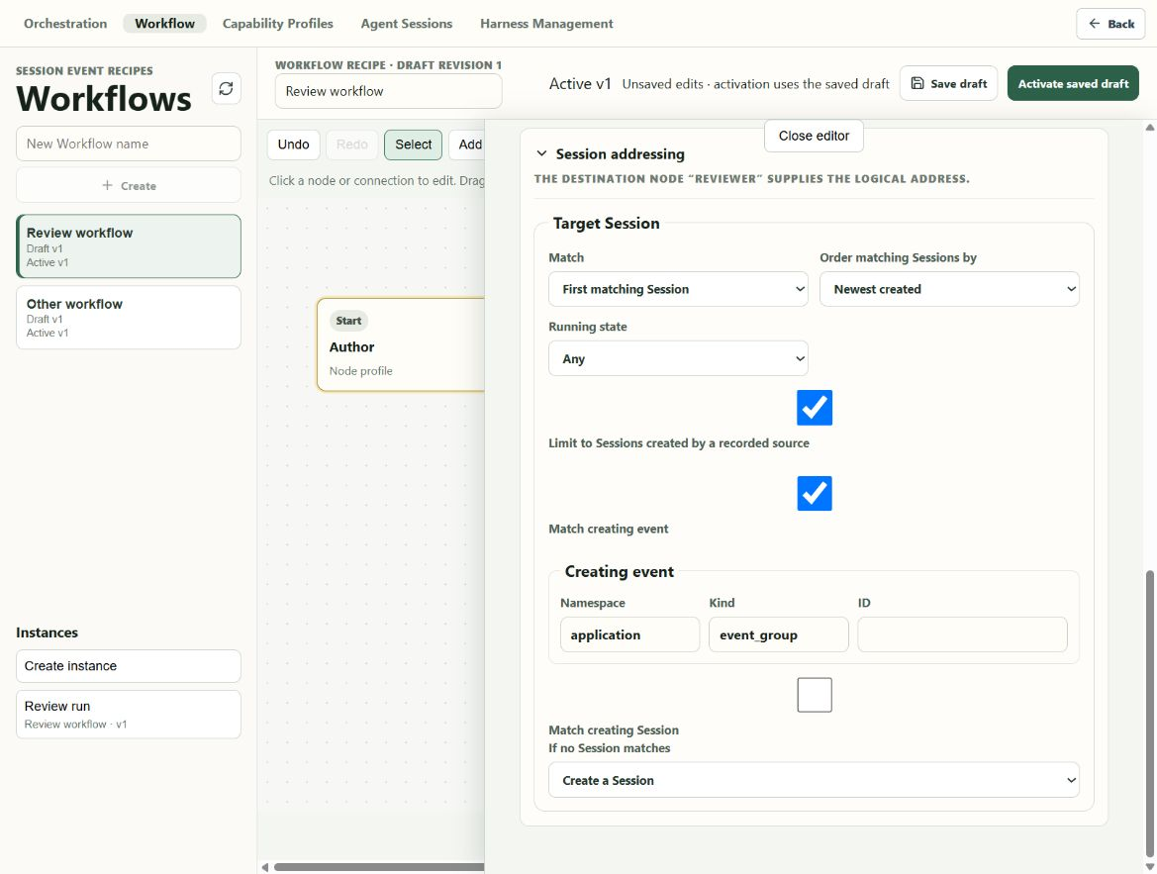
WORKFLOW CONNECTION
12
Recorded-source filter
1
Optional filter
LIVE LOCAL FIXTURE
Limit matches to Sessions made by a recorded source.
2
Event reference
Namespace, kind, and ID name the creating event.
3
Fallback
Create a Session when no Session matches.
Needs polish: checkbox size and label spacing are still uneven.
Notes:
This state shows the deeper Session addressing rule. It can match the event or Session that created the target. The fields work, but the checkbox layout needs another pass.
[Sources]
- Local in-app browser capture: 18-recorded-source-target.png
[/Sources]

Slide 13
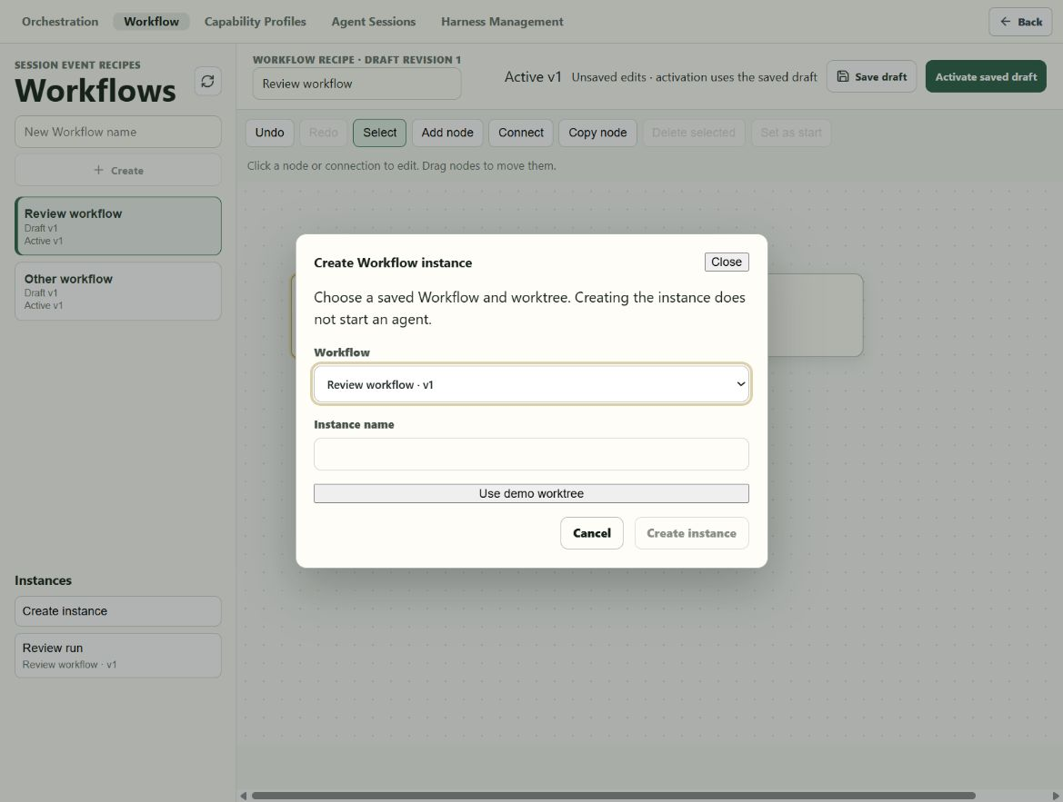
WORKFLOW INSTANCE
13
Create Workflow instance
1
Choose a saved Workflow
LIVE LOCAL FIXTURE
The picker uses an active saved revision.
2
Name the instance
The run gets a clear name in the instance list.
3
Choose a worktree
The dialog states that creation does not start an agent.
Notes:
The missing instance flow is restored. The user chooses the Workflow, instance name, and worktree. Creating the instance saves it but does not send a request.
[Sources]
- Local in-app browser capture: 09-create-instance.png
[/Sources]

Slide 14
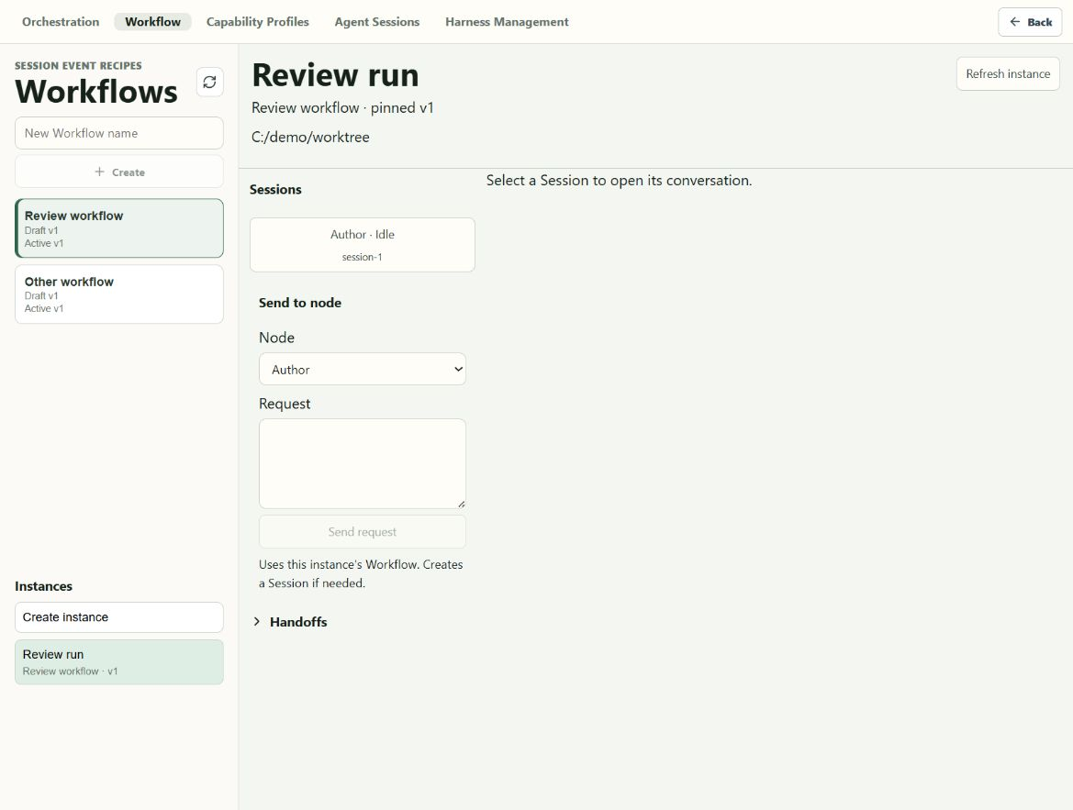
WORKFLOW INSTANCE
14
Saved Workflow instance
1
Pinned recipe
LIVE LOCAL FIXTURE
The header shows the saved Workflow revision and worktree.
2
Send to a node
Choose a node and enter the request for that node.
3
Session list
Sessions created for the instance appear beside the request form.
Notes:
Opening a saved instance shows its pinned recipe and worktree. Requests are sent to a selected node. The Session list records what belongs to the instance.
[Sources]
- Local in-app browser capture: 10-saved-instance.png
[/Sources]

Slide 15
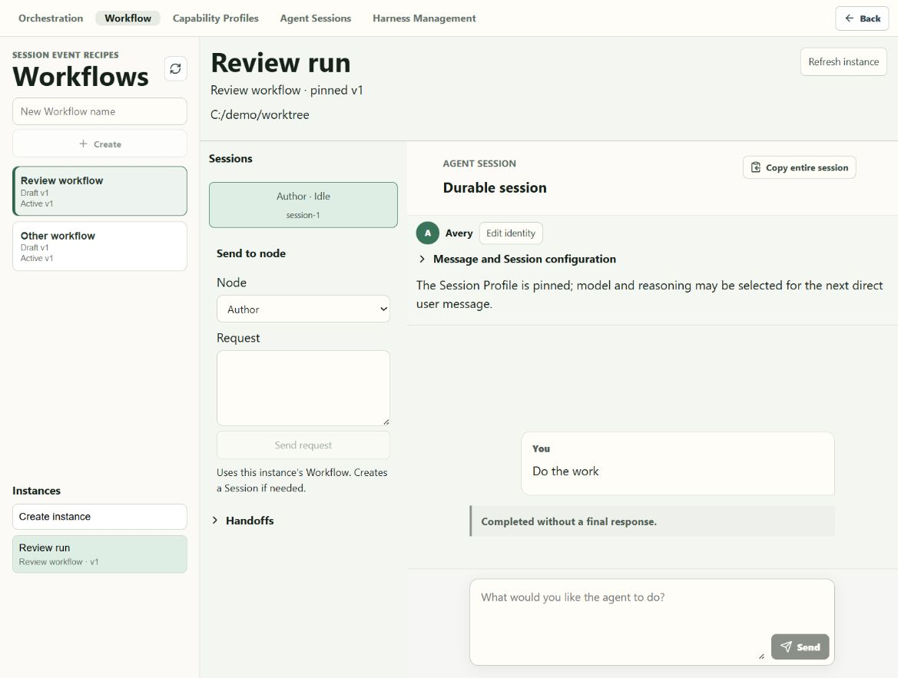
WORKFLOW INSTANCE
15
Session inside an instance
1
Workflow context stays open
LIVE LOCAL FIXTURE
The instance and node request remain on the left.
2
Session opens on the right
The selected Session shows its identity and conversation.
3
Back returns to the last view
The product navigation keeps this as one joined flow.
Notes:
A Session can be opened without leaving the Workflow instance. This gives the instance a useful working view while preserving normal Agent Session controls.
[Sources]
- Local in-app browser capture: 11-instance-session.png
[/Sources]

Slide 16
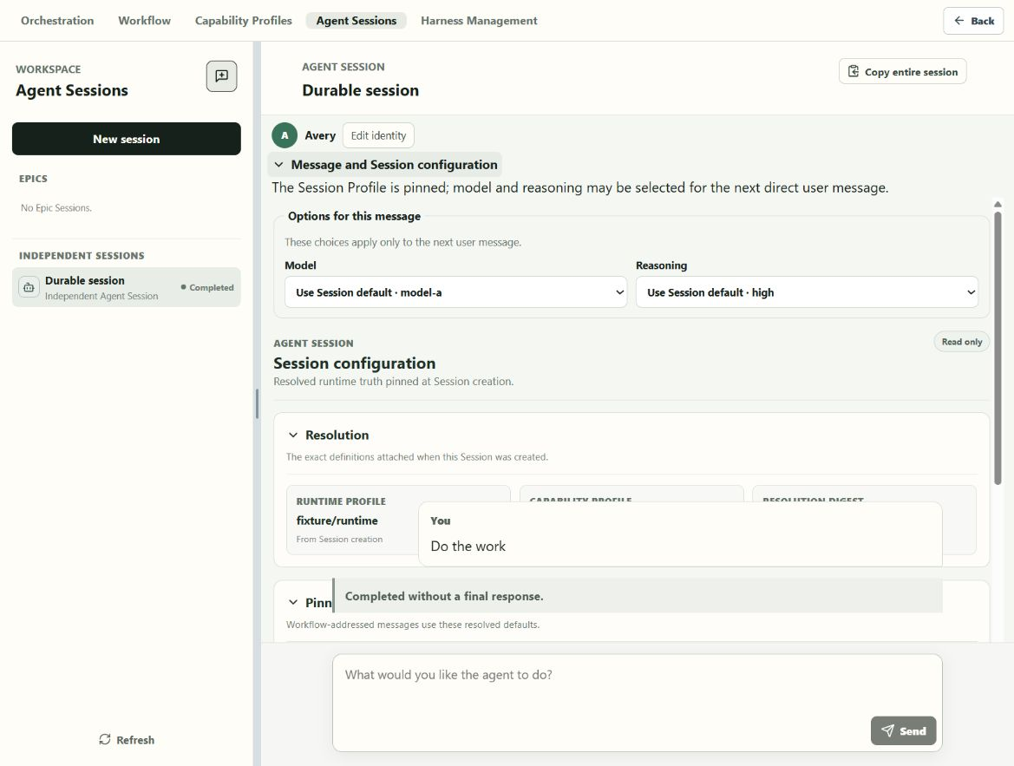
AGENT SESSION
16
Direct message controls
1
Next message only
LIVE LOCAL FIXTURE
Model and reasoning choices apply to one direct user message.
2
Pinned Session profile
The resolved runtime, profile revision, and digest are read only.
3
Workflow messages stay pinned
They continue to use the node defaults.
Needs polish: the conversation card overlaps the open settings at this width.
Notes:
The user can choose any model and reasoning level exposed by the attached runtime for the next direct message. The Session Profile remains pinned. The open panel still collides with the conversation layer at this width.
[Sources]
- Local in-app browser capture: 07-session-settings.png
[/Sources]

Slide 17
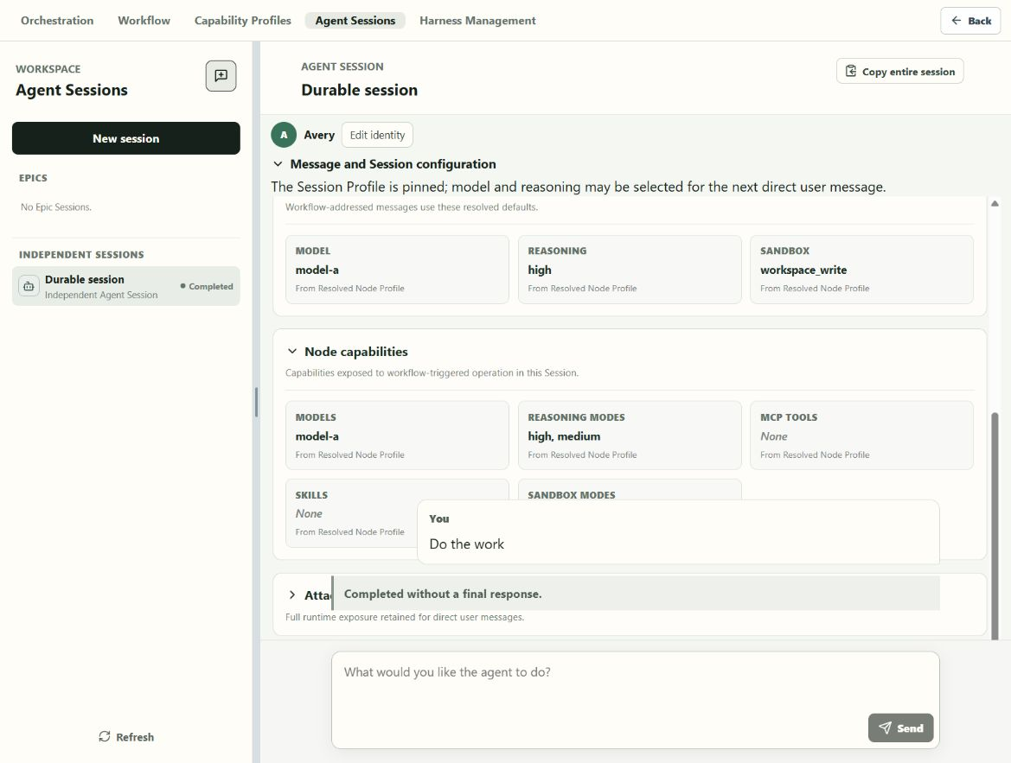
AGENT SESSION
17
Session profile details
1
Pinned defaults
LIVE LOCAL FIXTURE
Model, reasoning, and sandbox show their node source.
2
Node capabilities
The Session shows what Workflow messages may use.
3
Runtime and deliveries
Both have separate collapsible sections below.
Needs polish: fixed conversation content covers the lower profile sections.
Notes:
The source labels make the pinned values easy to trace. The structure is clear, but the conversation and composer layers cover part of the open configuration on this screen.
[Sources]
- Local in-app browser capture: 13-session-runtime-and-deliveries.png
[/Sources]

Slide 18
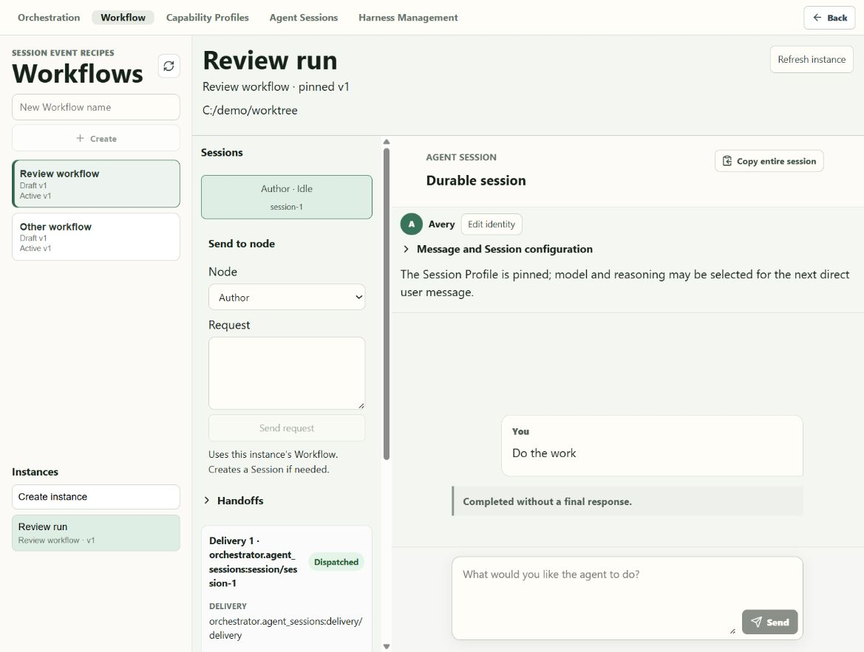
SESSION EVENT
18
Delivery details
1
Delivery status
LIVE LOCAL FIXTURE
The card shows that the request was dispatched.
2
Recorded fields
Target, creation, sequence, and invocation are kept together.
3
Grouped with the instance
The delivery sits beside the Session it addressed.
Needs polish: long IDs break into hard-to-read lines in the narrow column.
Notes:
Expanding the delivery shows the stored delivery record. The information is useful, but raw identifiers need truncation, copy actions, or a wider detail view.
[Sources]
- Local in-app browser capture: 14-delivery-details.png
[/Sources]

Slide 19
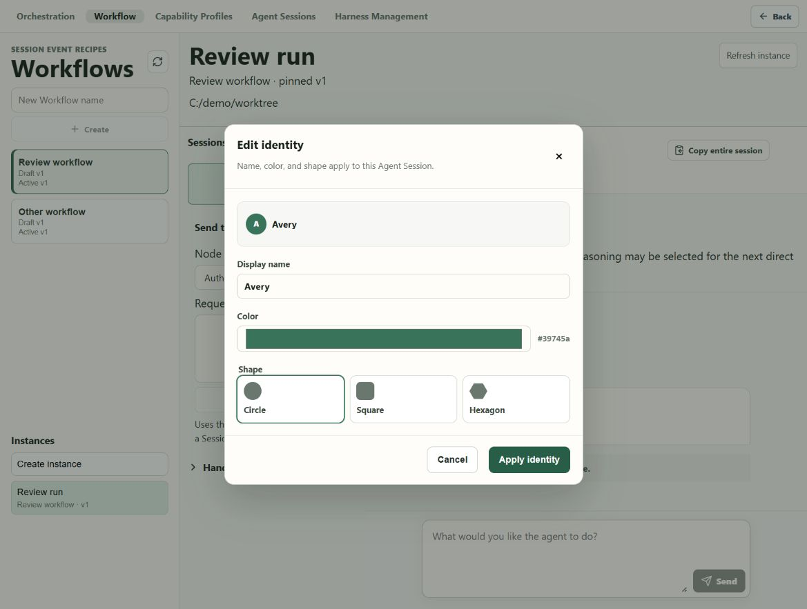
AGENT SESSION
19
Agent identity
1
Initials preview
LIVE LOCAL FIXTURE
The preview uses the Agent name inside the chosen shape.
2
Color picker
The selected color and hex value appear together.
3
Three shapes
Circle, square, and hexagon are available.
Notes:
The requested identity controls are present in the Agent Session. The dialog changes display name, color, and shape for that Session.
[Sources]
- Local in-app browser capture: 12-agent-identity.png
[/Sources]

Slide 20
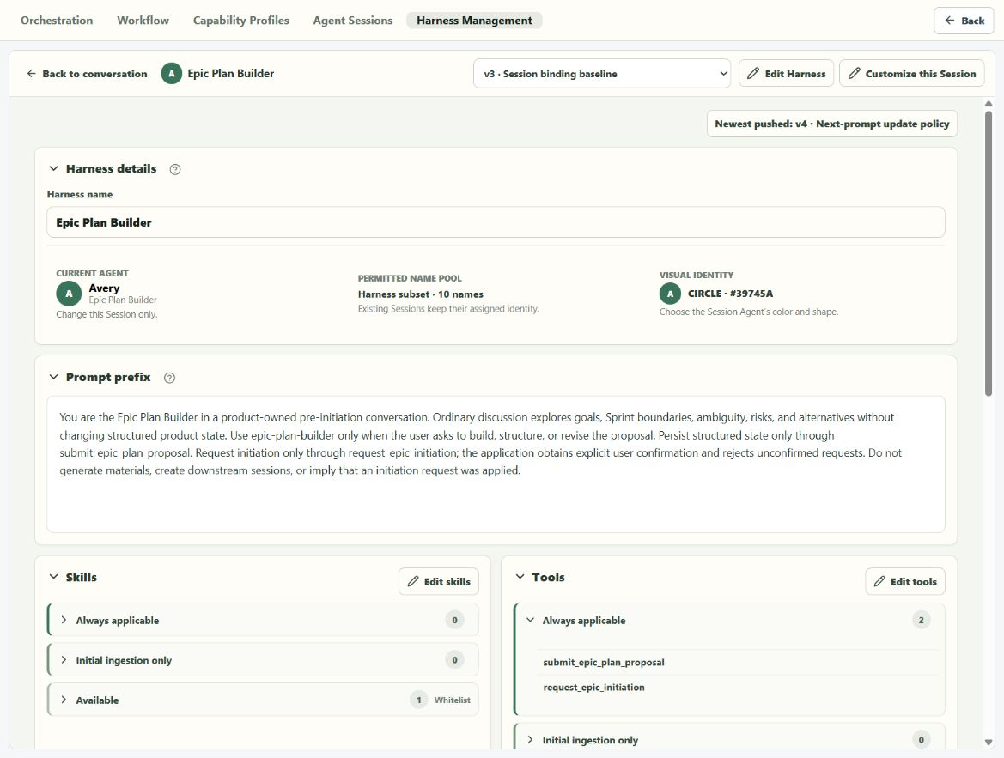
LEGACY SURFACE
20
Remaining Harness Management screen
1
Still in the product
LIVE LOCAL FIXTURE
Harness Management remains in the top navigation.
2
Old mixed object
It still groups prompt, skills, tools, model, and sandbox.
3
Not yet retired
The new screens now work beside this older screen.
Open decision: keep this only as a migration view, or remove it when the new UI is accepted.
Notes:
The merge did not remove the old Harness Management screen. It now sits beside Capability Profiles, Workflow node profiles, and Session Profiles. That overlap should be resolved in a later retirement pass.
[Sources]
- Local in-app browser capture: 16-legacy-harness-management.png
[/Sources]

