Slide 1
Citation Analysis & Gradoop
Andreas + Eric

Slide 2
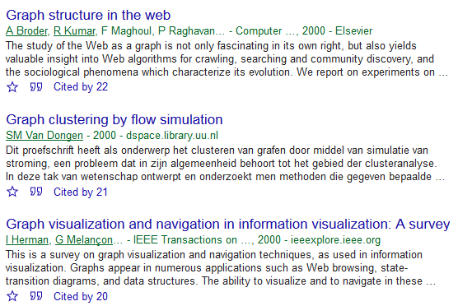
Citation Analysis
CR_A
year: 2000 #cit: 22
CR_B
year: 2000 #cit: 21
CR_C
year: 2000 #cit: 20
* As of May 2018, the three papers have been cited by 3816, 1734, and 1893 publications, respectively.

Slide 3
Temporal Graph
New publications cite other publications → Graph changes over time
2001
2002
2003
2004
CR_C
2005
CR_A
CR_B
year: 2000 #cit: 2
year: 2000 #cit: 2
year: 2000 #cit: 0
2006
1
5
12
8
20
14
18
20
22
5
8
12
16
21

Slide 4
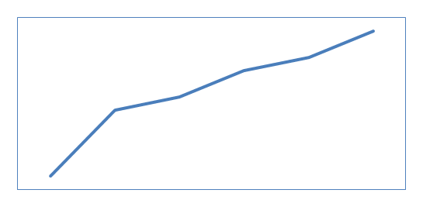
Graph Aggregation
Node aggregation by publication year; edge weight = count
2001
2002
2000
2003
2004
2005
2006

Slide 5
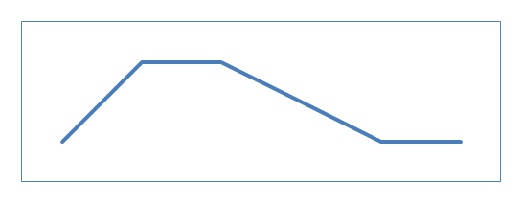
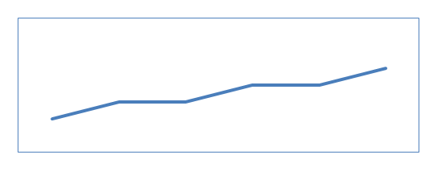
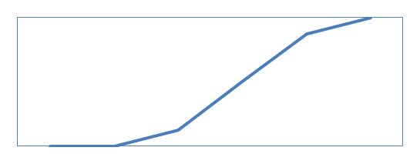
Graph Aggregation
2000
Aggregation does not fully capture inherent patterns
Example: Node Aggregation by publication year; edge weight = count
Can you spot the sleeping beauty?
CR_A
Common life cycle
2001
2002
2003
CR_B
Constant Performer
2004
2005
Sleeping Beauty
CR_C
2006

Slide 6
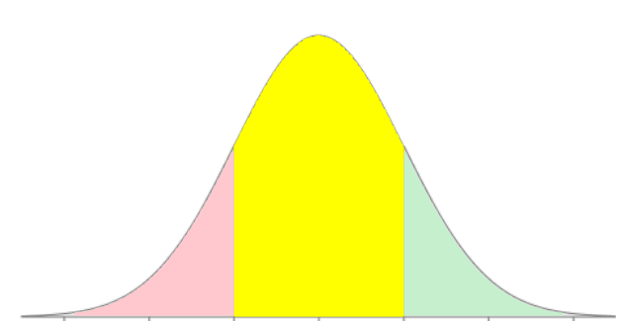


Sequence Type Computation
Observed values (number of citation per publication year)
Expected values
z-value: Standard Normal Distribution (mean=0, std.dev=1)
$$22∙\frac{9}{63}≈3.1$$
$$\frac{6−3.1}{√3.1}≈1.6$$
-3 -2 -1 0 1 2 3

Slide 7
Hierarchical Grouping
Drill-down + Roll-up in "Graph Grouping Hierarchies"
2000
2001
2002
2003
CR_A
2004
CR_B
2005
CR_C
2006

Slide 8
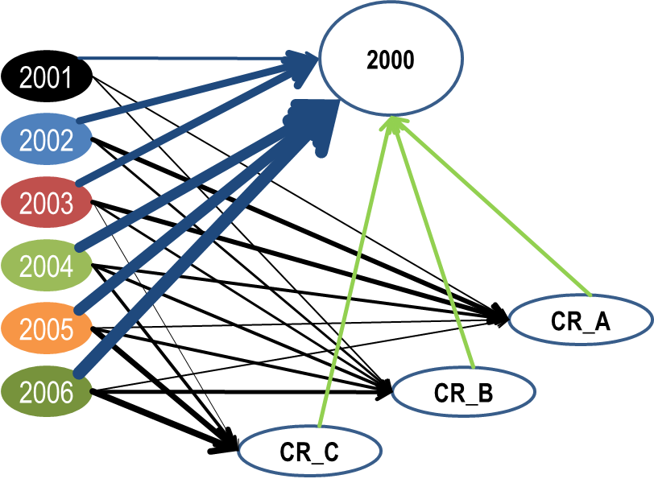
Scope
Example for scope definition for User-defined functions
2000
2000
2000
2001
2001
2001
2002
2002
2002
2003
2003
2003
2004
2004
2004
2005
CR_A
2005
2005
2006
2006
2006
CR_B
CR_C
FOREACH cr:CR
MATCH (cr:CR) <– [:cites] – (py:YEAR) (cr:CR) –> [:roll-up] – (cry:YEAR) <- [:cites] – (py2:YEAR)

