Slide 1
New analysis features of the CRExplorer for identifying influential publications
Andreas Thor ¹, Lutz Bornmann ² Werner Marx ³, Rüdiger Mutz ⁴
¹ University of Applied Sciences for Telecommunications Leipzig, thor@hft-leipzig.de
² Administrative Headquarters of the Max Planck Society, bornmann@gv.mpg.de
³ Max Planck Institute for Solid State Research, w.marx@fkf.mpg.de
⁴ ETH Zürich, mutz@gess.ethz.ch

Slide 2
CRExplorer: Overview

Slide 3





CRExplorer: Workflow
Import
Authors
RPY (Ref Pub Year)
Title, DOI, …
Publications
Extraction
Filtering
Deduplication
Cited References
Data Cleaning
Visual (RPYS)
Indicators
Cleaned
Cited References
Analysis
Graph / Annotated Cited References
Export

Slide 4
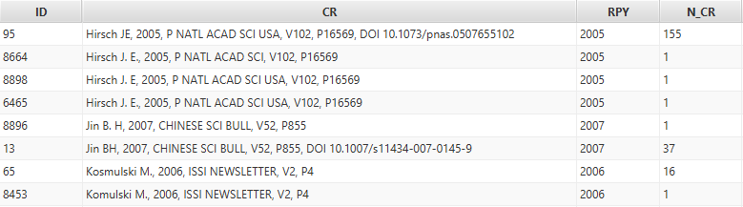

Deduplication: Clustering + Merge
Different variants of the same Cited Reference
Clustering based on string similarity
Configuration: Threshold (e.g., 80%) + use of DOI, Volume and Page Number
Merging: Cluster representative + Accumulation of N_CR

Slide 5



Sequence Types
Observed values (number of citation per publication year)
A
Common life cycle
B
Constant Performer
C
Sleeping Beauty

Slide 6
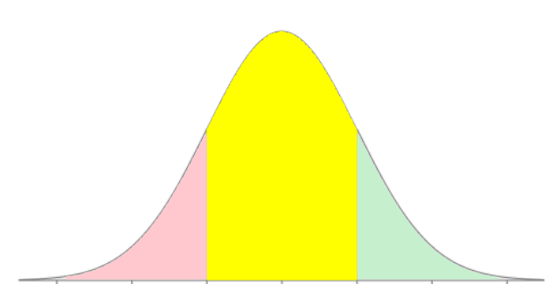


Sequence Type Computation
Observed values (number of citation per publication year)
Expected values
z-value: Standard Normal Distribution (mean=0, std.dev=1)
$$22∙\frac{9}{63}≈3.1$$
$$\frac{6−3.1}{√3.1}≈1.6$$
-3 -2 -1 0 1 2 3

