Slide 1
New analysis features of the CRExplorer for identifying influential publications
Andreas Thor ¹, Lutz Bornmann ² Werner Marx ³, Rüdiger Mutz ⁴
¹ University of Applied Sciences for Telecommunications Leipzig, thor@hft-leipzig.de
² Administrative Headquarters of the Max Planck Society, bornmann@gv.mpg.de
³ Max Planck Institute for Solid State Research, w.marx@fkf.mpg.de
⁴ ETH Zürich, mutz@gess.ethz.ch
23rd International Conference on Science and Technology Indicators (STI 2018), 12-14 September 2018, Leiden

Slide 2
CRExplorer: Overview

Slide 3





CRExplorer: Workflow
Import
Authors
RPY (Ref Pub Year)
Title, DOI, …
Publications
Extraction
Filtering
Deduplication
Cited References
Data Cleaning
Visual (RPYS)
Indicators
Cleaned
Cited References
Analysis
Graph / Annotated Cited References
Export

Slide 4
Reference Publication Year Spectroscopy (RPYS)
Method to analyze historical roots based on cited references within single research fields
RPYS is based on the analysis of the frequency with which references are cited in the publications of a specific research field in terms of the publication years of these CRs.
Origins show up in the form of more or less pronounced peaks mostly caused by individual publications that are cited particularly frequently
Historical analysis of single research fields
Select publications of interest
Analyze the references cited in them (especially the referenced publication years)
#Citations for each CR vs. #Citations for all CRs of the same Year

Slide 5
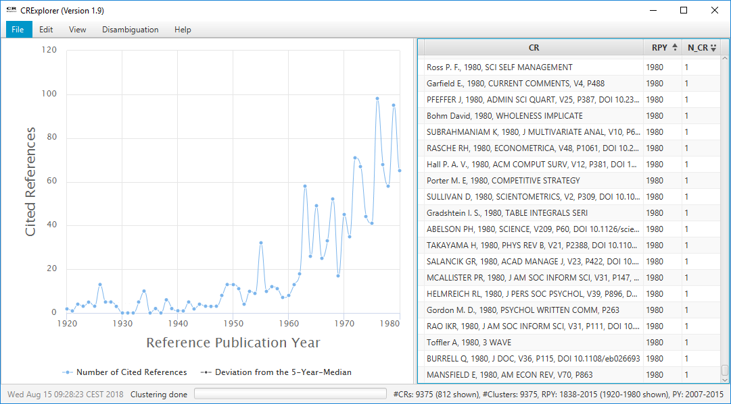
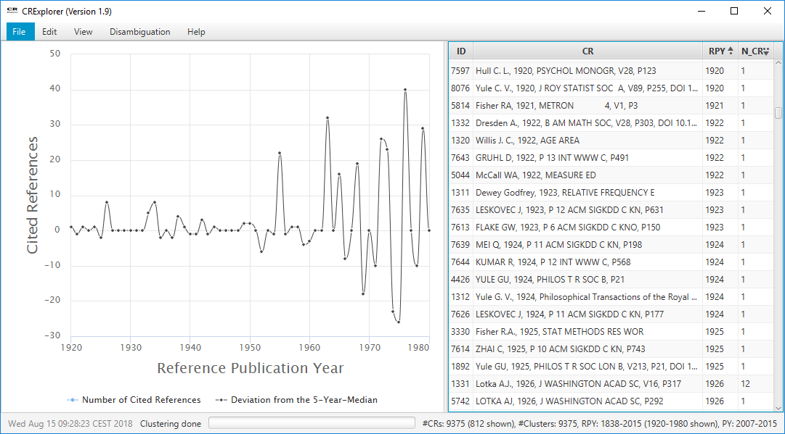
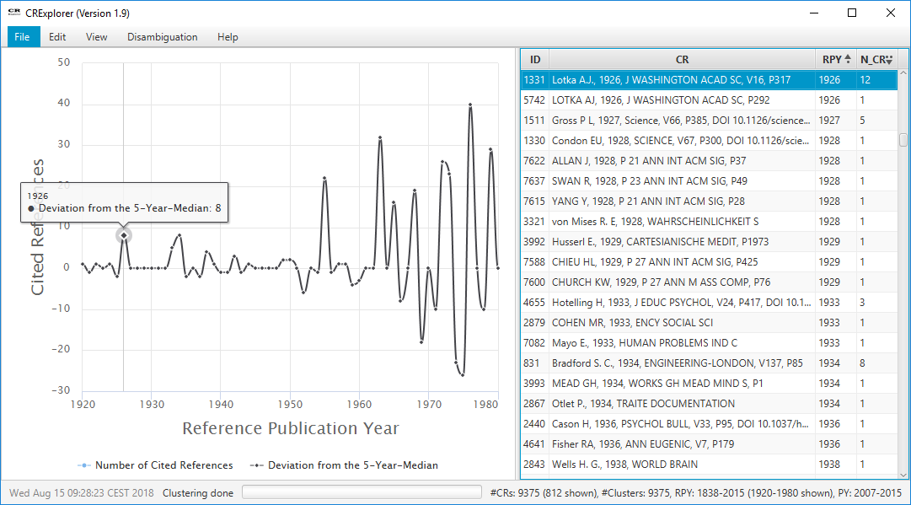
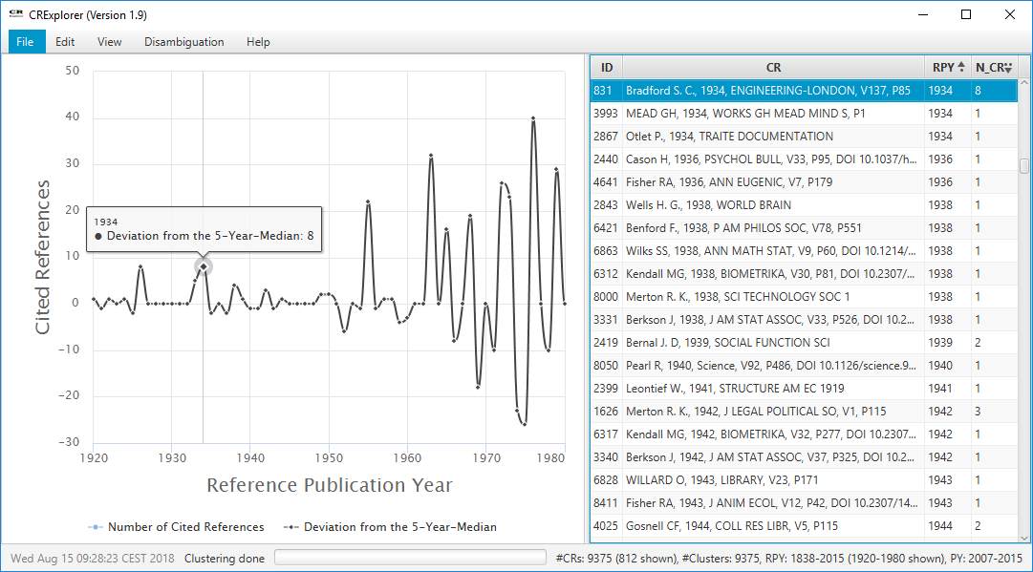
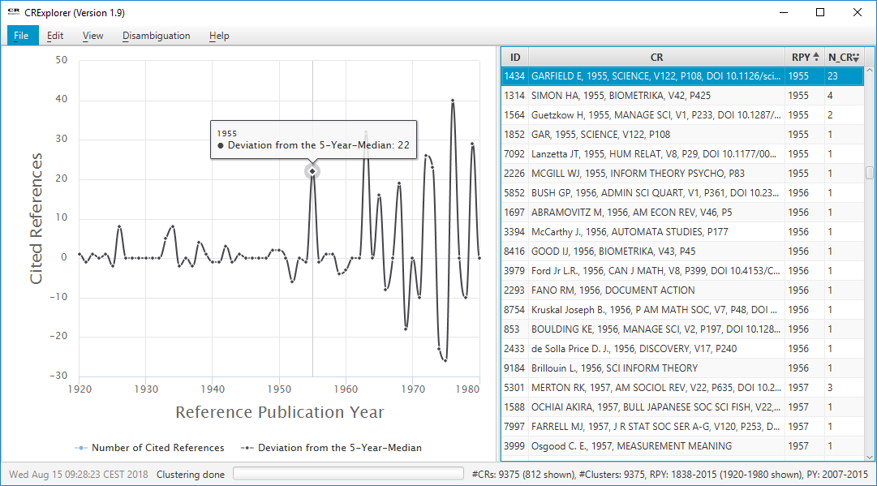
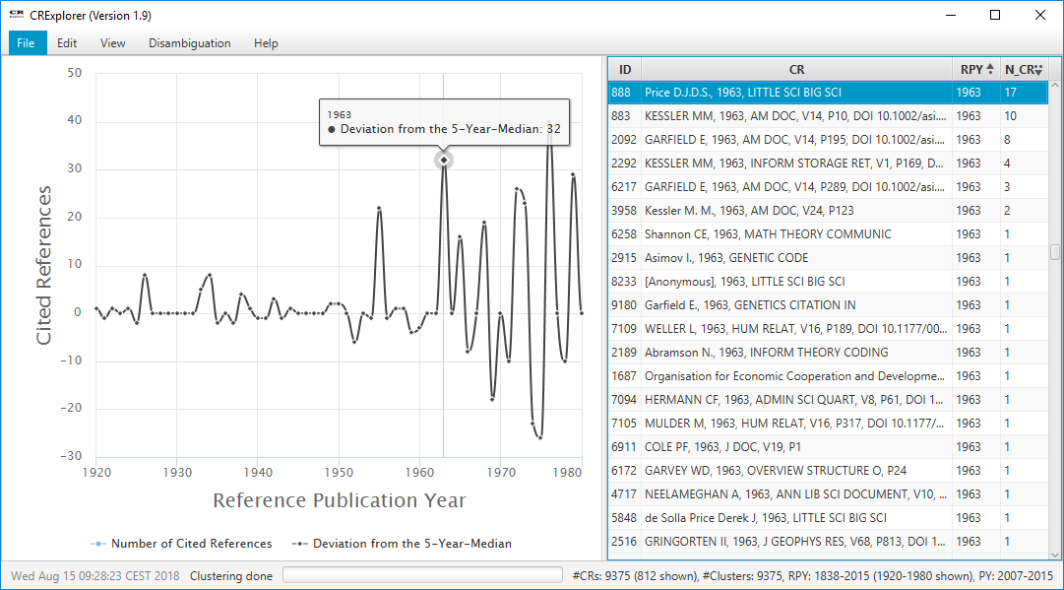
RPYS: Example
Scientometrics papers (1978-2016) → 33,812 Cited References

Slide 6
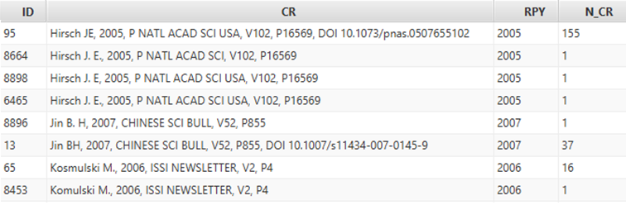
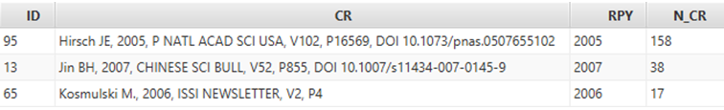
Deduplication: Clustering + Merge
Different variants of the same Cited Reference
due to typos, missing bibliographic information, different abbreviation styles, …
Clustering based on string similarity (author, title) and year
Configuration: Threshold (e.g., 80%) + use of DOI, Volume and Page Number
Merging: Cluster representative + Accumulation of N_CR

Slide 7

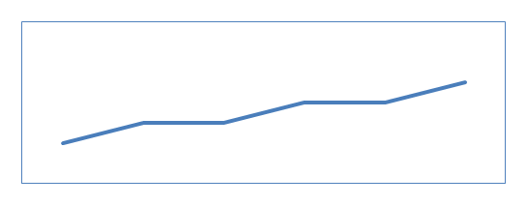
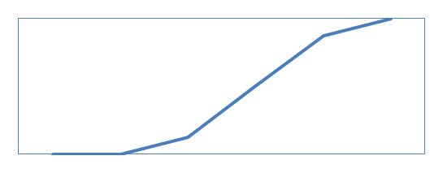
Sequence Types
Number of citations per publication year …
... induce time sequence patterns for cited references
A
Common life cycle
B
Constant Performer
C
Sleeping Beauty

Slide 8
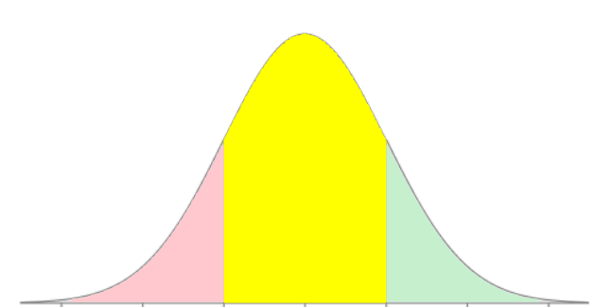


Sequence Computation
Observed values (number of citation per publication year)
Expected values
z-value: Standard Normal Distribution (mean=0, std. dev.=1)
$$22∙\frac{9}{63}≈3.1$$
$$\frac{6−3.1}{√3.1}≈1.6$$
-3 -2 -1 0 1 2 3

Slide 9
Sequence Types
Classification of z-value patterns
Common life cycle
A
Constant Performer
B
Sleeping Beauty
C

Slide 10
Indicators
Cited reference | N_CR | N_PYEARS
Lotka (1926) The frequency distribution of scientific productivity | 155 | 36
de Solla Price (1963) Little science, big science | 216 | 36
Garfield (1979) Citation indexing: its theory and application in science, technology, and humanities | 151 | 34

Slide 11
N_CR = Number of citations
N_PYEARS = Number of PY in which a CR has been cited
PERC_PYEAR = percentage of citing years in which the CR has been cited = N_PYEARS / #citing years with at least one citation to a CR in RPY
There are 36 PYs (out of 39) with at least one citation of Lotka
In 36 years
PY = {1978, …, 2016} → |PY|=39
Cited reference | N_CR | N_PYEARS | PERC_PYEAR
Lotka (1926) The frequency distribution of scientific productivity | 155 | 36 | 100%
de Solla Price (1963) Little science, big science | 216 | 36 | 94.74%
Garfield (1979) Citation indexing: its theory and application in science, technology, and humanities | 151 | 34 | 91.89%
In 38 years there is at least one publication that cites a CR with RPY=1963 (No CR cited in PY=1978)
=34/37
PY \ PY₁₉₇₉ = {1978, 1979}

