Slide 1
New analysis features of the CRExplorer for identifying influential publications
Andreas Thor ¹, Lutz Bornmann ² Werner Marx ³, Rüdiger Mutz ⁴
¹ University of Applied Sciences for Telecommunications Leipzig, thor@hft-leipzig.de
² Administrative Headquarters of the Max Planck Society, bornmann@gv.mpg.de
³ Max Planck Institute for Solid State Research, w.marx@fkf.mpg.de
⁴ ETH Zürich, mutz@gess.ethz.ch
23rd International Conference on Science and Technology Indicators (STI 2018), 12-14 September 2018, Leiden

Slide 2
CRExplorer: A Tool for Cited References Analysis
What are the most important publications in a research field? On which shoulders does the research stand?
Identify those publications in a research ﬁeld or on a speciﬁc topic …
… which have been inﬂuential over many years in the past
… were highly cited over a longer time period or at certain time points (shortly or several years after publication)
Cited References Explorer
Workflow-based Data Analysis (GUI + Script language)
Import / export data formats: Scopus, Web of Science, CrossRef, CSV
Automatic Data Extraction and Data Cleaning
Different types of analysis
Visual (Reference Publication Year Spectroscopy)
Indicator-based (Top-N, Sequence)
http://www.crexplorer.net
Run (Java Web Start) or download (JAR), Guide + Datasets, Papers (e.g., use cases)

Slide 3





Cited references analysis: Workflow
Publication set
representing a speciﬁc ﬁeld (e.g. bibliometrics) or
dealing with a speciﬁc topic (e.g. research on Aspirin)
Import
Authors
RPY (Ref Pub Year)
Title, DOI, …
Publications
Extraction
Filtering
Deduplication
Cited References
Data Cleaning
Visual (RPYS)
Indicators
Cleaned
Cited References
Analysis
Graph / Annotated Cited References
Export
Notes:
Extraction, Cleaning, Analysis will be illustrated by examples in the following slides

Slide 4

Pre-Processing
Data Extraction of bibliographic information of Cited References (Strings)
Regular Expressions (Patterns), Integrity checks
Data Filtering
by Citing Publication Year (PY)
by Reference Publication Year (RPY)
by Number of Citations (N_CR)
Data Cleaning (Deduplication)
Detecting and merging duplicates is important for high-quality data analysis
Notes:
2x Hirsch-CR aus unterschiedlichen Quellen
Vor Filterung nach N_CR am besten Deduplication

Slide 5
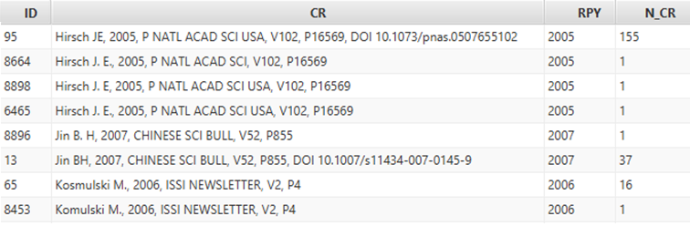
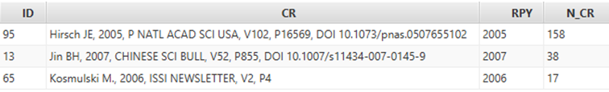
Deduplication (Disambiguation): Clustering + Merge
Different variants of the same Cited Reference
due to typos, missing bibliographic information, different abbreviation styles, …
Clustering based on string similarity (author, title) and year
Configuration: Threshold (e.g., 80%) + use of DOI, Volume and Page Number
Merging: Cluster representative + Accumulation of N_CR
Notes:
Syntactical differences
Missing information (e.g.. DOI) bei #8664
Punctuation (authors‘ initials)
Heteorgenous Journal name (USA #8664 vs. #8898)
Typos (Ko*s*mulski)
Cluster representative = Cited Reference of a cluster with the highest number of N_CR
Import + Data Cleaning = First part of worklow → Export possible
(Use CRExplorer as a data cleaning tool.)

Slide 6
Reference Publication Year Spectroscopy (RPYS)
Method to analyze historical roots based on cited references within single research fields
Analysis of the frequency with which references are cited in the publications in terms of the publication years of these CRs.
Spectrogram
Origins show up in the form of more or less pronounced peaks mostly caused by individual publications that are cited particularly frequently
Number of Cited References
Reference Publication Year (RPY)

Slide 7
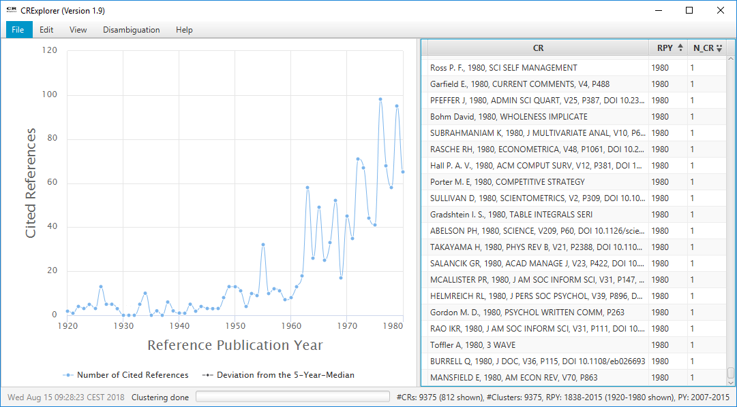
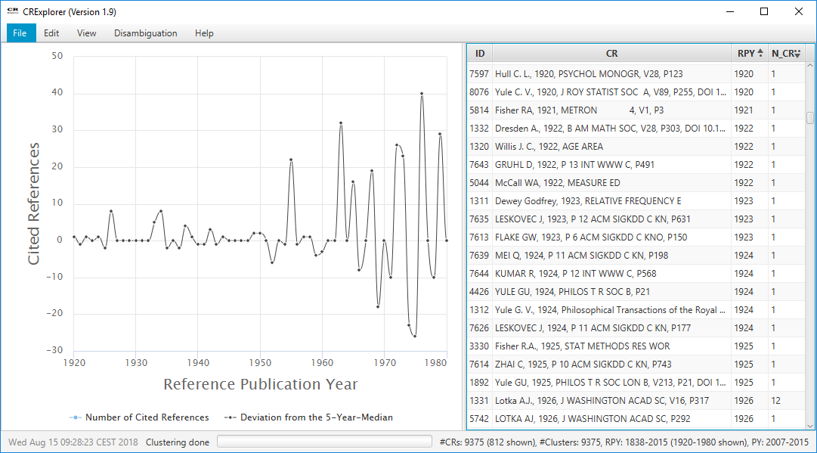
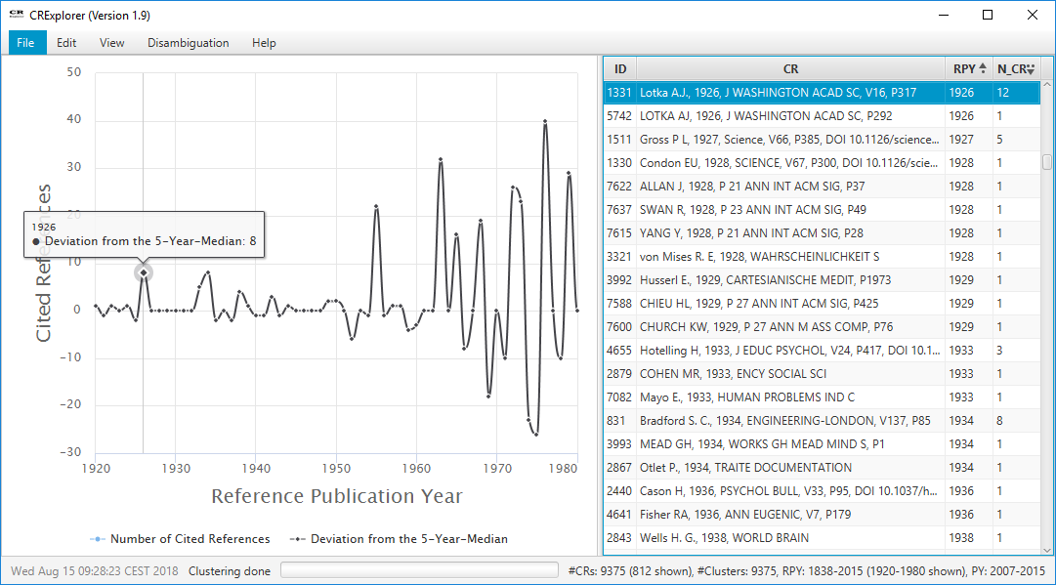
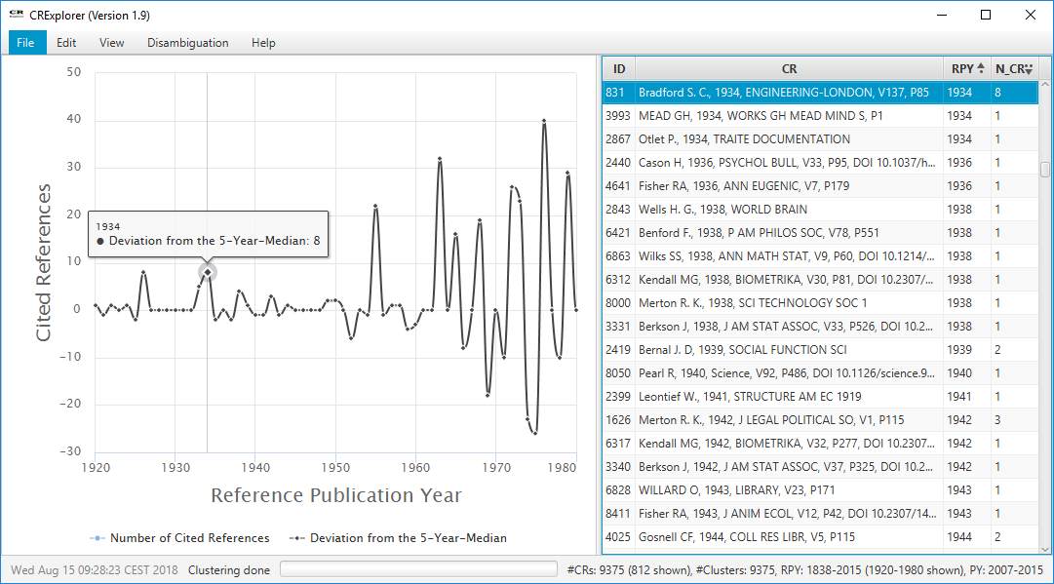
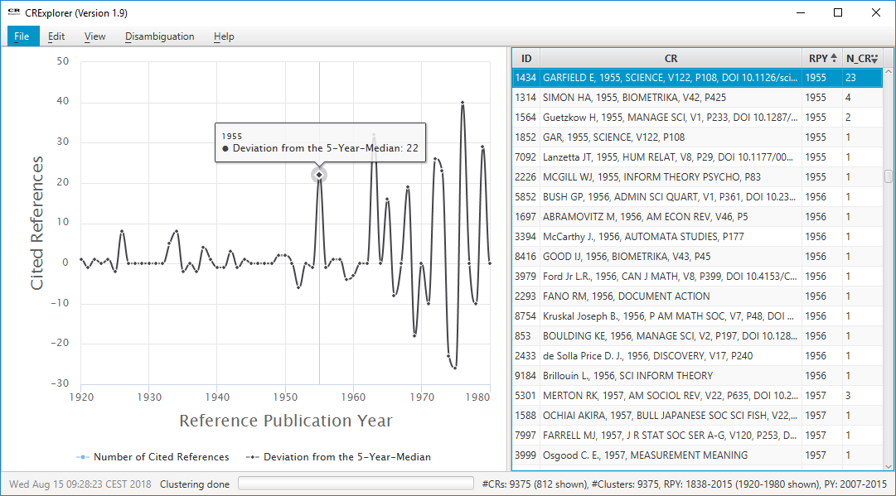
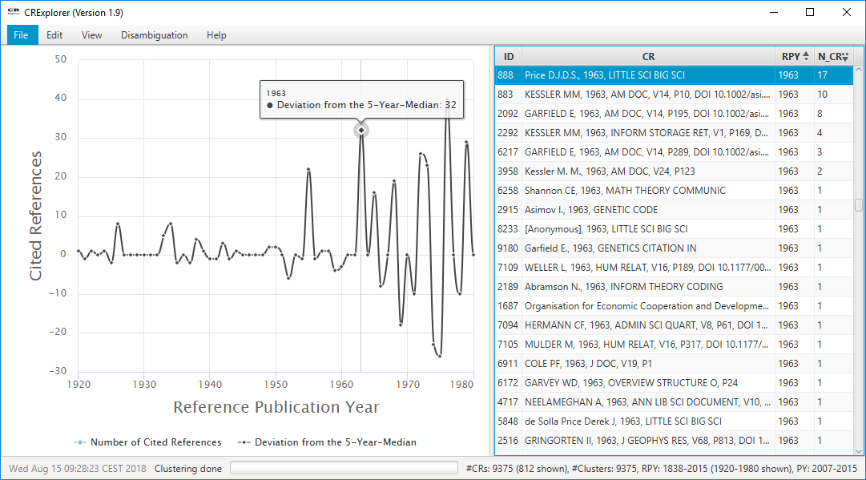
RPYS: Example
Scientometrics papers (2007-2015) → 9,375 Cited References
Notes:
Übergang zur nächsten Folie: N_CR in Tabelle … aber wie verteilt sich das?
We know that a CR has been cited X times … but how are the citations distributed across the publication years?

Slide 8

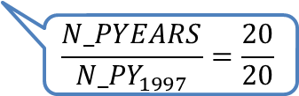
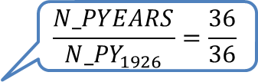

Number of Publication Years (PYs)
N_PYEARS = No. of PYs in which the CR has been cited
N_PY_{RPY} = No. of PYs in which a CR from RPY has been cited
PERC_PYEAR = N_PYEARS / N_PY_{RPY}
In how many publication years has Lotka (1926) been cited?
… has not been cited in 1978, 1979, and 1983
Scientometrics papers (1978-2016) → 39 publication years
Cited reference | N_CR | N_PYEARS | PERC_PYEAR
Lotka (1926) The frequency distribution of scientific productivity | 155 | 36 | 100%
Garfield (1979) Citation indexing: its theory and application in … | 151 | 34 | 92%
Small, H., (1973) Co-citation in the scientific literature: A new measure … | 162 | 33 | 85%
Katz, J.S., Martin, B.R., (1997) What is research collaboration? | 171 | 20 | 100%
$$\frac{N_PYEARS}{{N_PY}_{1926}}=\frac{36}{36}$$
$$\frac{N_PYEARS}{{N_PY}_{1979}}=\frac{34}{37}$$
$$\frac{N_PYEARS}{{N_PY}_{1973}}=\frac{33}{39}$$
$$\frac{N_PYEARS}{{N_PY}_{1997}}=\frac{20}{20}$$
Notes:
Übergang zur nächsten Folie
N_PYEARS is independent of other CRs
We are looking for a relative comparison w.r.t. other CRs

Slide 9
Top-N
Relative comparison of Cited References w.r.t. the Reference Publication Year (RPY) and the Publication Year (PY) of citing publications
N_TOP10 = Number of publication years in which the CR has been in the Top-10% of all CRs of the same RPY
Scientometrics papers (1978-2016) → 39 publication years
Was Lotka (1926) a higly cited paper in each citing publication year?
Cited reference | N_CR | N_PYEARS | NTOP_10
Lotka (1926) The frequency distribution of scientific productivity | 155 | 36 | 36
Garfield (1979) Citation indexing: its theory and application in … | 151 | 34 | 34
Small, H., (1973) Co-citation in the scientific literature: A new measure … | 162 | 33 | 33
Katz, J.S., Martin, B.R., (1997) What is research collaboration? | 171 | 20 | 18
If the Cited Reference has been cited in a publication year, it was in the top 10% of all cited references of its RPY.
Notes:
Top-N relative Indicator
Übergang zu nächster Folie: Time-Development

Slide 10

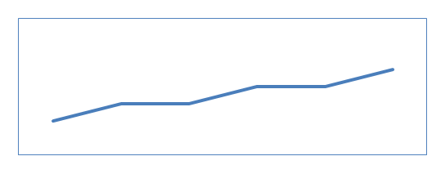
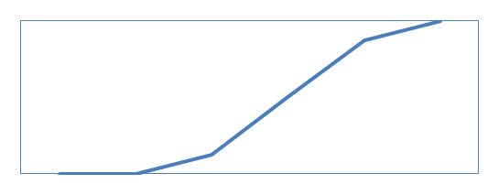
Sequence Types
SEQUENCE and TYPE: Distribution of citations over time and identification of common time-series patterns
Example: Number of citations per publication year …
... induce time sequence patterns for cited references
Is the number of cita-tions per publication year increasing or decreasing over time?
A
Common life cycle
B
Constant Performer
C
Sleeping Beauty*
* van Raan, A.F.J. Scientometrics (2004) Sleeping Beauties in science

Slide 11
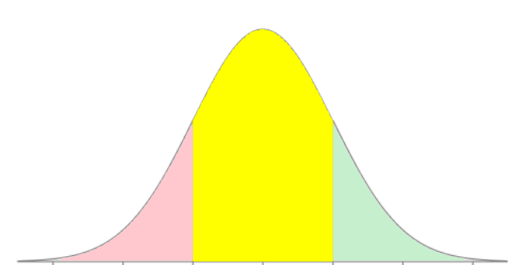


Sequence Computation
Observed values (number of citation per publication year)
Expected values
z-value: Standard Normal Distribution (mean=0, std. dev.=1)
$$22∙\frac{9}{63}≈3.1$$
$$\frac{6−3.1}{√3.1}≈1.6$$
-3 -2 -1 0 1 2 3
Notes:
Expected value = #citations if it follows the overall trend of #citations (CR = „average CR“)
What is the proportion of citations in 2002 to the total number of citations?
Multiply proportion with the overall number of citations of the CR
We see there is a difference between observed and expected value → we quantify
We perform a normalization and categorization

Slide 12
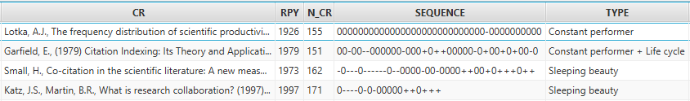
Sequence Types
Classification of Cited References based on z-value patterns
Scientometrics dataset (1978-2016)
Common life cycle
Constant Performer
Sleeping Beauty
A
B
C
Notes:
This allows us to describe the pattern as a sequence of values (-, 0, +)
CRExplorer has encoded rules that define / assign type baed on sequence pattern
Some CRs do not fall into any type
Some CRs may belong to several types (they show the characteristics of several types)

Slide 13
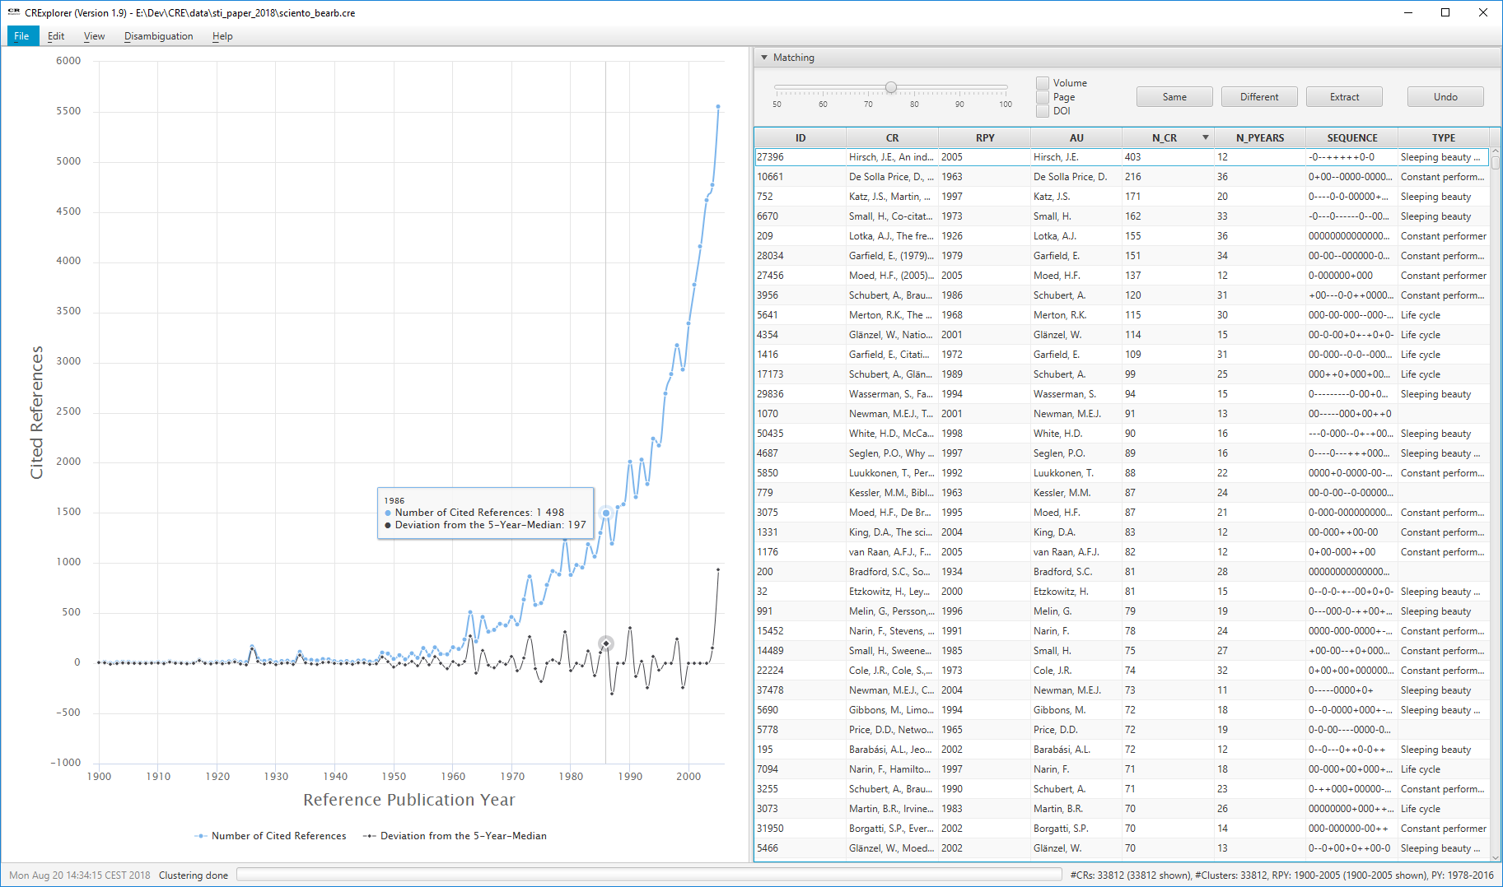

CRExplorer: User Interface
Notes:
Übergang von vorheriger:
This is how the result looks like in CRExplorer
To achieve this a user performs several steps in the workflow …

Slide 14
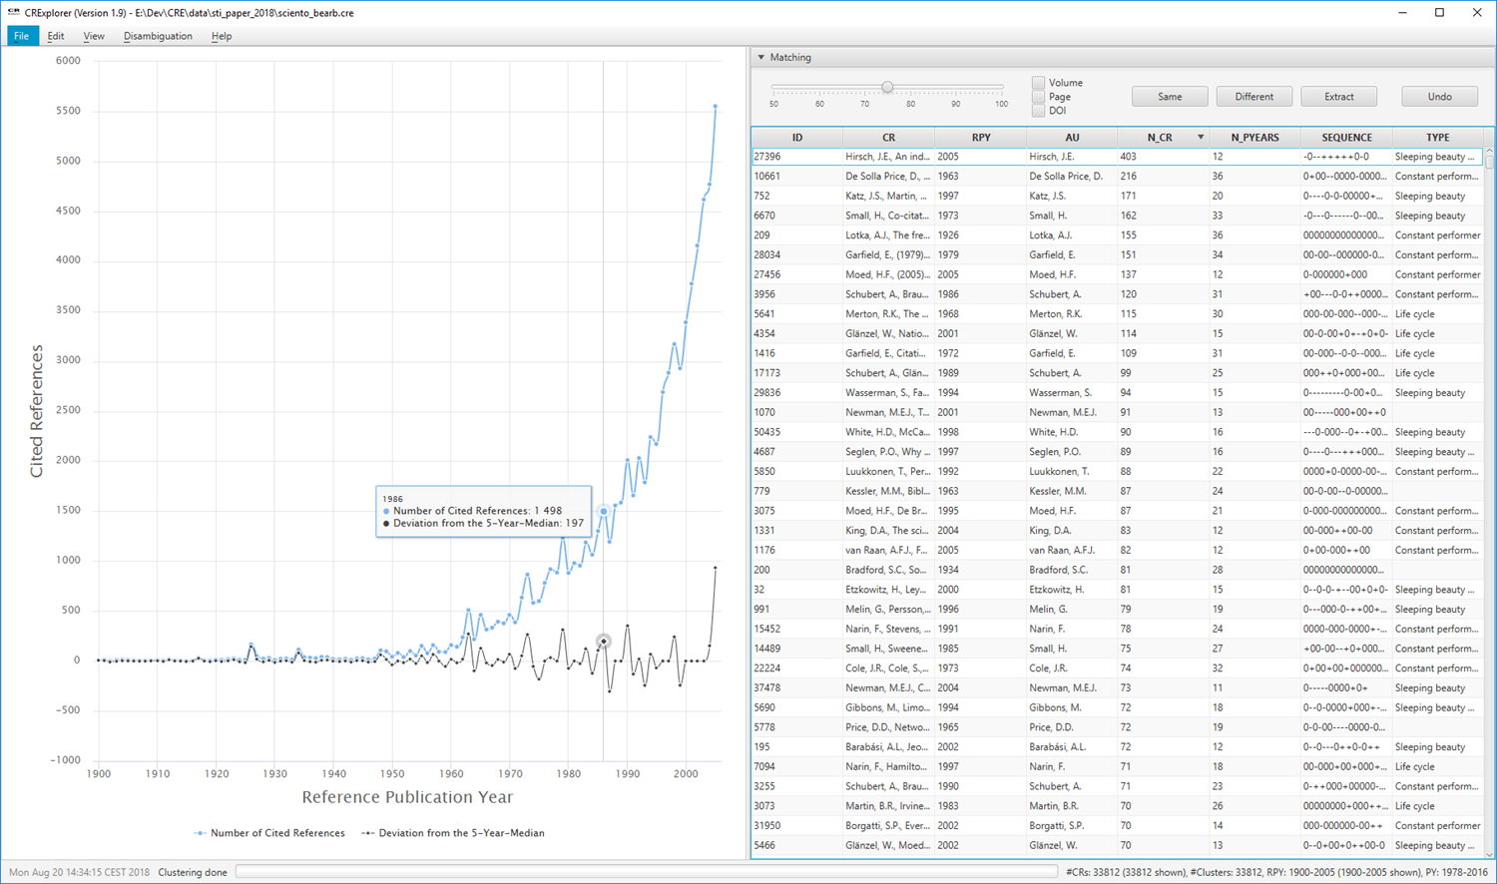
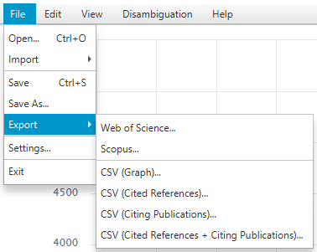
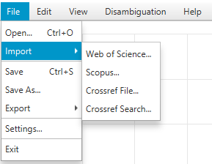
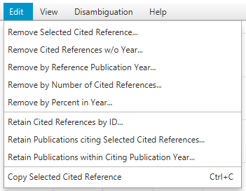

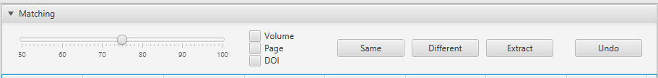
Interactive Workflow using GUI
Notes:
Übergang zu nächster:
* Instead of a sequence of clicks a user can encode the workflow definition in a script program

Slide 15
CRExplorer‘s Script Language
importFile (
dir: "E:/data/input/",
type: "WOS",
sampling: "RANDOM",
maxCR: 1000
)
cluster(
threshold: 0.8,
volume: true,
page: true,
DOI: false
)
merge ()
removeCR (RPY: [0, 1995])
exportFile (
file: "E:/data/output.csv",
type: "CSV_CR"
)
Script language for workflow automation
Reproducibility of results
Same analysis procedure for different publication sets
Processing large files

Slide 16
Summary + Future Work
CRExplorer: A Tool for Cited References Analysis
Data Extraction + Data Cleaning (Deduplication)
Reference Publication Year Spectroscopy (RPYS)
Indicators (TOP-N, Sequence)
Script-based Automation
New import / export formats
User-defined indicators
Help wanted ☺
Website: http://www.crexplorer.net
Source: https://github.com/andreas-thor/cre
Thank you!

Slide 17
Cited References Analysis
What are the most important publications in a research field?
On which shoulders does the research stand?
Identify those publications in a research ﬁeld or on a speciﬁc topic …
… which have been inﬂuential over many years in the past
… were highly cited over a longer time period or at certain time points (shortly or several years after publication)

Slide 18
Indicators
Relative comparison of Cited References w.r.t. the Reference Publication Year (RPY) and the Publication Year (PY) of citing publications
N_PYEARS and PERC_PYEAR
Absolute and relative number of PYs in which a Cited Reference has been cited
TOP-N
Number of times a Cited Reference has been in the Top-N% in the PY-wise ranking of Cited References
SEQUENCE and TYPE
Distribution of citations over time and identification of common time-series patterns
Lotka (1926) The frequency distribution of scientific productivity has been cited by 155 publications.
In how many publication years has Lotka (1926) been cited?
Was Lotka (1926) a higly cited paper in each citing publication year?
Is the number of citations per publication year increasing over time? Or decreasing? Or …

