Slide 1
Marine processing r092019_000000
TARGET DATASET:
ICOADS R3.0.0 back to 1950 + up to 2010
Period initially 1945-2014
Initially about 217 sid-dck, but PRE-SELECTED BY LIZ-DAVE
PROCESSING:
WMO Publication 47 MD enrichment
Improved duplicate identification
ID, datetime, position corrections
Enhanced QC (MetOffice QC)
Improved with supplemental data rescue where useful (063-714)

Slide 2

Marine processing software
CODE IMPLEMENTATION
Main languages: R, python3, bash
Dedicated scripts/launchers for release
RELEASE PROCESSING
Full processing in JASMIN/LOTUS
Minimum processing unit (observational data streams): monthly sid-dck files
Bash launchers: bsub job array submission per sid-deck

Slide 3
MARINE PROCESSING LEVELS
level0: is the source data set ready to be ingested in the marine processing chain. The original file format is preserved.
level1a: is the initial selection of source data mapped to the CDM including:
supplemental data
data filtering (via initial fixing of known errors in filtering fields)
data model-invalid report removal
level1b: is the data merged to the linkage and duplicate output, with file ID re-asingment (dates)
level1c: final data validation (ID, datetime) and cleaning
level1d: external MD enrichment
level1e: same as level1d, with position, parameter and tracking quality control output added.
level2: data ready to ingest in the database, with parameter and sid-dck selection.
L1a:
read + selection + CDM
L1b:
merge + reordering
L1c:
validation & cleaning
L1d:
external MD enrichment
L1e main:
marine QC
L1e merge:
add QC flags
L2:
data to CDM

Slide 4

General data flow
ICOADS
IMMA1
ICOADS
*
NOC corrections
WMO
PUB 47
background
climatology
data/MD SOURCES
extract source
md preprocess
marine QC
special SUITES
config
level1a
level1[b-e]
configuration
header
obs_*
CDM branches
observational
obs level2
configuration
header
obs_*
*_configuration
CDM tables

Slide 5
Observational branch- complete level1f!
config
level1a
extract source
ICOADS
level1b
NOC corrections
level1c
header
level1d
md pre-proccess
WMO
PUB 47
obs_*
background
climatology
NOC corrections
level1e
marine QC
ICOADS
level1f
buoy QC
level2
header
obs_*

Slide 6
Data directory
/<gws>
/data
/datasets
/<dataset>
/level0
/user_manual
/WMO_Publication_47
/release_summaries
/<release>
/<dataset>
/<sid-dck>
/NOC_corrections
/v?xYYYY
/<release>
/<dataset>
/level1a
/<version>
/<sid-dck>
/level1b
/level1c
/level1d
/level1e
/level2
/metoffice_qc
/base
/dbuoy_track
/wmo_publication_47*
/monthly
/NOC_corrections*
/v?xYYYY
* post-processed

Slide 7
Code reporsitory
/<parent_code_path>
/glamod-marine-processing
/glamod-marine-config
/cfg-suite
/cfg-suite
/<release>
/metadata-suite
/metadata-suite
/<release>
/obs-suite
/obs-suite
/<release>
/qc-suite
/qc-suite
/<release>
/user-manual
/user-manual
/<version>

Slide 8
Obs-suite:make_release_source_tree.py
/<data_path>
/<release>
/<source>
/level1a
/sid-dck
/level1d
/sid-dck
/invalid
/sid-dck
/log
/sid-dck
/excluded
/sid-dck
/quicklooks
/sid-dck
/log
/sid-dck
/quicklooks
/sid-dck
/level1e
/sid-dck
/log
/sid-dck
/level1b
/sid-dck
/quicklooks
/sid-dck
/log
/sid-dck
/reports
/sid-dck
/quicklooks
/sid-dck
/level2
/sid-dck
/level1c
/sid-dck
/log
/sid-dck
/log
/sid-dck
/excluded
/sid-dck
/quicklooks
/sid-dck
/reports
/sid-dck
/invalid
/sid-dck
/configuration

Slide 9
Obs-suite: Filenames-needs update
fileID: yyyy-mm-<release>-<update>
yyyy: data year
mm: data month
release: release name
update: update date (yyyymm) | 000000 major release

Slide 10
Obs-suite: data flow, needs update
yyyy_mm.csv
TBC
/auxiliary
/pub47
/monthly_station_list
Full transitioning through levels (remove from origin)
/sources
/IMMA1_R3.0.0T
/ICOADS_R3.0.0T
Selected transitioning through levels
/xxx
Free format/content
yyyy_mm.xx
/rxx
/dataset
/level0
/dck-sid
yyyy_mm_rxx_<>.psv
/level1a
/dck-sid
/invalid
yyyy_mm_rxx_<>_.psv
/dck-sid
/excluded
yyyy_mm_rxx_<>.psv
/level1b|c|d
/dck-sid
yyyy_mm_rxx_<>.psv
/level2
/dck-sid
/configuration_tables

Slide 11
Obs-suite: L1a. io-needs update
/<release>/<source>
/level0
/<sid-dck>
yyyy_mm.xx
/level1a
/<sid-dck>
<table>-fileID.psv
/excluded
/<sid-dck>
fileID_<ef>.psv
/invalid
fileID_data.psv
py script: L1a_main.py
Input file
/<sid-dck>
job launcher:
L1a_launcher.sh
L1a_main_job.sh
bsub_array_output_hdlr.sh
Output file
fileID_mask.psv
/quicklooks
fileID.json
/<sid-dck>
fileID: yyyy-mm-release-update
fileID.nc
L1a_main.py
/log
fileID_main.log
/<sid-dck>
fileID_main.ok|error
L1a_launcher.sh|L1a_main_job.sh | bsub_array_output_hdlr.sh

Slide 12
Obs-suite: L1a. main flow- needs update
1
read
2
select target data
3
clean data
4
map to CDM
5
out to file
yyyy_mm.xx
modules.mdf_reader
data ingestion & validation
modules.metmetpy
fix filter fields
main
clean data
modules.cdm
map data
modules.cdm
write table files
main
filter data
header
mask₀
data₀^{d}
data₁^{d}
mask₁
data₂^{d}
data^{CDM}
obs_*
merge into reader?

Slide 13
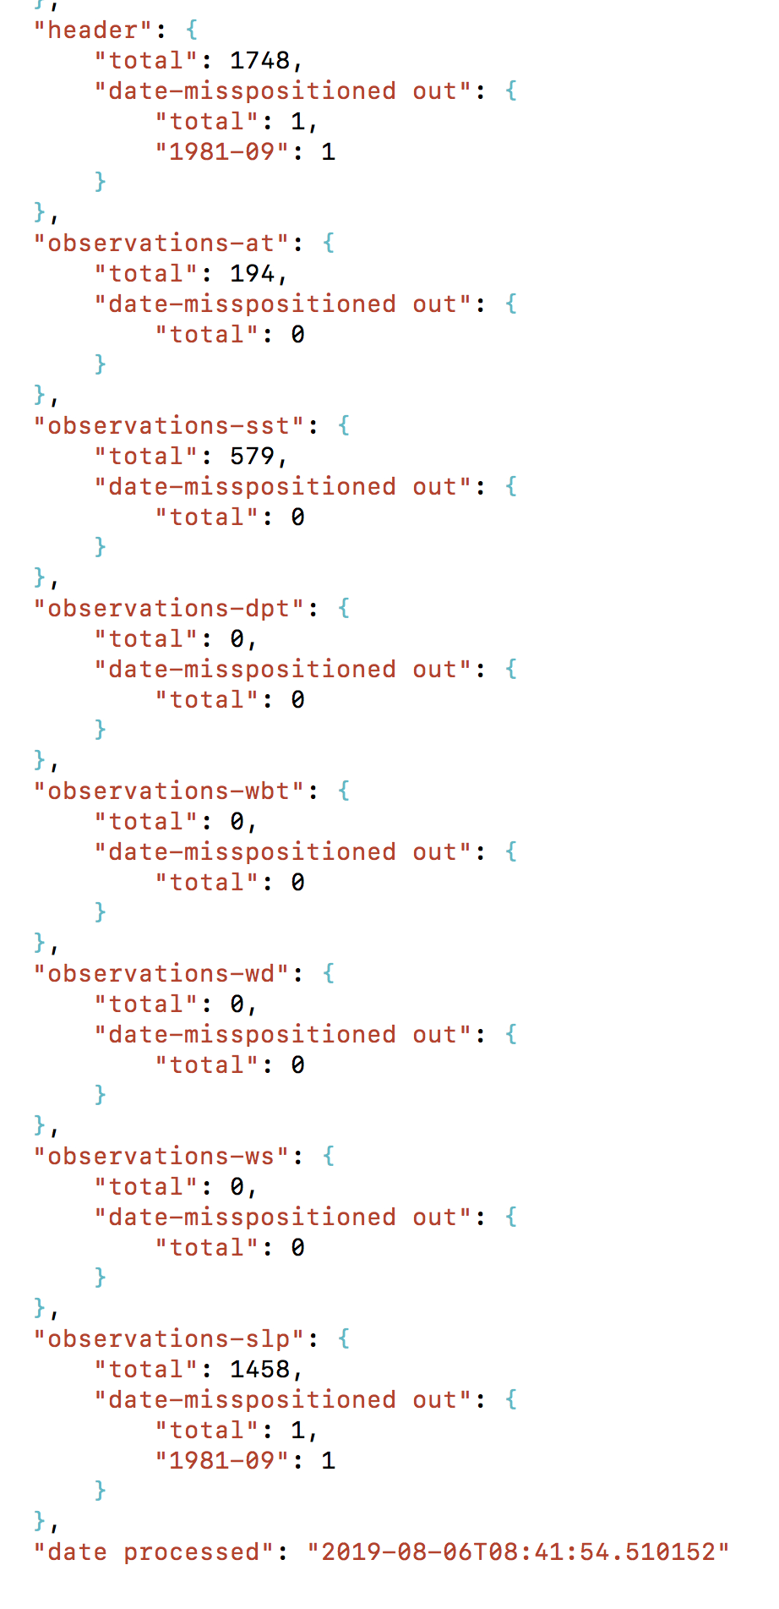
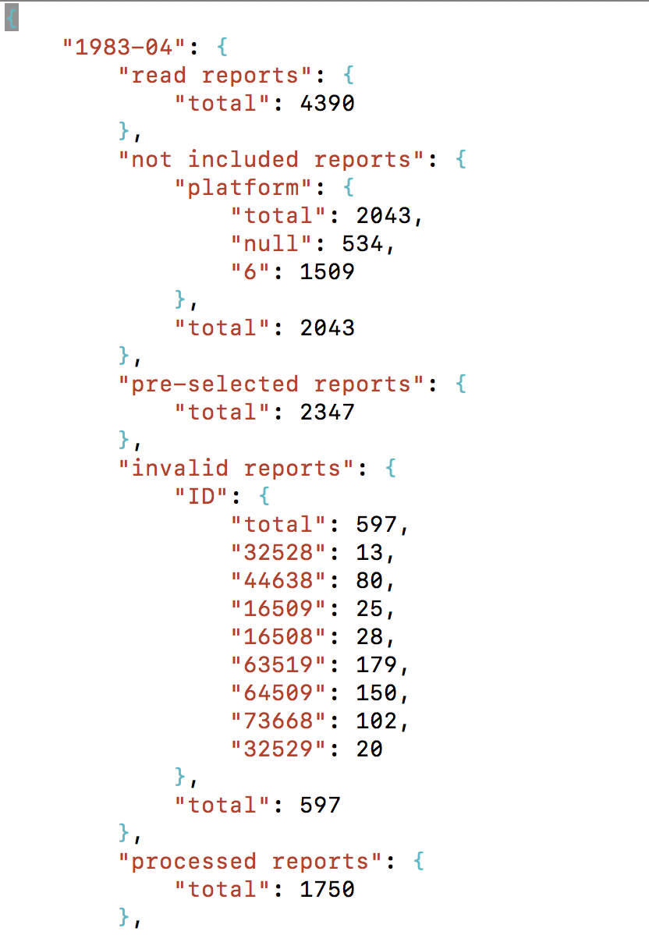
Obs-suite: L1a. io tracking- needs update
/<release>/<source>
/level1a
/quicklooks
/<sid-dck>
fileID.json

Slide 14
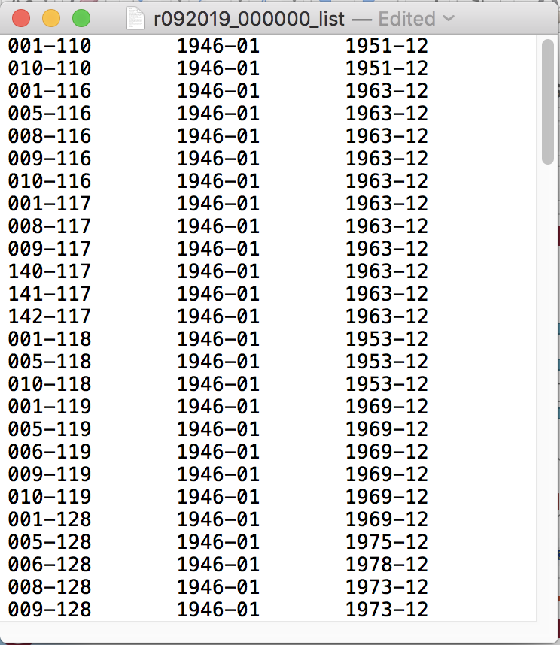
Obs-suite: Configuration. Needs update
config_file_path = /gws/nopw/j04/c3s311a_lot2/code/marine_code/<release> /configuration_files
Release list: <config_file_path>/r092019_000000_list.txt ( deck_list_1946_onwards edited)
Input to job launchers
Used in release status notebook
Would have to be split & tagged by sources if these where different:
r092019_000000_IMMA1_R3.0.0T | icoads_R3000T
r092019_000000_icoads_r3100….
merge into reader?

Slide 15
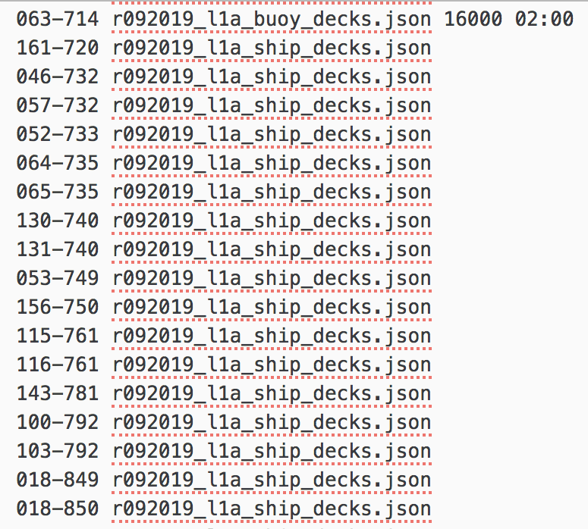
Obs-suite: L1a configuration. Update
sid-dck_{i}
yyyy-mm_{k}
L1a_main_job.sh
*_l1a_*.json
L1a_main.py
L1a_launcher.sh
*_l1a_jobs.txt
sid-dck_{i}
L1a_regroup_job.sh
L1a_regroup.py
r092019_l1a_jobs.txt
*_list.txt
What needs to be configured on a sid-dck basis: only L1a_main related configuration, monthly regrouping needs no specific parameterization
memo and time allocation for L1a_main.py job (if other than default required for sid-dck)
L1a_main.py configuration file
This is configured in file <config_file_path>/r092019_l1a_jobs.txt, that is parser by L1a_launcher to configure L1a_main jobs.
merge into reader?

Slide 16
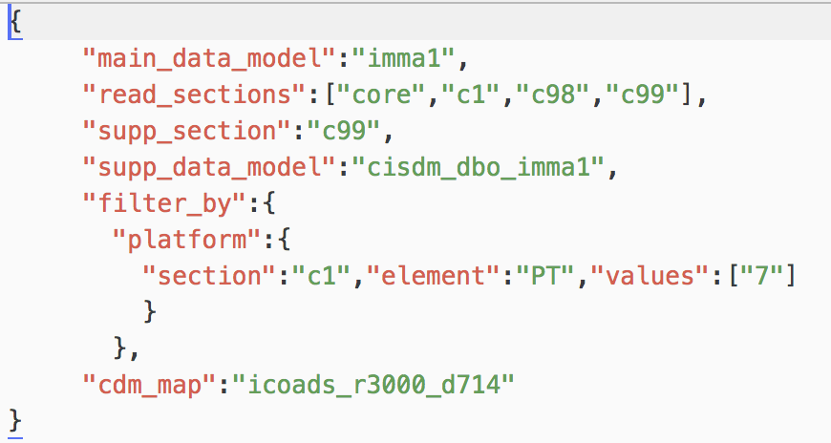
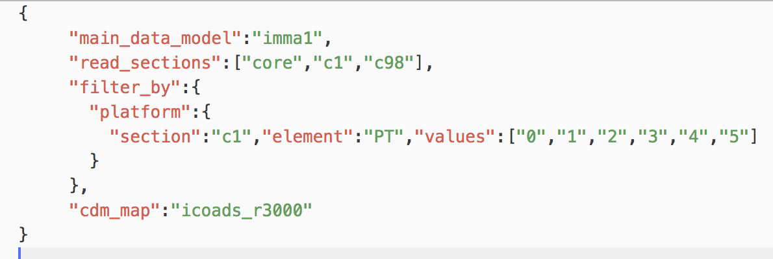
Obs-suite: L1a configuration-needs update
What needs to be configured: <config_file_path>/r092019_l1a_*.json
To read source data (mdf_reader tool)
main_data_model: name of data model in reader tool
read_sections: sections to read from data model
supp_section: name of supp section as in list read_sections
supp_data_model: name of supp data model in reader tool
To select data
filter_by: field(s) in data model and value(s) to select
To map to CDM (cdm tool):
cdm_map: name of mapping used by the cdm tool
r092019_l1a_buoy_decks.json
r092019_l1a_ship_decks.json
merge into reader?

Slide 17
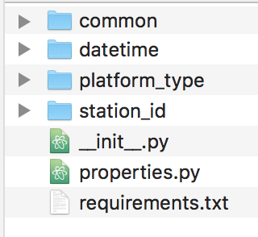
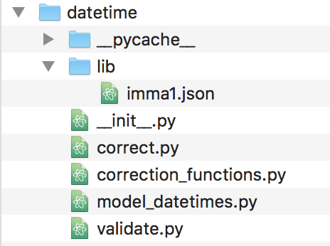
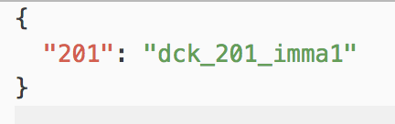
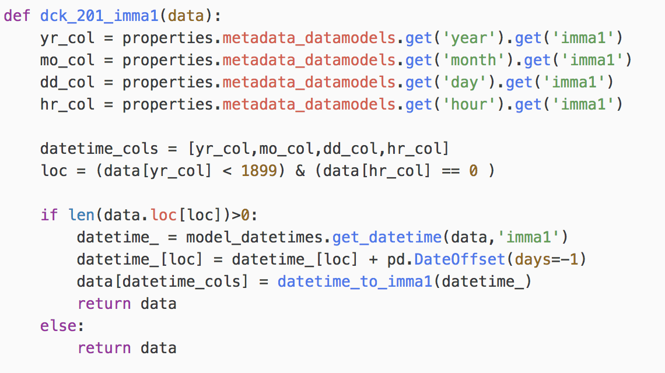
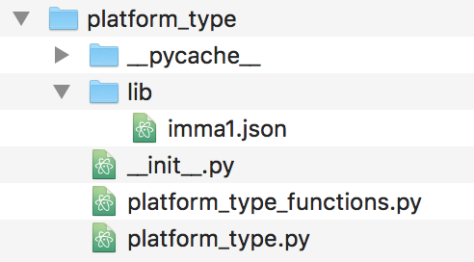
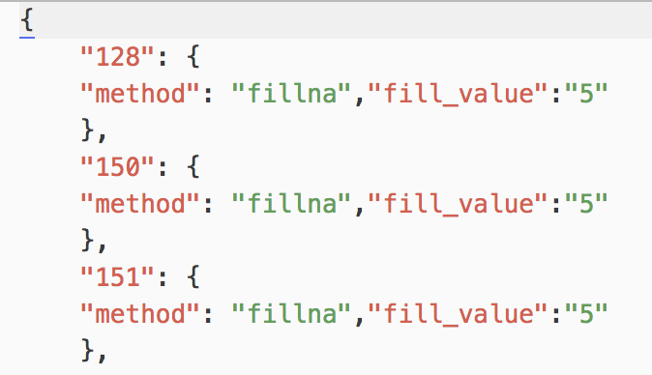
Obs-suite: metmetpy Needs update
Python module to:
validate: creates a new boolean series from input data
correct: modifies a data field(…) from input data
on a data field / data format / dck basis
data = datetime.correct(data,data_model,deck,log_level= 'INFO')
data = platform.correct(data,data_model,deck,log_level= 'INFO')

Slide 18
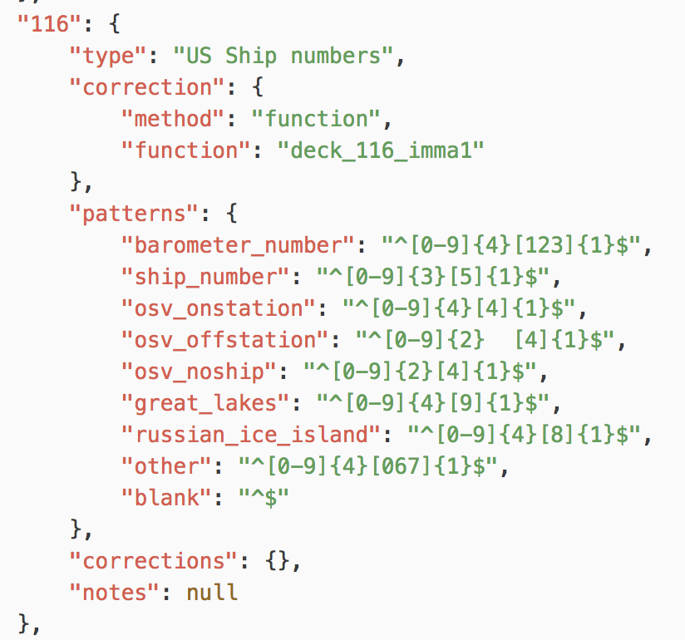
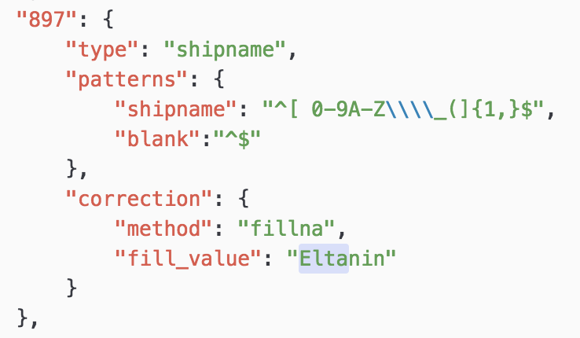
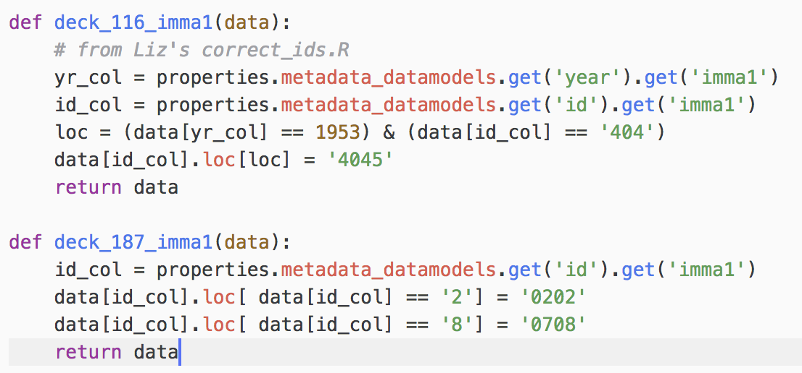
Obs-suite:metmetpy:IDs! Needs update
metmetpy.station_id:
validates: against regex patterns in lib/data_model.json (NaN = True if “^$”)
corrects: corrects IDs according to correction in lib/data_model.json
decks 110-196, plus ship name decks and my 3 test decks
What is corrections and what added value info?
How do we validate and reformat shipnames?
Finally we first correct and afterwards validate. But we still be correcting some of the cases of Liz’s codes here: Eltanin and callsigns: everything that makes them callsigns….
And what Dave suggested in 254 and new suggestions….

Slide 19
Obs-suite: L1b main flow. Needs update
linkage and duplicate flagging
/L0a/*/
yyyy-mm.imma
L1b_main
*.r
/L1b/linkage/origin_<release>_<update>/*/
yyyy_mm.txt
L1b_main_ingest.sh
L1b_merge.py
/L1a/*/
*-yyyy_mm.psv
/L1b/linkage/correction_<release>_<update>
yyyy_mm.txt
/L1b/*/
*-yyyy_mm.psv
merge into reader?

Slide 20
Obs-suite: L1c. Needs update
L1c_main.py
/L1b/*/
*-yyyy_mm.psv
/L1b/linkage/correction_<release>_<update>
yyyy_mm.txt
/L1c/*/
*-yyyy_mm.psv

Slide 21
Notes on git versioninig
See https://git-scm.com/book/en/v2/Git-Basics-Tagging
GIT AND VERSIONS/TAGS:
create repo marine_processing
Add a test file
clone to computer:
cd /Users/iregon/dessaps
git clone git@git.noc.ac.uk:iregon/marine_processing.git
cd marine_processing
Create a version:
git tag -a v0.0 -m "Initial version”
Do a change and create another version
git add ini_file.txt
git commit -m 'New line added’
git tag -a v0.1 -m 'New version’
To change between versions:
git checkout vX.x
Push versions to remote
git push origin v0.0
git push origin v0.1
Clone tags
git clone git@git.noc.ac.uk:iregon/marine_processing.git --branch vX.x --single-branch
will clone to marine_processing
git clone git@git.noc.ac.uk:iregon/marine_processing.git --branch vX.x --single-branch release_sw
will clone to ./release_sw
code_path: /gws/nopw/j04/c3s311a_lot2/code/marine_code
release_sw: any name you decide to give it. I.E. r092019
/<code_path>
/<release_sw>
/obs-suite
/config-suite
/extract
/linkage
/pub47
/MO_QC
/MO_Tracking_QC
data release | remote_repository url | version
r092019 | https://github.com/glamod/marine_processing.git | v0
r092019_01012020 |  | v0
r092019_01032020 |  | v1
r092020 |  | v1

Slide 22
Obs-suite: dashboard db. Needs udpate
dashboard.db
/<source_release>
/dashboard
/config
create_dashboard_db_main.py

Slide 23
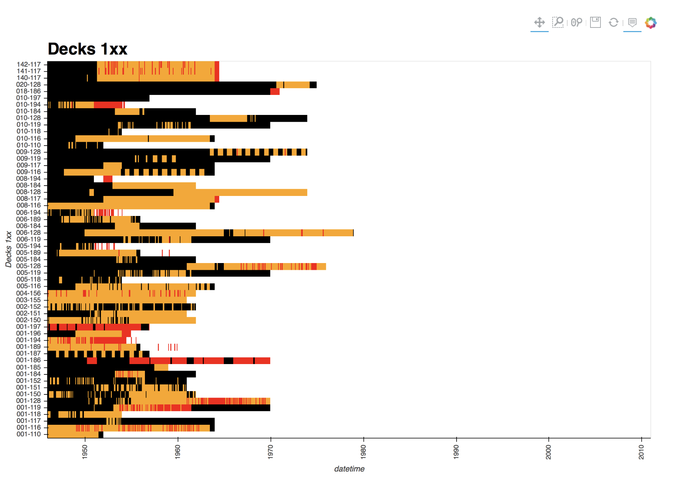
Obs-suite: Release status dashboard
Runs from Jasmin to the local browser follow up processing status and main output with interactive graphs
Overall status: last processing level reached on a sid-dck | yyyy-mm file basis

Slide 24
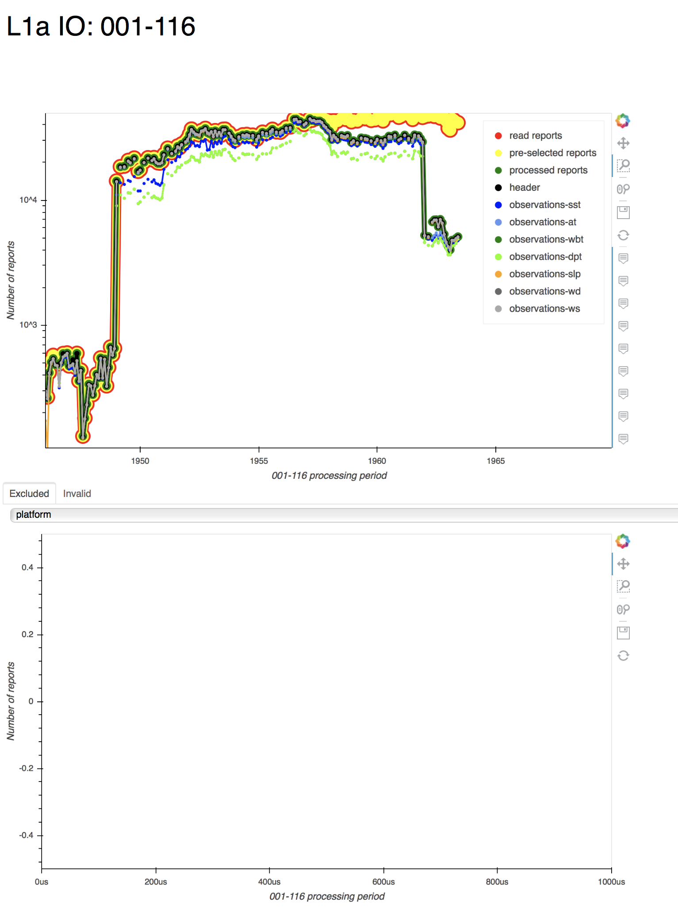
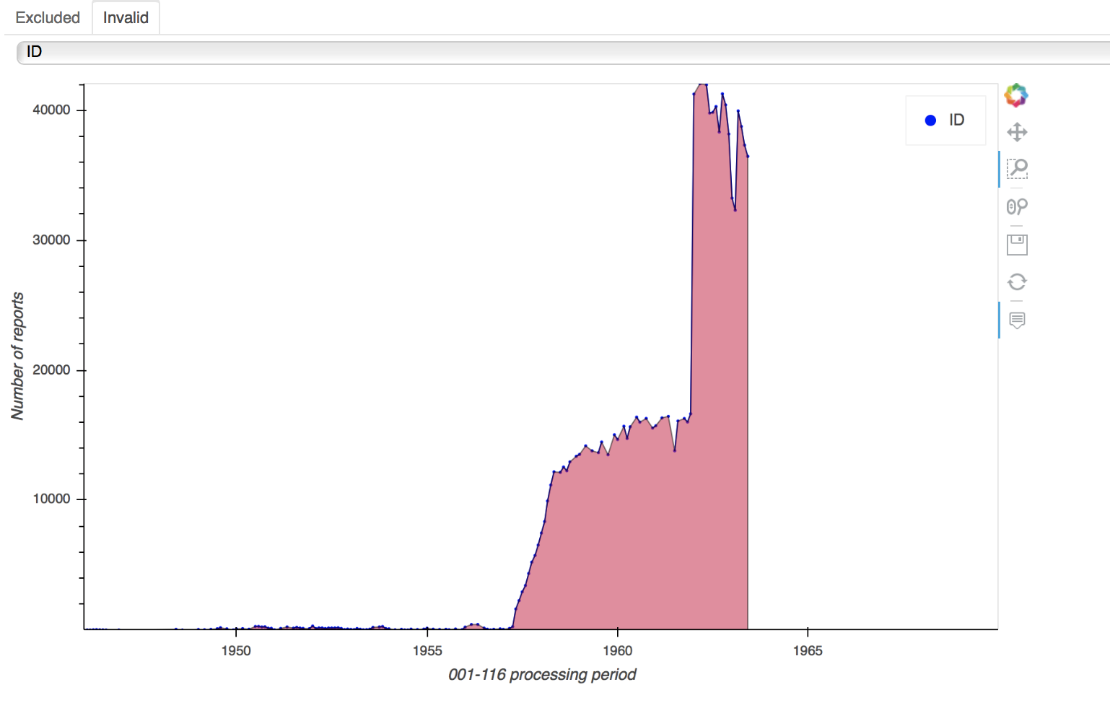
Obs-suite: Release status dashboard
sid-dck levelxx status: feeds on the levelxx quicklook files (.json, .nc)
Add same but with percent of observations-* with respect to header table reports

Slide 25
THOUGHTS FOR FUTURE
Releases management
report_release_id | report_update_id | obs_release_id | obs_update_id | report_id | observation_id
… |  |  |  |  | ….
… |  |  |  |  | ….
“LATEST” TABLES
A ‘version’ field in CDM was agreed after this
header
observations-*
report_id | ….
 | ….
 | ….
report_id | observation_id | ….
 |  | ….
 |  | ….
“HISTORY” TABLES
header
observations-*
report_release_id | report_update_id | report_id | ….
 |  |  | ….
 |  |  | ….
report_release_id | report_update_id | obs_release_id | obs_update_id | report_id | observation_id
 |  |  |  | ….
 |  |  |  | ….

Slide 26
SW configuration
/glamod-marine-processing
/metadata-suite
/obs-suite
/configuration_files
/<release>_<update>
/<dataset>
/qc-suite
/scripts
….
/modules
/reports
/pyenvs
/dashboard

Slide 27
Generic process launcher (ARRAY) - old
fileID: yyyy-mm-<release>-<update>
process_array_launcher.sh release update dataset process_config_file source-deck-list | -f 0/1 –r 0/1 –s yyyy –e yyyy
process_array.py /scratch-nompiio/<user_id>/<release>/<dataset>/<update>/<process>/<sid-dck> ($LSB_JOBINDEX)
-f process only failed: 0 (true) | 1 (false)
defaults to 1
<py script> data_path release update dataset sid-dck yyyy mm process_config_file
-r remove source level data: 0 (true) | 1 (false)
defaults to 1. Disabled for level0 data removing
/<dataset>
-s start processing year
/levelxx
/<sid-dck>
<table>-fileID.psv
-e end processing year
/quicklooks
/scratch-nompiio/<user_id>/
<release>/<dataset>/
<process>/<sid-dck>
/<sid-dck>
fileID.json
process_array_output_hdlr.py
/scratch-nompiio/<user_id>/<release>/<dataset>/<update>/<process>/<sid-dck> status rm_input ($LSB_JOBINDEX)
/log
<BSUB_idx>.input|o
/<sid-dck>
fileID.ok|failed
<BSUB_idx>.ho
remove_level_data.sh sid_dck release update dataset source_level
clean.o
/source_level
/<sid-dck>
*

Slide 28
Generic process launcher - new(ARRAY)
fileID: yyyy-mm-<release>-<update>
process_array_launcher.sh process_config_file source-deck-periods process-list | -f 0/1 –r 0/1 –s yyyy –e yyyy
<py script> process_config_file_$LSB_JOBINDEX
-f process only failed: 0 (true) | 1 (false)
defaults to 1
/<dataset>
-r remove source level data: 0 (true) | 1 (false)
defaults to 1. Disabled for level0 data removing
/levelxx
/<sid-dck>
<table>-fileID.psv
-s start processing year
/quicklooks
-e end processing year
/<sid-dck>
fileID.json
/scratch-nompiio/<user_id>/
<release>/<dataset>/
<process>/<sid-dck>
process_array_output_hdlr.py process_config_file _$LSB_JOBINDEX status rm_input
/log
/<sid-dck>
fileID.ok|failed
<BSUB_idx>.input|o
remove_level_data.sh sid_dck release update dataset source_level
<BSUB_idx>.ho
/source_level
/<sid-dck>
*
clean.o

Slide 29
level1a process launcher (ARRAY)
fileID: yyyy-mm-<release>-<update>
process_array_launcher.sh level1a_config_file source-deck-periods process-list | -f 0/1 –s yyyy –e yyyy
-f process only failed: 0 (true) | 1 (false)
defaults to 1
level1a.py level1a_config_file_$LSB_JOBINDEX
-s start processing year
/<dataset>
-e end processing year
/level1a
/<sid-dck>
<table>-fileID.psv
/quicklooks
/<sid-dck>
fileID.json
/invalid
/scratch-nompiio/<user_id>/
<release>/<dataset>/
<process>/<sid-dck>
/<sid-dck>
fileID-[data|mask].psv
/excluded
/<sid-dck>
fileID-<element>.psv
<BSUB_idx>.input|o
process_array_output_hdlr.py level1a_config_file _$LSB_JOBINDEX status rm_input
<BSUB_idx>.ho
/log
/<sid-dck>
fileID.ok|failed

Slide 30
level1b process launcher (ARRAY)
fileID: yyyy-mm-<release>-<update>
process_array_launcher.sh level1b_config_file source-deck-periods process-list | -f 0/1 –s yyyy –e yyyy
-f process only failed: 0 (true) | 1 (false)
defaults to 1
level1b.py level1b_config_file_$LSB_JOBINDEX
-s start processing year
/<dataset>
-e end processing year
/level1b
/<sid-dck>
<table>-fileID.psv
fileID_leak: yyyc-mc-<release>-<update>-yyyy-mm
<table>-fileID_leak.psv
/quicklooks
/<sid-dck>
fileID.json
/scratch-nompiio/<user_id>/
<release>/<dataset>/
<process>/<sid-dck>
process_array_output_hdlr.py level1b_config_file _$LSB_JOBINDEX status rm_input
/log
/<sid-dck>
fileID.ok|failed
<BSUB_idx>.input|o
<BSUB_idx>.ho

Slide 31
level1b process launcher (ARRAY)
fileID: yyyy-mm-<release>-<update>
process_array_launcher.sh release update dataset /level1b.json source-deck-list | -f 0/1 –s yyyy –e yyyy
process_array.py /scratch-nompiio/<user_id>/<release>/<dataset>/<update>/<process>/<sid-dck> ($LSB_JOBINDEX)
-f process only failed: 0 (true) | 1 (false)
defaults to 1
-s start processing year
level1c.py data_path release update dataset sid-dck yyyy mm /level1a.json
-e end processing year
/<dataset>
/level1b
/<sid-dck>
<table>-fileID.psv
/quicklooks
/<sid-dck>
fileID.json
/scratch-nompiio/<user_id>/
<release>/<dataset>/
<process>/<sid-dck>
/invalid
/<sid-dck>
header-fileID-<element>.psv
process_array_output_hdlr.py
/scratch-nompiio/<user_id>/<release>/<dataset>/<update>/<process>/<sid-dck> status rm_input ($LSB_JOBINDEX)
<BSUB_idx>.input|o
/log
<BSUB_idx>.ho
/<sid-dck>
fileID.ok|failed
clean.o

Slide 32
Generic process launcher (ARRAY)
fileID: yyyy-mm-<release>-<update>
process_config_file main_script loggers
<process>: process_config_file basename
main_script: “main_script” field process_config_file
loggers: tagged in data_level with <process>

Slide 33
Generic process launcher (ARRAY)
Required settings for array launcher in process_config_file
Default job settings (example): under “job”
"job":
{
"data_level": "level1a",
"source_level": "level0",
"source_file_ext":"imma",
"source_filename_prefix":"",
"source_filename_suffix":"",
"environment": "0",
"job_memo_mb": 4000,
"job_time_hr": "01",
"job_time_min": "30",
"script_name":"level1a.py"
}
sid-dck specific settings (example): will override default if set
”001-110":
{
"job_memo_mb": 16000,
"job_time_hr": "02",
"job_time_min": "30”
}

Slide 34
Generic process launcher
process_launcher.sh release update dataset process_config_file source-deck-list | -f 0/1 –s yyyy –e yyyy
<py script> data_path release update dataset sid-dck year_start year_end process_config_file
-f process only failed: 0 (true) | 1 (false)
defaults to 1
/<dataset>
-s start processing year
/levelxx
/<sid-dck>
?
-e end processing year
/quicklooks
/<sid-dck>
?
/scratch-nompiio/<user_id>/
<release>/<dataset>/
<process>/<sid-dck>
process_output_hdlr.py /scratch-nompiio/user_id/ data_path release update dataset process data_level sid-dck status
/log
<process>.o
/<sid-dck>
<fileID>-<process>.ok|failed
<process>.ho
fileID: <release>-<update>

Slide 35
Generic process launcher
Required settings for array launcher in process_config_file
Default job settings (example): under “job”
"job":
{
"data_level": "level1a",
"environment": "0",
"job_memo_mb": 4000,
"job_time_hr": "01",
"job_time_min": "30",
"script_name":"level1a.py"
}
sid-dck specific settings (example): will override default if set
”001-110":
{
"job_memo_mb": 16000,
"job_time_hr": "02",
"job_time_min": "30”
}

