Slide 1
Dremel Dissected
TUM, Andreas Zimmerer, FooBar

Slide 2
Overview
Intro: Why Dremel? (Also Drill)
How does Dremel work?
Challenges…
Performance
Bench against Apache Drill
Outlook for production systems

Slide 3
Why Dremel?
It’s a good idea to support non-relational data:
Alternative would be normalizing data and joining the parts
-> might be very costly
Dremel utilizes the benefits of column stores for nested data
Dremel is highly parallelizable

Slide 4
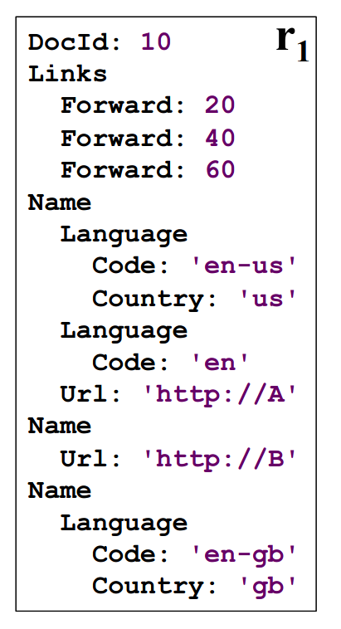
How does Dremel Work?
Shredding documents into columns:
How do we compute repetition and definition levels?

Slide 5
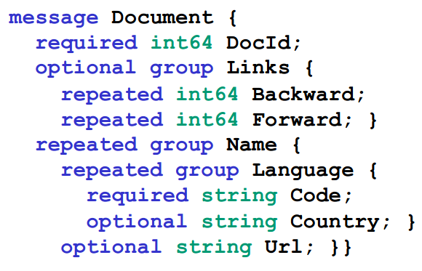
How does Dremel Work?
Computing definition and repetition levels:
0 | 1 | 2 | 3
DocId
 | Links | Backward
 |  | Forward
 | Name | Language
 |  |  | Country
 |  | Url

Slide 6
How does Dremel Work?
Retrieving a record: (1) Create a FSM with the fields

Slide 7
How does Dremel Work?
Example: Record Assembly
Retrieving a record: (2) Assemble record by jumping from field to field with the FSM

Slide 8
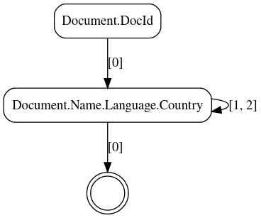
Example: Record Assembly
Three Ingredients: Document Structure, Record Data, FSM
DocId r d
10 | 0 | 0
... | 0 | 0
N.L.Country r d
us | 0 | 3
NULL | 2 | 2
NULL | 1 | 1
gb | 1 | 3
... | 0 | 3

Slide 9
Example: Record Assembly
Assembled Record:
DocId r d
10 | 0 | 0
... | 0 | 0
N.L.Country r d
us | 0 | 3
NULL | 2 | 2
NULL | 1 | 1
gb | 1 | 3
... | 0 | 3

Slide 10
Example: Record Assembly
Assembled Record:
DocId: 10
DocId r d
10 | 0 | 0
... | 0 | 0
N.L.Country r d
us | 0 | 3
NULL | 2 | 2
NULL | 1 | 1
gb | 1 | 3
... | 0 | 3

Slide 11
Example: Record Assembly
Assembled Record:
DocId: 10
DocId r d
10 | 0 | 0
... | 0 | 0
N.L.Country r d
us | 0 | 3
NULL | 2 | 2
NULL | 1 | 1
gb | 1 | 3
... | 0 | 3

Slide 12
Example: Record Assembly
Assembled Record:
DocId: 10
DocId r d
10 | 0 | 0
... | 0 | 0
N.L.Country r d
us | 0 | 3
NULL | 2 | 2
NULL | 1 | 1
gb | 1 | 3
... | 0 | 3

Slide 13
Example: Record Assembly
Assembled Record:
DocId: 10
Name: {
Lang: {
Country: 'us'
DocId r d
10 | 0 | 0
... | 0 | 0
N.L.Country r d
us | 0 | 3
NULL | 2 | 2
NULL | 1 | 1
gb | 1 | 3
... | 0 | 3

Slide 14
Example: Record Assembly
Assembled Record:
DocId: 10
Name: {
Lang: {
Country: 'us'
}
DocId r d
10 | 0 | 0
... | 0 | 0
N.L.Country r d
us | 0 | 3
NULL | 2 | 2
NULL | 1 | 1
gb | 1 | 3
... | 0 | 3

Slide 15
Example: Record Assembly
Assembled Record:
DocId: 10
Name: {
Lang: {
Country: 'us'
}
DocId r d
10 | 0 | 0
... | 0 | 0
N.L.Country r d
us | 0 | 3
NULL | 2 | 2
NULL | 1 | 1
gb | 1 | 3
... | 0 | 3

Slide 16
Example: Record Assembly
Assembled Record:
DocId: 10
Name: {
Lang: {
Country: 'us'
}
Lang: {
DocId r d
10 | 0 | 0
... | 0 | 0
N.L.Country r d
us | 0 | 3
NULL | 2 | 2
NULL | 1 | 1
gb | 1 | 3
... | 0 | 3

Slide 17
Example: Record Assembly
Assembled Record:
DocId: 10
Name: {
Lang: {
Country: 'us'
}
Lang: { }
DocId r d
10 | 0 | 0
... | 0 | 0
N.L.Country r d
us | 0 | 3
NULL | 2 | 2
NULL | 1 | 1
gb | 1 | 3
... | 0 | 3

Slide 18
Example: Record Assembly
Assembled Record:
DocId: 10
Name: {
Lang: {
Country: 'us'
}
Lang: { }
DocId r d
10 | 0 | 0
... | 0 | 0
N.L.Country r d
us | 0 | 3
NULL | 2 | 2
NULL | 1 | 1
gb | 1 | 3
... | 0 | 3

Slide 19
Example: Record Assembly
Assembled Record:
DocId: 10
Name: {
Lang: {
Country: 'us'
}
Lang: { }
}
DocId r d
10 | 0 | 0
... | 0 | 0
N.L.Country r d
us | 0 | 3
NULL | 2 | 2
NULL | 1 | 1
gb | 1 | 3
... | 0 | 3

Slide 20
Example: Record Assembly
Assembled Record:
DocId: 10
Name: {
Lang: {
Country: 'us'
}
Lang: { }
}
DocId r d
10 | 0 | 0
... | 0 | 0
N.L.Country r d
us | 0 | 3
NULL | 2 | 2
NULL | 1 | 1
gb | 1 | 3
... | 0 | 3

Slide 21
Example: Record Assembly
Assembled Record:
DocId: 10
Name: {
Lang: {
Country: 'us'
}
Lang: { }
}
DocId r d
10 | 0 | 0
... | 0 | 0
N.L.Country r d
us | 0 | 3
NULL | 2 | 2
NULL | 1 | 1
gb | 1 | 3
... | 0 | 3

Slide 22
Example: Record Assembly
Assembled Record:
DocId: 10
Name: {
Lang: {
Country: 'us'
}
Lang: { }
}
Name: {
Lang: {
Country: 'gb'
DocId r d
10 | 0 | 0
... | 0 | 0
N.L.Country r d
us | 0 | 3
NULL | 2 | 2
NULL | 1 | 1
gb | 1 | 3
... | 0 | 3

Slide 23
Example: Record Assembly
Assembled Record:
DocId: 10
Name: {
Lang: {
Country: 'us'
}
Lang: { }
}
Name: {
Lang: {
Country: 'gb'
DocId r d
10 | 0 | 0
... | 0 | 0
N.L.Country r d
us | 0 | 3
NULL | 2 | 2
NULL | 1 | 1
gb | 1 | 3
... | 0 | 3

Slide 24
Example: Record Assembly
Assembled Record:
DocId: 10
Name: {
Lang: {
Country: 'us'
}
Lang: { }
}
Name: {
Lang: {
Country: 'gb'
}
}
DocId r d
10 | 0 | 0
... | 0 | 0
N.L.Country r d
us | 0 | 3
NULL | 2 | 2
NULL | 1 | 1
gb | 1 | 3
... | 0 | 3

Slide 25
Challenges

Slide 26
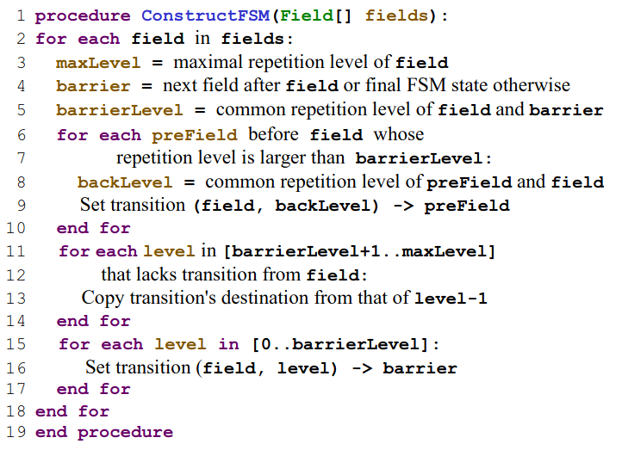
FSM Construction

Slide 27
FSM Construction
No
Instead: Insert reflexive edge

Slide 28
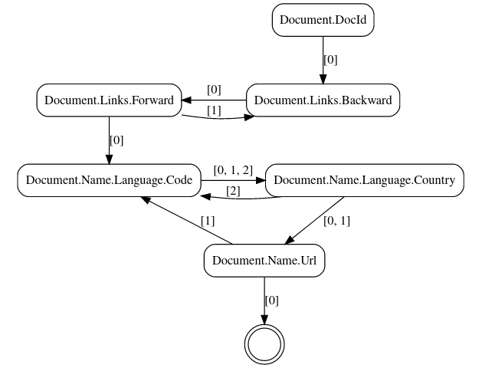
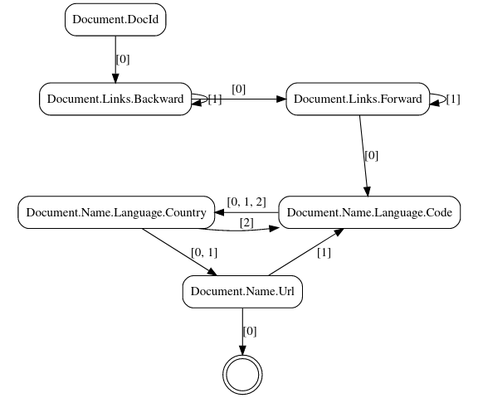
Algorithms Compared
Version from Paper:
Modified Version:
Notes:
digraph finite_state_machine {
size="8,5"
node [shape = doublecircle]; "end" [label=""];
node [shape = rect, style = rounded];
rankdir = UD;
"Document.DocId" -> "Document.Links.Backward" [label="[0]"];
subgraph cluster_0 {
color=none
{rank=same "Document.Links.Backward" "Document.Links.Forward"}
"Document.Links.Backward" -> "Document.Links.Forward" [label="[0]"];
"Document.Links.Forward" -> "Document.Links.Backward" [label="[1]"];
}
subgraph cluster_1 {
color=none
{rank=same "Document.Name.Language.Country" "Document.Name.Language.Code"}
"Document.Name.Language.Country" -> "Document.Name.Language.Code" [label="[2]"];
"Document.Name.Language.Code" -> "Document.Name.Language.Country" [label="[0, 1, 2]"];
}
"Document.Name.Url" -> "end" [label="[0]"];
"Document.Name.Url" -> "Document.Name.Language.Code" [label="[1]"];
"Document.Name.Language.Country" -> "Document.Name.Url" [label="[0, 1]"];
"Document.Links.Forward" -> "Document.Name.Language.Code" [label="[0]"];
}
digraph finite_state_machine {
size="8,5"
node [shape = doublecircle]; "end" [label=""];
node [shape = rect, style = rounded];
rankdir = UD;
"Document.DocId" -> "Document.Links.Backward" [label="[0]"];
subgraph cluster_0 {
color=none
{rank=same "Document.Links.Backward" "Document.Links.Forward"}
"Document.Links.Backward" -> "Document.Links.Forward" [label="[0]"];
"Document.Links.Backward" -> "Document.Links.Backward" [label="[1]"];
"Document.Links.Forward" -> "Document.Links.Forward" [label="[1]"];
}
subgraph cluster_0 {
color=none
{rank=same "Document.Name.Language.Country" "Document.Name.Language.Code"}
"Document.Name.Language.Country" -> "Document.Name.Language.Code" [label="[2]"];
"Document.Name.Language.Code" -> "Document.Name.Language.Country" [label="[0, 1, 2]"];
}
"Document.Name.Url" -> "end" [label="[0]"];
"Document.Name.Url" -> "Document.Name.Language.Code" [label="[1]"];
"Document.Links.Forward" -> "Document.Name.Language.Code" [label="[0]"];
"Document.Name.Language.Country" -> "Document.Name.Url" [label="[0, 1]"];
}

Slide 29
Common Ancestor
TODO

Slide 30
Some Numbers...

Slide 31
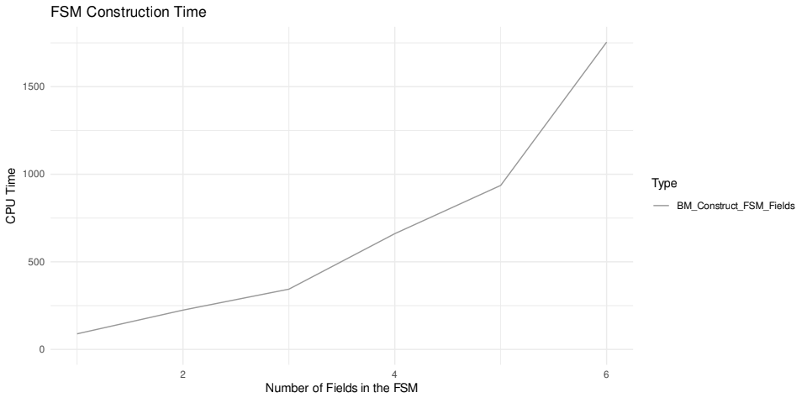
Performance: FSM Generation

Slide 32
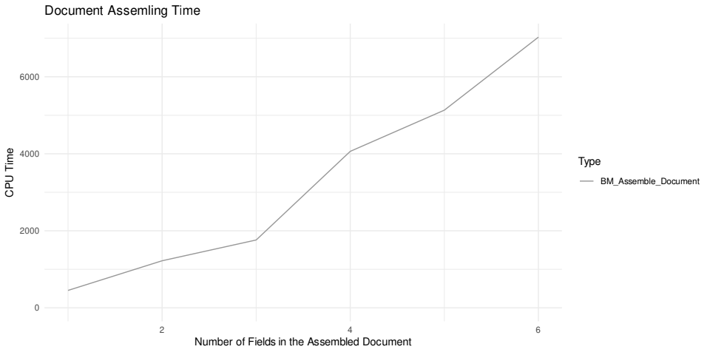
Performance: Record Assembly
Nesting level increases

Slide 33
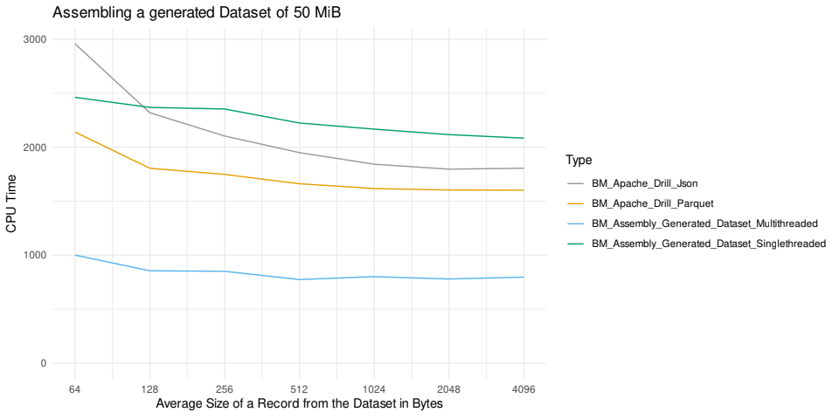
Performance against Apache Drill

Slide 34
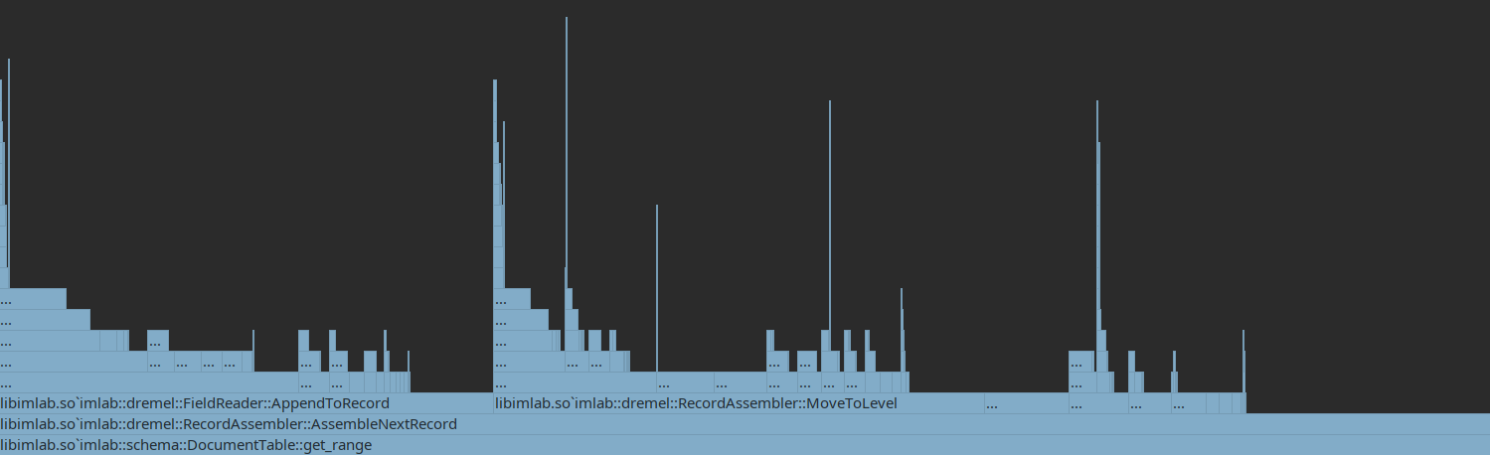
Profiling
SetString()
Time spent with Protobuf

Slide 35
Outlook
Compiling instead of interpreting
Not using Protobuf

