Slide 1

Imlab: Dremel
Andreas Zimmerer
Technische Universität München
Garching, 27. Januar 2020

Slide 2
Overview
Why Dremel?
How does Dremel Work?
Example: Record Assembly
Challenges
Benchmarks
Outlook

Slide 3
Why Dremel?
It’s a good idea to support non-relational data:
Alternative would be normalizing data and joining the parts
-> might be very costly
Dremel utilizes the benefits of column stores for nested data
Dremel is highly parallelizable

Slide 4
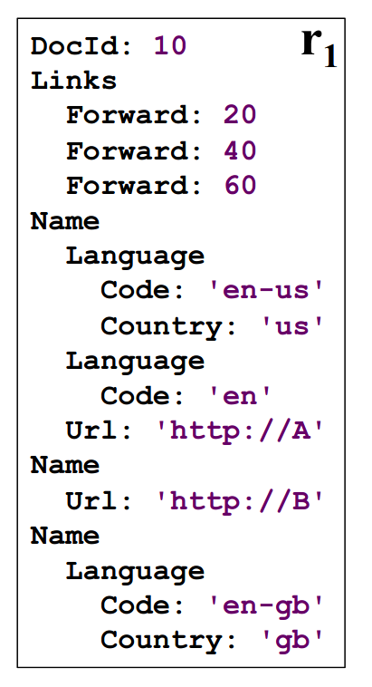
How does Dremel Work?
Shredding documents into columns:
DocId0 | r | d
10 | 0 | 0
L.Backward | r | d
NULL | 0 | 1
L.Forward | r | d
20 | 0 | 2
40 | 1 | 2
60 | 1 | 2
N.L.Code | r | d
en-us | 0 | 2
en | 2 | 2
NULL | 1 | 1
en-gb | 1 | 2
N.L.Country | r | d
us | 0 | 3
NULL | 2 | 2
NULL | 1 | 1
gb | 1 | 3
N.Url | r | d
http://A | 0 | 2
http://B | 1 | 2
NULL | 1 | 1
How do we compute repetition and definition levels?

Slide 5
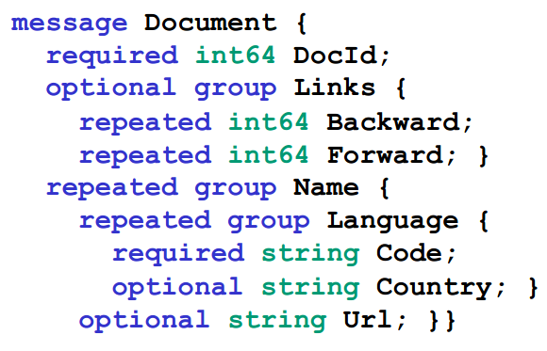
How does Dremel Work?
Computing definition and repetition levels:
The definition level is always fixed for a field, and is used for specifying which field in the message was NULL.
The definition level of a field is the number of potentially undefined (optional and repeated) fields in the path.
The repetition level tells us at which level a field is repeated.
The maximum repetition level of a field is the number of repeated fields in the path.
=> with these two values we can losslessly reconstruct
records

Slide 6
How does Dremel Work?
Retrieving a record: (1) Create a FSM with the fields
Question: How can we reconstruct a (partial) record?
=> We construct a FSM that defines how we jump between fields.
e.g. given a previous field and a repetition level, what‘s the next field?
We can also construct a FSM that constructs only a partial record, but still preserves the record structure.

Slide 7
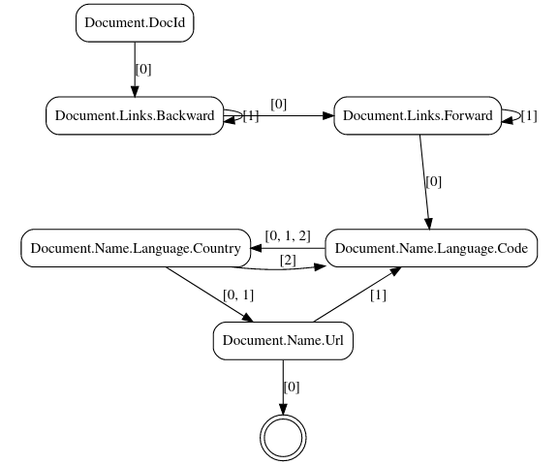
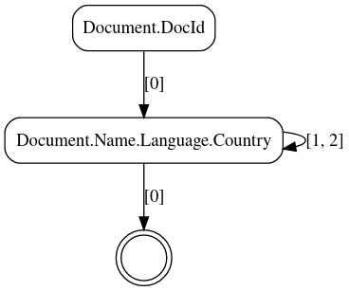
How does Dremel Work?
Full FSM with all fields Partial FSM for DocId and Country

Slide 8
How does Dremel Work?
Retrieving a record: (2) Assemble record by jumping from field to field with FSM
Example: Record Assembly

Slide 9
Example: Record Assembly
Three Ingredients:
(1) Document Structure (2) Record Data (3) FSM
DocId r d
10 | 0 | 0
... | 0 | 0
N.L.Country r d
us | 0 | 3
NULL | 2 | 2
NULL | 1 | 1
gb | 1 | 3
... | 0 | 3

Slide 10
Example: Record Assembly
Assembled Record:
DocId r d
10 | 0 | 0
... | 0 | 0
N.L.Country r d
us | 0 | 3
NULL | 2 | 2
NULL | 1 | 1
gb | 1 | 3
... | 0 | 3

Slide 11
Example: Record Assembly
Assembled Record:
DocId: 10
DocId r d
10 | 0 | 0
... | 0 | 0
N.L.Country r d
us | 0 | 3
NULL | 2 | 2
NULL | 1 | 1
gb | 1 | 3
... | 0 | 3

Slide 12
Example: Record Assembly
Assembled Record:
DocId: 10
DocId r d
10 | 0 | 0
... | 0 | 0
N.L.Country r d
us | 0 | 3
NULL | 2 | 2
NULL | 1 | 1
gb | 1 | 3
... | 0 | 3

Slide 13
Example: Record Assembly
Assembled Record:
DocId: 10
DocId r d
10 | 0 | 0
... | 0 | 0
N.L.Country r d
us | 0 | 3
NULL | 2 | 2
NULL | 1 | 1
gb | 1 | 3
... | 0 | 3

Slide 14
Example: Record Assembly
Assembled Record:
DocId: 10
Name: {
Lang: {
Country: 'us'
DocId r d
10 | 0 | 0
... | 0 | 0
N.L.Country r d
us | 0 | 3
NULL | 2 | 2
NULL | 1 | 1
gb | 1 | 3
... | 0 | 3

Slide 15
Example: Record Assembly
Assembled Record:
DocId: 10
Name: {
Lang: {
Country: 'us'
}
DocId r d
10 | 0 | 0
... | 0 | 0
N.L.Country r d
us | 0 | 3
NULL | 2 | 2
NULL | 1 | 1
gb | 1 | 3
... | 0 | 3

Slide 16
Example: Record Assembly
Assembled Record:
DocId: 10
Name: {
Lang: {
Country: 'us'
}
DocId r d
10 | 0 | 0
... | 0 | 0
N.L.Country r d
us | 0 | 3
NULL | 2 | 2
NULL | 1 | 1
gb | 1 | 3
... | 0 | 3

Slide 17
Example: Record Assembly
Assembled Record:
DocId: 10
Name: {
Lang: {
Country: 'us'
}
Lang: {
DocId r d
10 | 0 | 0
... | 0 | 0
N.L.Country r d
us | 0 | 3
NULL | 2 | 2
NULL | 1 | 1
gb | 1 | 3
... | 0 | 3

Slide 18
Example: Record Assembly
Assembled Record:
DocId: 10
Name: {
Lang: {
Country: 'us'
}
Lang: { }
DocId r d
10 | 0 | 0
... | 0 | 0
N.L.Country r d
us | 0 | 3
NULL | 2 | 2
NULL | 1 | 1
gb | 1 | 3
... | 0 | 3

Slide 19
Example: Record Assembly
Assembled Record:
DocId: 10
Name: {
Lang: {
Country: 'us'
}
Lang: { }
DocId r d
10 | 0 | 0
... | 0 | 0
N.L.Country r d
us | 0 | 3
NULL | 2 | 2
NULL | 1 | 1
gb | 1 | 3
... | 0 | 3

Slide 20
Example: Record Assembly
Assembled Record:
DocId: 10
Name: {
Lang: {
Country: 'us'
}
Lang: { }
}
DocId r d
10 | 0 | 0
... | 0 | 0
N.L.Country r d
us | 0 | 3
NULL | 2 | 2
NULL | 1 | 1
gb | 1 | 3
... | 0 | 3

Slide 21
Example: Record Assembly
Assembled Record:
DocId: 10
Name: {
Lang: {
Country: 'us'
}
Lang: { }
}
DocId r d
10 | 0 | 0
... | 0 | 0
N.L.Country r d
us | 0 | 3
NULL | 2 | 2
NULL | 1 | 1
gb | 1 | 3
... | 0 | 3

Slide 22
Example: Record Assembly
Assembled Record:
DocId: 10
Name: {
Lang: {
Country: 'us'
}
Lang: { }
}
DocId r d
10 | 0 | 0
... | 0 | 0
N.L.Country r d
us | 0 | 3
NULL | 2 | 2
NULL | 1 | 1
gb | 1 | 3
... | 0 | 3

Slide 23
Example: Record Assembly
Assembled Record:
DocId: 10
Name: {
Lang: {
Country: 'us'
}
Lang: { }
}
Name: {
Lang: {
Country: 'gb'
DocId r d
10 | 0 | 0
... | 0 | 0
N.L.Country r d
us | 0 | 3
NULL | 2 | 2
NULL | 1 | 1
gb | 1 | 3
... | 0 | 3

Slide 24
Example: Record Assembly
Assembled Record:
DocId: 10
Name: {
Lang: {
Country: 'us'
}
Lang: { }
}
Name: {
Lang: {
Country: 'gb'
DocId r d
10 | 0 | 0
... | 0 | 0
N.L.Country r d
us | 0 | 3
NULL | 2 | 2
NULL | 1 | 1
gb | 1 | 3
... | 0 | 3

Slide 25
Example: Record Assembly
Assembled Record:
DocId: 10
Name: {
Lang: {
Country: 'us'
}
Lang: { }
}
Name: {
Lang: {
Country: 'gb'
}
}
DocId r d
10 | 0 | 0
... | 0 | 0
N.L.Country r d
us | 0 | 3
NULL | 2 | 2
NULL | 1 | 1
gb | 1 | 3
... | 0 | 3

Slide 26
Challenges

Slide 27
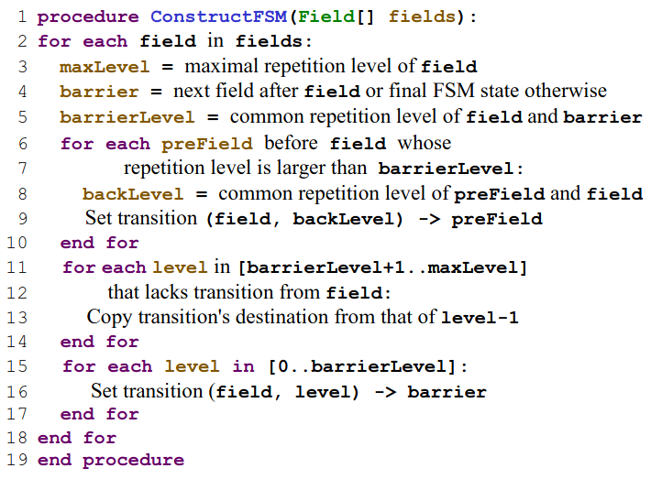
FSM Construction

Slide 28
FSM Construction
No
Instead: Insert reflexive edge

Slide 29
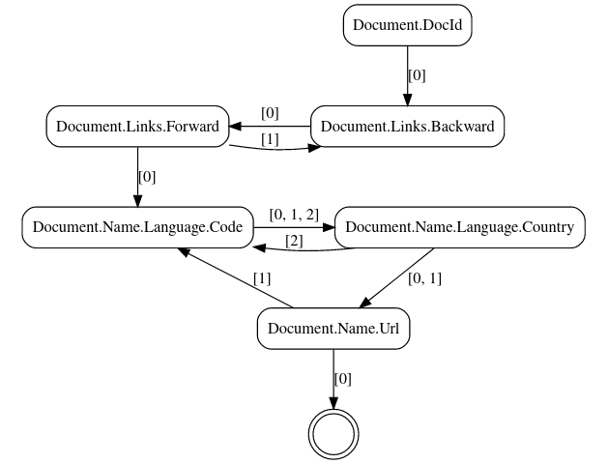
FSM Construction: Algorithms Compared
Version from Paper:
Modified Version:
Notes:
digraph finite_state_machine {
size="8,5"
node [shape = doublecircle]; "end" [label=""];
node [shape = rect, style = rounded];
rankdir = UD;
"Document.DocId" -> "Document.Links.Backward" [label="[0]"];
subgraph cluster_0 {
color=none
{rank=same "Document.Links.Backward" "Document.Links.Forward"}
"Document.Links.Backward" -> "Document.Links.Forward" [label="[0]"];
"Document.Links.Forward" -> "Document.Links.Backward" [label="[1]"];
}
subgraph cluster_1 {
color=none
{rank=same "Document.Name.Language.Country" "Document.Name.Language.Code"}
"Document.Name.Language.Country" -> "Document.Name.Language.Code" [label="[2]"];
"Document.Name.Language.Code" -> "Document.Name.Language.Country" [label="[0, 1, 2]"];
}
"Document.Name.Url" -> "end" [label="[0]"];
"Document.Name.Url" -> "Document.Name.Language.Code" [label="[1]"];
"Document.Name.Language.Country" -> "Document.Name.Url" [label="[0, 1]"];
"Document.Links.Forward" -> "Document.Name.Language.Code" [label="[0]"];
}
digraph finite_state_machine {
size="8,5"
node [shape = doublecircle]; "end" [label=""];
node [shape = rect, style = rounded];
rankdir = UD;
"Document.DocId" -> "Document.Links.Backward" [label="[0]"];
subgraph cluster_0 {
color=none
{rank=same "Document.Links.Backward" "Document.Links.Forward"}
"Document.Links.Backward" -> "Document.Links.Forward" [label="[0]"];
"Document.Links.Backward" -> "Document.Links.Backward" [label="[1]"];
"Document.Links.Forward" -> "Document.Links.Forward" [label="[1]"];
}
subgraph cluster_0 {
color=none
{rank=same "Document.Name.Language.Country" "Document.Name.Language.Code"}
"Document.Name.Language.Country" -> "Document.Name.Language.Code" [label="[2]"];
"Document.Name.Language.Code" -> "Document.Name.Language.Country" [label="[0, 1, 2]"];
}
"Document.Name.Url" -> "end" [label="[0]"];
"Document.Name.Url" -> "Document.Name.Language.Code" [label="[1]"];
"Document.Links.Forward" -> "Document.Name.Language.Code" [label="[0]"];
"Document.Name.Language.Country" -> "Document.Name.Url" [label="[0, 1]"];
}

Slide 30
Common Ancestor
Order is important!
CoAn of Code and Country -> Language
CoAn of Country and Code -> Name

Slide 31
Benchmarks

Slide 32
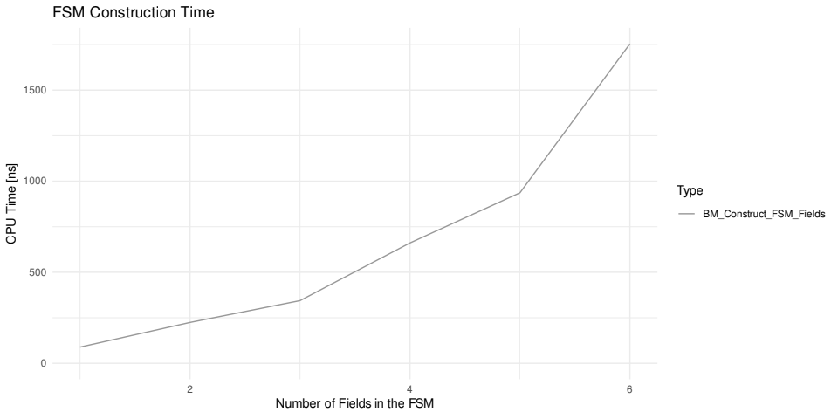
Benchmarks

Slide 33
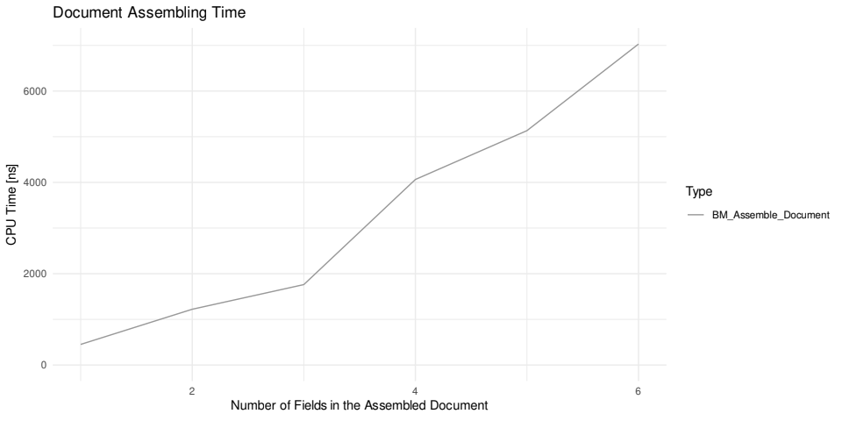
Benchmarks
Nesting level increases

Slide 34
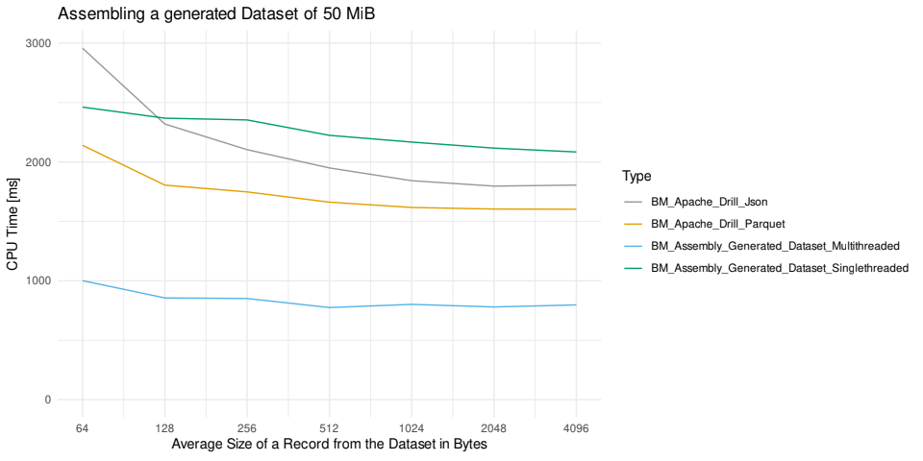
Performance against Apache Drill

Slide 35
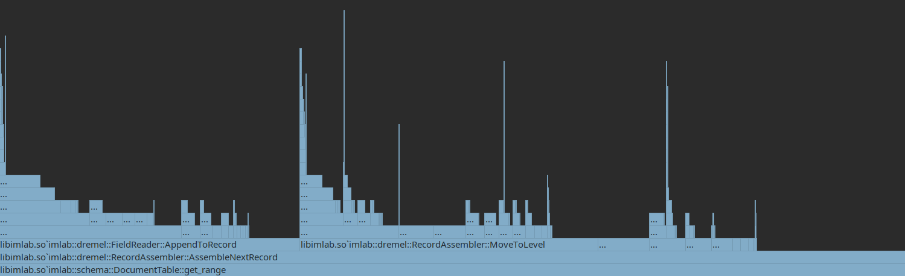
Profiling
SetString()
SetMessage()
Time spent with Protobuf

Slide 36
Summary & Outlook
FSM construction is fast and only needed once (=> neglectable overhead)
Record assembly takes a lot of time (copies & heap allocs with Proto)
Compilation instead of interpretation
Not using Protobuf

