Slide 1
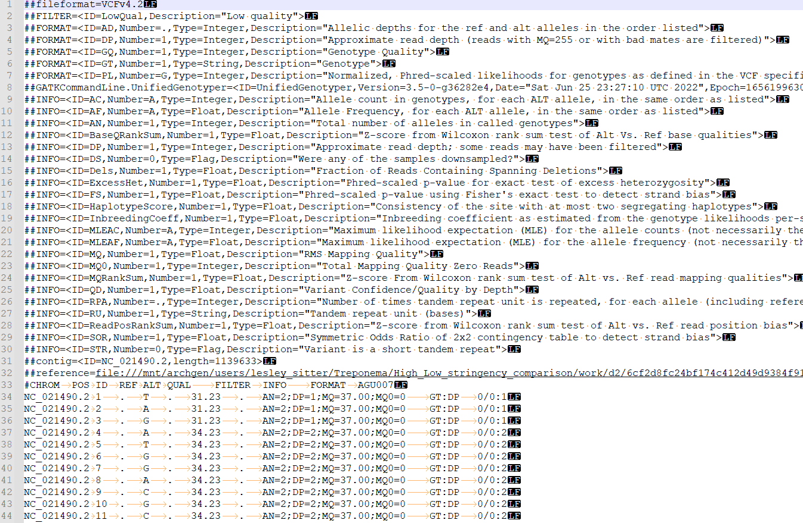

Slide 2
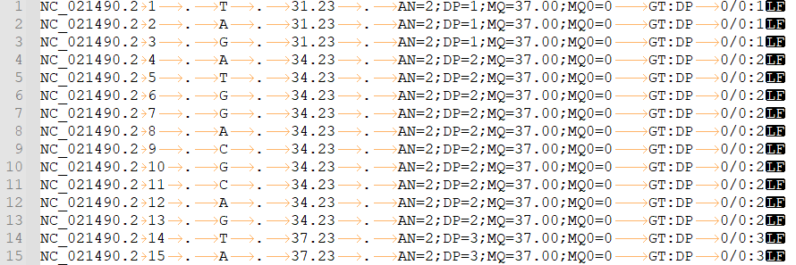

Slide 3
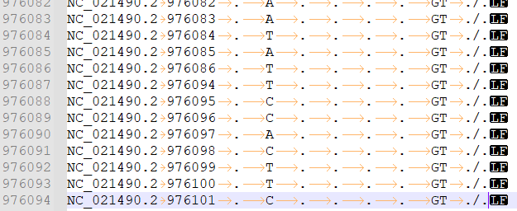
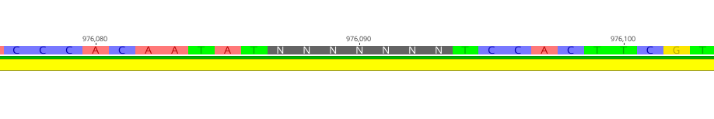
🗸
✗

Slide 4
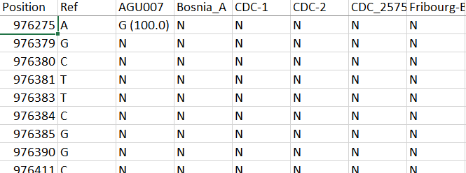
✗
🗸
SNPtable.tsv from MultiVCF.

Slide 5
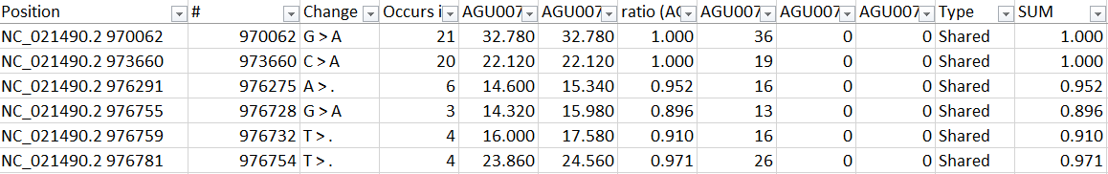
SNPtable.tsv from MultiVCF.
Table from SNPevaluation
?

Slide 6
Table from SNPevaluation
Positions column is derived from concatenating column one and two of a VCF # column is derived from the MultiVCF SNP table
Coordinates of both columns don’t match, comparing the two we can see the issue

Slide 7
SNPtable.tsv from MultiVCF.
SNPtable reports a truthfull coordinate. SNPevaluation assumes that UnifiedGenotyper does EMIT ALL, and does not skip any positions… therefore the line number = the position
However, UG does in fact NOT EMIT ALL sites, but ignores ambigious characters for some reason
This causes a shift between line numbers and the actual position.

Slide 8
SNPtable.tsv from MultiVCF.
SNPtable reports a truthful coordinate. SNPevaluation assumes that UnifiedGenotyper does EMIT ALL, and does not skip any positions… therefore the line number = the position
However, UG does in fact NOT emit all sites, but ignores ambiguous characters for some reason
This causes a shift between line numbers and the actual position, making SNPevaluation pick the wrong VCF lines and causing a bunch of weird lines such as reference calls.

Slide 9
Fix?
First would be to patch the N’s in the reference genome. This is underway, using the modern genomes to reconstruct the area’s affected. All 45 N’s are located in one single gene, MSP Porin, 1521bp, 977441…975921 so our mapping data should be able to patch these small “gaps” of missing calls.
Second solution was correcting the VCF files by creating an easy R script.
Script looks for differences in position between current row and the next row, this should give a value of 1
For values >1 a dummy dataframe is created with successive coordinates, and a “non-mapped” data type NC_021490.2 976087 . N . . . . GT ./. And inserts this in data.table in the location that a gap is notices
One caveat is that it not yet has any way of dealing with large ambigious regions at the starting positions as this method subtracts the next row’s coordinate from the current... If the first row start at 200, then it wont know. And if the VCF stops at some point but the genome is larger, it has no way of knowing that This will be fixed later this week, but has no impact on the Treponema work

Slide 10
