Slide 1
Status

Slide 2
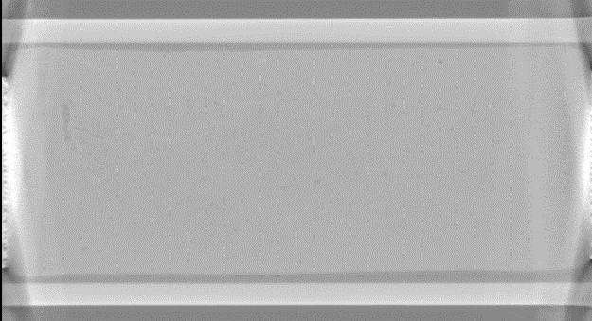
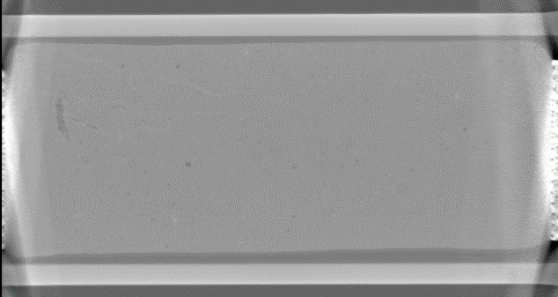
Difference between 5 and 65 bar
Ikke så stor forskel.
Den største forskel er attenuationsværdien.

Slide 3
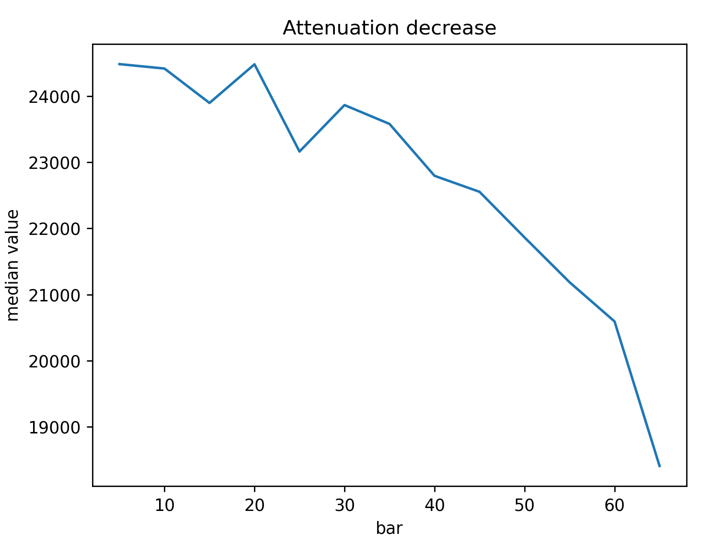
Decrease in attenution across files
Why? And is it a problem? Maybe it makes the registration a little more difficult. I have tried to even out the difference but it cannot remake the exact same attenation values across the sample.

Slide 4


Elastix
Difference image of same air pocked after registration (5 bar and 65 bar)
Air pocket in sample

Slide 5
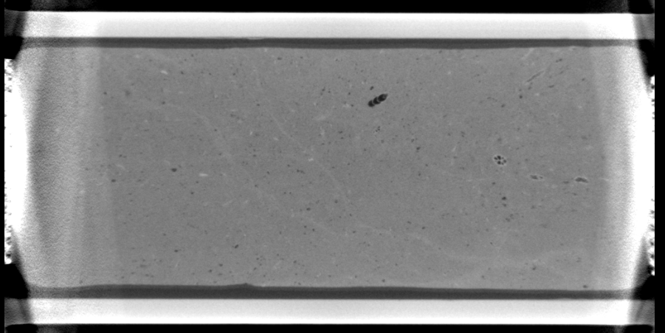
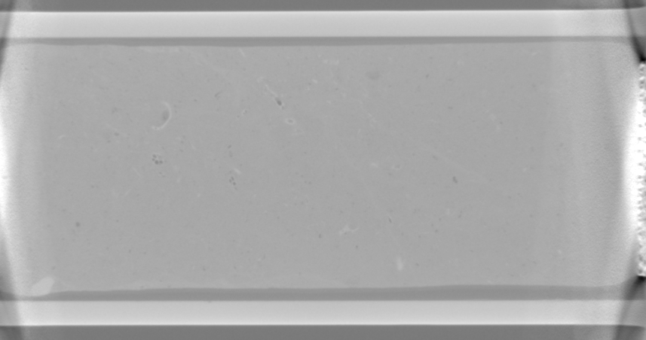
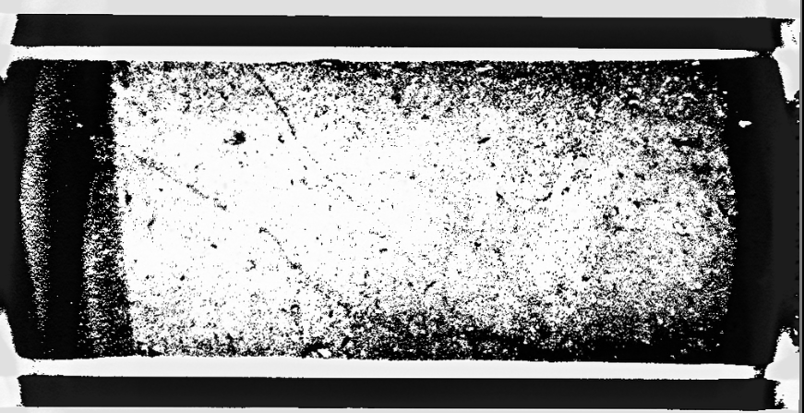
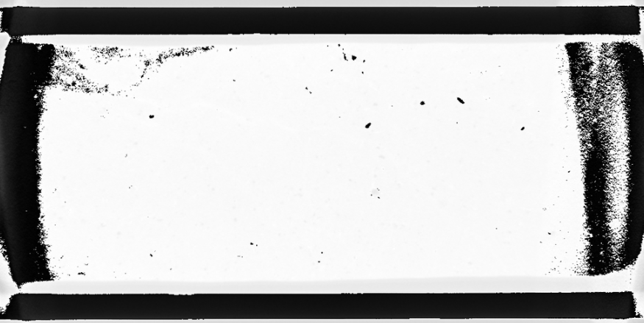
Elastix
Sometimes elastix does not work too well. Especially on big images:
Before
After

